Slide 1
AMP Channel Access
Date: 25 July 2025
Name | Affiliation | Address | Phone | Email
Rojan Chitrakar | Huawei | Singapore |  | rojan.chitrakar@huawei.com
Lei Huang
Ian Bajaj
Notes:
Jul 12, 2010
Page 1

Slide 2
Selected approved motions regarding uplink channel access
MM-6: 802.11bp to define a slot-based procedure to enable one or more clients to access the medium to send uplink AMP PPDU(s).
MM-8: 802.11bp supports a time-slot based random access mechanism for Active Tx non-AP AMP STAs:
  AMP AP transmits an AMP frame that indicates one or more time-slots.
MM-9: 802.11bp supports a time-slot based scheduled access mechanism for Active Tx non-AP AMP STAs:
  AMP AP transmits an AMP frame to assign one or more transmission time-slots.
FM-3: When the AP solicits UL AMP PPDUs from 802.11bp clients using a slot-based procedure, the AMP Trigger frame shall carry the following parameters
  Number of slots for UL PPDU transmissions in that TXOP
MM-5: AMP trigger frame may indicate parameters for a slot-based procedure of time slots to AMP non-AP STA(s).

Slide 3
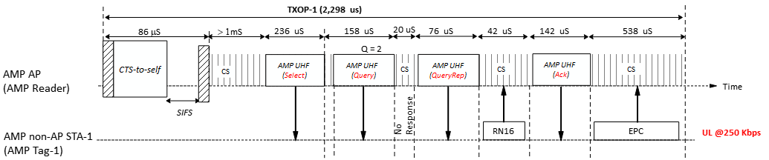
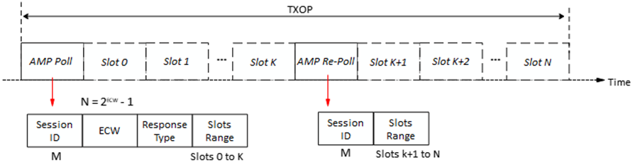
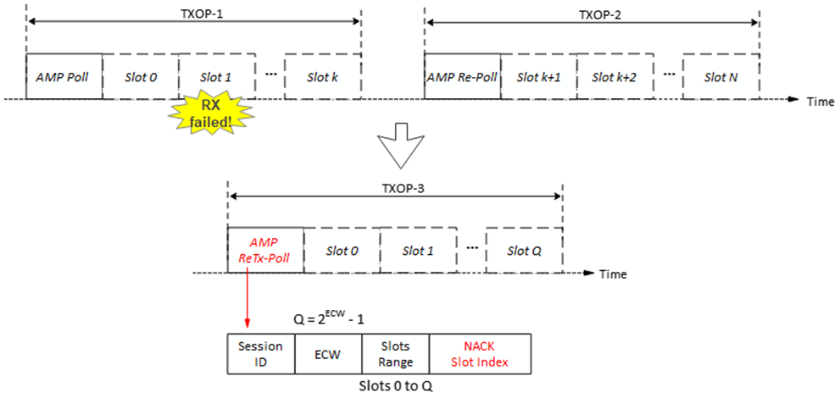
Recap
In [2], [3] we proposed to consider the channel access scheme for Active Tx non-AP AMP STAs and backscatter non-AP AMP STAs separately.
The channel access scheme for Backscatter non-AP AMP STAs could be similar to UHF RFID. [3]
The channel access scheme for Active Tx non-AP AMP STAs could be more elaborate. [2]
There were feedback that unified channel access scheme would be preferred (if possible). We hear you.

Slide 4
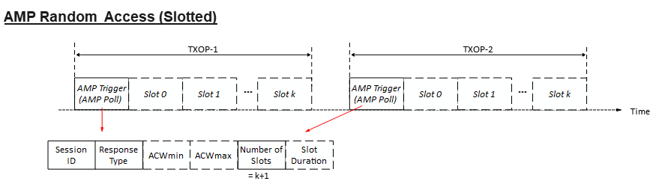
AMP Random Access (Slotted)
In a slotted (or multi-slot) random access, the AMP Trigger frame allocates two or more consecutive slots for uplink transmissions in a TXOP. The AMP Trigger frame indicates:
  Session ID: Identifies a random access session.
  Response Type: Type of the solicited uplink response e.g., ID, EPC, Sensor Data, Unspecified etc.
  ACW (AMP Contention Window):
    ACWmin: Smallest ACW
    ACWmax: Largest ACW
  Number of Slots (N): The number of slots immediately after the AMP Trigger frame that are allocated for uplink transmissions.
  Slot Duration: Duration of a time-slot.
Non-AP AMP STA’s actions:
1) Upon receiving an AMP Trigger frame with a new session ID :
ACW is initialized to ACWmin
ABO Counter (ABOC) is initialized to a random value in [0, ACW]
Contend for uplink transmission
2) Upon receiving an AMP Trigger frame (with a known session ID) and the STA hasn’t transmitted yet:
Contend for uplink transmission
3) Upon receiving an AMP Trigger frame (with a known session ID) after an unsuccessful* transmission:
ACW = min (2*ACW + 1, ACWmax)
ABO counter is initialized to a random value in [0, ACW]
Contend for uplink transmission
Contend for uplink transmission:
If ABO Counter < N (Number of Slots), the non-AP AMP STA transmits in a slot (= ABOC) allocated by the AMP Trigger frame.
Else, STA cannot transmit. ABO counter = ABO counter – N;
* Non-AP AMP STAs that have successfully transmitted do not contend again in the same session

Slide 5
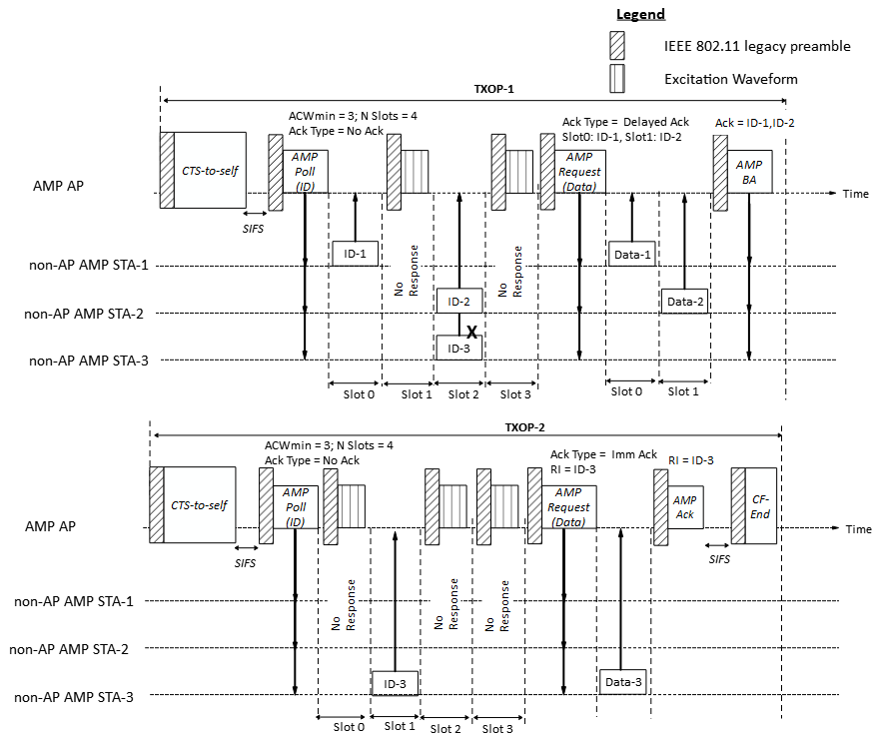
AMP Random Access (Slotted) – Example 1
TXOP-1:
First AMP Trigger (Random access) specifies:
  Number of Slots (N) = 4
  Response Type = ID
  ACWmin = 3
The 3 non-AP AMP STAs initialize ACW to ACWmin (3); randomly choose ABOC in [0, 3] as 0, 2, 2 respectively. Since all ABOC are less than N (4), all STAs transmit in the chosen slots. Transmission of STA-1 and STA-2 succeed.
AMP AP transmits the second AMP Trigger to schedule uplink transmissions of Data for STA-1 and STA-2.
TXOP-2:
Third AMP Trigger is the same as the first AMP Trigger.
Since its transmission failed, STA-3 updates ACW = 2*3 +1 = 7, and randomly chooses ABOC in [0, 7] as 1 and transmits in slot 1, which is successfully receive by the AMP AP. STA-1 & STA-2 do not contend this time.
AMP AP transmits the fourth AMP Trigger to trigger the uplink transmissions of Data from STA-3.
Note: AMP AP may transmit excitation waveforms in empty slots.

Slide 6
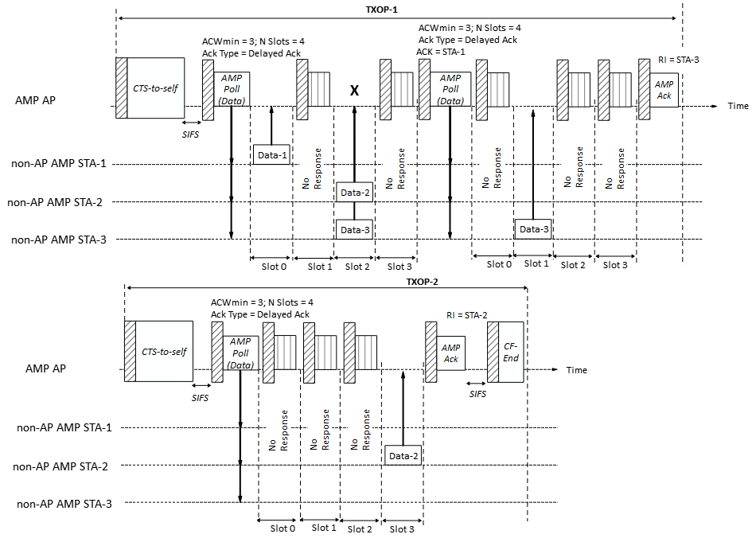
AMP Random Access (Slotted) – Example 2
TXOP-1:
First AMP Trigger (Random access) specifies:
  Response Type = Data
The 3 non-AP AMP STAs initialize ACW to ACWmin (3); randomly choose ABOC in [0, 3] as 0, 2, 2 respectively. Since all ABOC are less than N (4), all STAs transmit in the chosen slots. Transmission of STA-1 succeed.
AMP AP transmits second AMP Trigger to continue the random access session in the same TXOP.
Since their transmission failed, STA-2 & STA-3 update ACW = 2*3 +1 = 7, and randomly chooses ABOC in [0, 7] as 1 & 7. STA-3 transmits in slot 1, which is successfully received by the AMP AP. Since its ABOC is > 4, STA-2 does not contend but updates ABOC to 7 – 4 = 3.
TXOP-2:
AMP AP transmits third AMP Trigger to continue the random access session.
Since its ABOC is less than N (4), STA-2 transmit in slot 3.
STA-1 & STA-3 do not contend this time.

Slide 7
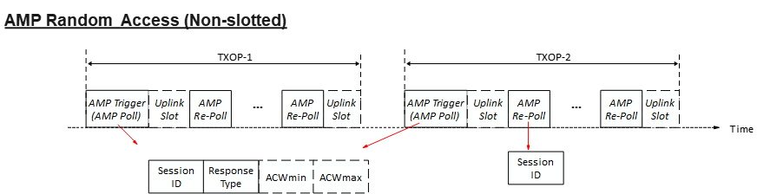
AMP Random Access (Non-slotted)
Multi-slot channel access may not be feasible for some class of non-AP AMP STAs (e.g., due to very poor clock accuracy).
In a non-slotted (or single-slot) random access, every slot for uplink transmission begins with a downlink AMP frame (e.g., an AMP Trigger frame). The AMP Trigger frame indicates:
  Session ID: Identifies a random access session.
  Response Type: Type of the solicited uplink response e.g., ID, EPC, Sensor Data, Unspecified etc.
  ACW (AMP Contention Window):
    ACWmin: Smallest ACW
    ACWmax: Largest ACW
  Slot Duration: (Optional) Duration of a time-slot.
  Note: Number of Slots is not required for non-slotted uplink access and is assumed to be 1.
A variant of AMP Trigger frame (AMP Re-Poll) is used to continue the random access within a TXOP and indicates:
  Session ID: Identifies the random access session.
Non-AP AMP STA’s actions:
1) Upon receiving an AMP Poll frame with a new session ID :
ACW is initialized to ACWmin
ABO Counter (ABOC) is initialized to a random value in [0, ACW]
Contend for uplink transmission
2) Upon receiving an AMP Poll frame or an AMP Re-Poll frame with a known session ID:
Contend for uplink transmission
3) Upon receiving an AMP Poll frame (with a known session ID) after an unsuccessful* transmission:
ACW = min (2*ACW + 1, ACWmax)
ABO counter is initialized to a random value in [0, ACW]
Contend for uplink transmission
Contend for uplink transmission:
If ABO Counter = 0, STA transmits in the slot.
Else, STA cannot transmit. ABO counter = ABO counter – 1;
* STA that have successfully transmitted do not contend again in the same session

Slide 8
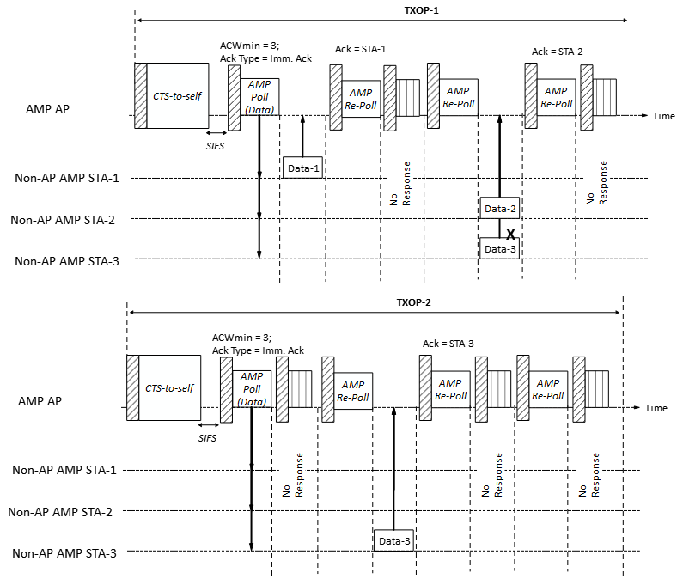
AMP Random Access (Non-slotted) – Example 1
TXOP-1:
First AMP Trigger (Random access (RA)) specifies:
  Response Type = Data
  ACWmin = 3
  Number of slots is not included, so -> non-slotted.
The 3 non-AP AMP STAs initialize ACW to ACWmin (3); randomly choose ABOC in [0, 3] as 0, 2, 2 respectively. Since STA-1’s ABOC = 0, STA-1 transmits after the AMP Poll. STA-2 & STA-3 updates ABOC to 1.
AMP AP transmits second AMP Trigger (AMP Re-Poll) to continue the RA but there is no response. STA-2 & STA-3 transmit after the 2nd AMP Re-Poll. Transmission of STA-1 succeed.
TXOP-2:
AMP AP transmits another AMP Poll to continue the RA.
Since its transmission failed, STA-3 updates ACW = 2*3 +1 = 7, and randomly chooses ABOC in [0, 7] as 1 and transmits once its ABOC is 0, which is successfully receive by the AMP AP. STA-1 & STA-2 do not contend in TXOP-2.
Note: The AMP Re-Poll may also carry acks.

Slide 9
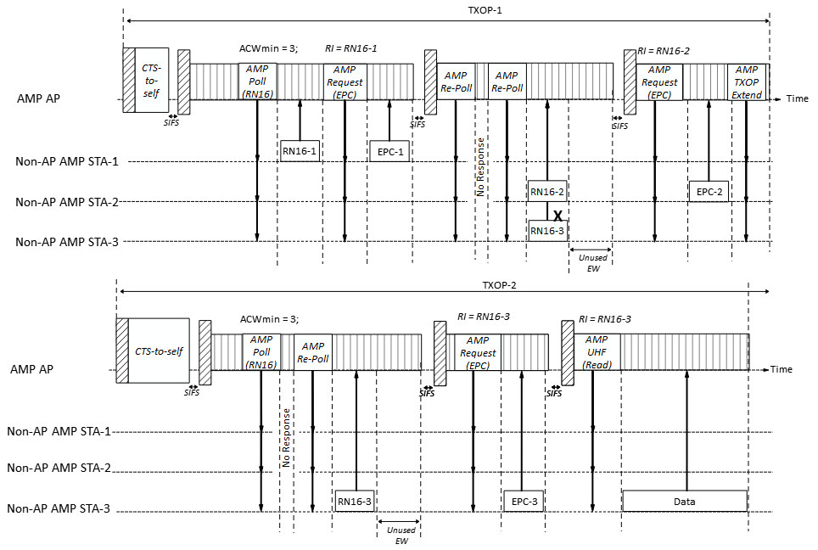
AMP Random Access (Non-slotted) – Example 2
Example of backscatter channel access. AMP AP is trying to read STA-3’s data.
TXOP-1:
First AMP Trigger (Random access (RA)) specifies:
  Response Type = RN-16
  ACWmin = 3
  Number of slots is not included, so -> non-slotted.
The 3 non-AP AMP STAs initialize ACW to ACWmin (3); randomly choose ABOC in [0, 3] as 0, 2, 2 respectively. Since STA-1’s ABOC = 0, STA-1 transmits after the AMP Poll. STA-2 & STA-3 updates ABOC to 1. AMP AP transmits AMP Request to solicit STA-1’s EPC.
AMP AP transmits second AMP Trigger (AMP Re-Poll) to continue the RA but there is no response. STA-2 & STA-3 transmit after the 2nd AMP Re-Poll. Transmission of STA-1 succeed. AMP AP transmits AMP Request to solicit STA-2’s EPC. AMP AP transmits AMP TXOP Extend to cause STAs that are still contend to save relevant RA parameters (ABOC, Session ID, ACW).
TXOP-2:
AMP AP transmits another AMP Poll to continue the RA.
Since its transmission failed, STA-3 updates ACW = 2*3 +1 = 7, and randomly chooses ABOC in [0, 7] as 1 and transmits once its ABOC is 0, which is successfully receive by the AMP AP. STA-1 & STA-2 do not contend in TXOP-2.
Note: AMP AP may break its transmissions in a TXOP over several AMP DL PPDUs due to L-SIG consideration. This may lead to some unused excitation waveforms in the PPDU.

Slide 10
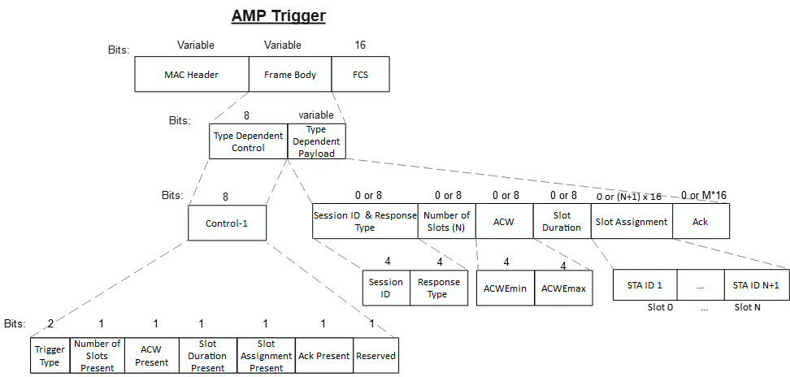
AMP Trigger frame
Important fields in the Frame Body field:
Control field:
  Trigger Type: Indicates Trigger variant: Poll (Random Access), Re-Poll (Continue RA), Request (Scheduled Access)
  Various presence bits
Payload field:
  Session ID: Identifies a random access session.
  Response Type: Type of the solicited uplink response e.g., ID, EPC, Sensor Data, Unspecified etc.
  Number of Slots (N): The number of slots immediately after the AMP Trigger frame that are allocated for uplink transmissions.
  ACW (AMP Contention Window):
    ACWEmin: Smallest ACW
    ACWEmax: Largest ACW
  Slot Duration: Duration of a time-slot.
  Slot Assignment: Assignment of slots for scheduled access.
  Ack: Acknowledgment for one or more uplink transmissions.
Note: The presence of fields depend on the Trigger variant. E.g., AMP Re-Poll may only carry the Session ID & Response Type field and optionally the Ack field.

Slide 11
Summary
We shared the details of a time-slot based random access scheme for uplink channel access with the following features:
  Allows AMP AP to adapt the channel access parameters based on deployment scenarios.
  Allows non-AP AMP STAs to join the random access session at any stage.
  Retransmission is initiated by non-AP AMP STAs.
  Priority of access is given to non-AP AMP STAs that have not transmitted yet.
  The scheme can be adapted flexibly depending on deployment scenarios, e.g., slotted (multi-slot) version for Active Tx non-AP AMP STAs, or non-slotted (single-slot) version for Backscatter non-AP AMP STAs.
We proposed different variants of the AMP Trigger frame for random access:
  AMP Poll: AMP Trigger frame to initiate a new random access session.
  AMP Re-Poll: AMP Trigger frame to continue a random access session in the same TXOP.
  AMP Request: AMP Trigger frame to initiate scheduled access.

Slide 12
SP 1
Do you agree to add to 11bp SFD:
An AMP AP transmits a first variant of the AMP Trigger frame indicating a time-slot based random access session for non-AP AMP STAs. The frame carries:
  Session ID: Identifies the random access session
  Response Type: Type of the solicited uplink response
  ACW: Indicates the upper limits of the random access contention window
  The frame may also carry a Number of Slots indicating the number of slots immediately after the AMP Trigger frame that are allocated for uplink transmissions
  Other parameters are TBD.
  Name of the AMP Trigger frame variant is TBD.

Slide 13
SP 2
Do you agree to add to 11bp SFD:
Upon receiving the first variant of the AMP Trigger frame indicating a time-slot based random access session, a non-AP AMP STA performs the following actions:
  If it is a new session, the non-AP AMP STA initializes ACW and randomly chooses an ABO Counter in the range [0, ACW]. Else, if it a known session and the non-AP AMP STA’s previous transmission was unsuccessful, the non-AP AMP STA updates the ACW to (2*ACW+1) and randomly chooses an ABO Counter in the range [0, ACW].
  If the ABO Counter is less than the number of slots (N) allocated by the AMP Trigger frame, the non-AP AMP STA transmits an uplink AMP PPDU carrying the requested response in one of the slot allocated by the AMP Trigger frame. Else, ABO Counter is decremented by N.

Slide 14
SP 3
Do you agree to add to 11bp SFD:
An AMP AP may transmit a second variant of the AMP Trigger frame to continue a time-slot based random access session. The frame carries:
  Session ID: Identifies the random access session
  Other parameters are TBD.
  Name of the AMP Trigger frame variant is TBD.

Slide 15
SP 4
Do you agree to add to 11bp SFD:
Upon receiving the second variant of the AMP Trigger frame that continues a time-slot based random access session with a known session ID, a non-AP AMP STA performs the following actions: :
  If the non-AP AMP STA has not yet transmitted its uplink response, and the ABO Counter is equal to 0, the non-AP AMP STA transmits an uplink AMP PPDU carrying the requested response; else the ABO Counter is decremented by 1.

Slide 16
SP 5
Do you agree to add to 11bp SFD:
An AMP AP transmits a third variant of the AMP Trigger frame indicating a time-slot based scheduled access for non-AP AMP STAs. The frame carries:
  Response Type: Type of the solicited uplink response
  The frame may also carry:
    Number of Slots (N) indicating the number of slots immediately after the AMP Trigger frame that are allocated for uplink transmissions, and,
    IDs of two or more non-AP AMP STAs that are scheduled for uplink transmission.
  Other parameters are TBD.
  Name of the AMP Trigger frame variant is TBD.

Slide 17
SP 6
Do you agree to add to 11bp SFD:
Upon receiving the third variant of the AMP Trigger frame indicating a time-slot based scheduled access for non-AP AMP STAs, a non-AP AMP STA performs the following actions: :
  If the AMP Trigger frame carries the ID of the non-AP AMP STA, the non-AP AMP STA transmits an uplink AMP PPDU carrying the requested response.

Slide 18
References
[1] IEEE 802.11-24/1613r7, Specification framework for tgbp
[2] 11-25/0817r0, Random access for Active Tx non-AP AMP STAs (Rojan Chitrakar)
[3] 11-25/0818r0, Channel access for Backscatter non-AP AMP STAs – way forward (Rojan Chitrakar)
[4] 11-25/917r0, Multiple TXOP discussion (Liwen)
[5] 11-25/1242r0, Amp acknowledgments (Rojan Chitrakar)

