Slide 1
MAC Aspects of Backscatter non-AP AMP STAs
Date: 29 July 2025
Name | Affiliation | Address | Phone | Email
Rojan Chitrakar | Huawei | Singapore |  | rojan.chitrakar@huawei.com
Lei Huang
Ian Bajaj
Notes:
Jul 12, 2010
Page 1

Slide 2
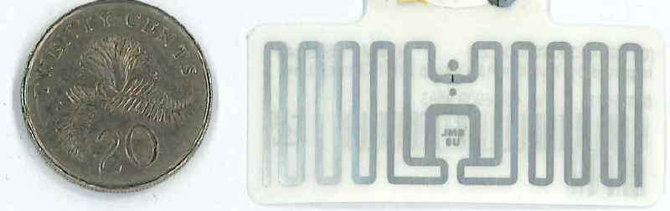
Recap [3]
The simplest forms of backscatter non-AP AMP STAs (e.g., sticker form tags similar to passive RFID tags) are likely to be hardware limited [2], [4]:
  Small Capacitor size (~100 pF); versus (~100 nF) for active Tx non-AP AMP STAs
  Operations outside of excitation periods will be very limited. Tags may only be able to retain few essential context across TXOPs.
  Long wakeup settling time (~ 1ms)
  Less time within TXOP for actual communication
  Clock accuracy of ~10⁵ ppm; versus ≤ 10⁴ ppm for active Tx non-AP AMP STAs
  Synchronization (e.g., to slot boundary) will be a lot more challenging.
  Such non-AP AMP STAs can be expected to also support the UHF RFID standard [1].
In [3], we also considered whether the channel access for Backscatter and Active Tx non-AP AMP STAs should be considered independently instead of a unified scheme. However, more evaluation may be required for this topic.
In this contribution, we will focus on other MAC aspects of backscatter non-AP AMP STAs that may not be directly related to channel access.

Slide 3
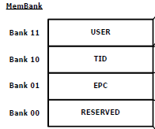
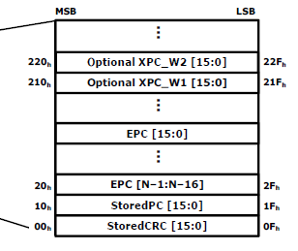
Tag identity and memory bank
Electronic Product Code (EPC) is very popular for object identification. While EPC is generally associated with UHF RFID, their usage is not limited to UHF RFID. We think EPC can be used to identify non-AP AMP STAs, in which case the mandatory portion of the EPC Memory structure as defined by [2] can be reused.
EPC memory contains a StoredCRC at addresses 00h to 0Fh, a StoredPC at 10h to 1Fh, an EPC beginning at 20h.
StoredCRC is a CRC-16 computed over the StoredPC and the EPC.
StoredPC indicates information about the memory:
  b0 – b4: Length of EPC in words
  b5: RUM (Read user memory indicator)
  b6: XI (XPC_W1 indicator)
  b7: T (Numbering system identifier toggle)
    0: GS1 EPCglobal Application
    1: Non GS1 EPCglobal Application
Memory Bank
TID and USER memory may be optionally supported.

Slide 4
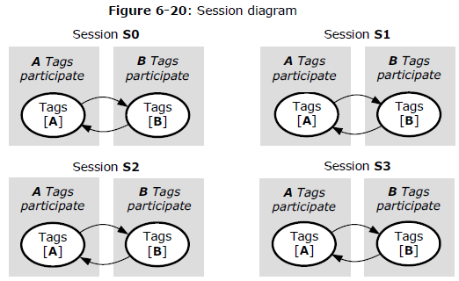
Tag sessions and flags
UHF RFID Standard defines 4 sessions (denoted S0, S1, S2, and S3) to allow two or more Interrogators (Readers) to independently inventory a common tag population. A tag maintains an independent inventoried flag for each of its four sessions. Each inventoried flag has two values, denoted A and B. At the beginning of each and every inventory round an Interrogator chooses to inventory either A or B tags in one of the four sessions. After singulating a tag (i.e., reading its EPC), an Interrogator may issue a command that causes the tag to invert its inventoried flag for that session (i.e. A→B or B→A). In addition, tags also maintain a SL flag that can be set with the UHF Select command.
We think that the four session flags and the SL flag can by supported by non-AP AMP STAs to support dense deployments.

Slide 5
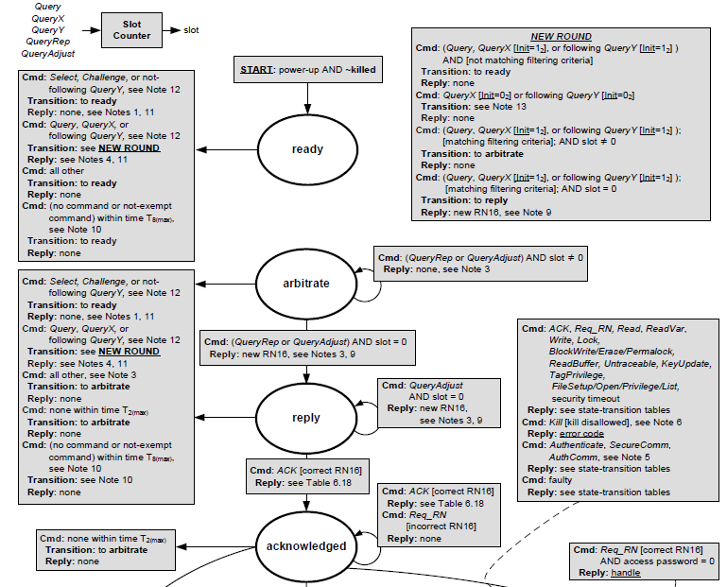
Tag states
The UHF RFID Standard defines various metastates that determines the tag’s actions and responses to UHF commands. E.g., a tag is in the arbitrate state during random access and transitions to the reply state after backscattering RN16 and proceeding to the acknowledged state once its EPC has been read.
While the channel access protocol may be redefined in 802.11bp, we think that the applicable tag metastates can be reused. If needed, the state transitions can be redefined in 802.11bp, for example, a tag may directly move from arbitrate to acknowledged state if a non-AP AMP STA is allowed to directly transmit its EPC during the random access.

Slide 6
UHF Commands
The UHF RFID Standard defines 3 sets of Interrogator Commands. We think the following UHF commands can be reused in 802.11bp:
  Select command: allows an Interrogator to select a tag subpopulation based on user-defined criteria
  Read: allows an Interrogator to read part or all of a tag’s Reserved memory, EPC memory, TID memory, or the currently open file in User memory.
  Write: allows an Interrogator to write a word in a tag’s Reserved memory, EPC memory, TID memory, or the currently open file in User memory.
  Authenticate: allows an Interrogator to perform tag, Interrogator, or mutual authentication.
  Support of Inventory commands (Query, QueryAdjust, QueryRep, ACK, and NAK) is TBD and depends on the channel access mechanism defined for backscatter non-AP AMP STAs.

Slide 7
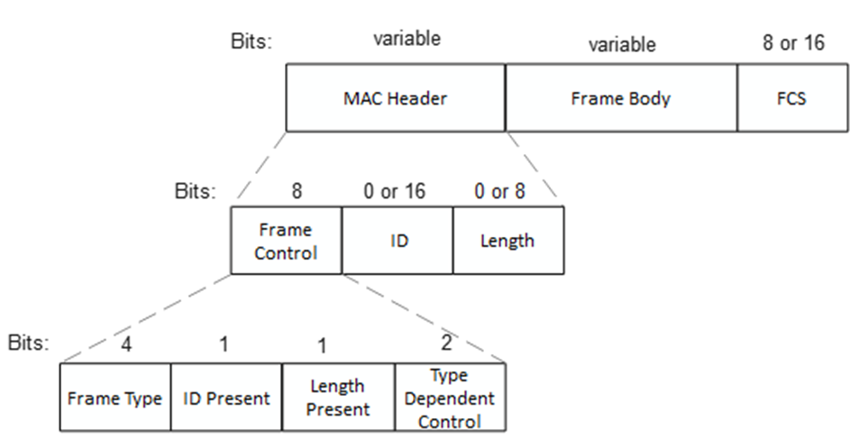
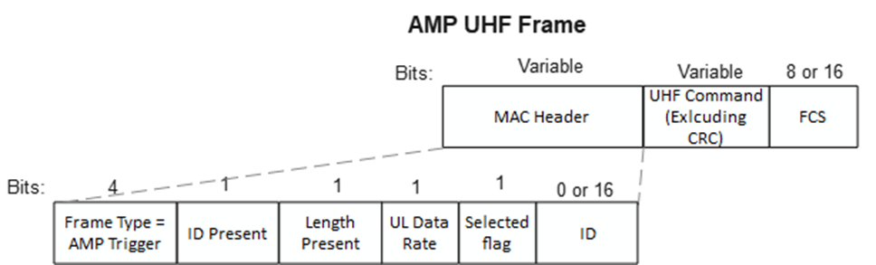
AMP frame for backscatter communication
Frame Control (8 bits):
Frame Type (4 bits): Indicates various AMP frame types
ID Present (1 bit): Presence of ID field
Length Present (1 bit): Presence of Length field
Type Dependent Control (2 bits)
ID (0 or 16 bits): Carries the Receiver ID or Transmitter ID if applicable.
  Recommend 16-bits ID space to reduce ID collisions and align with UHF RN16.
Length (0 or 8 bits): Indicates the length of the Frame Body field if present
Example AMP Backscatter frame to carry UHF Commands:

Slide 8
Summary
Backscatter non-AP AMP STAs should support at least the following as defined by the UHF RFID Standard [1]:
Memory structure: EPC is mandatory. TID and USER memory may be optionally supported.
Sessions and flags: 1) Inventoried flags for S0, S1, S2, S3 sessions; 2) Selected flag (SL)
UHF commands: Select, Read, Write, Authenticate.
States: tag states that correspond to the supported UHF commands are reused
We also proposed the format of the AMP frames for backscatter communication.
Channel access for backscatter non-AP AMP STAs is TBD.

Slide 9
SP 1
Do you agree to add to the 11bp SFD:
A Backscatter non-AP AMP STA uses Electronic Product Code (EPC) as its unique global identifier.
  NOTE – EPC is defined by the EPC Tag Data Standard (TDS)

Slide 10
SP 2
Do you agree to add to the 11bp SFD:
Backscatter non-AP AMP STAs support the tag memory defined by the UHF RFID Standard.
  EPC memory (StoredCRC, StoredPC and EPC) is mandatory
  Reserved, TID and USER memory are optional
  NOTE – UHF RFID Standard refers to the EPC® Radio-Frequency Identity Generation-2 UHF RFID Standard.

Slide 11
SP 3
Do you agree to add to the 11bp SFD:
11bp shall support the following UHF commands for backscatter communication:
  Select, Read, Write, Authenticate
  Other UHF commands supported by 11bp is TBD
  NOTE – The UHF commands are defined by the EPC® Radio-Frequency Identity Generation-2 UHF RFID Standard.

Slide 12
SP 4
Do you agree to add to the 11bp SFD:
Backscatter non-AP AMP STAs support the following flags defined by the UHF RFID Standard.
  Inventoried flags for S0, S1, S2, S3 sessions
  Selected flag (SL)

Slide 13
SP 5
Do you agree to add to the 11bp SFD:
Backscatter non-AP AMP STAs support the tag states (as defined by the UHF RFID Standard) that correspond to the supported UHF commands.

Slide 14
SP 6
Do you agree to add to the 11bp SFD:
11bp defines an AMP UHF frame to carry UHF command.
  The UHF command is carried in the Payload field

Slide 15
References
[1] EPC® Radio-Frequency Identity Generation-2 UHF RFID Standard V3.0 (GS1)
[2] 11-24/1237, AMP Tag Requirements for Close-range Mono-Static Backscattering (Rui Cao et. al)
[3] 11-25-0818r0, Channel access for Backscatter non-ap AMP STAs – way forward (Rojan Chitrakar et. al.)
[4] 24/722r0, Introduction to passive sub-1GHz RFID systems (Franz Amtmann)
[5] 11-25-1102r0, AMP Frame Format (Rojan Chitrakar et. al.)
[6] EPC Tag Data Standard (TDS) 2.0

