Slide 1
AMP Enhanced Bi-Static Back Scattering Non AP STA with Gains
Date: 2025-07-28
Authors:

Slide 2
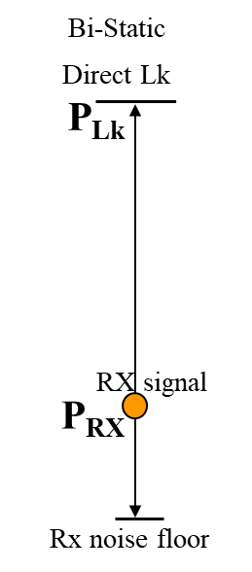
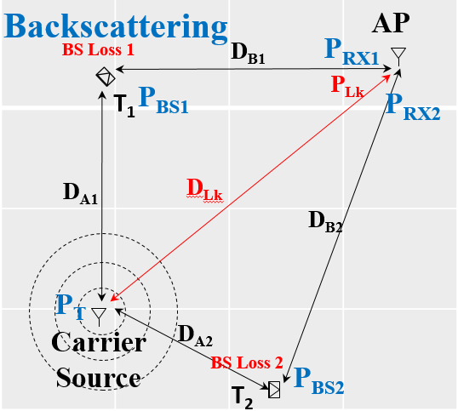
Abstract
The BS UL range of standard AMP BS STAs, was calculated in [1] to be limited by the direct leakage to ~ 2 m.
It was also proposed in [1] that the range can be extended to ~ 8 m utilizing BS gain of 12 dB.
In [2], a reflective type BS gain was proposed, suggesting gain of 15 dB @ 900 MHz and 100 uW power consumption
Here we broaden the bistatic extended range perspective including antennas gain/directivity and review a repeater/directional type BS gain option for enhanced AMP BS Bi-static non-AP STAs

Slide 3
Background: Direct Leakage vs. Bi-Static BS Signal Magnitudes
In many deployment scenarios, the direct leakage signal from the carrier source to the AP has a much higher power than the RX signal backscattered from the AMP non-AP STA.
The instantaneous dynamic range available at the AP (45-50 dB), limits the BS UL range.

Slide 4
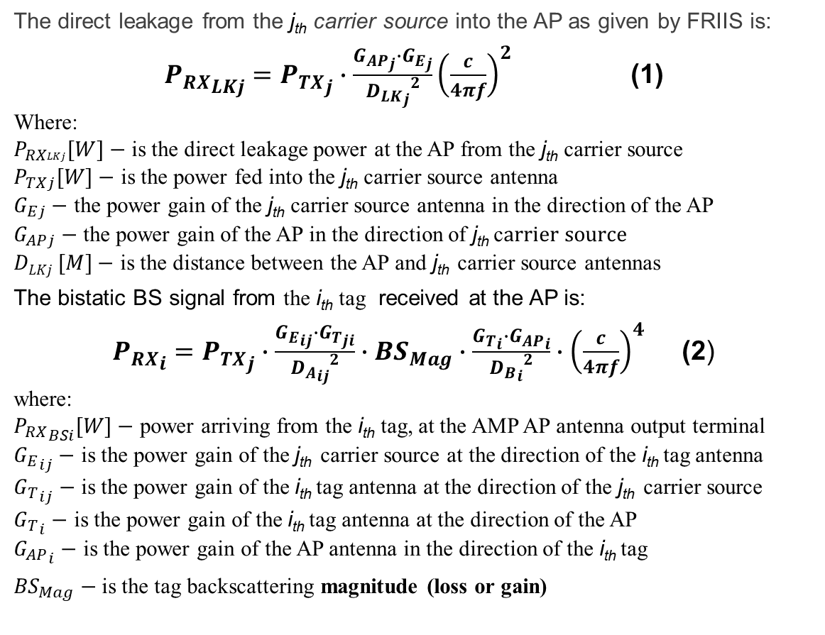
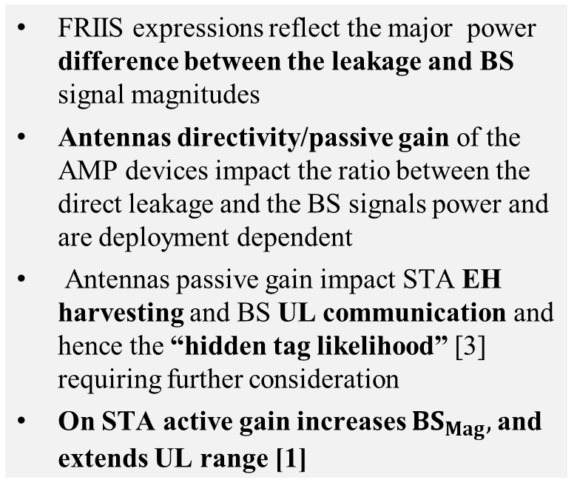
Magnitude Expressions for Direct Leakage and Bi-Static BS Signal
The direct leakage from the j_{th} carrier source into the AP as given by FRIIS is:
${P_{RX}}_{LKj}={P_{TX}}_{j}∙\frac{{G_{AP}}_{j}∙{G_{E}}_{j}}{{{D_{LK}}_{j}}^{2}}{\left(\frac{c}{4πf}\right)}^{2}$ (1)
Where:
$P_{RXLKj}[W]−$ is the direct leakage power at the AP from the j_{th} carrier source
$P_{TXj}[W]−$ is the power fed into the j_{th} carrier source antenna
$G_{Ej}−$ the power gain of the j_{th} carrier source antenna in the direction of the AP
$G_{APj}−$ the power gain of the AP in the direction of j_{th} c$arrier source$
$DLKj [M]−$ is the distance between the AP and j_{th} carrier source antennas
The bistatic BS signal from the i_{th} tag received at the AP is:
${P_{RX}}_{i}={P_{TX}}_{j}∙\frac{{G_{E}}_{ij}∙{G_{T}}_{ji}}{{{D_{A}}_{ij}}^{2}}∙{BS}_{Mag}∙\frac{{G_{T}}_{i}∙{G_{AP}}_{i}}{{{D_{B}}_{i}}^{2}}∙{\left(\frac{c}{4πf}\right)}^{4}$ (2)
where:
${P_{RX}}_{BSi}[W]−$ power arriving from the i_{th} tag, at the AMP AP antenna output terminal
${G_{E}}_{ij}−$ is the power gain of the j_{th} carrier source at the direction of the i_{th} tag antenna
${G_{T}}_{ij}−$ is the power gain of the i_{th} tag antenna at the direction of the j_{th} carrier source
${G_{T}}_{i}−$ is the power gain of the i_{th} tag antenna at the direction of the AP
${G_{AP}}_{i}−$ is the power gain of the AP antenna in the direction of the i_{th} tag
${BS}_{Mag}−$ is the tag backscattering magnitude (loss or gain)
𝑓 [𝐻𝑧]− is the UL frequency
𝑐 [𝑀/𝑆𝑒𝑐]− is the speed of light
FRIIS expressions reflect the major power difference between the leakage and BS signal magnitudes
Antennas directivity/passive gain of the AMP devices impact the ratio between the direct leakage and the BS signals power and are deployment dependent
Antennas passive gain impact STA EH harvesting and BS UL communication and hence the “hidden tag likelihood” [3] requiring further consideration
On STA active gain increases ${BS}_{Mag},$and extends UL range [1]

Slide 5
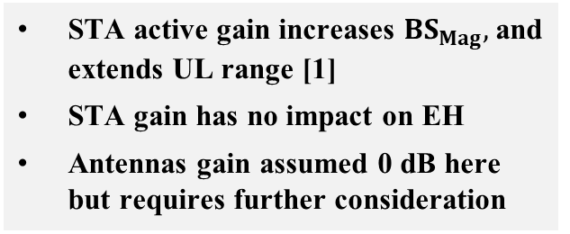
Revisit: Impact of BS Loss/Gain on 2.4 GHz Bistatic BS Range
Link Assumptions [1]:
STA active gain increases ${BS}_{Mag},$and extends UL range [1]
STA gain has no impact on EH
Antennas gain assumed 0 dB here but requires further consideration
TX Power @ the Exciter - P_{TX} | 20 dBm
Reader Effective DR | 50 dB
Reader min SNR | 3 dB
Antennas Gain | 0 dB, this is a major simplification in respect to(1) and (2)
FRIIS & SNR [dB] for backscattering loss of 5 dB (0 dB active gain):
D_{A}, D_{B}, D_{Lk} [m] | P_{BS} [dBm] | P_{RX} [dBm] | P_{Lk} [dBm] | P_{Lk} -P_{RX} [dB] | SNR[dB] | P_{EH} [dBm]
1, 5, 5 | -25 | -79 | -34 | 45 | 5 | -20 @ 2.4GHz
2, 2, 3.1 | -31 | -77 | -30 | 47 | 3 | -26 @ 2.4GHz
FRIIS & SNR [dB] for backscattering gain of 1 dB (e.g. 5 dB loss + 6 dB gain):
D_{A}, D_{B}, D_{Lk} [m] | P_{BS} [dBm] | P_{RX} [dBm] | P_{Lk} [dBm] | P_{Lk} -P_{RX} [dB] | SNR[dB] | P_{EH} [dBm]
2, 2, 3.1 | -25 | -71 | -30 | 41 | 9 | -26 @ 2.4GHz
4, 4, 6.2 | -31 | -83 | -36 | 47 | 3 | -32 @ 2.4GHz
FRIIS & SNR [dB] for backscattering gain of 7 dB (e.g. 5 dB loss + 12 dB gain):
D_{A}, D_{B}, D_{Lk} [m] | P_{BS} [dBm] | P_{RX} [dBm] | P_{Lk} [dBm] | P_{Lk} -P_{RX} [dB] | SNR[dB] | P_{EH} [dBm]
4, 4, 6.2 | -25 | -77 | -36 | 41 | 9 | -32 @ 2.4GHz
8, 8, 12.4 | -31 | -89 | -42 | 47 | 3 | -38 @ 2.4GHz

Slide 6
Discussion
The BS UL range can be extended by adding gain to the AMP STA [1]. BS gain increase P_{BS} and hence P_{RX} while P_{LK} is unchanged.
Adding STA gain of up to 15 dB, theoretically extend UL range from ~ 2 m to ~ 10 m. Active STA gain will increase UL STA power consumption
EH at S1G offers ~ 20 dB higher power for charging and enables extended harvesting range [1]. This will balance UL and EH ranges and compensate for the extra power consumption that the STA gain requires
BS Gain

Slide 7
Example: BS STA with Repeater/Directional Gain
Carrier Source
H/V antenna can also be utilized
for improved harvesting
Ant
A repeater amplifier between the H/V antennas (mutually isolated) can be utilized for imitating BS gain.
P_{EH}
AP
BS Tag with HV Antenna
V
Ant
H/V
Antenna
RX
TX
G
H
Amplifier
UL modulation

Slide 8
Summary
Enhanced bistatic BS AMP STA for extended UL range, requires active gain on STA
Balancing UL and EH ranges in enhanced BS STAs, can be achieved through S1G energizing antennas on the STA
Enhanced BS STA active gain can utilize reflective or directive/repeater topologies
Slide 8

Slide 9
References
[1] 11-25-0307r0 “UL Monostatic and Bistatic Range Extension Considerations”; Dror Regev (Huawei)
[2] 11-22/1893r0 “Ambient Power Enabled IoT Technologies” Hao Min (Shanghai Quanray Electronics)
[3] 11-25-0784r0 “AMP Spatial "Hidden Tag" Deployment Scenario”; Dror Regev (Huawei)
Slide 9

