Slide 1
AMP Multi Energizer/Exciter Deployment Scenarios
Date: 2025-07-31
Authors:

Slide 2
Abstract
This discussion reviews spatial AMP coverage scenarios requiring multi exciter/energizer devices, for active and bistatic BS AMP tags.

Slide 3
Background: AMP Tag Coverage Range Recap
Active and bistatic BS AMP tags with enhanced capabilities, are limited in terms of harvesting & communication ranges
In [1], the AP WPT correspondence with 2 energizers was considered and included a proposal to simultaneously energize from multiple energizers to cover a space with a larger dimension delivering adequate energy
In [2], the effect of antenna directivity was overviewed, showing that “hidden tags” may exist as a result of the energizer/exciter and AP position. It was indicated that multiple energizer/exciter devices can minimize the likelihood for uncharged or unexcited AMP tags

Slide 4
Recap: AMP “Hidden Tags” for a Single Exciter
Assume active or bistatic BS tags with enhanced capability:
AP
Tag T₁ can possibly be charged by the energizer but may not be able to communicate with the AP as a result of low antenna gain in the AP direction
Tag T₂ may have an adequate antenna gain towards the AP and hence can communicate, yet cannot be charged/excited, since it has low antenna gain in the direction of the exciter
Therefore, both T₁ and T₂ can be viewed as inactive “hidden tags”
Positioning (location & orientation) of the AP, may dictate hidden tag positions
Object Sensed
T₁
T₂
Energizer& Carrier Source

Slide 5



Example of AMP Deployment with Two Exciters
T₁ has good antenna gain towards exciters 1 and 2, and hence may be charged by either one, or by both simultaneously if their signal interference is constructive. However, T₁ has very low antenna gain in the direction of the AP, thus can not communicate.
Tag T₂ may be able to charge mainly from exciter 2 and communicate with the AP.
Exciter 2 enabled the functionality of tags like T₂ which are hidden from exciter 1. The two exciters increase the total space coverage and may reduce the total likelihood for hidden tags
AP
Object Sensed
T₂
T₁
Exciter 1
$$DB2$$
Exciter 2
P_{TX}
$$DA1$$
$$DA2$$
P_{TX}

Slide 6
Example of AMP Deployment with Four Exciters
E₁
AP
E₂
Consider a space covered by 4 AMP exciters
Each exciter is assigned to a different AMP section of the space to be covered
The 4 exciters enable the coverage of the full space required for the respective use case
There are coverage overlaps of exciter sections within the full space. These may result in constructive interference but also in destructive interference and EH “null zones” in simultaneous WPT charging
1
D_{B1}
2
D_{A11}
D_{B4}
D_{B2}
12
D_{A24}
D_{A23}
D_{A22}
T₁
D_{A14}
D_{B3}
124
123
T₄
T₃
T₂
14
1234
23
134
234
D_{A33}
D_{A44}
D_{A32}
34
D_{A34}
4
3
E₄
E₃

Slide 7
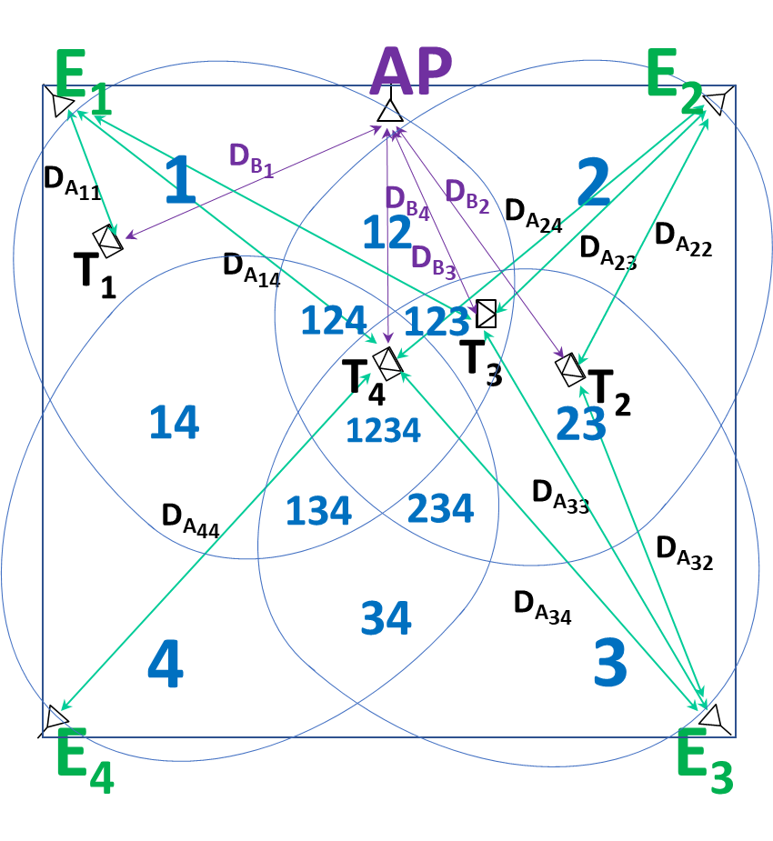
Considerations for AMP Space with Four Exciters
Some AMP spaces (e.g. home, office), may not be covered by a single exciter and multiple exciters may be required
Simultaneous tag charging from multi energizers, depend on the respective interference and may require AP management
Simultaneous excitement of multi carrier sources for bistatic BS may be prohibitive and carrier sourcing by different exciters is likely be controlled by the AP
When WPT and communication frequencies are S1G and 2.4 GHz, simultaneous WPT and communications with different exciters, may be an option. The AP may be deaf for WPT.

Slide 8
Summary
Most earlier AMP discussions assumed a deployment of one energizer/exciter
Desirable AMP use cases, require deployments of multi energizer/exciter units and space sections to increase coverage, AP-tag ranges and reduce the likelihood of hidden tags
Multiple exciters, dictate “multi dimensional” management of the AP to overcome destructive EH interferences and collisions of multiple carrier sources
Future work needs to expand AMP deployments and use cases that employ multiple exciters
Slide 8

Slide 9
References
11-25-0319r0 “Correspondence between Energizers and AMP non-AP STAs”; Yinan Qi (OPPO)
11-25-784r0 “AMP Spatial “Hidden Tag” Deployment Scenario”; Dror Regev (Huawei)
Slide 9

