Slide 1
AMP Tag Active Mode Performance Example and Review
Date: 2025-09-02
Authors:

Slide 2
Abstract
This contribution is based on an 2023 ISSCC paper [1] and reviews performance aspects and design blocks of active transmitters.
In [2], a 2.45GHz active transmitter with an EIRP of -25dBm and 158uW power consumption was assumed / described.
While [1] and [2] designs may differ, the paper may serve as a reference and offer a basis for performance considerations and trad-offs in active transmitters.
Additionally, since TX EIRP is a function of TX antenna gain and directivity, their impact on performance is discussed here.

Slide 3
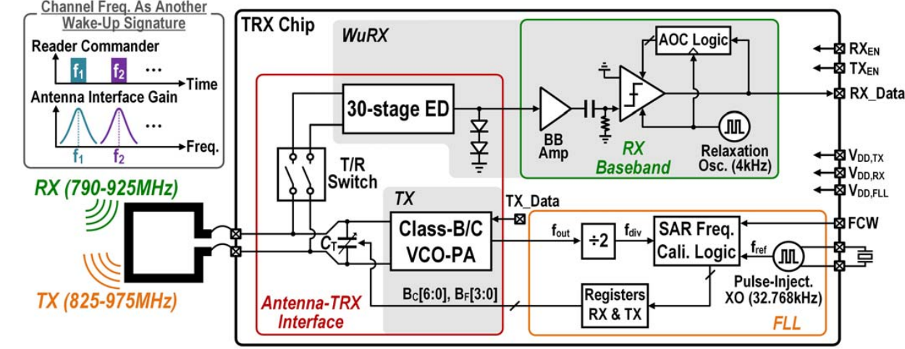
AMP Active Tag Top Level Schematic [1]
Freq. Control
Frequency reference
S1G LC low power oscillator
Frequency locking
RF TX frequency is calibrated by a switched capacitor array (embedded in C_{T}), controlled by a frequency locked loop (FLL) with a reference of 32.768kHz.
TX data is modulated on the TX frequency at the LC oscillator circuit block

Slide 4
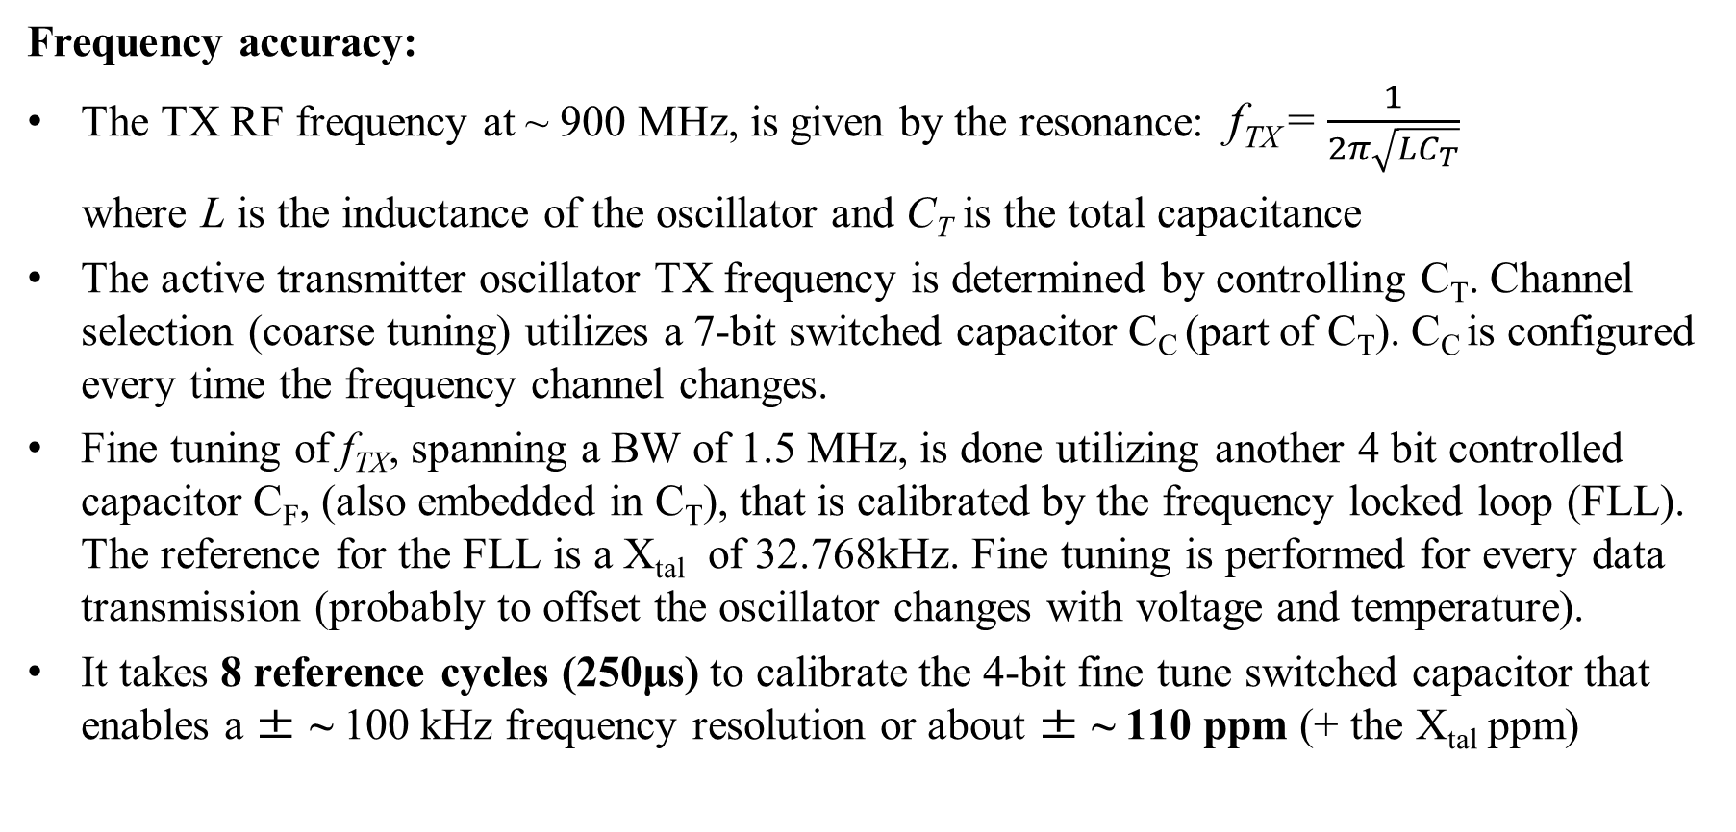
AMP Active Tag TX Frequency Accuracy [1]
Frequency accuracy:
The TX RF frequency at ~ 900 MHz, is given by the resonance: f_{TX} = $\frac{1}{2π\sqrt{LC_{T}}}$
where L is the inductance of the oscillator and C_{T} is the total capacitance
The active transmitter oscillator TX frequency is determined by controlling C_{T}. Channel selection (coarse tuning) utilizes a 7-bit switched capacitor C_{C} (part of C_{T}). C_{C} is configured every time the frequency channel changes.
Fine tuning of f_{TX}, spanning a BW of 1.5 MHz, is done utilizing another 4 bit controlled capacitor C_{F}, (also embedded in C_{T}), that is calibrated by the frequency locked loop (FLL). The reference for the FLL is a X_{tal} of 32.768kHz. Fine tuning is performed for every data transmission (probably to offset the oscillator changes with voltage and temperature).
It takes 8 reference cycles (250μs) to calibrate the 4-bit fine tune switched capacitor that enables a ± ~ 100 kHz frequency resolution or about ± ~ 110 ppm (+ the X_{tal} ppm)

Slide 5
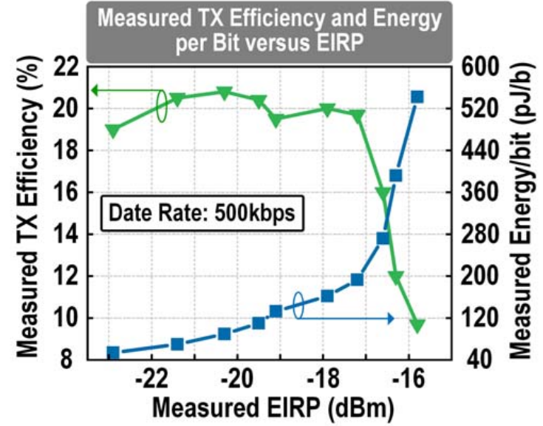
AMP Active Mode Power Consumption [1]
The X_{tal} reference, consumes 21 nW and is always-ON to reduce the system latency
The RX BB (for WUR) consumes 17.8nW and is always ON
TX oscillator consumes 35 uW w/o modulation @ V_{DD}=0.9 v & -22 dBm EIRP
FLL consumes 66 uW and is turned “Off” after 250uS when calibration is achieved
For EIRP of -22dBm, data rate of 500kbs can be achieved.
A trade-off exists between EIRP and energy per bit
TX efficiency of ~ 20 % is shown for -22 to -17dBm EIRP

Slide 6
Discussion and Trade-Offs [1]
A method to achieve ± ~ 150 ppm, in an active transmitter is proposed.
A crystal oscillator reference is required for this method
Frequency calibration interval for every data transmission > 250 uS
Frequency calibration interval for changing TX channel may be even longer
A trade-off exists between EIRP and energy per bit and may dictate an inverse proportion between range and data rate

Slide 7
Further TX Transmitter Trade-Offs
Antenna gain/directivity increases EIRP in active tags, yet decreases spatial coverage
Hence, TX range maybe highly dependent on the tag orientation

Slide 8
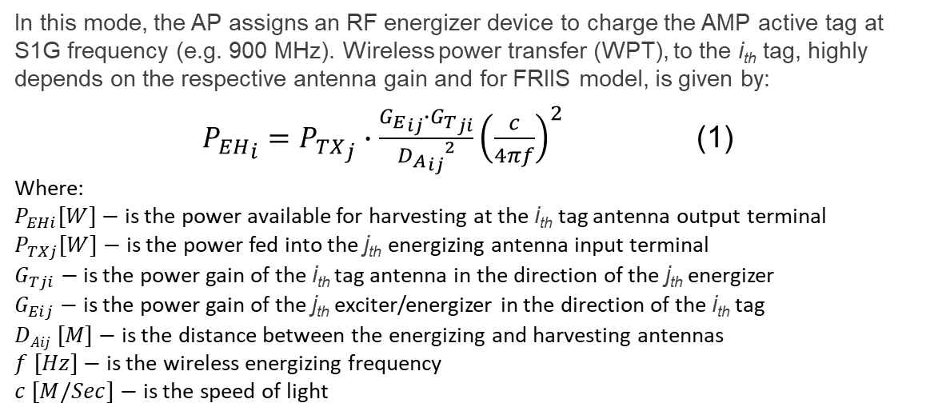

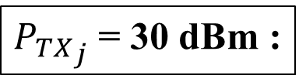
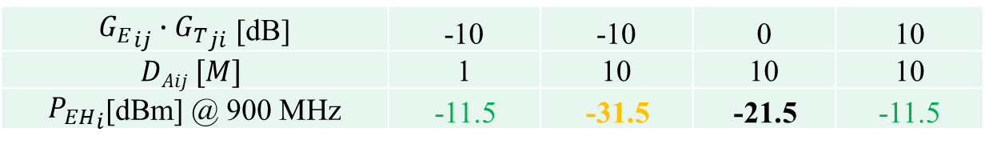
AMP Antenna Gains and Distance vs. Energy Harvesting Power
In this mode, the AP assigns an RF energizer device to charge the AMP active tag at S1G frequency (e.g. 900 MHz). Wireless power transfer (WPT), to the i_{th} tag, highly depends on the respective antenna gain and for FRIIS model, is given by:
${P_{EH}}_{i}={P_{TX}}_{j}∙\frac{{G_{E}}_{ij}∙{G_{T}}_{ji}}{{{D_{A}}_{ij}}^{2}}{\left(\frac{c}{4πf}\right)}^{2}$ (1)
Where:
$P_{EHi}[W]−$ is the power available for harvesting at the i_{th} tag antenna output terminal
$P_{TXj}[W]−$ is the power fed into the j_{th} energizing antenna input terminal
$G_{Tji}−$ is the power gain of the i_{th} tag antenna in the direction of the j_{th} energizer
$G_{Eij}−$ is the power gain of the j_{th} exciter/energizer in the direction of the i_{th} tag
$DAij [M]−$ is the distance between the energizing and harvesting antennas
$f [Hz]−$ is the wireless energizing frequency
$c [M/Sec]−$ is the speed of light
J_{th} Energizer
i_{th} Tag
$${D_{A}}_{ij}$$
X
0 dBi
Z
Y
Isotropic Antenna
Antenna with
High Gain
AP
${G_{E}}_{ij}∙{G_{T}}_{ji}$ [dB] | -10 | -10 | 0 | 10
$$DAij [M]$$ | 1 | 10 | 10 | 10
${P_{EH}}_{i}$[dBm] @ 900 MHz | -11.5 | -31.5 | -21.5 | -11.5
${P_{TX}}_{j}$= 30 dBm :
Tags at 10 meter from the energizer, will be energized much faster when the total product of both tag and energizer gains is higher than 0 dB

Slide 9
High Antenna Gain / EIRP and Active Tag Deployment
✓

Energizer
Tag
X
Tag
0 dBi
Energizer
X
Z
0 dBi
Y
Z
Isotropic Antenna
Antenna with
High Gain
AP
Y
Isotropic Antenna
Antenna with
High Gain
AP
EIRP is reported for the antenna maximum gain direction. EIRP leveraging high antenna gain maybe efficient when the AP and energizer are “effectively” collocated.
However, in other scenarios such tag directivity can result a “hidden tag”.
Hence, increasing EIRP through higher antenna gain may not be always desirable.

Slide 10


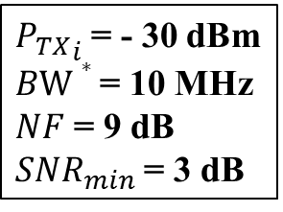
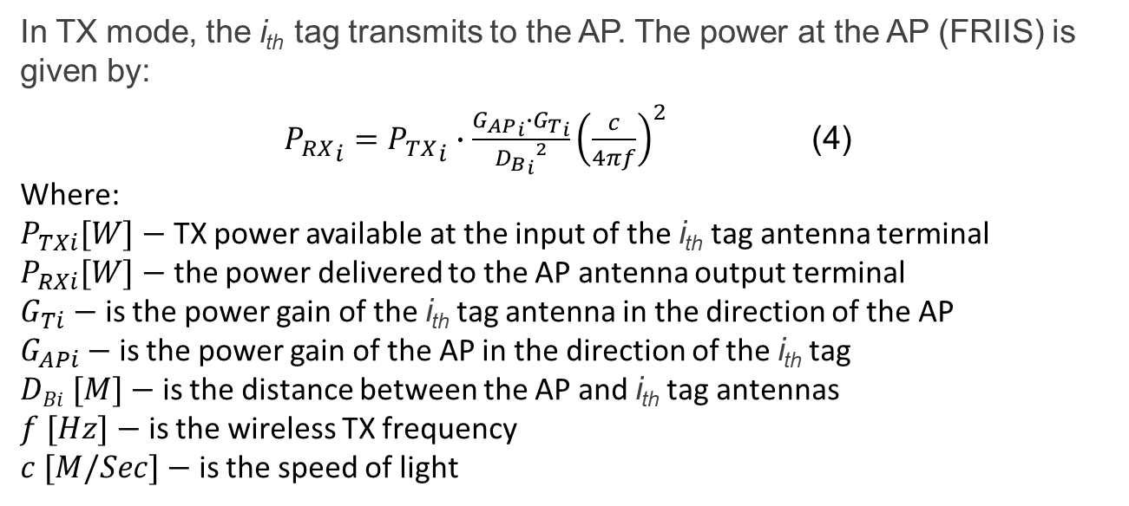
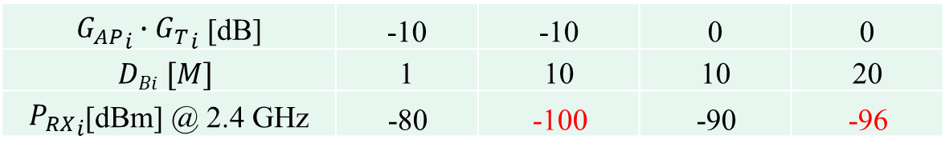
AMP Antennas Gain and Distance vs. AP RX Signal Power
In TX mode, the i_{th} tag transmits to the AP. The power at the AP (FRIIS) is given by:
${P_{RX}}_{i}={P_{TX}}_{i}∙\frac{{G_{AP}}_{i}∙{G_{T}}_{i}}{{{D_{B}}_{i}}^{2}}{\left(\frac{c}{4πf}\right)}^{2}$ (4)
Where:
$P_{TXi}[W]−$ TX power available at the input of the i_{th} tag antenna terminal
$P_{RXi}[W]−$ the power delivered to the AP antenna output terminal
$G_{Ti}−$ is the power gain of the i_{th} tag antenna in the direction of the AP
$G_{APi}−$ is the power gain of the AP in the direction of the i_{th} tag
$DBi [M]−$ is the distance between the AP and i_{th} tag antennas
$f [Hz]−$ is the wireless TX frequency
$c [M/Sec]−$ is the speed of light
i_{th} Tag
Antenna with
High Gain
X
0 dBi
Z
Y
$${D_{B}}_{i}$$
Isotropic Antenna
AP
${P_{TX}}_{i}$= - 30 dBm
$BW∗$= 10 MHz
$NF$ = 9 dB
${SNR}_{min}$ = 3 dB
${G_{AP}}_{i}∙{G_{T}}_{i}$ [dB] | -10 | -10 | 0 | 0
$$DBi [M]$$ | 1 | 10 | 10 | 20
${P_{RX}}_{i}$[dBm] @ 2.4 GHz | -80 | -100 | -90 | -96
$$∗Needs verification$$
For a minimum ${P_{RX}}_{i}$of -92 dBm, @ 10 meter, the min. required antenna gains product is ${G_{AP}}_{i}∙{G_{T}}_{i}$ = - 2 dB

Slide 11
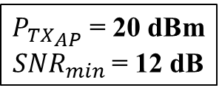
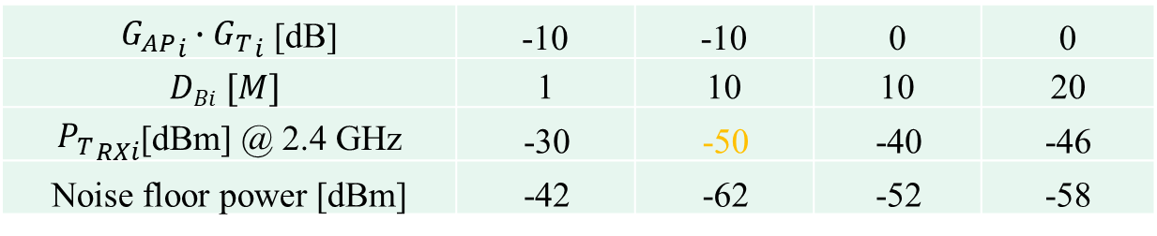
AMP Tag Antennas Gain Range and Tag ED Sensitivity
In RX mode, similar gain calculations can be performed
X
i_{th} Tag
0 dBi
Z
Y
Isotropic Antenna
Antenna with
High Gain
AP
${P_{TX}}_{AP}$= 20 dBm
${SNR}_{min}$ = 12 dB
${G_{AP}}_{i}∙{G_{T}}_{i}$ [dB] | -10 | -10 | 0 | 0
$$DBi [M]$$ | 1 | 10 | 10 | 20
${P_{T}}_{RXi}$[dBm] @ 2.4 GHz | -30 | -50 | -40 | -46
Noise floor power [dBm] | -42 | -62 | -52 | -58
For ${SNR}_{min}$ = 12 dB, @ 10 meter, assuming ED sensitivity of -50dBm, the required minimum antenna gains product is ${G_{AP}}_{i}∙{G_{T}}_{i}$ ≈ 0 dB

Slide 12
Summary
This document reviews performance aspects and design blocks of active transmitters, showing an approach for achieving better than ± 1000 ppm in TX and the respective performance and trade-offs
The consequences of the tag’s antenna gain and EIRP are also explored considering EH, TX and RX performance
TX (UL) performance is the main challenge, despite the fact that there is no inherent leakage (e.g. exciter direct leakage as in BS tags). It may be challenging to achieve 50 meters of range as suggested in [2], especially when considering antenna gains
Slide 12

Slide 13
References
[1] Z. Yang et al, A ULP Long-Range Active-RF Tag with Automatic Antenna-Interface Calibration Achieving 20.5% TX Efficiency at -22dBm EIRP, and -60.4dBm Sensitivity at 17.8nW RX Power. 2023 IEEE International Solid-State Circuits Conference (ISSCC)
[2] 11-25-1497r0 “Uplink Rates for Active Transmission”; Amichai Sanderovich (Wiliot)
Slide 13

