Slide 1
DL PPDU Format for Backscattering Communication
Date: 2025-07-22
Authors:

Slide 2
Introduction
One unified AMP DL PPDU format has been agreed to support all use cases [1]
  Several optional sub-fields (e.g. excitation) are defined for backscattering without frequency shift [2]
In [3], multi-TXOP operation is proposed for backscattering operation reusing UHF RFID logical interface to
  support a sequence of backscattering information exchange protocol
  comply with the TXOP limit
In this contribution, we evaluate the needed DL PPDU structure for backscattering operation

Slide 3
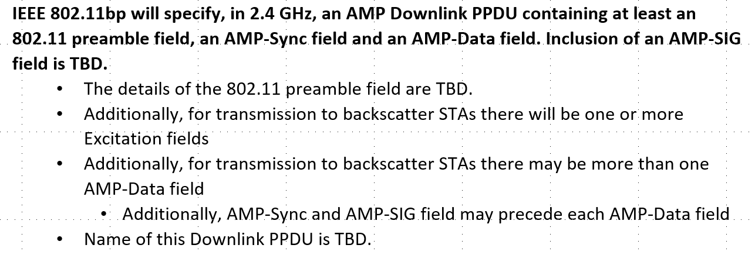
AMP DL PPDU
Motion:
  Many potential variations
WiFi preamble
 | AMP SYNC, AMP Data |  | AMP SYNC, AMP Data (Optional) | …
Excitation (Optional)
Excitation (Optional)
WiFi preamble
AMP SYNC, AMP Data
  (DL PPDU variant for Non-backscattering)

Slide 4
Backscattering Operation Examples
UHF RFID Inventory protocol sequence example
Successful Read
Reader
Tag
No reply
Invalid ACK
No reply
Several proposals to reuse UHF RFID logical interface [4, 5]
  The inventory protocol duration is dynamic
    Number of tags, error recovery, etc.
Challenges to fit the whole sequence in one DL PPDU
  PHY preamble LENTH cannot be revised dynamically
  PPDU (TXOP) duration limit to ~3ms
Multi-TXOP operation is discussed in [3]
  Adapt to 802.11 protocol with better channel utilization efficiency

Slide 5
DL PPDU for Backscattering
To simplify the reader design
  Only defines two DL PPDU structures
  Split long inventory sequence into independent backscattering PPDUs
First PPDU in a TXOP
WiFi preamble
 | AMP SYNC, AMP Data
Excitation
Excitation
Following PPDU in a TXOP
WiFi preamble
AMP SYNC, AMP Data
Excitation
TXOP-1
Channel Contention
TXOP-2
CTS
WiFi preamble
 | AMP Query
WiFi preamble
AMP Query
CTS
WiFi preamble
 | AMP Trigger
WiFi preamble
AMP Trigger
No reply
Invalid ACK
No reply

Slide 6
Backscattering PPDU Duration Example
Example
 | Query (Trigger) |  | EPC
WiFi preamble | 32us |  | 32us
Excitation field for wakeup | ~1ms |  | ~1ms
SYNC | 16us |  | 16us
Data | ~100us |  | ~80
Excitation field for backscattering | ~80us (16-bits) |  | ~512 (128 bits)
Total | 1.228 ms | 228us | 1.64 ms | 640us

Slide 7
Discussions
One DL PPDU only contains one backscattering operation
  DL control command + backscattering reply
Similar to regular WiFi UL TB operation
  AMP MAC can pre-determine the PPDU duration through MAC-PHY interface
  PHY will access MAC payload (command) once per PPDU
  Within SIFS, MAC to decide whether to continue the TXOP
Cons:
  WiFi preamble overhead and SIFS overhead within one TXOP

Slide 8
Summary
Discussed about the simplification of AMP DL PPDU for Backscattering operation
Propose to only define two variants
  One for the first PPDU within a TXOP
  One for followup PPDU within a TXOP

Slide 9
SP1
Do you agree to add the following to 11bp SFD?
11bp defines two PPDU variants of the AMP DL PPDU for backscattering operation
  One for first PPDU in a TXOP
  The other one for the following PPDUs in a TXOP
WiFi preamble
 | AMP SYNC, AMP Data
Excitation
Excitation
WiFi preamble
AMP SYNC, AMP Data
Excitation

Slide 10
Reference
[1] 11-24-1613-10-00bp-specification-framework-for-tgbp
[2] 11-25-0075-00-00bp-Further Thoughts on AMP DL PPDU for Mono-static Backscattering
[3] 11-25-0917-00-00bp-multiple-txop-discussion
[4] 11-25-0061-00-00bp-AMP-monostatic-backscattering-operation
[5] 11-24/836, Thoughts on AMP UHF RFID Tags

Slide 11
Appendix

Slide 12
Example: Immediate Reply
Both Reader and Tag shall response within pre-defined time window during the frame exchange
  T1: Tag response time
  T2: Reader response time
  T3: No reply time wait time
AMP
Reader
Tag
AMP
Reader
Tag
No
reply
Invalid ACK
No reply

Slide 13
Example: Delayed Reply
Reader shall provide energy for the specified time for Tag to process and prepare response
Tag shall response within pre-defined time window
T₅: wait time for Reader
AMP
Reader
Tag
AMP
Reader
Tag

Slide 14
Examples: Authentication
TXOP-1
CCA
TXOP-2
AMP
Reader
Tag
TXOP-1 + TXOP-2 is too long
  may take milli-second processing time
  e.g. Write process, Authenticate process
  Tag may lose energy after TXOP-1
  “Extend” command instruct tag to retain state for in persistent memory

