Slide 1
AMP Backscattering UL SYNC Design Considerations
Date: 2025-07-23
Authors:

Slide 2
Introduction
Excitation field is sent by the reader for AMP backscattering tags to modulate the information
Up to 100k ppm tag clock inaccuracy induces large variation of backscattering frame starting point
SYNC field preceding the backscattered data is needed for the reader to detect the start of frame and perform PPM estimation.
In this contribution, repetitive SYNC field design for OOK backscattering are proposed

Slide 3
UL AMP PPDU for Backscattering
Immediate response: T1 (e.g. 16us)
Delayed response: T5 (e.g. 1~2 ms)
Reader
OFDM Preamble
Excitation
SYNC
TF
Excitation
Tag
UL SYNC
Tag ID
T1
Reader
OFDM Preamble
SYNC
TF
Excitation
Tag
UL SYNC
Response
T5

Slide 4
Backscattering SYNC Design
AMP UL PPDU format: SYNC + Data
  The UL frame is always “polled” by DL frame, no SIG needed
  Overlapped with Excitation field in DL PPDU
  UL SYNC identifies starting time of UL data
Backscattering tags with OOK modulation has clock inaccuracy of up to 100k ppm
  The modulated information will not be aligned with Excitation field symbol boundaries
  Each modulated bit will have up to 10% uncertainty in duration
UL SYNC | UL Data

Slide 5
Backscattering SYNC Design
UL SYNC needs to estimate PPM for data decoding
  Reader data detection performance is highly dependent on ppm
  Estimate ppm during SYNC helps to optimize Rx performance
SYNC false detection probability
  +/-100k ppm → tag response time varies by up to +/-10%
  For delayed response: 2ms processing time → +/-200us variation
  Reader needs to start SYNC detection early, detection window of ~400us
  SYNC sequence needs to be long enough to mitigate false trigger

Slide 6
Proposed UL Backscattering SYNC Structure
We propose a repetitive SYNC structure as below
  Repetitive structure also proposed in Ref. [3]
Base sequence needs to have good properties:
  Good auto-correlation with minimizing
    Pre-peak sidelobe
    Sidelobe between peak-to-peak => good cyclic autocorrelation properties
  Balanced ON-OFF duty cycle: no more than 3 consecutive OOK on
  High peak slope
  No need to consider cross-correlation with other sequences
Basic sequence
Copy 1
Basic OOK sequence
Copy 2
…
Basic OOK sequence
Copy N
Basic sequence
Copy 1
Basic OOK waveform
Copy 2
EOS bits

Slide 7
Backscattering SYNC Design Option
Option 1: repeated Manchester sequence + z
  Violation bit z to mitigate false alarm
  Bit by bit SYNC detection and PPM estimation is straightforward
  Pros: Low complexity receiver
  Cons: Limited sensitivity margin compared with data portion
Option 2: Repeated longer basic OOK sequence
  Correlation-based SYNC detector → better SYNC sensitivity
  PPM estimation from base sequence repetition
  More complex SYNC receive processing
0 0 0 0 0 0 0 0 … 0 z 1
Two repetition example:
Basic OOK sequence
S
Basic OOK sequence
S
EOS bit(s)
Basic sequence
Copy 1
Basic OOK waveform
Copy 2

Slide 8
Theoretical SYNC Sensitivity Gain
Choice of Base Sequence Length
Theoretical SYNC sensitivity gain compared with data
  Longer SYNC length has more gain
  Manchester (Basic Seq. len = 2) has no gain
  PPM degrades SYNC sensitivity gain 1~2 dB

Slide 9
PPM Estimation Requirement
Residual PPM target: < 20k
  <1dB loss from 0 ppm

Slide 10
PPM Estimation Configurations
Basic sequence S
  Len 2: [1 0] - Manchester
  Len 6: [1 0 1 1 0 0]
  Len 8: [1 1 0 0 1 0 1 0]
  Len 10: [0 1 1 0 1 1 1 0 0 0]
SYNC structure
  2 repetition: [S S 1]
  3 repetition: [S S S 1]
BW 20M; OOK chip duration: 0.5 us or 2 us
SYNC detection: xcorr(SYNC, 2S-1) and peak detection
No additive noise

Slide 11
PPM Estimation Example
Basic OOK sequence: Manchester S = [1 0]
  2 repetition: [S S 1]
  Chip duration 2 us; BW = 20M => 80 samples per basic OOK seq
  Estimated PPM: (80/(149-76) – 1) *1e6 = 95.98k
  PPM estimation error = 95.98k – 100k = -4.1k

Slide 12
PPM Estimation Error (Noise-Free)
Repetition = 2
Repetition = 3
Len 8 or 10 with 2 repetition meets residual PPM requirement (~within 10k)
Notes:
Legendary

Slide 13
Example: Basic Sequence Length 8
Base sequence S = [1 1 0 0 1 0 1 0]
  Two consecutive OOK on
  Autocorrelation of repetition 3 sequence [S S S 1] and 2S-1
    Autocorrelation has side lobe = 0 before first peak
    Good cyclic correlation property
    Peak slope = 1.5
Slope = 1.5

Slide 14
Example: Basic Sequence Length 8
Base sequence S = [1 1 1 0 0 1 0 0]
  Three consecutive OOK on
  Autocorrelation of repetition 3 sequence [S S S 1] and 2S-1
    Autocorrelation has side lobe < 0 before first peak
    Good cyclic correlation property
    Peak slope = 1
  Same Seq. proposed in Ref. [3]
Slope = 1

Slide 15
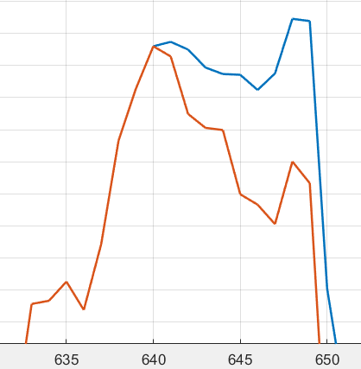
End of SYNC (EOS) bits
Repeated longer basic OOK sequence
  Correlation property of last basic OOK sequence is affected by first bit of data portion.
EOS bits protects correlation property of last basic OOK sequence.
10 samples

Slide 16
End of SYNC (EOS) bits, PPM = 0
Symbol timing error at last basic OOK sequence:
  abs(Peak timing index – ideal timing index) / chip duration

Slide 17
Backscattering SYNC Chip Rate
SYNC chip rate matches data chip rate
  Simpler implementation for tags
    No change of clock rate during Tx
    Single SYNC sequence for both data rates
  Better PHY efficiency: shorter SYNC duration for high data rate
    Reader knows the data rate of the backscattering PPDU
    UL SYNC is not used for coex
UL SYNC
1Mbps
UL SYNC
250Kbps

Slide 18
SYNC Detection Performance
Simulation Setting
Noise period 360 us before SYNC field
BW: 20M; OOK chip duration: 0.5 us or 2 us
Length-8 Basic SYNC sequence
  S = [1 1 0 0 1 0 1 0]
  S = [1 1 1 0 0 1 0 0]
Repetition with tail bit 1
  2 repetition: [S S 1]
  3 repetition: [S S S 1]
Non-Coherent Receiver
SYNC detection threshold: 1% FA

Slide 19
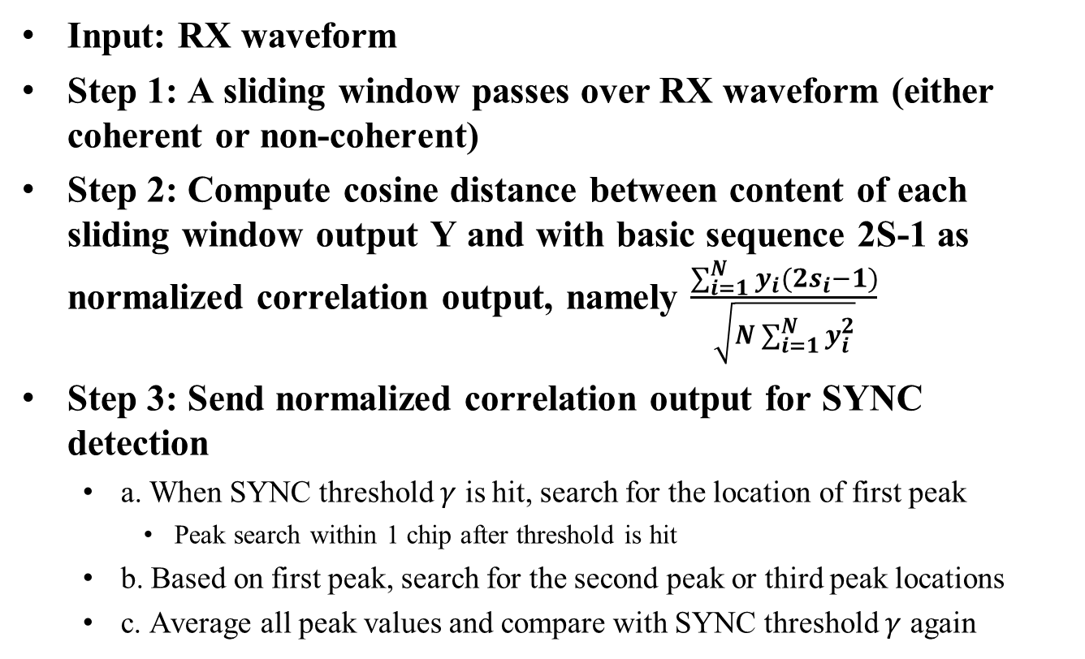
SYNC Detection Algorithm with RX Normalization
Input: RX waveform
Step 1: A sliding window passes over RX waveform (either coherent or non-coherent)
Step 2: Compute cosine distance between content of each sliding window output Y and with basic sequence 2S-1 as normalized correlation output, namely $\frac{\sum_{i=1}^{N}{y_{i}(2s_{i}−1)}}{\sqrt{N\sum_{i=1}^{N}{y_{i}^{2}}}}$
Step 3: Send normalized correlation output for SYNC detection
  a. When SYNC threshold $γ$ is hit, search for the location of first peak
    Peak search within 1 chip after threshold is hit
  b. Based on first peak, search for the second peak or third peak locations
  c. Average all peak values and compare with SYNC threshold $γ$ again

Slide 20
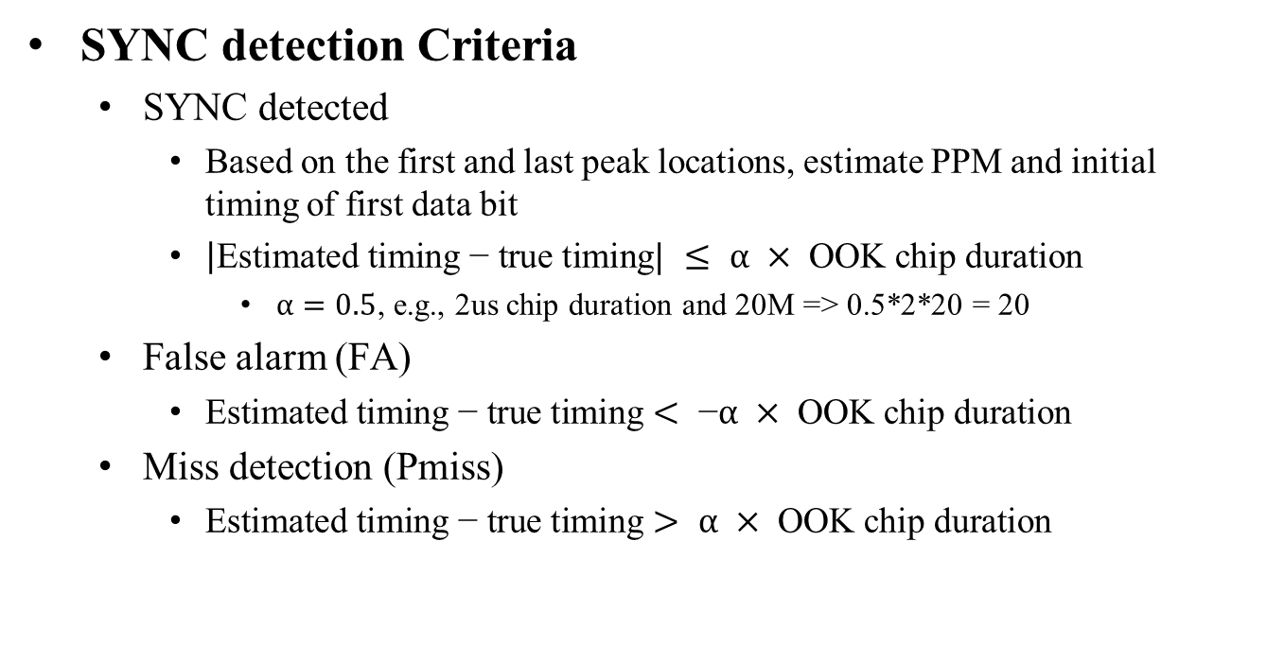
SYNC Detection Criteria
SYNC detection Criteria
  SYNC detected
    Based on the first and last peak locations, estimate PPM and initial timing of first data bit
    $\left|\text{Estimated} \text{timing}\text{ − }\text{true} \text{timing}\right.| ≤ α × \text{OOK} \text{chip} \text{duration}$
      $α=0.5$, e.g., 2us chip duration and 20M => 0.5*2*20 = 20
  False alarm (FA)
    $\text{Estimated} \text{timing}\text{ − }\text{true} \text{timing}< \text{−}α × \text{OOK} \text{chip} \text{duration}$
  Miss detection (Pmiss)
    $\text{Estimated} \text{timing}\text{ − }\text{true} \text{timing}> α × \text{OOK} \text{chip} \text{duration}$

Slide 21
FA-Pmiss vs SYNC Detection Threshold
S = [110010101]
S = [11100100]

Slide 22
SYNC Performance at PPM = 0
2 repetition is sufficient for SYNC performance

Slide 23
Summary
Presented UL backscattering SYNC design
  Repeated basic OOK sequence structure with tail bit
  SYNC chip rate matches data chip rate
Illustrated tail bit benefits
SYNC detection performance results show 2 repetition is sufficient

Slide 24
References
[1] Rui Cao, et. al., 11-25-0306-00-00bp-AMP-Backscattering-PPDU-and-SYNC-design, Mar 2025
[2] Manideep Dunna, et. al., Uplink SYNC Field Design for Backscatter STAs, April 2025
[3] Manideep Dunna, et. al., Uplink Backscatter SYNC Field Design, July 2025

Slide 25
SP1
Do you agree to add the following to 11bp SFD?
11bp defines single UL SYNC sequence for AMP UL PPDU generated by backscattering (OOK modulated)
  The UL SYNC sequence is transmitted with the same chip rate as UL Data field

Slide 26
SP2
Do you agree to add the following to 11bp SFD?
The UL backscattering SYNC consists of two or more repetition of basic sequence S and End of SYNC (EOS) bit(s)
  Length of basic sequence S is TBD
  Number of repetition is TBD
  Definition of EOS bit(s) is TBD

Slide 27
SP3
Do you agree to add the following to 11bp SFD?
The number of repetition of basic OOK sequence in the UL backscattering SYNC is 2

Slide 28
Appendix

Slide 29
Example: Basic Sequence Length 6
Base sequence S = [1 0 1 1 0 0]
  Two consecutive OOK on
  Autocorrelation of repetition 3 sequence [S S S 1] and 2S-1
    Autocorrelation has side lobe < 0 before first peak
    Cyclic correlation side lobe 0.33
    Peak slope = 1.33
Slope = 1.33

Slide 30
Example: Basic Sequence Length 10
Base sequence S = [0 1 1 0 1 1 1 0 0 0]
  Three consecutive OOK on
  Autocorrelation of repetition 3 sequence [S S S 1] and 2S-1
    Autocorrelation has side lobe <= 0 before first peak
    Cyclic correlation side lobe 0.2
    Peak slope = 1.2
Other examples:
  S = [0 1 1 1 0 1 0 0 1 0]
  S = [1 1 0 0 1 1 0 1 0 0]
Slope = 1

