Slide 1
Interference Mitigation in Bistatic Backscatter, Part 2
Date: 2025-07-27
Authors:
Name | Affiliation | Address | Phone | Email
Nelson Costa | HaiLa Technologies | Suite 403, 460 Saint-Catherine St. W. Montreal, QC. Canada |  | nelson@haila.io
Kamran Nishat |  |  |  | kamran@haila.io
Vytas Kezys |  |  |  | vytas@haila.io
Patricia Bower |  |  |  | pbower@haila.io

Slide 2
Abstract
In the following, we discuss self interference mitigation techniques in bistatic backscatter.
More specifically, we discuss different methods for using frequency separation to backscatter into one 20 MHz or one 40 MHz channel.
We show simulation results for receiver performance in these interference-limited scenarios.

Slide 3
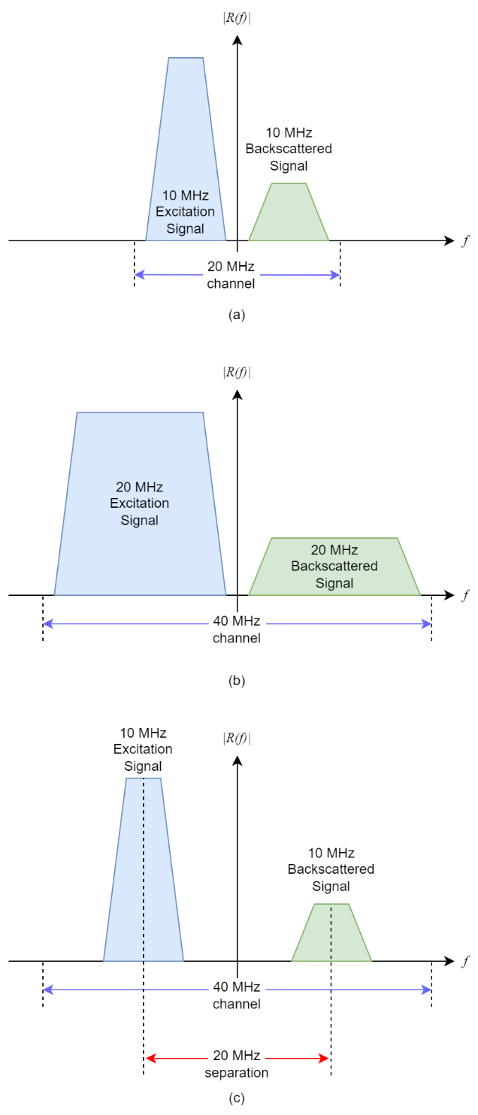
Backscatter Within One Channel: Three possibilities in 2.4 GHz
In 2.4 GHz, with the restriction that we wanted to use only one 20 or 40 MHz channel, we explored three possibilities.
(a) Using a 10 MHz excitation waveform, and backscattering that into the second half of a 20 MHz channel. (10 MHz separation)
(b) Using a 20 MHz excitation waveform, and backscattering that into the second half of a 40 MHz channel.
(c) Using a 10 MHz excitation waveform, and backscattering that into the opposite side of a 40 MHz channel. (20 MHz separation)
This last combination yields the best self interference margin.

Slide 4
Receiver Model for Sensitivity Simulations

Slide 5
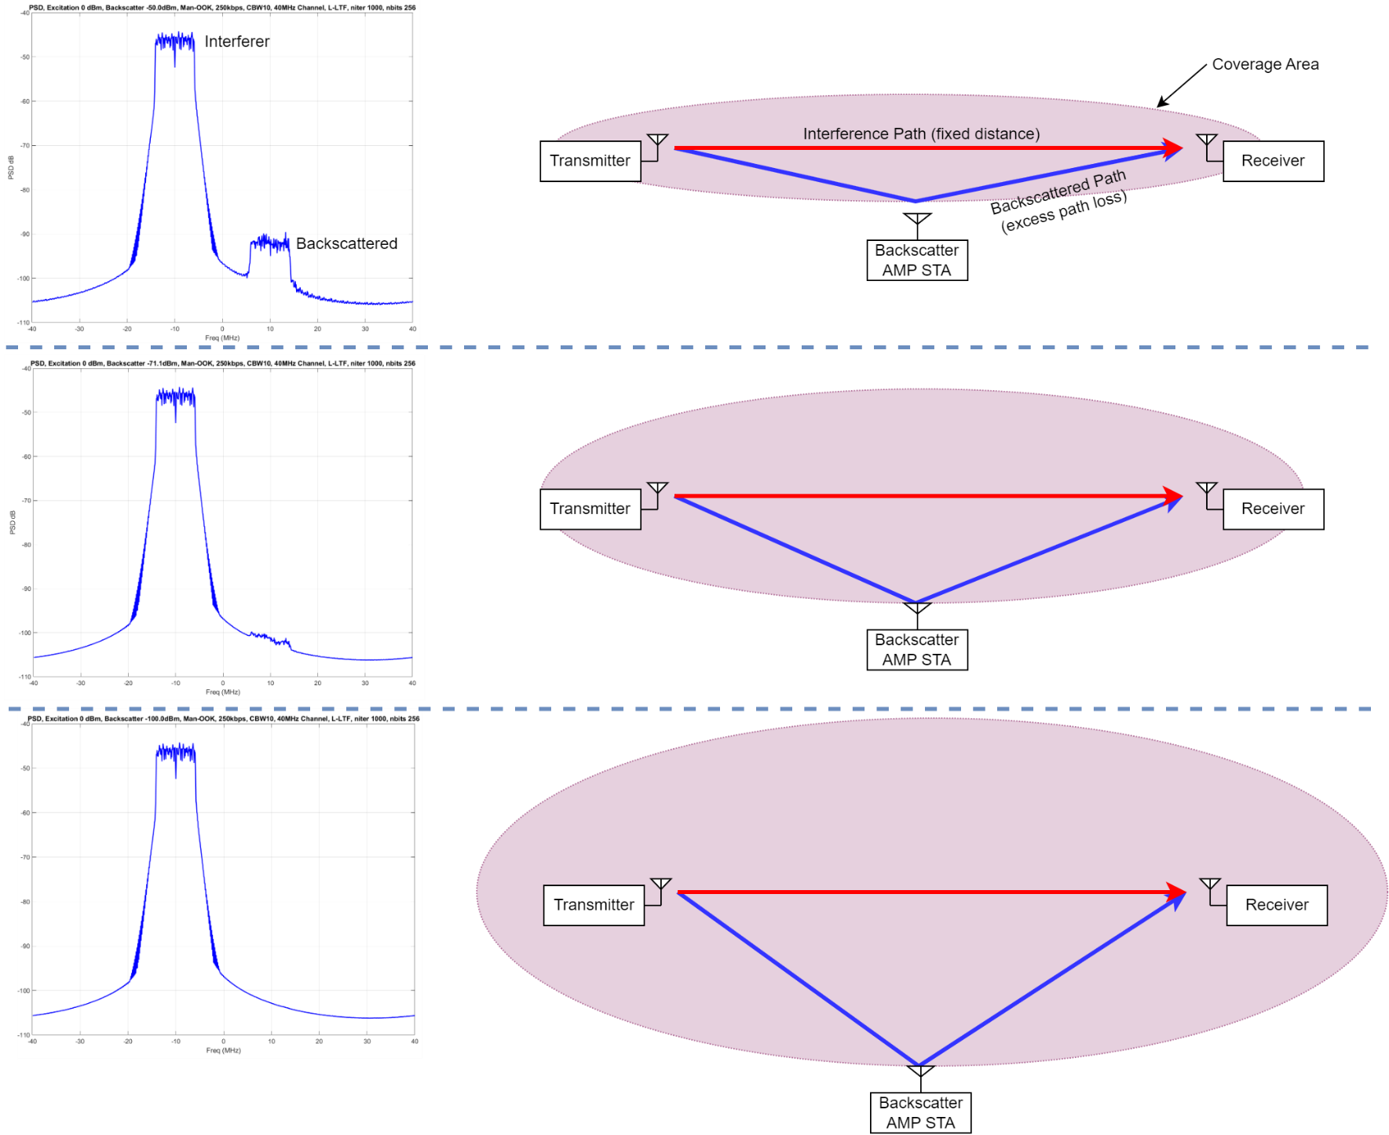
How does this model simulate sensitivity to self-interference?
As excess path loss increases, received power from the Backscatter AMP STA decreases
We are interference limited: With good filtering at the receiver, the energy leaking into the adjacent frequency is the limiting factor on receiver sensitivity.
10 MHz L-LTF centered in the two halves of a 40 MHz channel has the best BER performance.

Slide 6
Receiver Sensitivity: Results at 0 dBm Interference
Poorer performance
for all other combinations
Within one 20 MHz Channel
10 MHz L-LTF: doesn’t fall below 10% BER here
10 MHz Waveforms
250 kbps, 40 MHz chan.
10 MHz Waveforms
1 Mbps, 40 MHz chan.
Within one 40 MHz Channel
20 MHz TGbp mod. L-LTF: Poor performance.
10 MHz L-LTF, 20 MHz separation: Good performance.
10 MHz 25/0802, “HalfLTF”, 20 MHz separation: slightly worse than 10 MHz L-LTF.

Slide 7
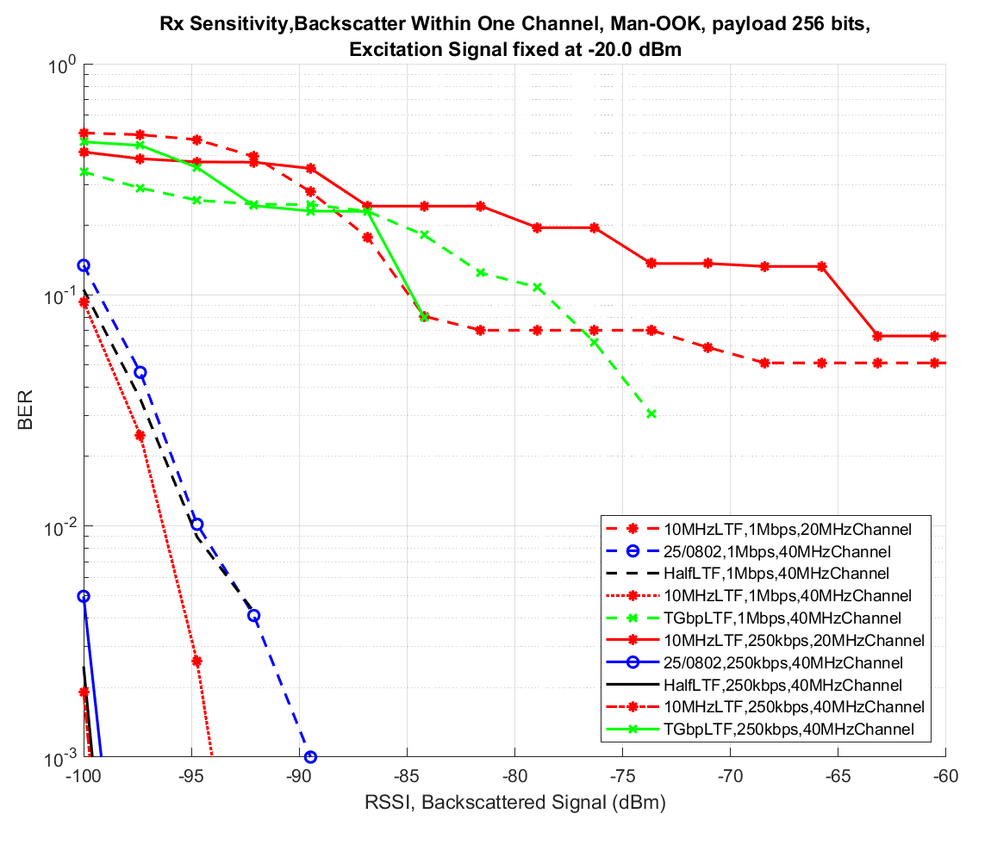
Receiver Sensitivity: Results at -20 dBm Interference
Within one 20 MHz Channel
10 MHz L-LTF: doesn’t fall below 1% BER here
10 MHz L-LTF, 20 MHz chan.
Within one 40 MHz Channel
20 MHz TGbp mod. L-LTF: go to 0 % BER at -84 dBm (250 kbps) and -73 dBm (1 Mbps).
10 MHz L-LTF, 20 MHz separation: best performer
10 MHz 25/0802: slightly worse than 10 MHz L-LTF.
“HalfLTF”, 20 MHz separation: slightly worse than 10 MHz L-LTF.
20 MHz TGbp L-LTF, 40 MHz chan.
10 MHz Waveforms
1Mbps, 40 MHz chan.
10 MHz Waveforms
250kbps, 40 MHz chan.

Slide 8
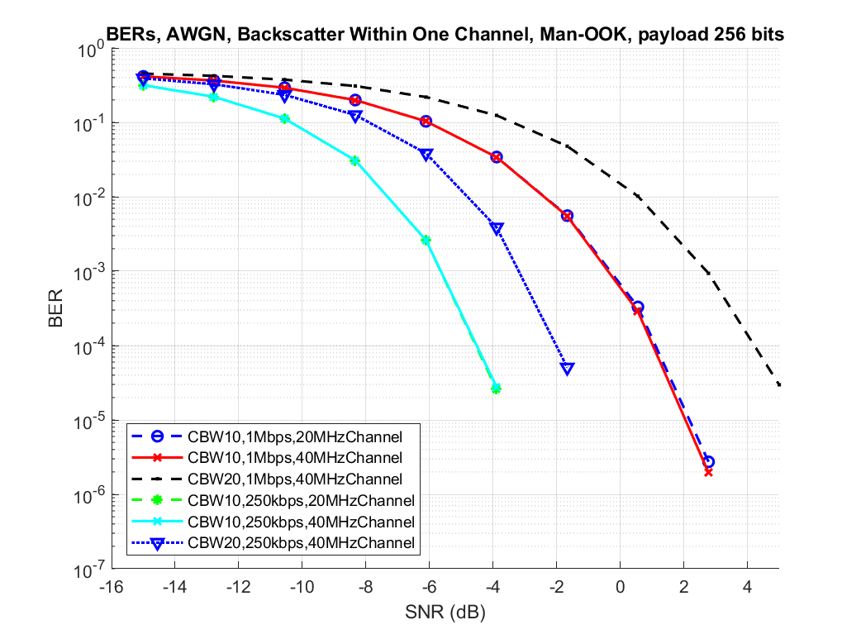
Receiver AWGN Performance (20 MHz TGbp Vs. 10 MHz L-LTF)
These simulations were done for the case where the interferer and backscatter powers are equal.
SNR sweep is done by adding AWGN to meet the target SNR.
The receiver’s AWGN performance is largely unaffected by the interferer, as we’re not interference limited.
Because of an SNR boost, there’s roughly 2 dB improvement for the 10 MHz L-LTF waveform versus 20 MHz TGbp modified L-LTF.
20 MHz TGbp L-LTF
10 MHz L-LTF

Slide 9
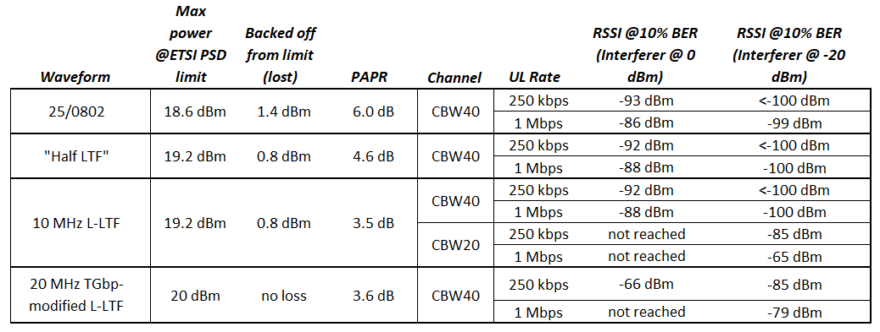
Performance Summary

Slide 10
Conclusion
We discussed interference mitigation for bistatic backscatter using frequency separation.
We explored three different scenarios where we reuse the same channel.
Using a 10 MHz L-LTF in a 20 MHz channel (10 MHz separation).
Using a 20 MHz TGbp-modified L-LTF in a 40 MHz channel.
Using a three different 10 MHz waveforms in a 40 MHz channel (20 MHz separation).
We propose optionally using a 10 MHz L-LTF as an excitation waveform.
We provided a receiver sensitivity model and simulation results for all the scenarios above.
Using 10 MHz L-LTF with 20 MHz separation inside of a 40 MHz channel provided the best receiver performance and self-interference mitigation.

Slide 11
Straw Poll 1
Do you agree add the following to the TGbp SFD?
11bp defines at least one mode of bistatic backscatter that can use frequency shifting within a 40 MHz channel.
Existing 40 MHz medium protection mechanisms will be leveraged.
References: 11-25/1228, 11-25/1229, 11-24/2128, 11-24/2002

Slide 12
Straw Poll 2
Do you agree that 11bp defines at least one 10 MHz excitation waveform for bistatic backscatter?
References: 11-25/1228, 11-25/1229

Slide 13
Straw Poll 3
Do you agree that 11bp can reuse the Clause 17 "half-clocked" L-LTF as an optional excitation waveform?
References: 11-25/1228, 11-25/1229

Slide 14
References
[1] N. Costa et al., Interference Mitigation in Bistatic Backscatter, Part 1, 11-25/1228, July 2025.
[2] Online, https://www.mathworks.com/help/wlan/ref/wlanlltf.html

Slide 15
Appendix: Why not use the 5 MHz L-LTF from 11y?
The ETSI PSD limit results in a 3.8 dBm penalty in max power

