Slide 1
Interference Mitigation in Bistatic Backscatter, Part 1
Date: 2025-07-27
Authors:
Name | Affiliation | Address | Phone | Email
Nelson Costa | HaiLa Technologies | Suite 403, 460 Saint-Catherine St. W. Montreal, QC. Canada |  | nelson@haila.io
Kamran Nishat |  |  |  | kamran@haila.io
Vytas Kezys |  |  |  | vytas@haila.io
Patricia Bower |  |  |  | pbower@haila.io

Slide 2
Abstract
In the following, we discuss self interference mitigation techniques for bistatic backscatter.

Slide 3
Bistatic Backscatter: Frequency Separation
Some members’ feedback has been focused on the MAC implications of frequency separation using two independent channels.
[3-4] present MAC mechanisms to reserve medium on two separate 20 MHz channels
To address these concerns, we propose a method by which we can use frequency separation within one 40 MHz channel for bistatic backscatter.
To address the MAC concerns, we propose to reuse the existing medium protection mechanisms for CBW40 channels in 2.4 GHz.
To address PHY considerations, in [5], we propose using a 10 MHz excitation waveform for bistatic backscatter within one CBW40 channel.

Slide 4
Backscatter Within One Channel: Advantages
Using one 40 MHz channel represents the best reuse of existing medium protection mechanisms.
Advantages of using one 40 MHz channel:
Reduced complexity.
Transmitter and receiver are on the same channel.
Reuse existing mechanisms for medium protection.
The receiver can use the excitation signal as training (timing recovery, channel estimation, interference mitigation etc.)

Slide 5
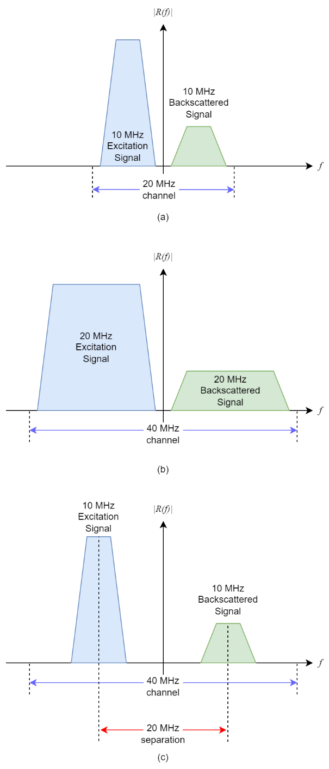
Backscatter Within One Channel: Three possibilities in 2.4 GHz
In 2.4 GHz, with the restriction that we wanted to use only one 20 or 40 MHz channel, we explored three possibilities for channel occupancy.
(a) Using a 10 MHz excitation waveform, and backscattering that into the second half of a 20 MHz channel. (10 MHz separation).
(b) Using a 20 MHz excitation waveform, and backscattering that into the second half of a 40 MHz channel.
(c) Using a 10 MHz excitation waveform, and backscattering that into the second half of a 40 MHz channel. (20 MHz separation)
The results of this study will be shown in the following presentation [5].

Slide 6
Candidate 10 MHz Excitation Waveforms
10 MHz “half-clocked” L-LTF from Clause 17 [8].
10 MHz custom waveform proposed in 25/0802 [7].
10 MHz “Half LTF”, created by taking the inside 33 carriers of a 20 MHz LTF.

Slide 7
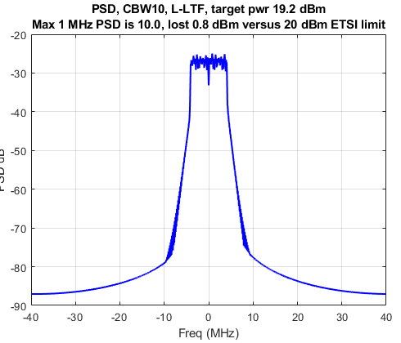
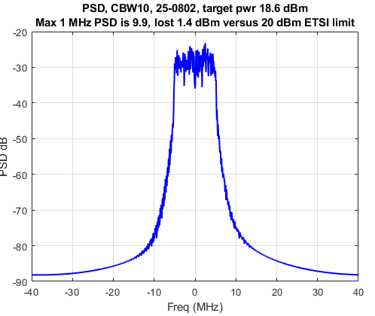
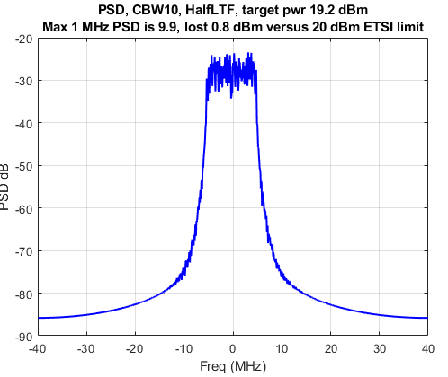
Comparison: 10 MHz Waveforms
 | Clause 17 10 MHz L-LTF | 10 MHz Waveform 25/0802 | 10 MHz “HalfLTF”
Max 1 MHz PSD | 10.0 dBm | 9.9 dBm | 9.9 dBm
Avg power @ 1 MHz PSD limit | 19.2 dBm | 18.6 dBm | 19.2 dBm
Backed off from 20 dBm limit (lost) | 0.8 dBm | 1.4 dBm | 0.8 dBm
PAPR | 3.5 dB | 6.0 dB | 4.6 dB

Slide 8
Excitation Waveform: 10 MHz L-LTF
To achieve the required frequency separation within one channel, we propose creating an excitation waveform by reusing the 10 MHz L-LTF defined in Clause 17.
This has several advantages
The waveform is simply a “half-clocked” version of the 20 MHz L-LTF.
Chipsets like Atheros already have the ability to transmit and receive 10 MHz signaling in the 2.4 GHz band.
The L-LTF can be used for training at the infrastructure receiver.

Slide 9
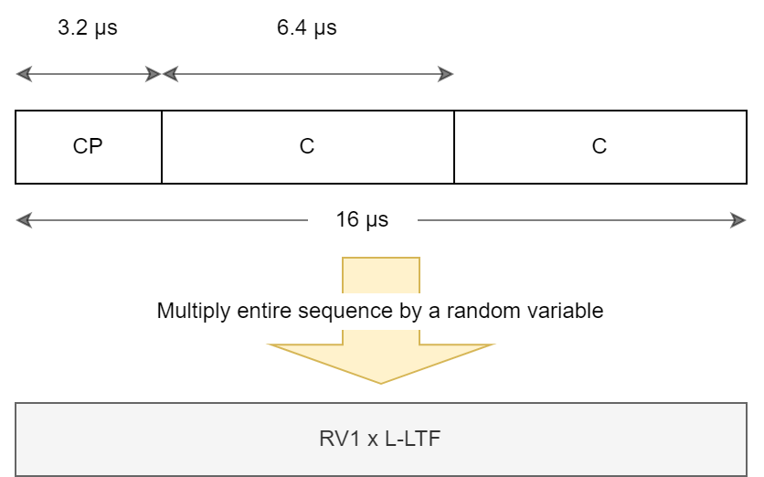
Excitation Waveform: 10 MHz L-LTF (2)
Our proposed methodology follows closely to what has already been discussed by the group for excitation waveforms.
Use the Clause 17 L-LTF as-is; it has excellent spectral properties.
These spectral properties are especially important when backscattering into the same channel.
The L-LTF can also be used for training at the receiver.
Multiply each 16 µs sequence with a random variable [+1, -1].

Slide 10
Candidate 20 MHz Excitation Waveforms
20 MHz L-LTF from Clause 17 [8].
20 MHz “TGbp-modified” L-LTF. Uses timing proposed in SFD clause PM-27

Slide 11
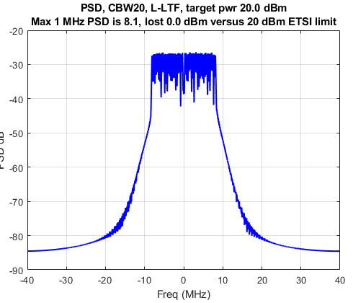
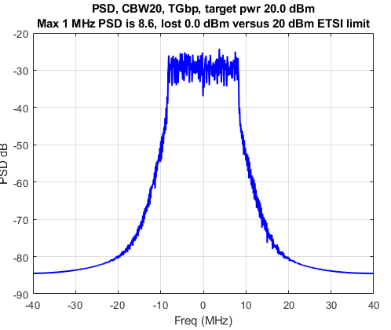
Comparison: 20 MHz Waveforms
 | Clause 17 20 MHz L-LTF | 20 MHz “TGbp-modified L-LTF”
Max 1 MHz PSD | 8.1 dBm | 8.6 dBm
Avg power @ 1 MHz PSD limit | 20 dBm | 20 dBm
Backed off from 20 dBm limit (lost) | None, can use max power. | None, can use max power.
PAPR | 3.5 dB | 3.6 dB

Slide 12
Conclusion
We discussed interference mitigation techniques for bistatic backscatter.
Interference mitigation is an important limiting factor in overall range, coverage area.
Frequency separation is a relatively simple and effective way of achieving interference mitigation in bistatic backscatter use cases.
We presented three possible ways we can use frequency separation within one channel.
We presented three candidate 10 MHz excitation waveforms, and two possible 20 MHz excitation waveforms.
Making the bandwidth >10 MHz does not guarantee we meet the ETSI PSD limit.
Backscattering into one channel is possible in 2.4 GHz, but there are trade-offs.
In the following presentation [5], we look at receiver performance in these interference scenarios.

Slide 13
References
[1] Y. Xin et al., Technical Report on Full Duplex for 802.11, 11-18/0498r8, Sept. 2018.
[2] P. Wang et al., Prototype of Full Duplex for 802.11, 11-18/1588, Sept. 2018.
[3] K. Nishat et al., Long-Range Backscatter Protection Mechanisms, 11-25/0264, Mar. 2025.
[4] K. Nishat et al., Bi-static Backscatter Protection Mechanisms - follow up, 11-25/0772, May 2025.
[5] N. Costa et al., Interference Mitigation in Bistatic Backscatter, Part 2, 11-25/1229, July 2025.
[6] V. Kezys, 802.11 compatible backscatter prototype, 11-23/0056, Jan 2023.
[7] K. Wang et al., OOK generation for AMP, 11-25/0802, May 2025.
[8] IEEE 802.11-2024.

Slide 14
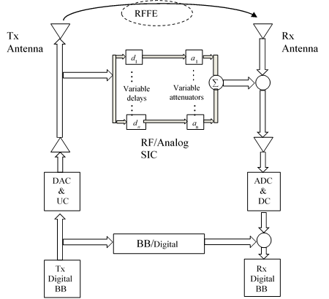
Monostatic Transceiver Architecture
The Full Duplex TIG Final report [1] provides an overview of monostatic backscattering transceiver architecture and provides some information on Self-Interference cancellation techniques.
Sources of self-interference include
Linear components (Tx/RX leakage, reflections in device, reflections from environment).
Interferer signal power can be equal to rx power.
Non-linear components (PA nonlinearity)
Tx noise (PA noise, phase noise)

Slide 15
Monostatic Vs. Bistatic Transceiver Architecture
X
In bistatic backscatter, the transmitter and receiver are not co-located.
The receiver is missing the direct feedback paths to the transmitter.
For bistatic backscatter, we need to consider other interference mitigation techniques.
We’ve presented frequency separation as a low-complexity solution for bistatic backscatter.
Frequency separation does not require direct feedback paths between the transmitter and receiver.
Frequency separation has been proven in silicon and successfully demonstrated. [6]
X

