Slide 1
Initial Thought on AMP-S1G Transmit Mask
Date: 2025-07-28
Authors:
Name | Affiliation | Address | Email
Panpan Li | Huawei | Singapore | lipanpan25@huawei.com
Lei Huang
Lumin Liu
Bin Qian |  | Shenzhen, China

Slide 2
Abstract
Transmit spectrum mask is defined in every IEEE 802.11 PHY subclause.
AMP-S1G need to define different spectrum mask from 2.4G.
AMP-S1G is likely to use similar bands with RFID.
AMP-S1G spectrum mask may borrow wisdom from EPC UHF RFID standard.
AMP-S1G spectrum mask should also follow IEEE 802.11 “traditions”.
Except spectrum mask, time-domain restrictions like RF envelope may be also needed.
This contribution intends to present some initial thoughts on AMP-S1G transmit specification from both frequency-domain and time-domain
Frequency-domain restriction: spectrum mask
Time-domain restriction: RF envelope
Notes:
为什么需要一个新的PPDU：不能满足mask
把问题放在前面，mask问题等，理论上任何WPT PPDU都可以只要250K就OK，比如说RFID packet. 11ah PPDU的问题，最小1M。目前没有可用的11 PPDU,不排除vender specific，。

Slide 3
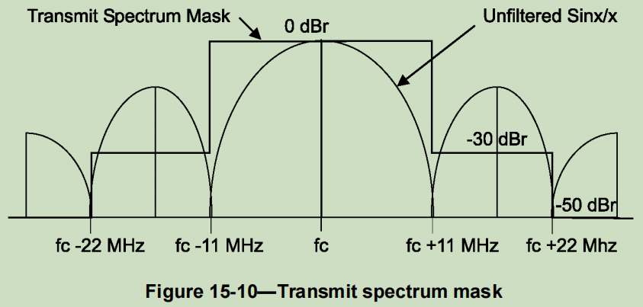
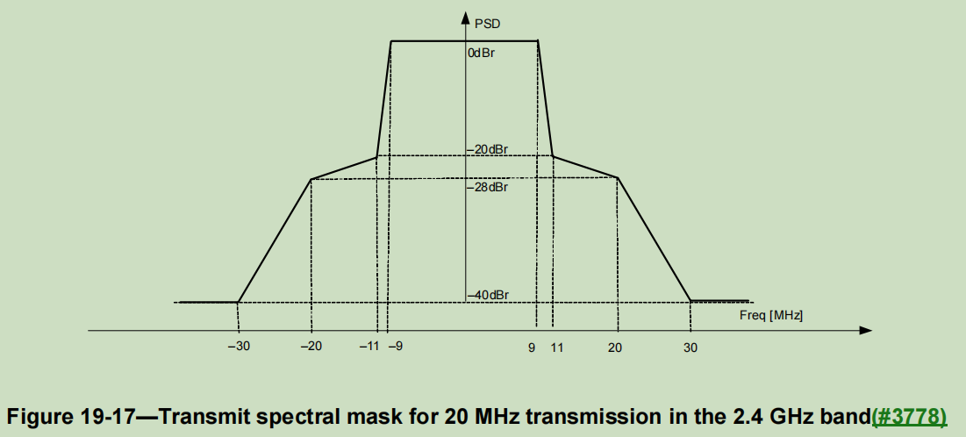
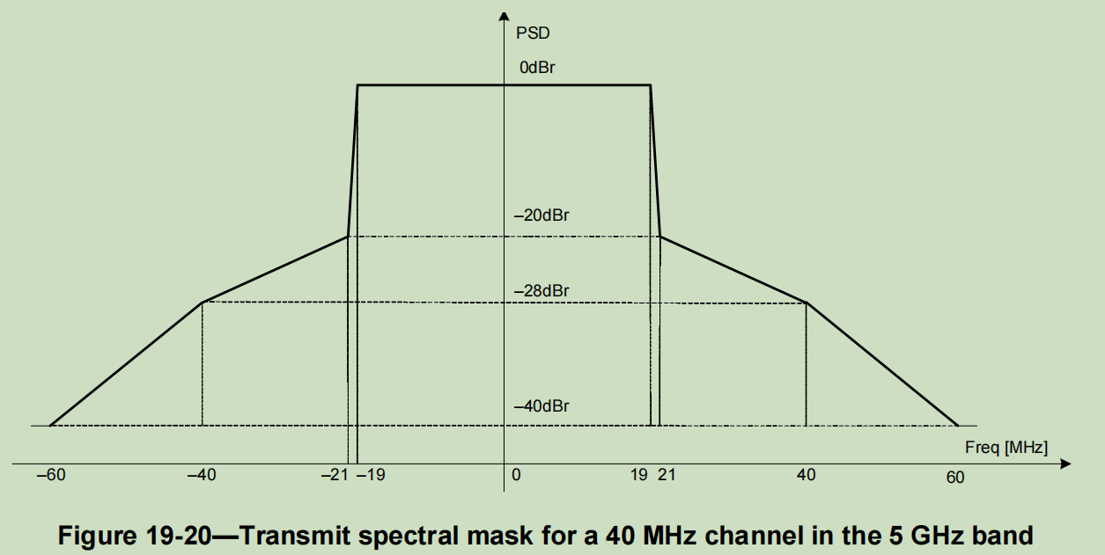
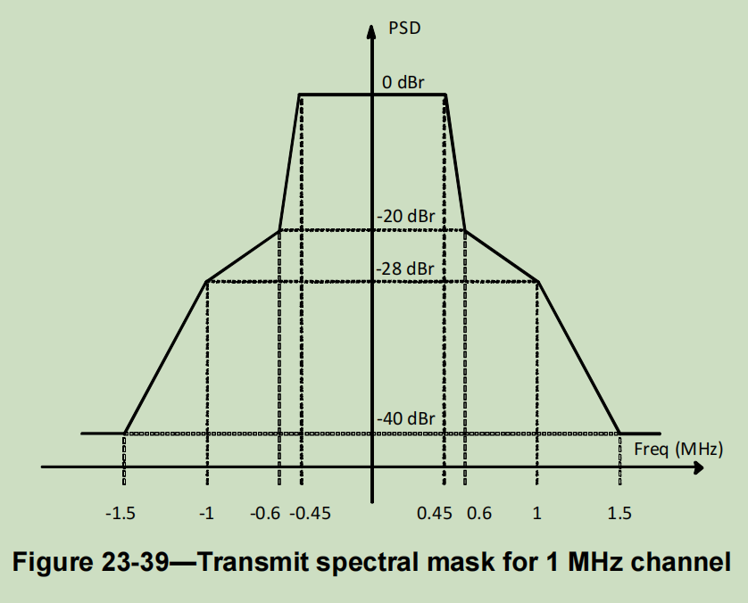
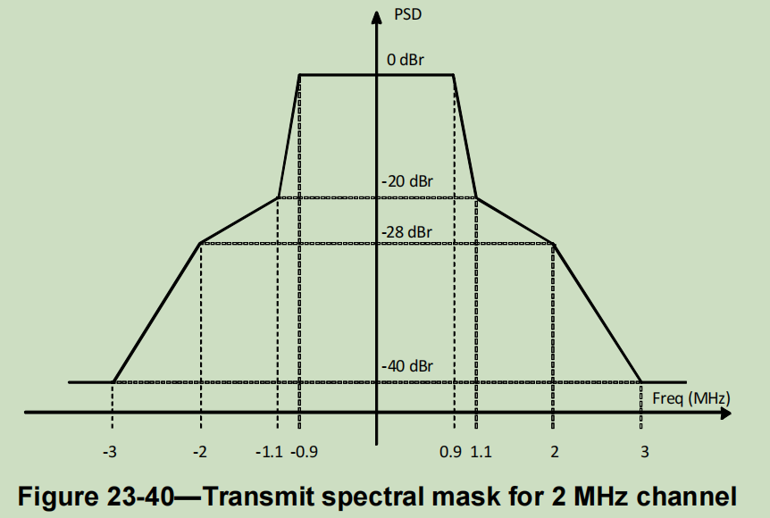
Background: IEEE 802.11 Spectrum Mask
IEEE spectrum masks [1]
DSSS waveform mask: Figure 15-10
OFDM based waveforms’ spectrum masks in are scaled (some plus slightly revised) from Figure 19-17

Slide 4
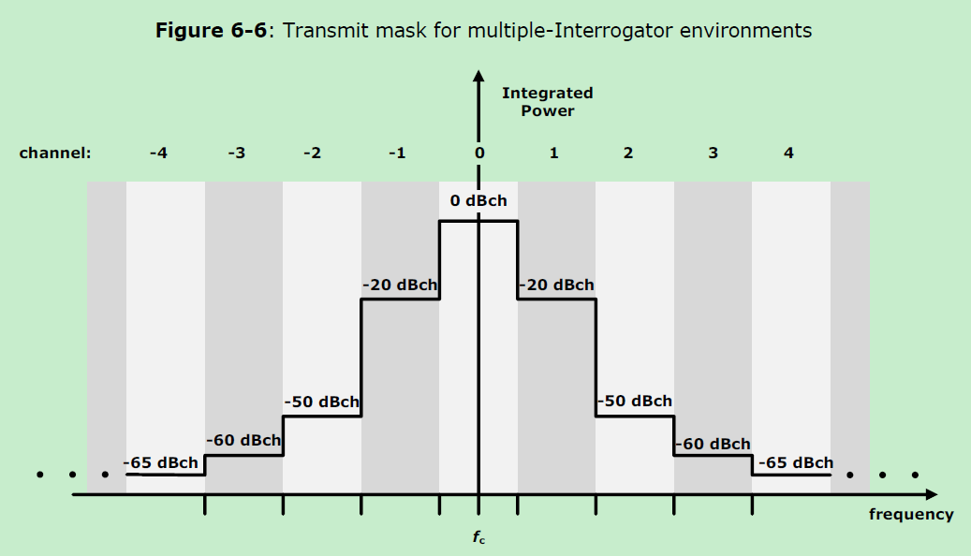
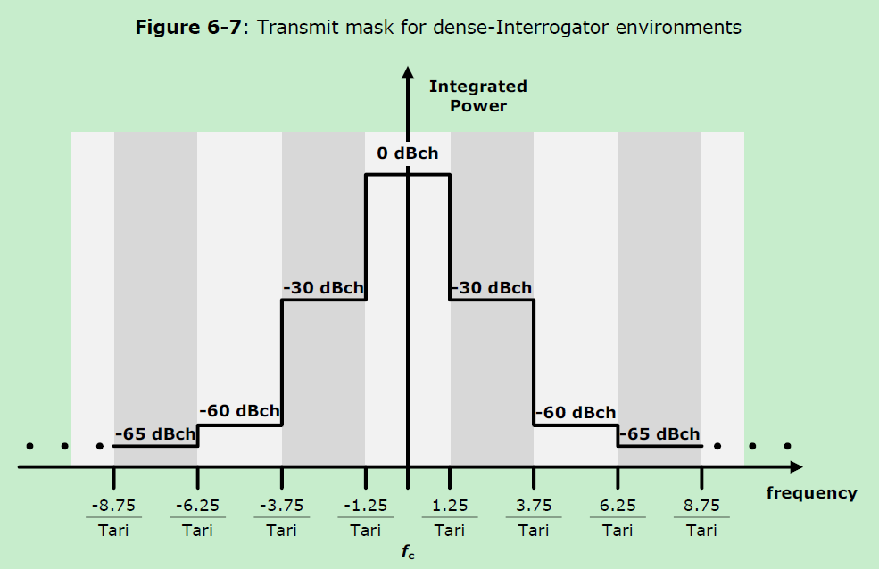
Background: UHF RFID Spectrum Mask
EPC UHF RFID standard only defines the spectrum mask for Interrogator-to-Tag communication (DL), while doesn’t specify the Tag-to-Interrogator (UL). [2]
For backscatter, if DL signal is restricted, then UL signal is naturally restricted (ignoring slight bandwidth expansion caused by UL MCS)

Slide 5
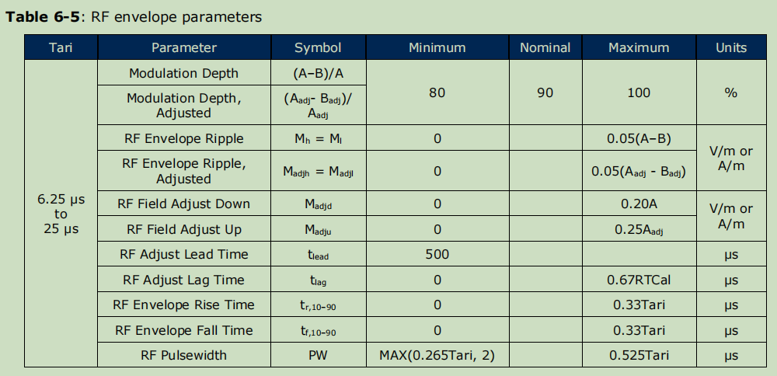
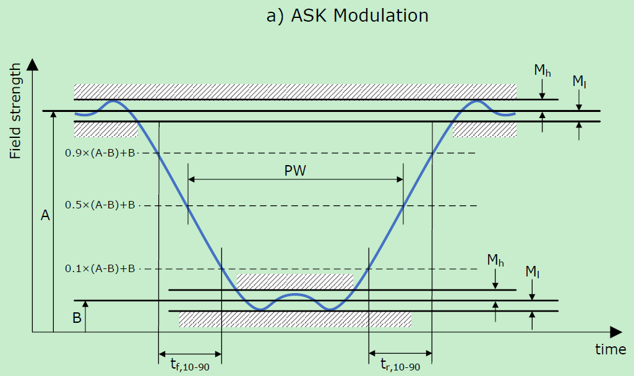
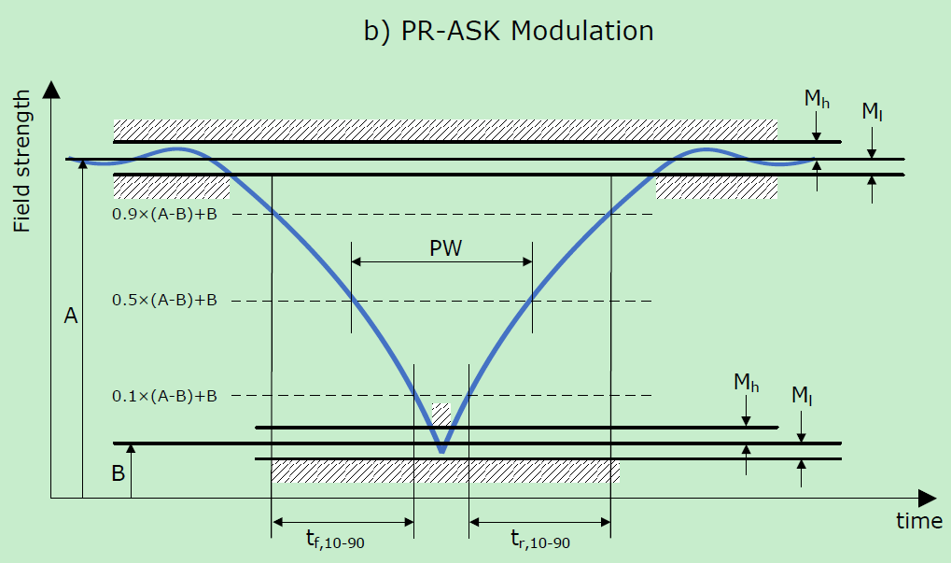
Background: UHF RFID RF envelope
Interrogator-to-Tag [2]
Consider pulse shaping

Slide 6
AMP-S1G Mask Considerations
Definitely need transmit spectrum mask
Will be reflected in “PHY Transmit Specification” in draft
Design considerations
Multiple bandwidths have multiple spectrum masks
Prefer a unified design, just scaled X-axis for different bandwidths
How many adjacent channels should be considered
How to decide the boundary of the mask
Options:
Option 1: IEEE 802.11 way: scale from existing masks in base standard Figure 19-17
Option 2: UHF RFID way: reuse UHF RFID spectrum mask
Option 3: Design new mask
Whether AMP-S1G need time-domain restriction like RF envelope is open for discussion

Slide 7
Spectrum Mask Option 1
Example AMP-S1G transmit spectrum mask
Scaled from IEEE 802.11 OFDM mask for 20MHz channel
Assume bandwidth B, which is the max allowable channel bandwidth according to regional regulations. B=200, 250, 400, 500kHz,…
D
0 dBr
E
C
-20 dBr
F
B
-28 dBr
G
A
-40 dBr
H
-3B/2
-B
-11B/20
-9B/20
9B/20
11B/20
B
3B/2

Slide 8
Spectrum Mask Option 2
Example AMP-S1G transmit spectrum mask
Reuse UHF RFID transmit mask
Assume bandwidth B, which is the max allowable channel bandwidth according to regional regulations. B=200, 250, 400, 500kHz,…
0 dBr
H
I
-20 dBr
-20 dBr
F
G
J
K
-50 dBr
-50 dBr
D
E
L
M
-60 dBr
-60 dBr
-65 dBr
B
C
N
O
-65 dBr
A
P
-7B/2
-5B/2
-3B/2
-B/2
B/2
3B/2
5B/2
7B/2

Slide 9
Spectrum Mask Option 3
Above two spectrums masks are both derived based on max channel bandwidths which regional regulations allow.
However, under Manchester coding + CW assumption, different data rates will result in different signal bandwidths (main lobe width).
May consider to choose different spectrum masks based on data rates.
Spectrum masks are scaled from Option 1 or Option 2
Data rate (kbps) | Signal BW | Spectrum mask (B=125kHz) | Spectrum mask (B=250kHz) | Spectrum mask (B=500kHz)
31.25 | 125 | √
62.5 | 250 |  | √
125 | 500 |  |  | √

Slide 10
Spectrum Mask Summary
Spectrum mask | Feature | Feature
Option 1 | Based on channel BW | Scaled based on IEEE 802.11 OFDM mask for 20MHz channel in 2.4G
Option 2 |  | Reuse UHF RFID transmit mask
Option 3 | Based on signal BW | Different mask for different data rate
Other options? | The numbers of adjacent channels and adjacent channel rejection ratios may be designed considering the interference under AMP-S1G scenarios.

Slide 11
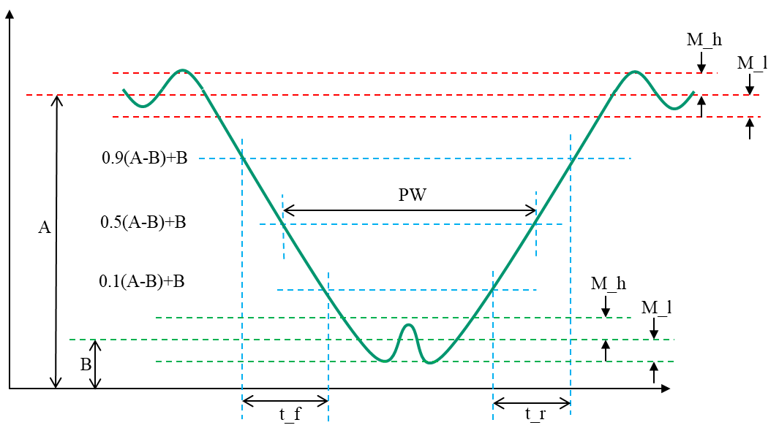
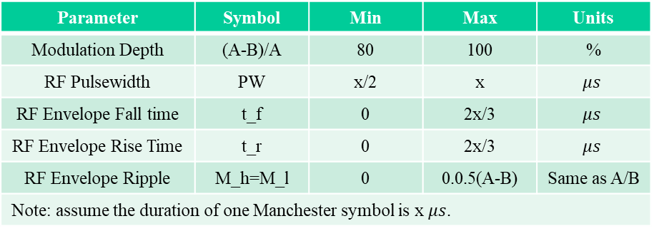
AMP-S1G RF Envelope
Example AMP-S1G RF envelope
Revised based on UHF RFID Interrogator to Tag RF envelope
Parameters and their ranges should be revised according to AMP-S1G MCS
Parameter | Symbol | Min | Max | Units
Modulation Depth | (A-B)/A | 80 | 100 | %
RF Pulsewidth | PW | x/2 | x | $$μs$$
RF Envelope Fall time | t_f | 0 | 2x/3 | $$μs$$
RF Envelope Rise Time | t_r | 0 | 2x/3 | $$μs$$
RF Envelope Ripple | M_h=M_l | 0 | 0.0.5(A-B) | Same as A/B
Note: assume the duration of one Manchester symbol is x $μs$.

Slide 12
Summary
This contribution discusses the AMP-S1G TX requirements
Frequency-domain: transmit spectrum mask is needed
Time-domain: RF envelope may be needed

Slide 13
Reference
[1] IEEE P802.11-REVme™/D7.0, August 2024
[2] EPC® Radio-Frequency Identity Generation-2 UHF RFID Standard

Slide 14
SP 1 (information collection)
Which option you prefer to define the spectrum mask for AMP in sub-1GHz?
Option 1
Option 2
Option 3

Slide 15
SP 2 (information collection)
Do you agree to define an RF envelope shown in slide 10 for AMP in sub-1GHz?
Yes
No
Abstain

