Slide 1
Initial Thought on AMP S1G Channelization
Date: 2025-07-28
Authors:
Name | Affiliation | Address | Email
Panpan Li | Huawei | Singapore | lipanpan25@huawei.com
Lei Huang
Lumin Liu
Bin Qian |  | Shenzhen, China

Slide 2
Abstract
In this document we propose the transmission bandwidths and channelization for AMP S1G
Transmission bandwidths (BW) refer to the channel widths (or BW modes) for which the AMP S1G PHY should provide support
Reflected in draft PHY subclause
Channelization refer to the process of breaking down the available spectrum in different regions into “channels”
Reflected in draft Annex E

Slide 3
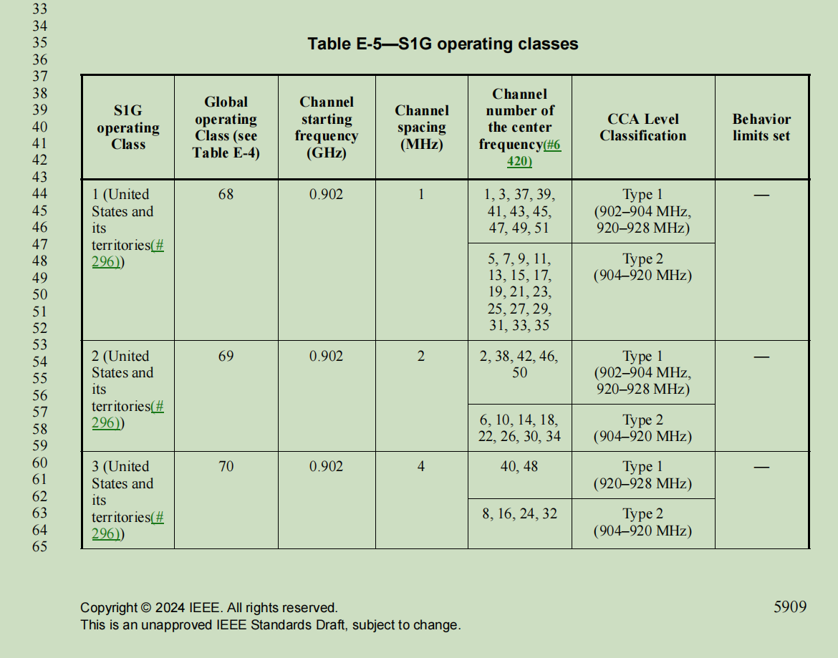
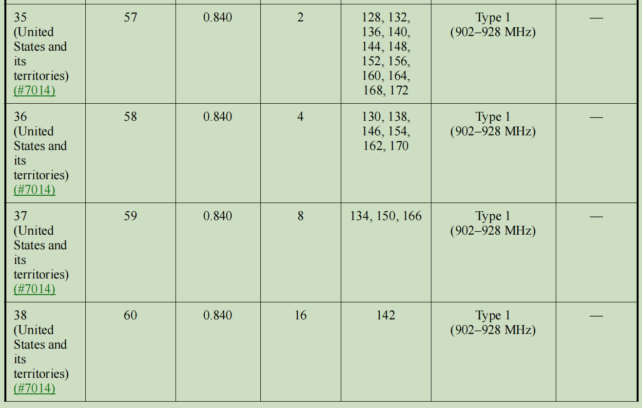
Recap: Channelization of 11ah (1/2)
[1-5] summarized the discussion and decisions on channelization in 11ah
Transmission bandwidth
1,2 MHz (Mandatory)
4, 8 and 16 MHz (Optional)
Channelization
S1G Operating classes are given in Table E-5 in P802.11-REVme/D7.0
However, 11ah channelization result in ~mW max allowable Tx Power according to corresponding regulations.
Notes:
Channel number不分国别，operating channel , not operating class

Slide 4
AMP-S1G Considerations
According to [6]:
to achieve 5m coverage in sub-1GHz, AP Tx power need to achieve 20-36dBm
The BW and channelization in 11ah cannot satisfy the Tx power requirement for AMP-S1G.
AMP-S1G need to seek different BW and channelization from 11ah.
Note that RFID regulations allow relatively high max allowable Tx power, while narrower BW.
Thus, this contribution will discuss the transmission BW and channelization for AMP-S1G based on RFID regulations.

Slide 5
US S1G Regulation: FCC 15.247 [7]
FH systems shall have,
From 15.247 (a)(1)(i) The maximum allowed 20 dB bandwidth of the hopping channel is 500 kHz
From 15.247 (b)(2) The max output power shall be 1 watt for systems with at least 50 hopping channels. Otherwise .25 watts
Digital modulation techniques shall have,
From 15.247 (a)(2) The minimum 6 dB bandwidth shall be at least 500 kHz
From 15.247 (b)(3) The max output power shall be 1 watt
Most RFID devices applicable in US adopt 500kHz BW, which is a universal safety choice under different modes and regulations.

Slide 6
China S1G Regulation: RFID [8]
Channel bandwidth (99% energy): 250kHz
Channel centre frequency
f_c=920.125+M*0.25, M=0, 1,…, 19
Adjacent channel rejection ratio:
First adjacent channel: -40dBr
Second adjacent channel: -60dBr
FHSS, maximum dwell time per hopping channel: 2 seconds
TX power:
Frequency (MHz) | TX power (e.r.p)
920.50-924.5 | 2W
920-925 | 100mW

Slide 7
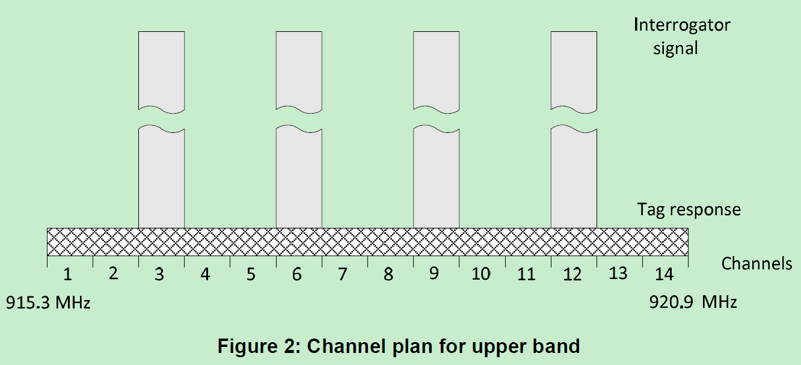
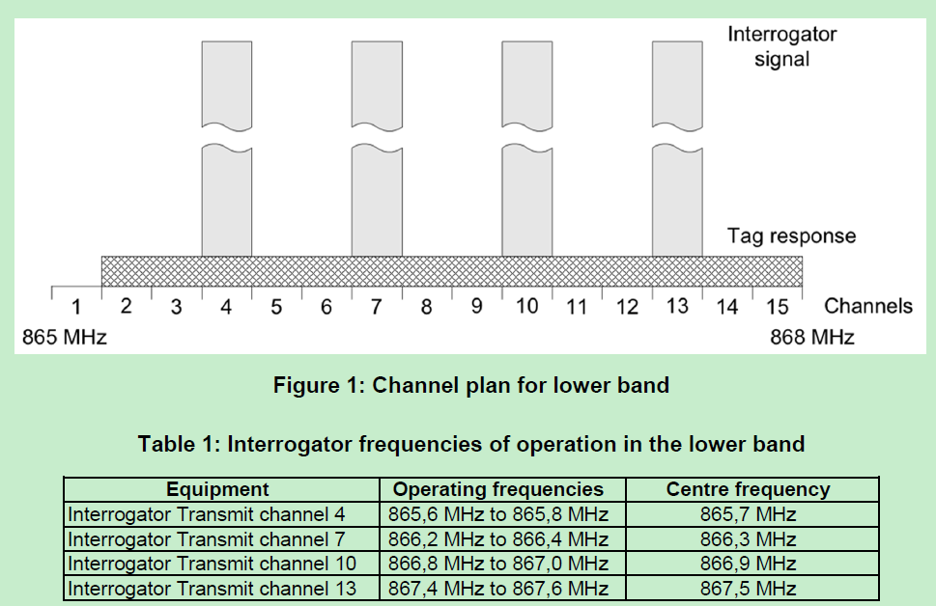
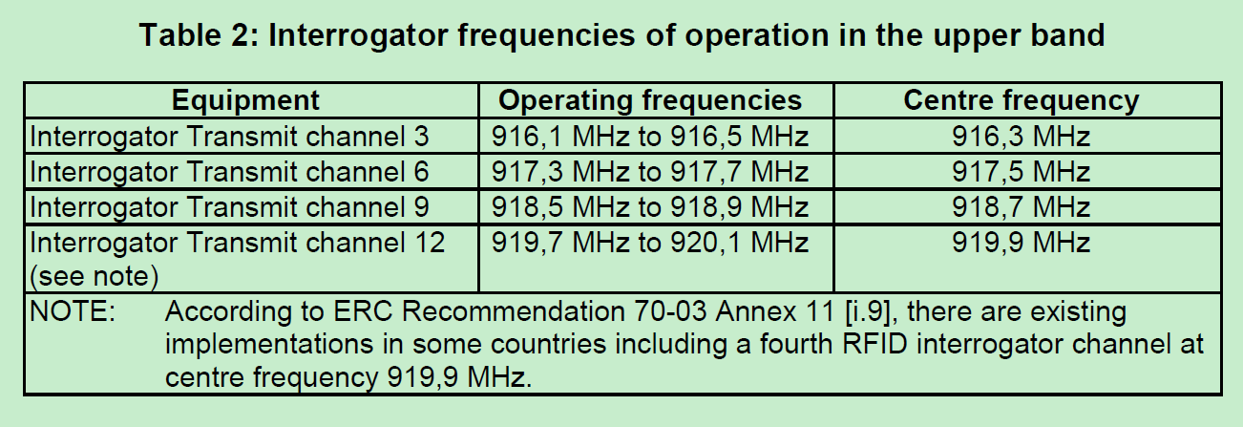
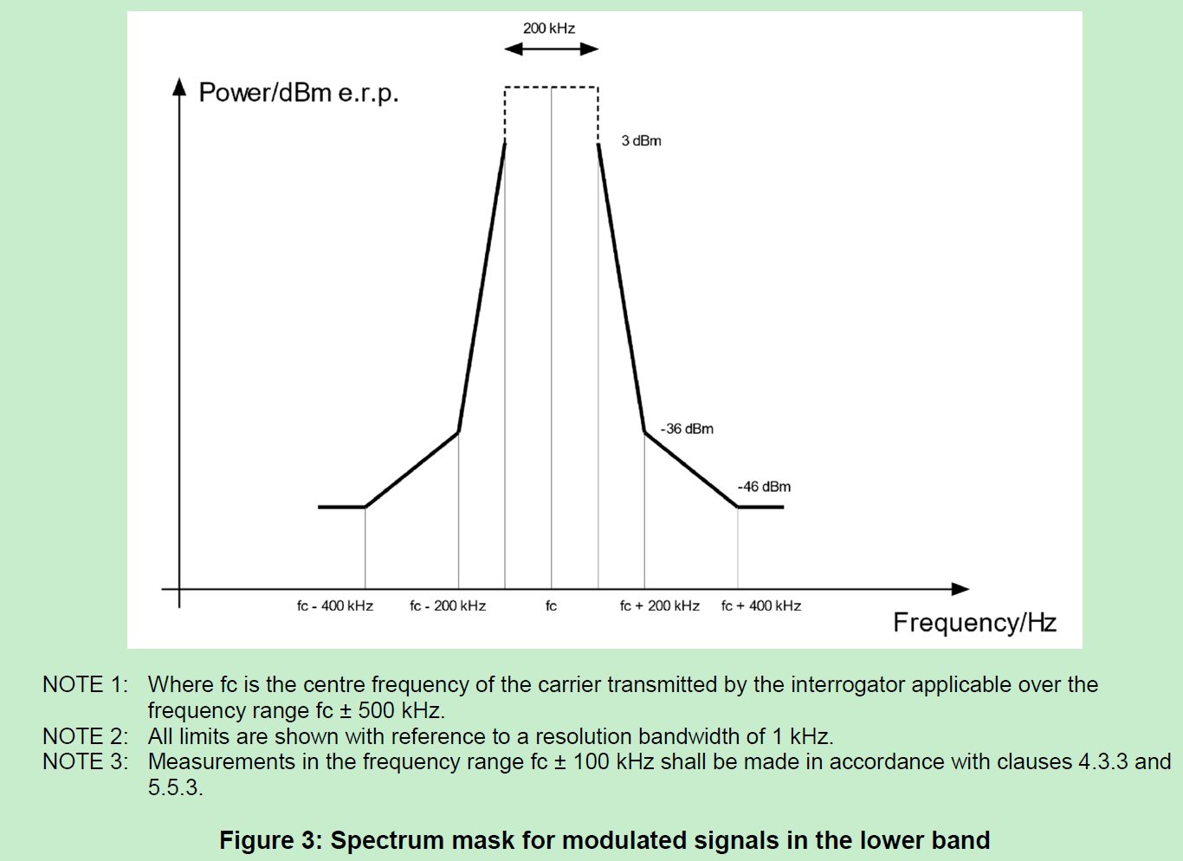
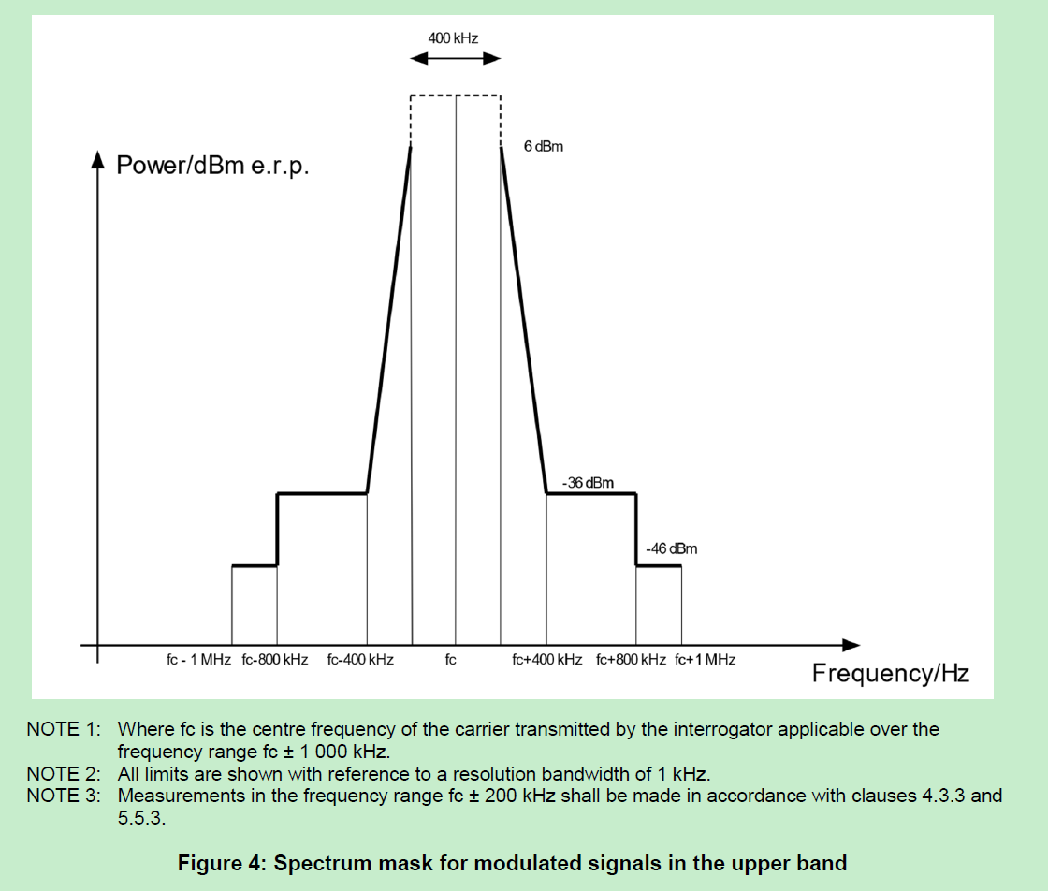
EU S1G Regulation: RFID [9]
Not sure whether EU can use RFID bands for AMP use.

Slide 8
Proposal for AMP-S1G Transmission Bandwidths
Definitely need a 250kHz
China can use
Better have 500kHz
US allow
Better also consider other available RFID BWs
EU: 200kHz, 400kHz
Encourage group to consider more regions
We propose that the following BWs be supported in the standard
At least 250kHz
Better have 500, 200, 400kHz

Slide 9
Proposal for AMP-S1G Channelization (1/6)
China
11ah has no China operating class, so follow the regulation
Operating bands: 920-925MHz
Support 250kHz, totally 20 channels
Center frequency
920.125+M*0.25, M=0,…,19
920MHz
925MHz
250kHz
……

Slide 10
Proposal for AMP-S1G Channelization (2/6)
Option 1
US
902-928MHz: support 500kHz, 52 channels
Support of 250kHz is open for discussion
Center frequency:
902.25+N*0.5, N=0,…,51
S1G Preamble
AMP-S1G portion
902MHz
928MHz
11ah: 1MHz
11ah: 2MHz
AMP-S1G 500kHz

Slide 11
Proposal for AMP-S1G Channelization (3/6)
Option 2
US
Consider to align the centre frequency with 11ah 1MHz channel
Advantage: easy for implementation at AP
Disadvantage: spectrum waste
S1G Preamble
AMP-S1G portion
May cannot be used as AMP-S1G channel if S1G preamble is 1MHz
902MHz
928MHz
11ah: 1MHz
11ah: 2MHz
AMP-S1G 500kHz

Slide 12
Proposal for AMP-S1G Channelization (4/6)
EU
865-868MHz: support 200kHz, 15 channels
Center frequency: 865.1+N*0.2, N=0,…,15;
915.3-920.9MHz: support 400kHz, 14 channels
Center frequency: 915.5+N*0.4, N=0,…,13;
865MHz
868MHz
915.3MHz
920.9MHz
11ah: 1MHz
11ah: 2MHz
AMP-S1G: 200kHz
AMP-S1G: 400kHz

Slide 13
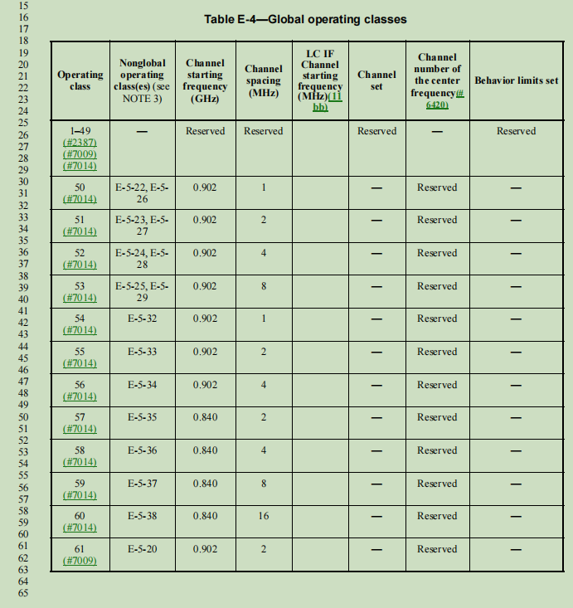
Proposal for AMP-S1G Channelization (6/6)
Change to the base standard IEEE P802.11-REVme/D7.0
Need to develop a new AMP-S1G operating classes
Or revise based on current Table E-5—S1G operating classes
Need to revise current Table E-4—Global operating classes

Slide 14
Summary
In this contribution, we present some initial thoughts on the channelization for AMP in sub-1Ghz.
Encourage group consider more regions

Slide 15
Reference
[1] 11-11-1238-00-00ah-channelization-and-bandwidth-modes-for-11ah
[2] 11-11-1296-03-00ah-potential-channelization-for-11ah
[3] 11-11-1329-00-00ah-motions-and-sp-on-channelization-for-11ah
[4] 11-11-1320-00-00ah-11ah-channelization-of-china
[5] 11-11-1318-00-00ah-japanese-channelization-for-802-11ah
[6] 11-25-0816-00-00bp-feasibility-study-of-mono-static-backscatter-in-sub-1-ghz
[7] 关于发布800/900MHz 频段射频识别（RFID）技术应用试行规定的通知.
[8] https://www.law.cornell.edu/cfr/text/47/15.247.
[9]https://www.etsi.org/deliver/etsi_en/302200_302299/302208/03.04.01_60/en_302208v030401p.pdf.

Slide 16
SP 1
Do you agree to add the following text to TG bp SFD?
11bp shall allow transmission in sub-1 GHz with at least the following bandwidths restricted by regional regulations: 250 kHz.
Yes
No
Abstain

Slide 17
SP 2
Do you agree to add the following text to TG bp SFD?
11bp shall adopt the channelization proposal contained in slide 9 of document 11/0xxxr0 for China
Yes
No
Abstain

