Slide 1
SYNC Field Design Discussion
Date: 2025-07-23
Authors:
Name | Affiliations | Address | Phone | Email
Shengquan Hu | Mediatek | 2840 Junction Ave. San Jose, CA, 95134 |  | Shengquan.hu@mediatek.com
You-Wei Chen |  |  |  | You-Wei.chen@mediatek.com
Jianhan Liu
Thomas Pare

Slide 2
Introduction
In this contribution, we will share our studies for the following two parts:
  Part-I: Baseline data PER performance simulations
  Part-II: Sync field design studies & simulations for DL/UL non-backscatter

Slide 3
Part-I
Baseline PER Simulations

Slide 4
Recap: Baseline Simulations
Contribution [1] proposes the methodology & settings for the baseline performance simulations to calibrate the results and compare the performance from different contributions
The baseline simulation scenarios and settings in [1] include:
  DL & UL
  non-backscatter & backscatter
  data rates: 250kbps and 1Mbps
  waveform: square pulse & OFDM with L-LTF
  detector: non-coherent (DL & UL) and coherent (UL)
  timing: ideal & non-ideal
  channel: AWGN
  ppm: 0
  payload: 100bits
In addition, evaluate BCC for UL non-backscatter
  BCC: on/off for UL non-backscatter;
  Data rate: 250kbps and 1Mbps
  Decoding: hard & soft decision;

Slide 5
Block Diagram Settings for DL Baseline Simulations
TX
RX
P_{miss} & P_{false}
noise
SYNC
data
Manchester
coding
Waveform
OOK
channel
+
SCO (ppm) & random dly
Envelope
detector
Down-sample
Bit retiming & data Decode
PER
SYNC
field
TX | Transmit Bandwidth (MHz) | 20
 | Transmit Waveform | Square Pulse, OFDM (L-LTF)
 | Chip Duration Tc (us) | 2 & 0.5
 | SYNC sequence Length | 16 & 32
 | Transmitter Clock Accuracy (ppm) | 0
 | Data Field Size | 100 bits
Channel
 | Channel | AWGN, D-LOS
RX | Receiver Bandwidth (MHz) | 80
 | Sampling Frequency (MHz) | 8
 | Receiver Clock Accuracy (ppm) | 0
 | Random delay | [0 80*Tc]
 | Receiver Type | non-coherent
 | Timing | Ideal, bit-retiming
 | Number of packets in simulations | 10k

Slide 6
DL, non-Coherent
OFDM vs Pulse: pulse waveform performs slightly better
Ideal vs non-ideal timing: degradation ~0.7dB

Slide 7
Performance Summary & Comparison
Aligned with the result in Ref [1], delta within ~0.2dB for non-ideal timing case
waveform | platform | 250kbps, non-coherent |  | 1Mbps, non-coherent
 |  | Ideal Timing | non-Ideal Timing | Ideal Timing | non-Ideal Timing
Pulse | Ref [1] | -7.00 | -6.30 | -3.47 | -2.60
 | MTK | -6.93 | -6.52 | -3.47 | -2.75
OFDM | Ref [1] | -6.90 | -6.20 | -3.00 | -2.20
 | MTK | -6.86 | -6.45 | -3.14 | -2.44

Slide 8
Block Diagram Settings for UL Baseline Simulations
TX
RX
P_{miss} & P_{false}
waveform
noise
SYNC & ppm Est
data
Manchester
coding
OOK
SCO (ppm) & random dly
channel
+
Envelope
detector
Down-sample
Bit retiming & data Decode
PER
SYNC
field
waveform
TX | Transmit Bandwidth (MHz) | 20
 | Transmit Waveform | Square Pulse, OFDM (L-LTF)
 | Chip Duration Tc (us) | 2 & 0.5
 | SYNC sequence Length | 16 & 32
 | Transmitter Clock Accuracy (ppm) | 0
 | Data Field Size | 100 bits
Channel
 | Channel | AWGN, D-LOS
RX | Receiver Bandwidth (MHz) | 20
 | Sampling Frequency (MHz) | 20
 | Receiver Clock Accuracy (ppm) | 0
 | Random delay | [0:0.25:20*Tc]
 | Receiver Type | Coherent & non-coherent
 | Timing | Ideal, bit-retiming
 | Number of packets in simulations | 10k

Slide 9
UL, non-Coherent
OFDM vs Pulse: pulse waveform is slightly better, ~0.2dB for 250kbps, up to 0.4dB for 1Mbps for ideal timing, difference gets a little bigger for non-ideal timing, up to 0.7dB
Ideal vs non-ideal timing: degradation up to 1.3dB

Slide 10
UL, Coherent
OFDM vs Pulse: pulse waveform outperforms OFDM up to 1dB for non-ideal timing case
Ideal vs non-ideal timing: degradation can be > 2dB

Slide 11
Performance Summary & Comparison
Except for a couple of cases, basically aligned with the results in Ref [1]
waveform | platform | 250kbps, non-coherent |  | 1Mbps, non-coherent
 |  | Ideal Timing | non-Ideal Timing | Ideal Timing | non-Ideal Timing
Pulse | Ref [1] | -3.50 | -2.60 | 0.30 | 1.40
 | MTK | -3.47 | -2.91 | 0.34 | 1.32
OFDM | Ref [1] | -3.40 | -2.40 | 0.70 | 2.10
 | MTK | -3.32 | -2.84 | 0.73 | 2.04
waveform | platform | 250kbps, coherent |  | 1Mbps, coherent
 |  | Ideal Timing | non-Ideal Timing | Ideal Timing | non-Ideal Timing
Pulse | Ref [1] | -9.30 | -7.40 | -3.30 | -1.20
 | MTK | -9.31 | -8.42 | -3.27 | -1.88
OFDM | Ref [1] | -9.00 | -7.30 | -2.90 | -0.60
 | MTK | -9.19 | -7.63 | -2.90 | -0.60

Slide 12
Performance Evaluation of UL Active Tx with BCC
BCC was proposed in [6,7] for UL Active (non-backscatter) transmission
We evaluate BCC performance for UL active Tx with the following settings in the simulations:
  K=7, R=1/2, same encoding polynomial as defined in 802.11n, etc
  Both hard decision & soft decision are considered
  non-coherent
  Other settings are same as non-BCC UL simulations
Simulations show the significant gains with BCC vs w/o BCC
waveform | platform | 250kbps, non-coherent |  | 1Mbps, non-coherent
 |  | Ideal Timing | non-Ideal Timing | Ideal Timing | non-Ideal Timing
OFDM | BCC off | -3.32 | -2.84 | 0.73 | 2.04
 | BCC on, hard | -5.03 | -4.36 | -1.28 | -0.13
 | BCC on, soft | -6.37 | -4.98 | -2.71 | -0.90

Slide 13
Part-II
SYNC Design & Simulations

Slide 14
Recap: SYNC Sequence Design
Contribution [2] shares the high-level thoughts on the Sync field design for both DL & UL:
  Total 4 base sequences
  Need of 5th sequence S₅ is TBD
  Detailed SYNC sequence design TBD
 | DL PPDU for non-AP STAs |  | UL PPDU from non-AP STAs
 | non-Backscatter | Backscatter | non-Backscatter | Backscatter
250kbps | f(S₁) | S₂ | S₃ | S₄
1Mbps | S₁ | N/A
4Mbps | N/A | N/A |  | N/A
Contribution [3~5] shares some SYNC field design considerations such as:
  False detection performance requirements
  Sync error rate
  ppm estimation capability
  etc
This contribution will focus on DL/UL non-backscatter Sync field design & performance evaluation

Slide 15
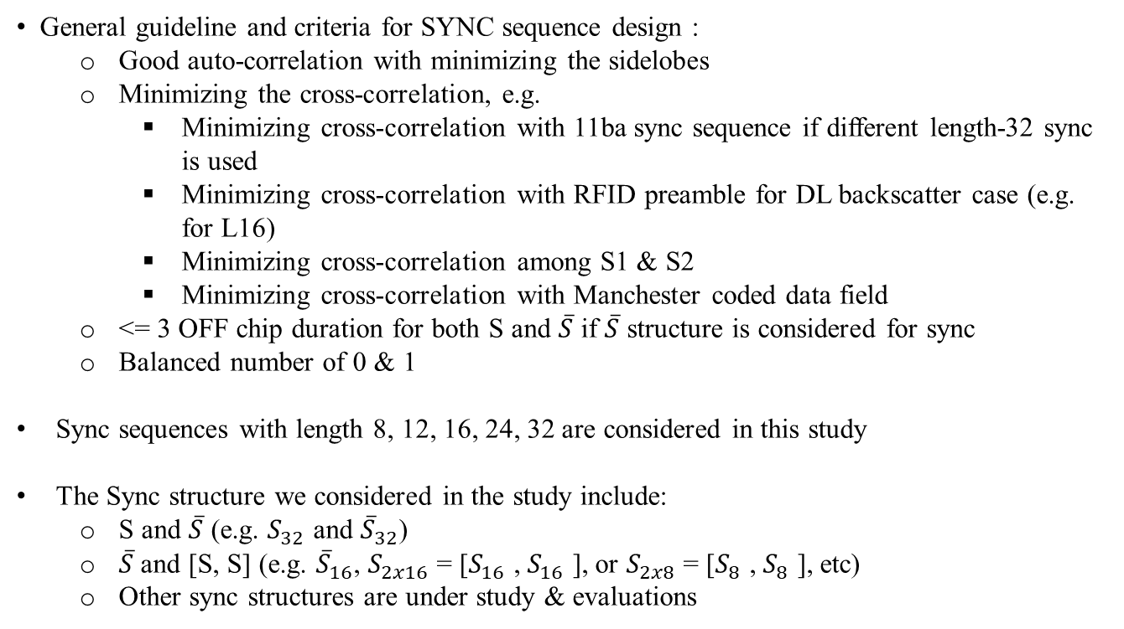
General Considerations of SYNC Sequence Design for DL Non-backscatter
General guideline and criteria for SYNC sequence design :
  Good auto-correlation with minimizing the sidelobes
  Minimizing the cross-correlation, e.g.
    Minimizing cross-correlation with 11ba sync sequence if different length-32 sync is used
    Minimizing cross-correlation with RFID preamble for DL backscatter case (e.g. for L16)
    Minimizing cross-correlation among S1 & S2
    Minimizing cross-correlation with Manchester coded data field
  <= 3 OFF chip duration for both S and $\overline{S}$ if $\overline{S}$ structure is considered for sync
  Balanced number of 0 & 1
Sync sequences with length 8, 12, 16, 24, 32 are considered in this study
The Sync structure we considered in the study include:
  S and $\overline{S}$ (e.g. $S_{32}$ and ${\overline{S}}_{32}$)
  $\overline{S}$ and [S, S] (e.g. ${\overline{S}}_{16}$, $S_{2x16}$ = [$S_{16}$ , $S_{16}$ ], or $S_{2x8}$ = [$S_{8}$ , $S_{8}$ ], etc)
  Other sync structures are under study & evaluations

Slide 16
Example of Updated Base Sync Sequence
L8
0 1 1 1 0 0 1 0
1 0 1 1 0 0 0 1
L12
0 1 0 0 1 1 1 1 0 0 0 1
1 0 0 0 1 1 1 0 1 0 0 1
L16
0 0 1 0 1 1 0 1 1 1 0 0 0 1 1 0
0 0 1 1 0 1 0 1 1 0 1 1 1 0 0 0
L24
0 0 0 1 1 0 1 1 1 0 0 1 1 1 0 1 0 0 1 1 0 1 0 0
0 0 1 0 1 1 0 0 1 0 1 1 1 0 0 1 1 1 0 1 1 0 0 0
0 0 0 1 1 1 0 0 1 1 1 0 1 0 0 0 1 1 0 1 1 1 0 1 0 0 1 0 0 1 0 1
0 0 0 1 1 1 0 1 0 1 1 0 0 1 0 1 1 0 1 0 0 0 1 1 0 1 1 1 0 0 1 0
0 0 0 1 1 1 0 1 1 1 0 0 0 1 0 1 1 1 0 0 1 0 0 1 1 0 1 0 0 1 0 1
0 1 0 0 1 1 1 0 1 1 0 0 0 1 0 1 1 0 1 0 0 1 1 0 1 0 1 1 1 0 0 0
L32

Slide 17
Example Illustration of Correlation for Sync with L32
11ba=[1 0 1 0 0 1 0 0 1 0 1 1 1 0 1 1 0 0 0 1 0 1 1 1 0 0 1 1 1 0 0 0];
11bp=[0 1 0 0 1 1 1 0 1 1 0 0 0 1 0 1 1 0 1 0 0 1 1 0 1 0 1 1 1 0 0 0];

Slide 18
Example Illustration of Correlation for Alternative Sync with L32
$S$=[0 0 1 0 1 0 1 1 0 1 1 1 0 0 0 1 1 0 1 0 0 1 1 0 1 1 1 0 1 0 0 0]
$\overline{S}$ =[1 1 0 1 0 1 0 0 1 0 0 0 1 1 1 0 0 1 0 1 1 0 0 1 0 0 0 1 0 1 1 1]
S with lower sidelobe before main peak could be assigned to lower data rate 250kbps, $\overline{S}$ could be assigned to higher data rate 1Mbps
<=1

Slide 19
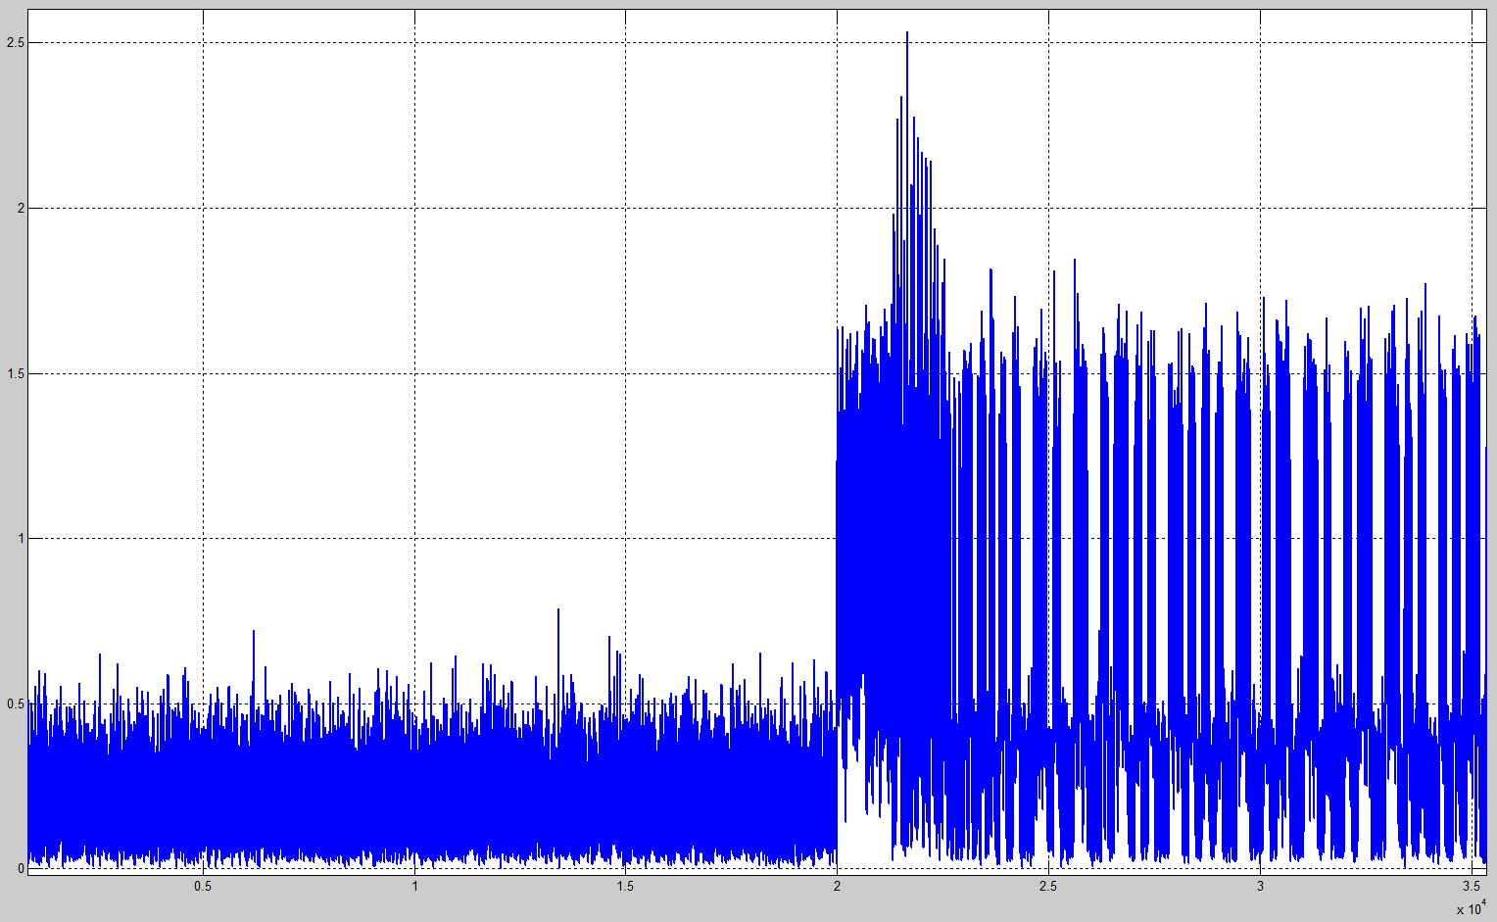

Simulation Settings for DL
DL AMP PPDU is transmitted as below for the simulations
As proposed in [3], false detection is evaluated over 5ms noise signal
2us chip duration for Sync, no Manchester coding
Sync error rate is evaluated starting from part of noise signal
Correlation based SYNC detector is used in the simulations
Sync detection threshold is chosen for target false error rate < 10^-4
32us
TBD us
L-STF
L-LTF
L-SIG
RL-SIG
U-SIG1
U-SIG2
AMP-SYNC
AMP-DATA
5ms
Correlate with
Ref Seq
Envelope:
Abs() & Accum
Shift register
$$\frac{x}{y}$$
detRatio
Sync false error evaluation
Sum samples
Sync error rate evaluation

Slide 20
Statistic of Detection Ratio
Sequence length-8, 12, 16/2x8, 24, 32/2x16 are considered
L2x8 for length-16 sequence with structure [S₈ S₈]
L2x16 for length-32 sequence with structure [S₁₆ S₁₆]
The detection thresholds are selected for each sequence length and used for Sync detection performance evaluation

Slide 21
Sync detection Error Rate for Different Sequence Length
DL, AWGN channel
0ppm, ideal sampling timing
Sync sequence length: L8, L12, L16/L2x8, L24, L32/L2x16
The detection thresholds selected in previous page are used in the simulations
L16 and L2x8 achieve similar detection performance
L32 and L2x16 achieve similar detection performance

Slide 22
Sync detection Error Rate vs Data PER
Similar observation as in [3]:
  L16: ~0.95dB margin vs 250kbps data @10% error rate
  L24: ~1.83dB margin vs 250kbps data @10% error rate
  L32: ~2.49dB margin vs 250kbps data @10% error rate
  L8 & L12 cannot meet performance requirements for 250kbps data
 | Pmiss@10% | Pmiss@1% | 250kbps@10% PER | 1Mbps@10% PER
L16 | -7.88 | -7.33 | -6.93 | -3.47
L24 | -8.76 | -8.00 | -6.93 | -3.47
L32 | -9.42 | -8.70 | -6.93 | -3.47

Slide 23
Sync Detection Performance with ppm
DL, AWGN channel
0, 1k, 10kppm
Sync sequence length: L16/L2x8, L24, L32/L2x16
Same detection thresholds selected in previous page are used in the simulations
Performance degradation is small for ~1kppm
Up to 0.4dB degradation for ~10kppm
L16 vs L2x8, L32 vs L2x16 perform similar

Slide 24
Data PER with Sync+ppm+non-ideal timing
DL, AWGN channel
1k ppm, non-ideal timing
Data (250kbps) PER with Sync & bit re-timing, non-coherent
Sync sequence length: L16, L32
Same detection thresholds selected in previous pages are used in this simulations
~1.5dB margin for L16 vs 250kbps data @10% error
~3.3dB margin for L32 vs 250kbps data @10% error
Data achieves similar performance for L16 & L32
NOTE-1: ~0.8dB degradation for ideal 250kbps data vs data+sync+ppm+non-ideal timing
NOTE-2: degradation of 1Mbps with sync+ppm+non-ideal timing becomes larger for (not shown here)

Slide 25
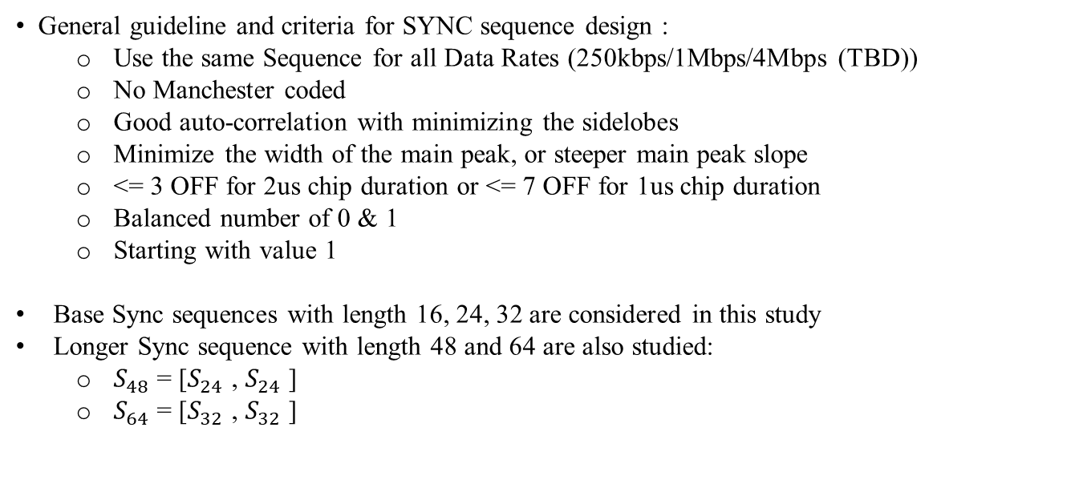
General Considerations of UL SYNC Sequence Design for Non-Backscatter Transmission
General guideline and criteria for SYNC sequence design :
  Use the same Sequence for all Data Rates (250kbps/1Mbps/4Mbps (TBD))
  No Manchester coded
  Good auto-correlation with minimizing the sidelobes
  Minimize the width of the main peak, or steeper main peak slope
  <= 3 OFF for 2us chip duration or <= 7 OFF for 1us chip duration
  Balanced number of 0 & 1
  Starting with value 1
Base Sync sequences with length 16, 24, 32 are considered in this study
Longer Sync sequence with length 48 and 64 are also studied:
  $S_{48}$ = [$S_{24}$ , $S_{24}$ ]
  $S_{64}$ = [$S_{32}$ , $S_{32}$ ]

Slide 26
Base Sync Sequence with Length 16
S16,1=1 1 0 1 1 1 0 0 0 1 0 1 0 0 1 0
S16,2=1 1 1 1 0 1 1 0 0 0 1 0 1 0 0 0
S16,3=1 0 1 1 1 1 0 0 0 1 1 0 0 1 0 0
S16,4=1 1 0 1 0 1 0 1 1 0 1 1 0 0 0 0
S16,1~4 for Sync length-16
S16,2~4 can be used as base seq to construct Sync length 32 with [S₁₆,S₁₆]
S16,1
[S_{16,2}, S_{16,2}]

Slide 27
Base Sync Sequence with Length 24
S24,1=1 1 1 1 0 0 1 0 1 0 0 1 0 1 0 1 0 1 0 0 1 1 0 0
S24,2=1 1 1 1 0 1 0 1 0 1 1 0 0 0 1 1 0 0 1 0 0 1 0 0
S24,3=1 1 1 1 1 0 1 0 0 1 1 0 0 1 1 0 0 0 0 1 0 1 0 0
S24,1~4 for Sync length-24
S24,2~3 can be used as base seq to construct Sync length 48with [S₂₄,S₂₄]
S24,1
[S_{24,3}, S_{24,3}]

Slide 28
Base Sync Sequence with Length 32
S32,1=1 1 1 1 0 0 1 1 0 0 1 1 0 1 0 0 1 0 0 1 0 1 0 0 1 0 1 0 1 0 1 0
S32,2=1 1 1 1 1 1 0 0 1 0 1 0 0 1 0 0 1 1 0 1 0 0 0 1 1 0 0 0 1 0 1 0
S32,3=1 0 1 0 1 1 1 1 1 1 0 0 1 0 1 0 0 1 0 0 1 1 0 1 0 0 0 1 1 0 0 0
S32,1~3 for Sync length-32
S32,2~3 can be used as base seq to construct Sync length 64 with [S₃₂,S₃₂]
S32,1
[S_{32,2}, S_{32,2}]

Slide 29
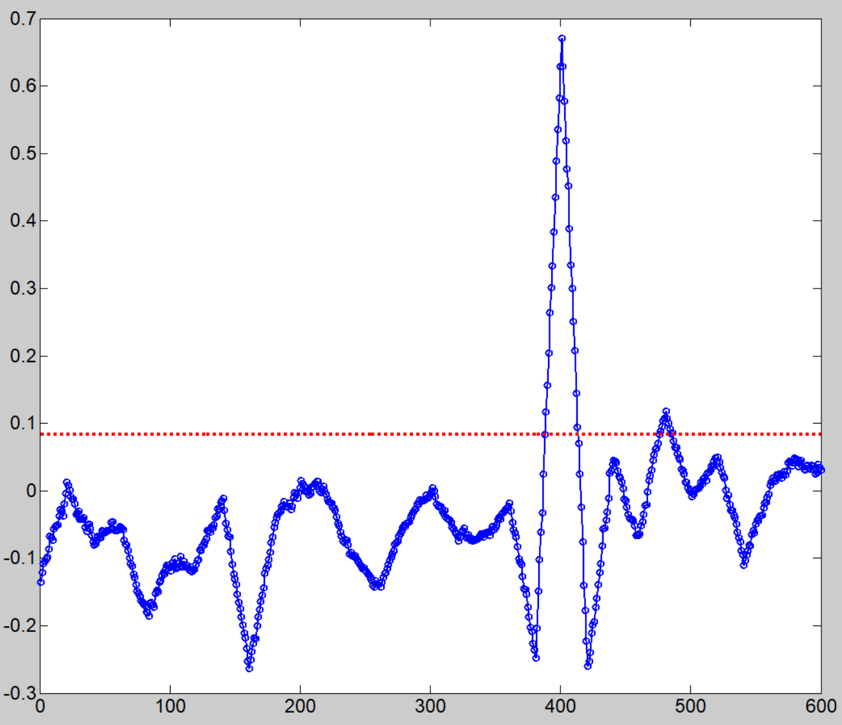
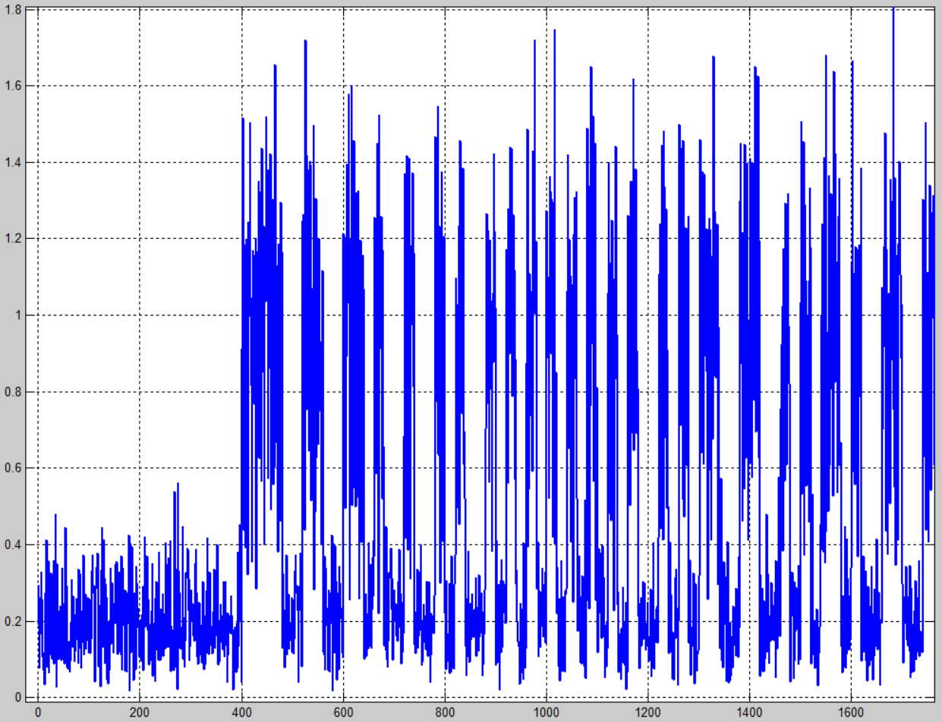
SYNC Simulation for UL Non-Backscatter
UL AMP PPDU is transmitted as below for the simulations
false detection is evaluated over SIFS+Δus noise signal
Sync chip duration is same as data, but no Manchester coding
Sync error rate is evaluated starting from part of noise signal
Correlation based SYNC detector is used in the simulations
Sync detection threshold is chosen for target false error rate < 10^-2
Others with same simulation settings as UL data simulations
TBD us
SIFS=16us
AMP-SYNC
AMP-DATA
Peak Search Window
1st Hit
detTh

Slide 30
Statistic of Detection Ratio for 250kbps
Sequence length-16, 24, 32, 48, 64 are considered
length-48 sequence with structure [S₂₄ S₂₄]
length-64 sequence with structure [S₃₂ S₃₂]
The detection thresholds are selected for each sequence length and used for Sync detection performance evaluation
The target Pfalse is considered as < 10^-2
2us chip for non-BCC, 250kbps
1us chip for BCC, 250kbps

Slide 31
Statistic of Detection Ratio for 1Mbps
Sequence length-16, 24, 32, 48, 64 are considered
length-48 sequence with structure [S₂₄ S₂₄]
length-64 sequence with structure [S₃₂ S₃₂]
The detection thresholds are selected for each sequence length and used for Sync detection performance evaluation
The target Pfalse is considered as < 10^-2
0.5us chip for non-BCC, 1Mbps
0.25us chip for BCC, 1Mbps

Slide 32
Performance of Failed Sync Detection: UL, 250kbps
Failed Detect: threshold check failed (i.e. failed to meet “> detTh”)
Sequence length-16, 24, 32, 48, 64 are considered
For no-BCC:
  sync sequence length-16 reserves enough margin vs data SNR requirement
For BCC:
  sequence length-48 gives better vs data SNR requirements;
  length-32 may work for practical cases with data under non-ideal timing etc
2us chip, no BCC
1us chip, BCC
Data:
-6.37dB (ideal)
-4.98dB (non-ideal)
Data: -3.32dB (ideal)

Slide 33
Performance of Failed Sync Detection: UL, 1Mbps
Failed Detect: threshold check failed (i.e. failed to meet “> detTh”)
Sequence length-16, 24, 32, 48, 64 are considered
For no-BCC:
  sync sequence length-16 reserves enough margin vs data SNR requirement
For BCC:
  sequence length-48 gives better margin vs data SNR requirements;
  length-32 may work for practical cases with data under non-ideal timing etc
0.5us chip, no BCC
0.25us chip, BCC
Data: 0.73dB (ideal)
Data:
-2.71dB (ideal)
-0.9dB (non-ideal)

Slide 34
Timing Error for UL Sync, 250kbps
Timing error is measured when 1st hit is reached:
  Based on 1st hit position, further search main peak within 1 chip window
  The timing error is calculated: ture-peak index – estimated-peak index (assume true/genie peak is known)
Simulation results show that 1-chip search window is good enough to achieve timing accuracy within [-25%, +25%] of chip
2us chip, no BCC
1us chip, BCC

Slide 35
Summary
In this contribution, we shared our baseline performance simulation results and DL/UL Sync studies for non-backscatter cases:
  Our baseline performance matches Ref [1] results
  BCC for UL active Tx shows significant performance gain, however, BCC requires longer Sync sequence to achieve better sync margin
  DL non-backscatter Sync:
    length >=16 (e.g.16/24/32) for DL can achieve reasonable margins vs data portion
  UL non-backscatter Sync:
    w/o BCC: length 16 achieve reasonable margin
    w/ BCC: may require length >= 32

Slide 36
Reference
[1]. 11-25-0798-00-00bp-amp-ook-simulation-methodology-and-baseline-results, by NXP
[2]. 11-25-0795-01-00bp-high-level-thoughts-on-amp-sync-field-design, by MTK
[3]. 11-25-0794-00-00bp-initial-thoughts-on-amp-downlink-sync-field-design, by QCOM
[4]. 11-25-0799-00-00bp-uplink-sync-field-design-for-backscatter-stas, by QCOM
[5]. 11-25-0862-00-00bp-discussion-on-uplink-sync-field-design-for-active-transmitters, by Huawei
[6]. 11-25-1002r0, Comparison between FEC/no-FEC for UL of active TX AMP STA, Amichai Sanderovich, et al
[7]. 11-25-1215r0, Discussion on AMP Active Transmission, By Alice Chen, etc

Slide 37
SP#1
Do you agree to add the following content to the 802.11bp SFD?
  The Uplink Sync Field Transmission from a non-Backscatter STA without BCC encoding for all data rates shall have a length of 16

Slide 38
SP#2
Do you agree to add the following content to the 802.11bp SFD?
  The Uplink Sync Field Transmission from a non-Backscatter STA with BCC encoding for data rates of 250kbps and 1Mbps (4Mbps TBD) shall have a length:
  Option-1: 32
  Option-2: 48

