Slide 1
AMP Downlink Sync Field Design for Transmission to Non-Backscatter STAs
Date: 2025-07-28
Authors:
Name | Affiliations | email
Steve Shellhammer | Qualcomm | shellhammer@ieee.org
Bin Tian |  | btian@qti.qualcomm.com
Pooria Pakrooh |  | ppakrooh@qti.qualcomm.com
Manideep Dunna |  | mdunna@qti.qualcomm.com
Alice Chen |  | alicel@qti.qualcomm.com

Slide 2
Introduction
We start with a few slides on the Duration of the Sync Field using Simulations, with and without Clock Offset
We begin with a discussion on the Requirements and then how those lead to the Downlink Sync Field Design
We provide a two options for the Sequence in the Downlink Sync Field Design, and provide Correlation Plots
Straw Polls
Backup Slides

Slide 3
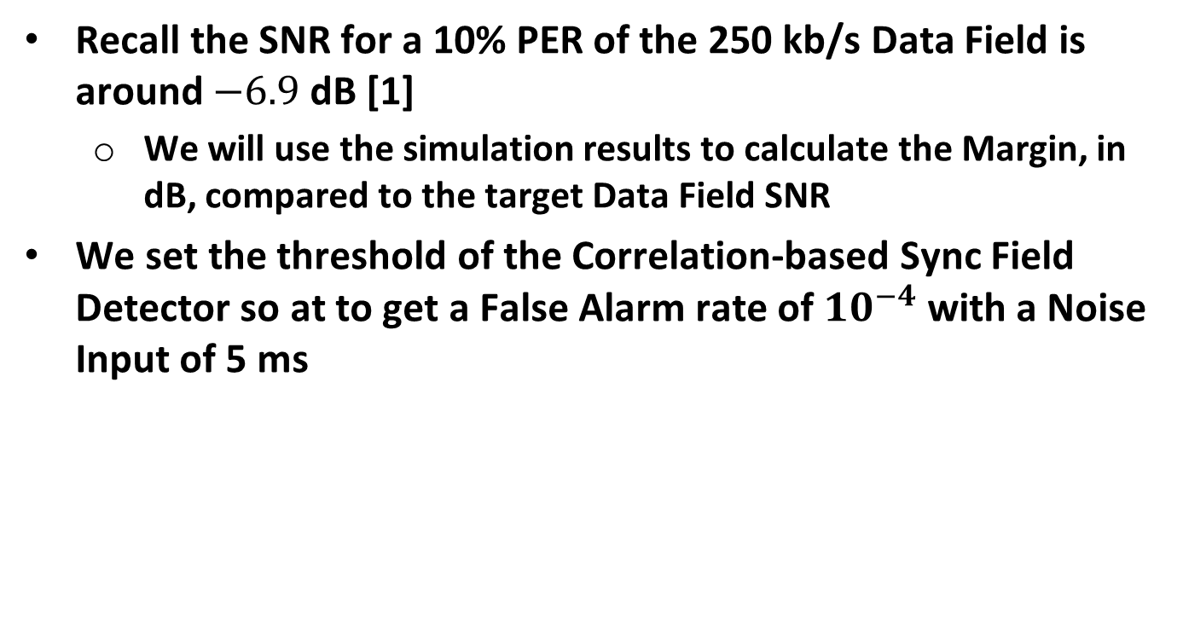
Sync Field Simulation
Recall the SNR for a 10% PER of the 250 kb/s Data Field is around $−6.9$dB [1]
  We will use the simulation results to calculate the Margin, in dB, compared to the target Data Field SNR
We set the threshold of the Correlation-based Sync Field Detector so at to get a False Alarm rate of $10^{−4}$ with a Noise Input of 5 ms

Slide 4
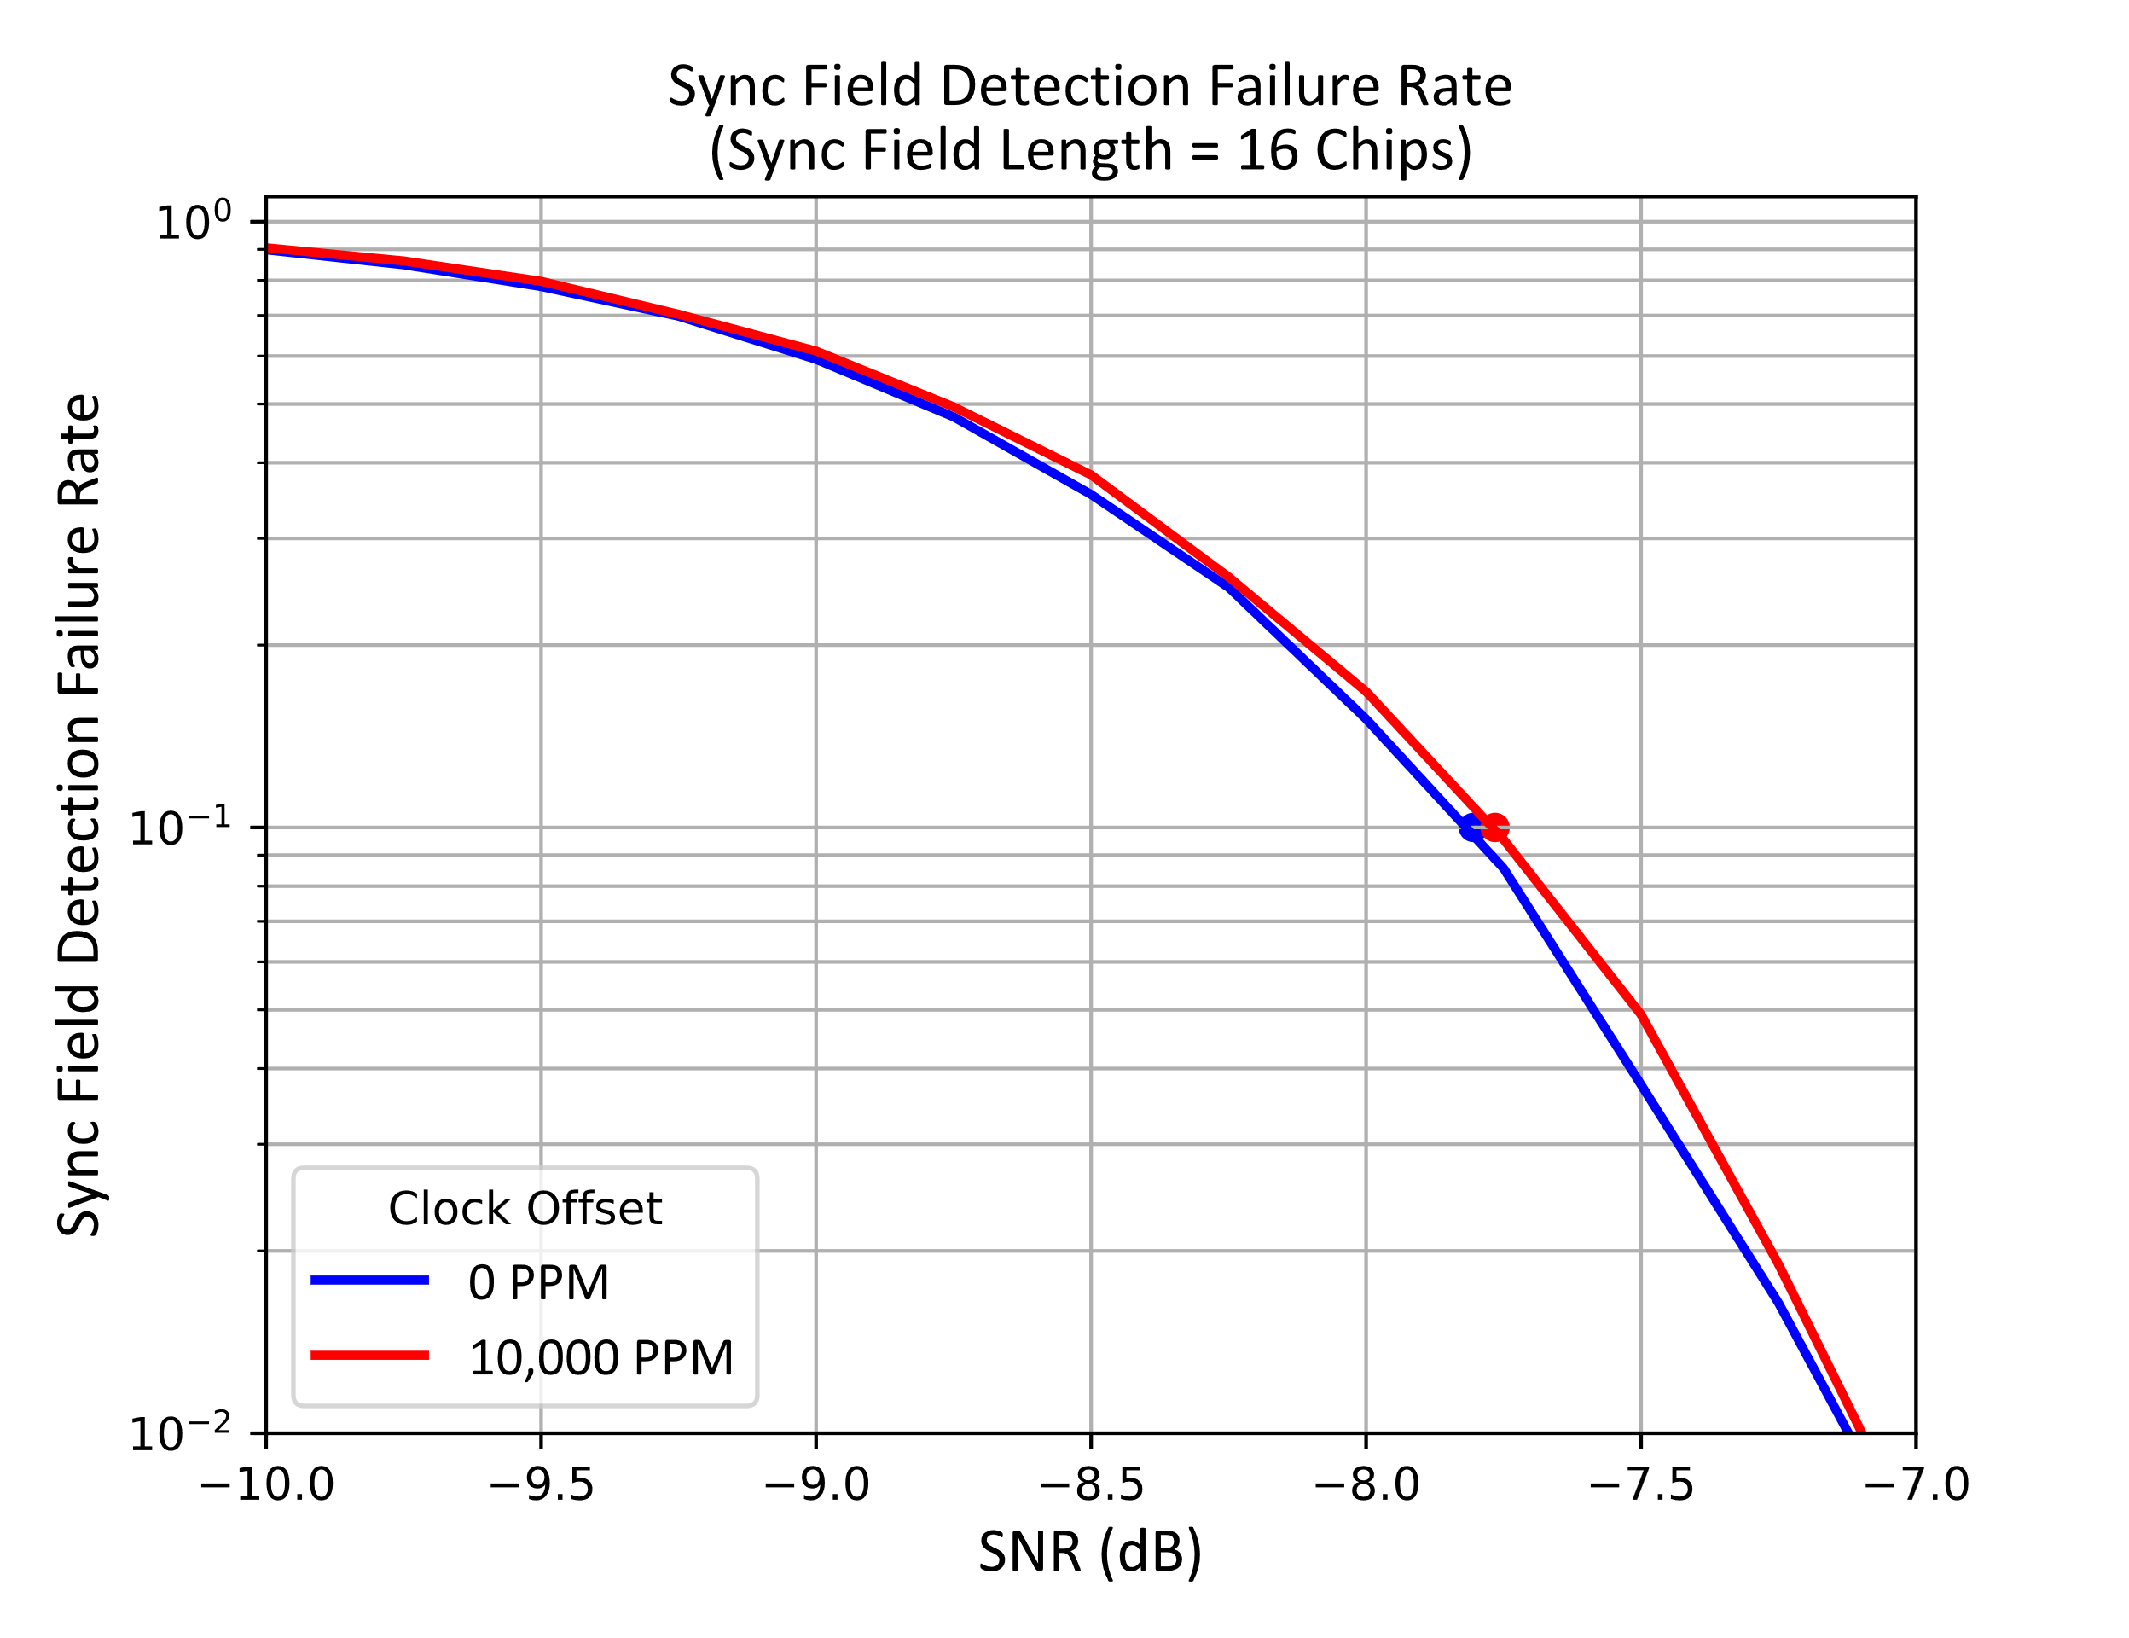
Length 16 Chip Sync Field (2 µs Chips)
Impact of Clock Offset is small

Slide 5
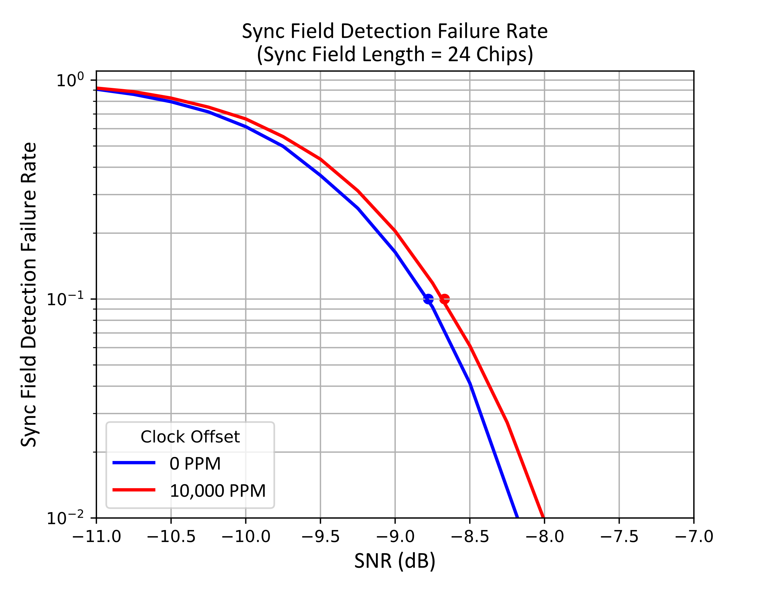
Length 24 Chip Sync Field (2 µs Chips)
Impact of Clock Offset is slightly larger due to longer sequence

Slide 6
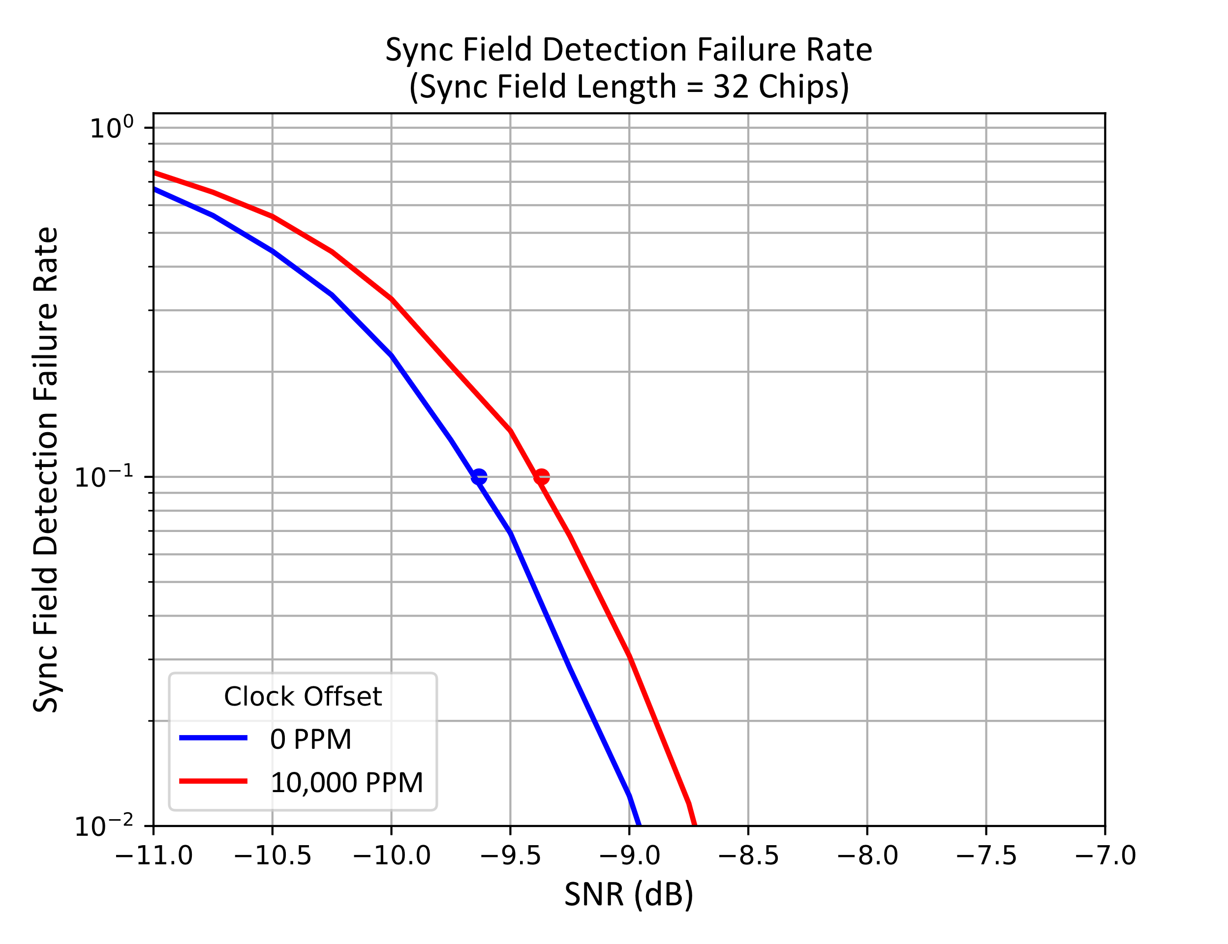
Length 32 Chip Sync Field (2 µs Chips)
Impact of Clock Offset is slightly larger due to longer sequence

Slide 7
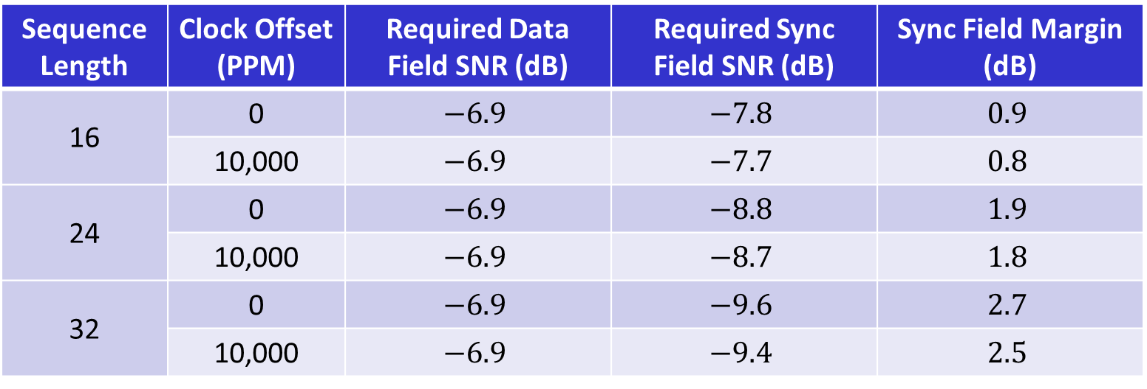
Sync Field Margin
Sequence Length | Clock Offset (PPM) | Required Data Field SNR (dB) | Required Sync Field SNR (dB) | Sync Field Margin (dB)
16 | 0 | $$−6.9$$ | $$−7.8$$ | $$0.9$$
 | 10,000 | $$−6.9$$ | $$−7.7$$ | $$0.8$$
24 | 0 | $$−6.9$$ | $$−8.8$$ | $$1.9$$
 | 10,000 | $$−6.9$$ | $$−8.7$$ | $$1.8$$
32 | 0 | $$−6.9$$ | $$−9.6$$ | $$2.7$$
 | 10,000 | $$−6.9$$ | $$−9.4$$ | $$2.5$$
A Length 24 Chip sequence provides sufficient margin

Slide 8
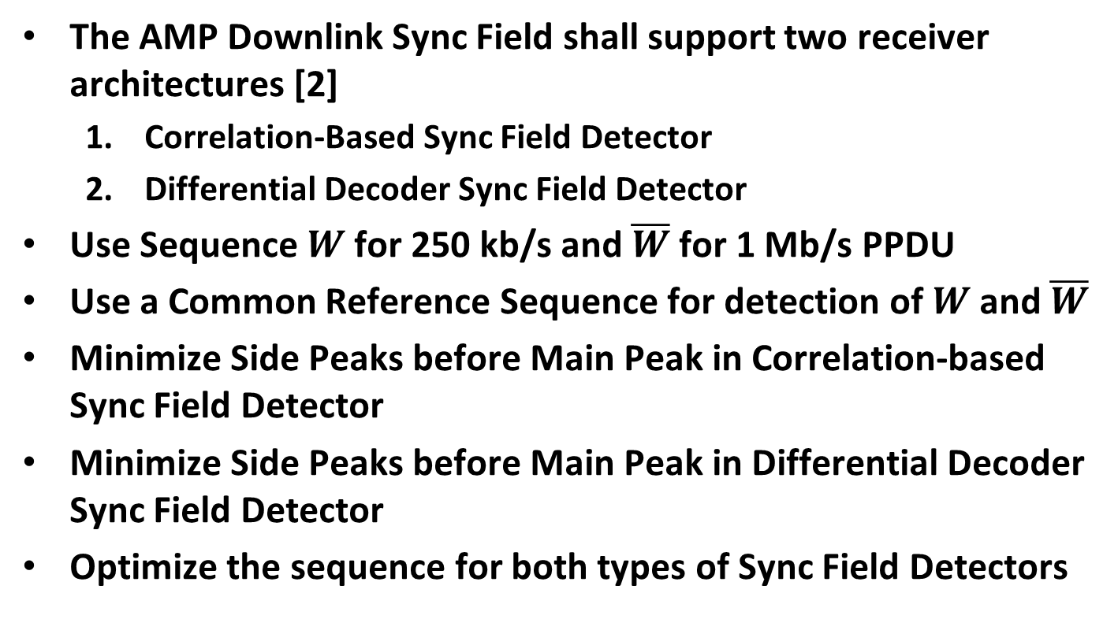
Our Recommended Requirements
The AMP Downlink Sync Field shall support two receiver architectures [2]
  Correlation-Based Sync Field Detector
  Differential Decoder Sync Field Detector
Use Sequence $W$ for 250 kb/s and $\overline{W}$ for 1 Mb/s PPDU
Use a Common Reference Sequence for detection of $W$ and $\overline{W}$
Minimize Side Peaks before Main Peak in Correlation-based Sync Field Detector
Minimize Side Peaks before Main Peak in Differential Decoder Sync Field Detector
Optimize the sequence for both types of Sync Field Detectors

Slide 9

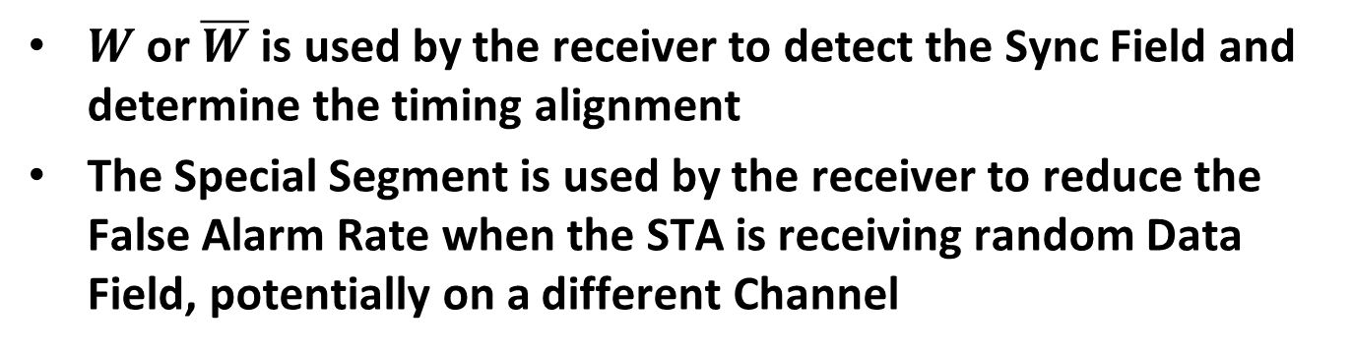
Sync Field Structure
We propose a Sync Field Structure which consists of two Segments [3]
$W$ or $\overline{W}$ is used by the receiver to detect the Sync Field and determine the timing alignment
The Special Segment is used by the receiver to reduce the False Alarm Rate when the STA is receiving random Data Field, potentially on a different Channel

Slide 10
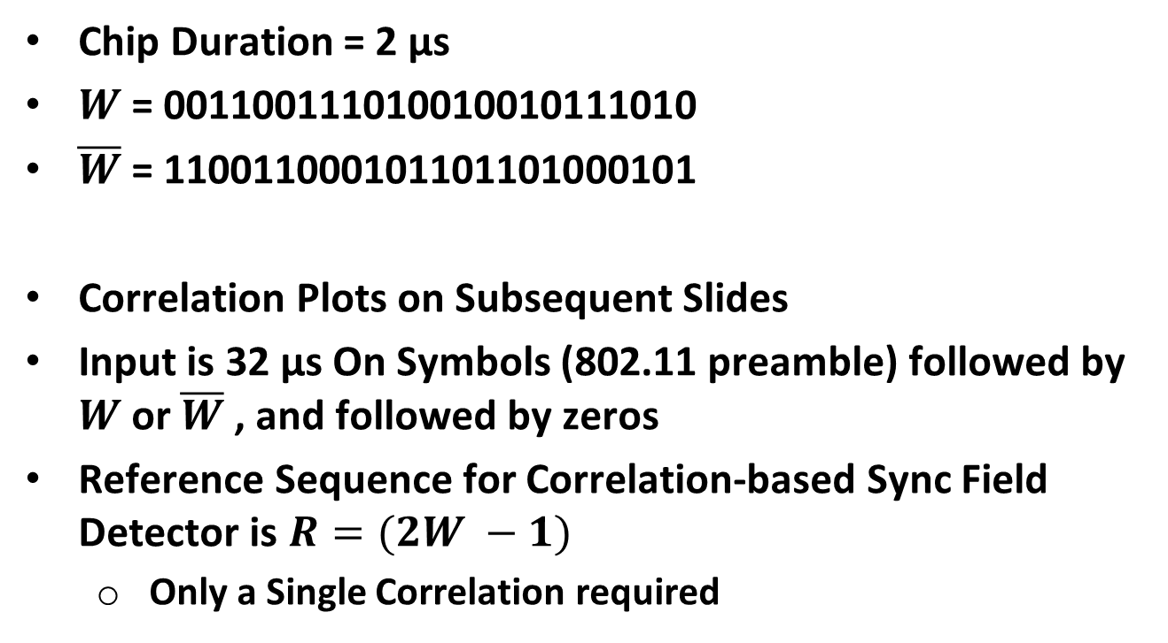
Option #1 Sync Field Design (Length 24 Chips)
Chip Duration = 2 µs
$W$ = 001100111010010010111010
$\overline{W}$ = 110011000101101101000101
Correlation Plots on Subsequent Slides
Input is 32 µs On Symbols (802.11 preamble) followed by $W$ or $\overline{W}$ , and followed by zeros
Reference Sequence for Correlation-based Sync Field Detector is $R=(2W −1)$
  Only a Single Correlation required

Slide 11
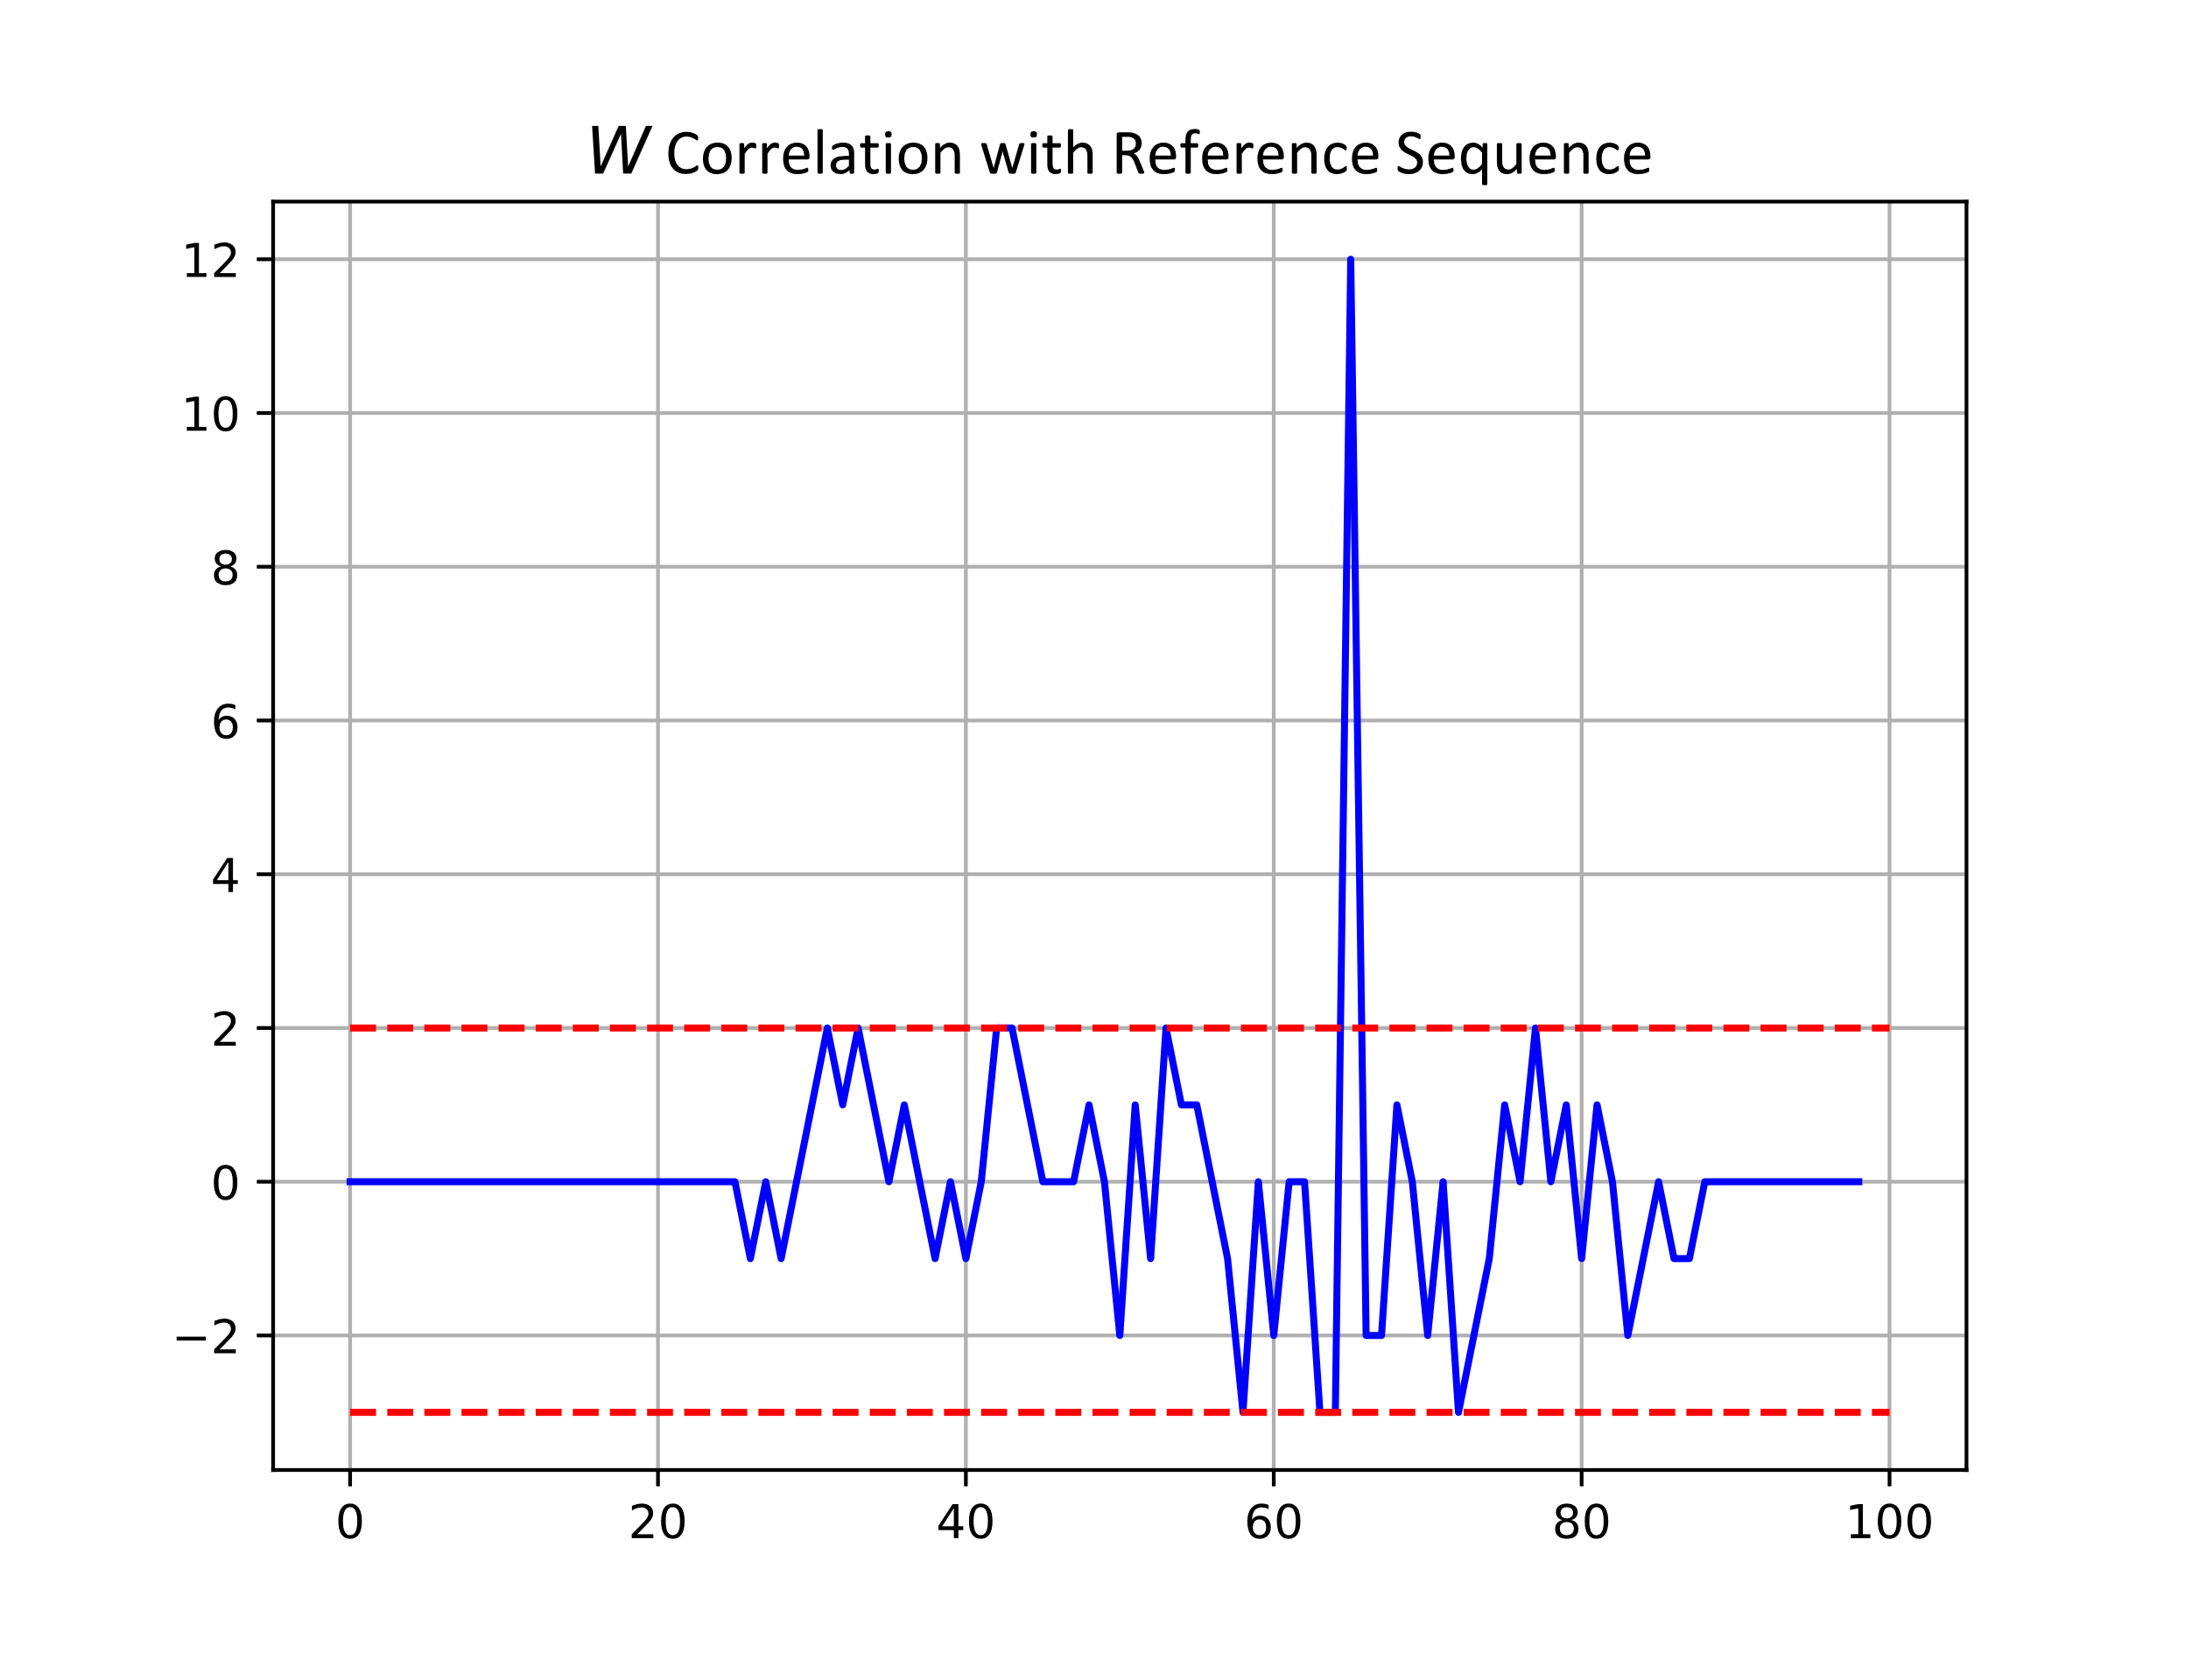

Correlation Plots – Correlation-Based Sync Field Detector
Main Peak = 12
Maximum Positive Peak before Main Peak = 2
Minimum Negative Peak before Main Peak = $−3$

Slide 12
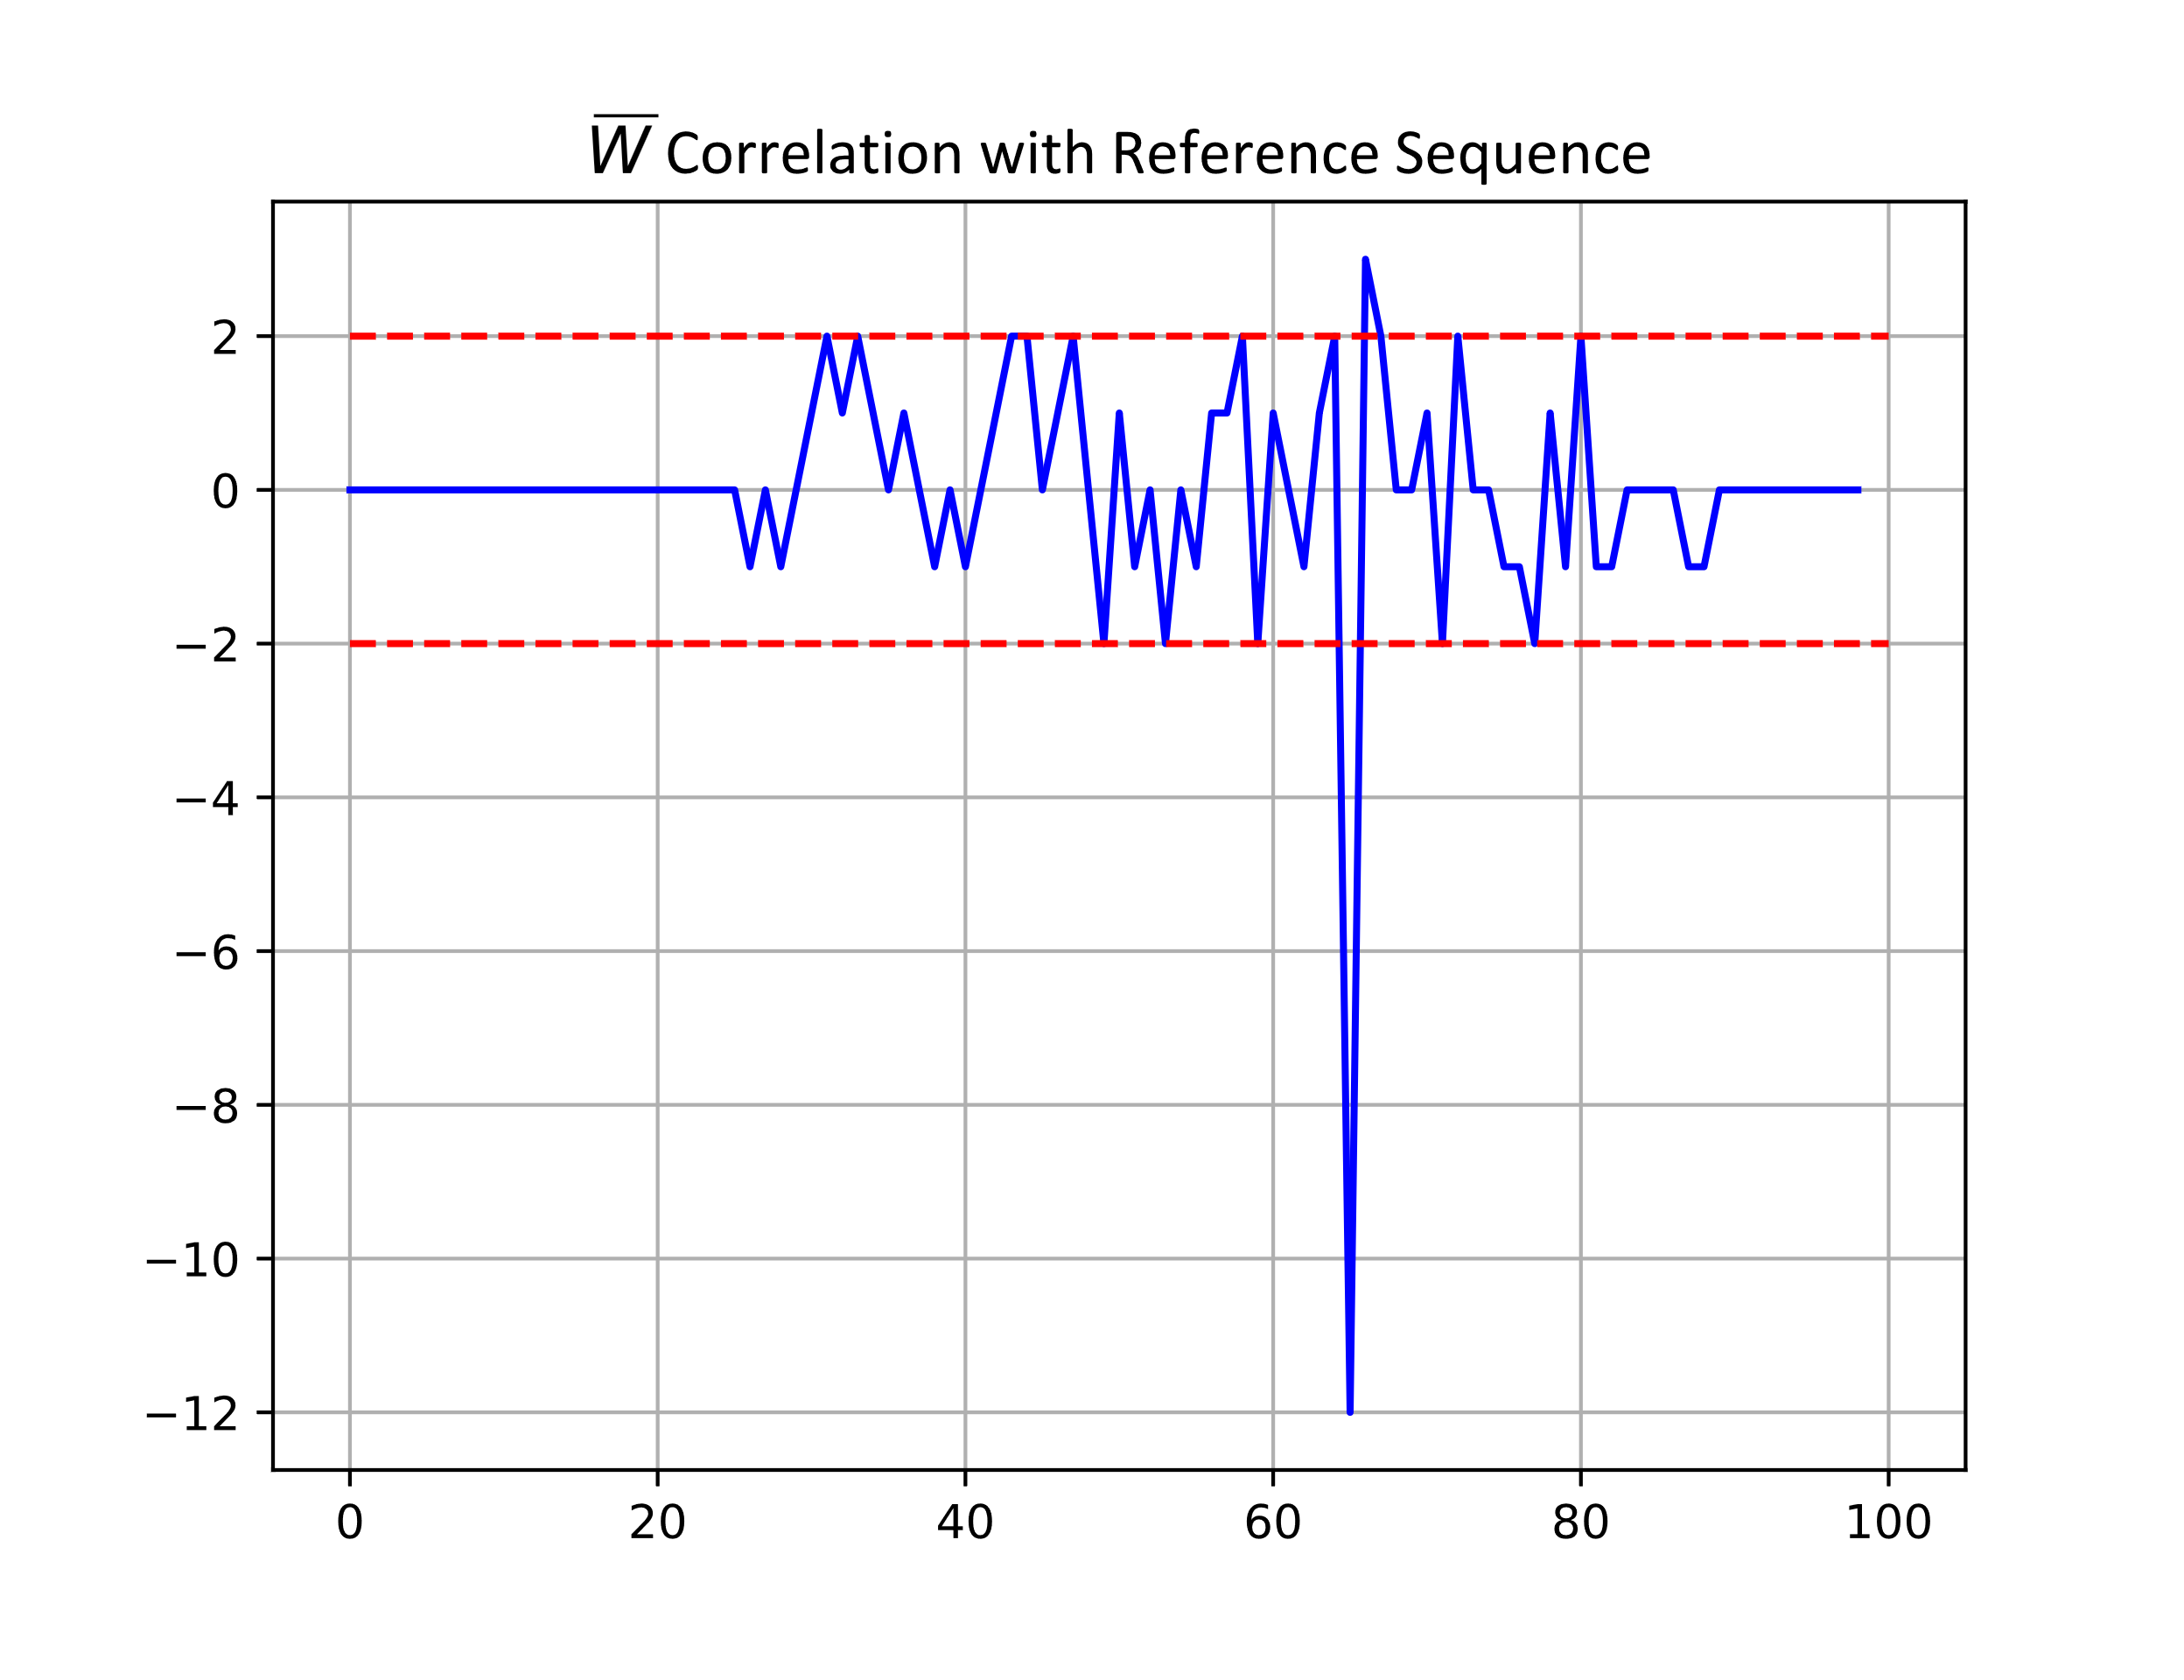

Correlation Plots – Correlation-Based Sync Field Detector
Main Peak = $−12$
Maximum Positive Peak before Main Peak = 2
Minimum Negative Peak before Main Peak = $−2$

Slide 13
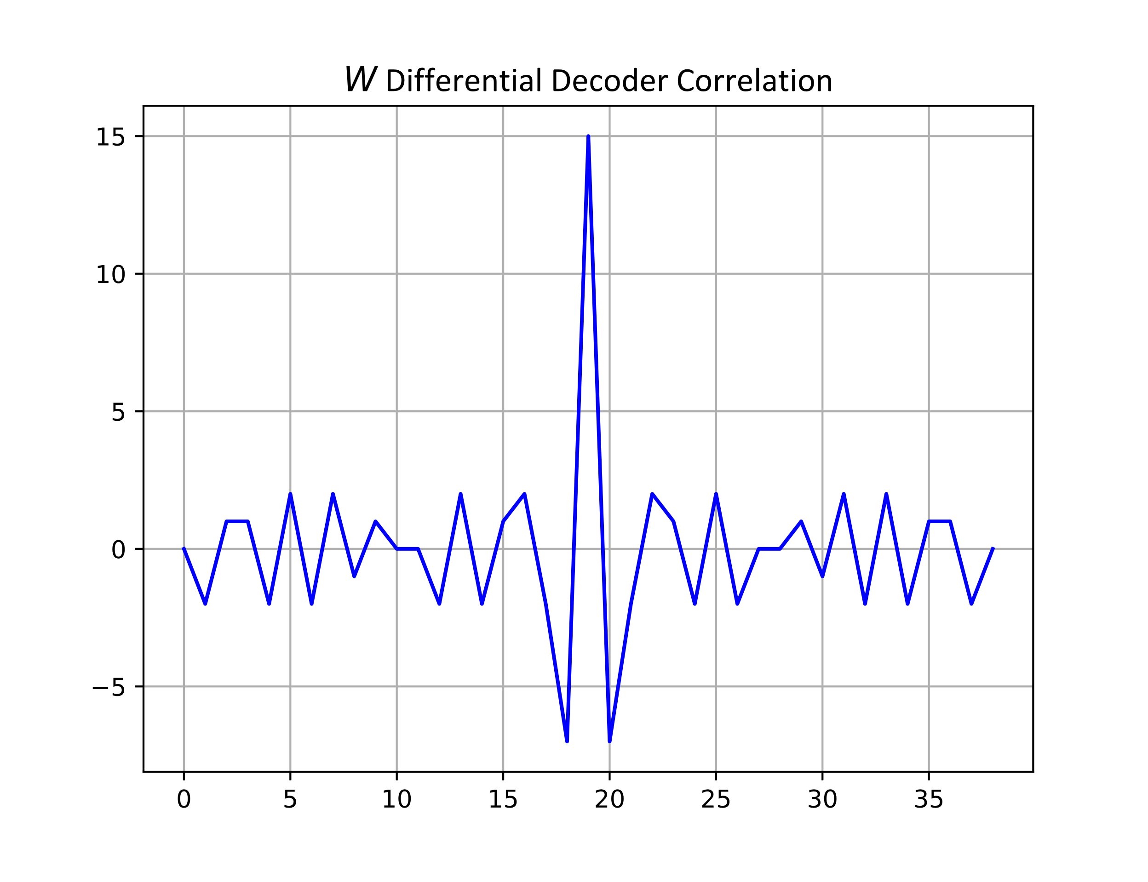
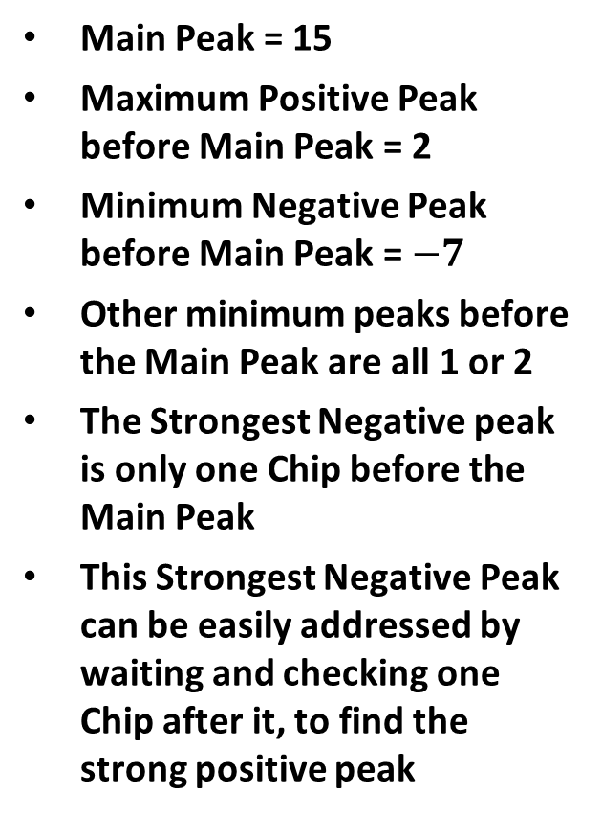
Correlation Plots – Differential Decoder Sync Field Detector
Main Peak = 15
Maximum Positive Peak before Main Peak = 2
Minimum Negative Peak before Main Peak = $−7$
Other minimum peaks before the Main Peak are all 1 or 2
The Strongest Negative peak is only one Chip before the Main Peak
This Strongest Negative Peak can be easily addressed by waiting and checking one Chip after it, to find the strong positive peak

Slide 14
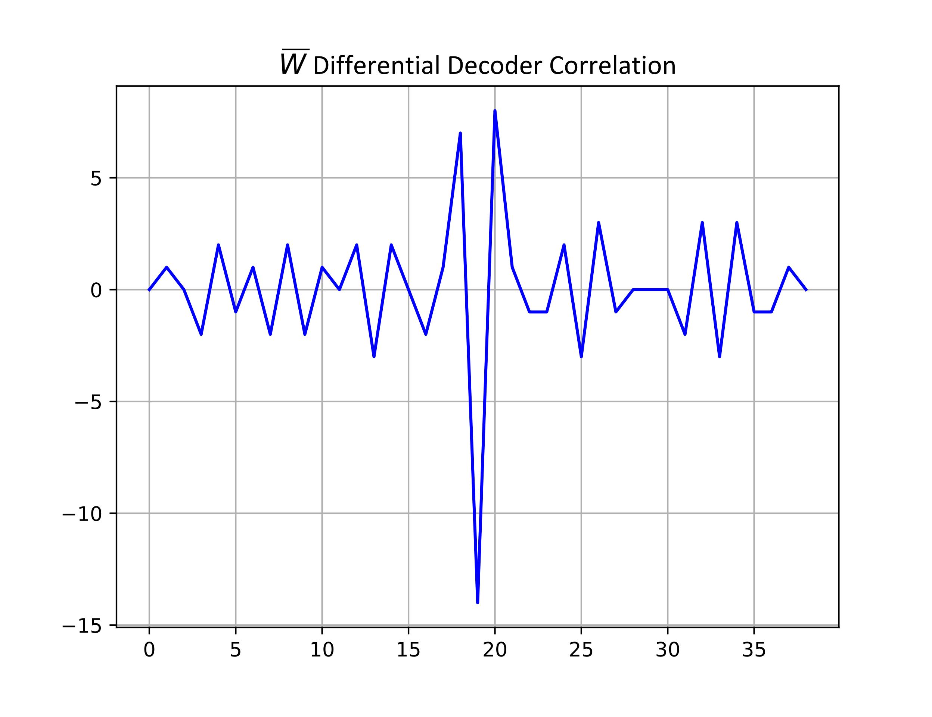
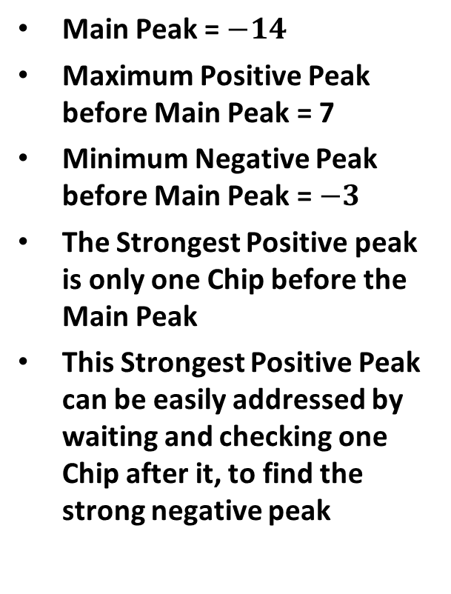
Correlation Plots – Differential Decoder Sync Field Detector
Main Peak = $−14$
Maximum Positive Peak before Main Peak = 7
Minimum Negative Peak before Main Peak = $−3$
The Strongest Positive peak is only one Chip before the Main Peak
This Strongest Positive Peak can be easily addressed by waiting and checking one Chip after it, to find the strong negative peak

Slide 15
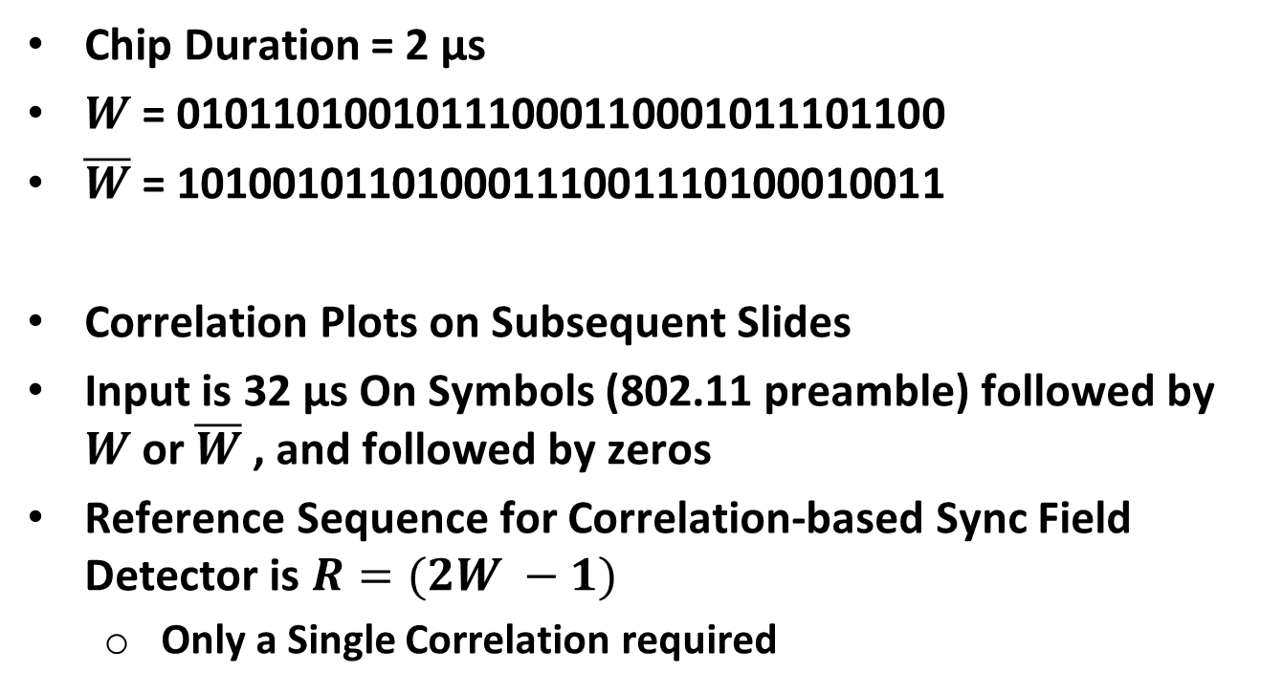
Option #2 Sync Field Design (Length 32 Chips)
Chip Duration = 2 µs
$W$ = 01011010010111000110001011101100
$\overline{W}$ = 10100101101000111001110100010011
Correlation Plots on Subsequent Slides
Input is 32 µs On Symbols (802.11 preamble) followed by $W$ or $\overline{W}$ , and followed by zeros
Reference Sequence for Correlation-based Sync Field Detector is $R=(2W −1)$
  Only a Single Correlation required

Slide 16
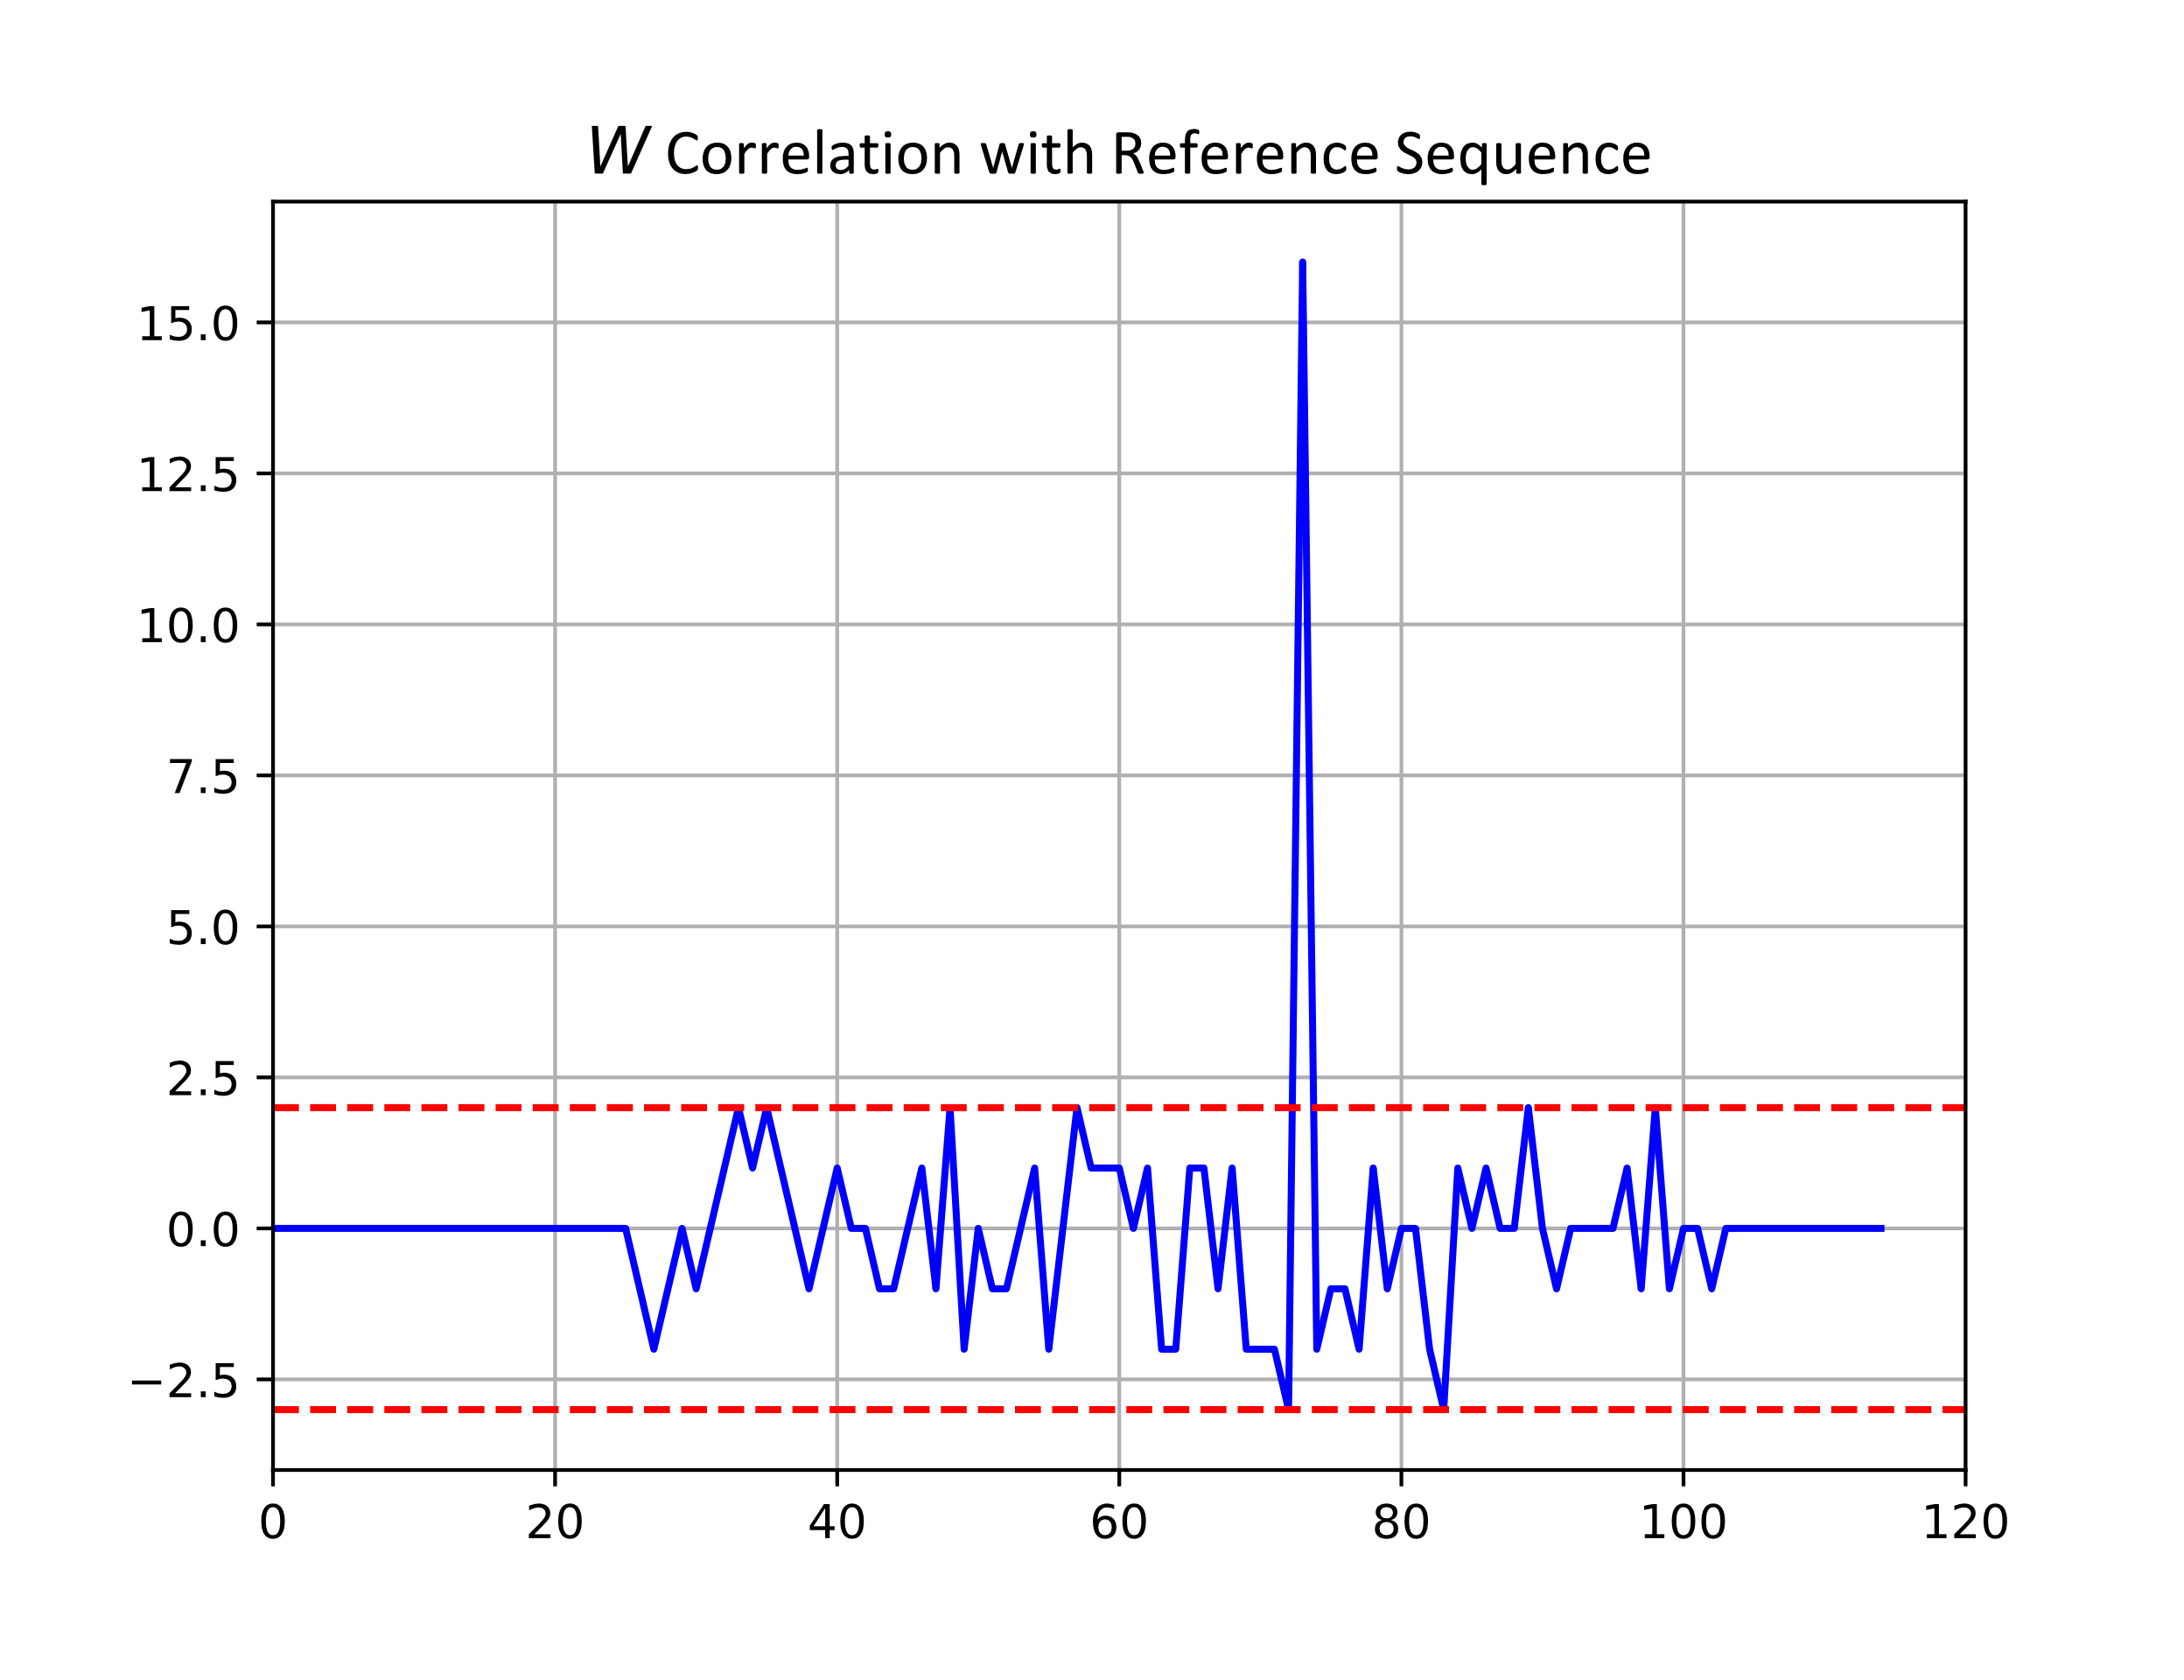
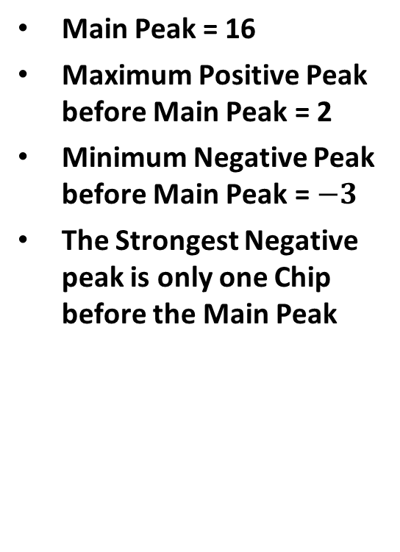
Correlation Plots – Correlation-Based Sync Field Detector
Main Peak = 16
Maximum Positive Peak before Main Peak = 2
Minimum Negative Peak before Main Peak = $−3$
The Strongest Negative peak is only one Chip before the Main Peak

Slide 17
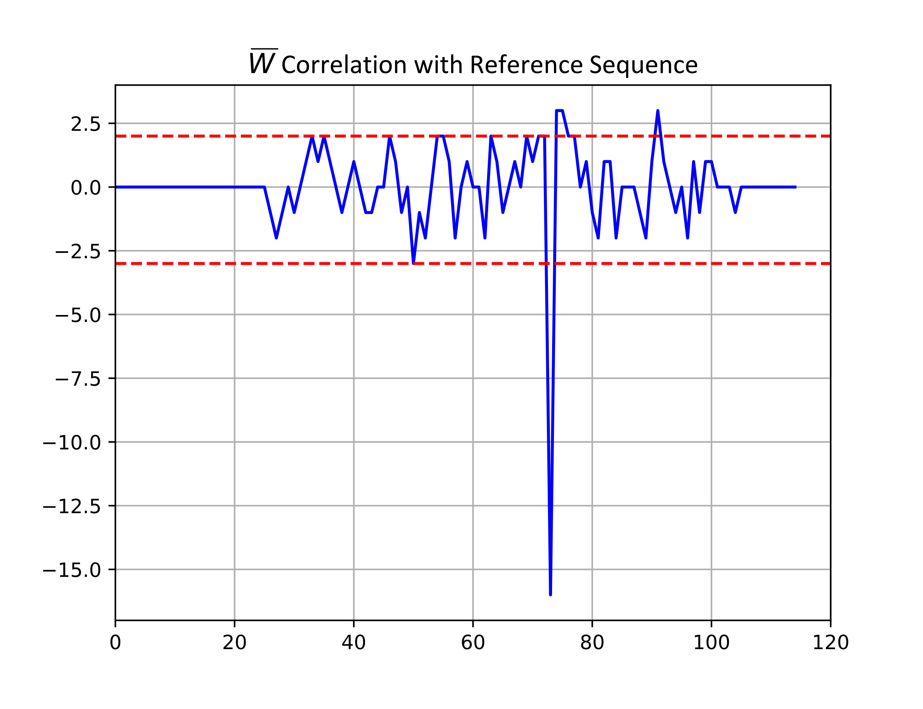

Correlation Plots – Correlation-Based Sync Field Detector
Main Peak = $−16$
Maximum Positive Peak before Main Peak = 2
Minimum Negative Peak before Main Peak = $−3$

Slide 18
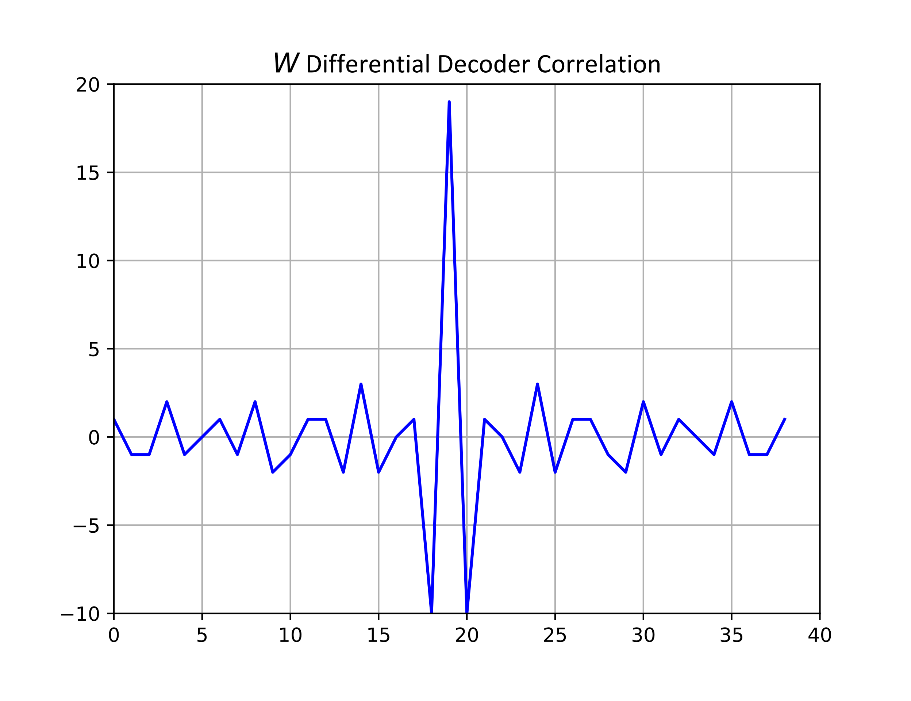
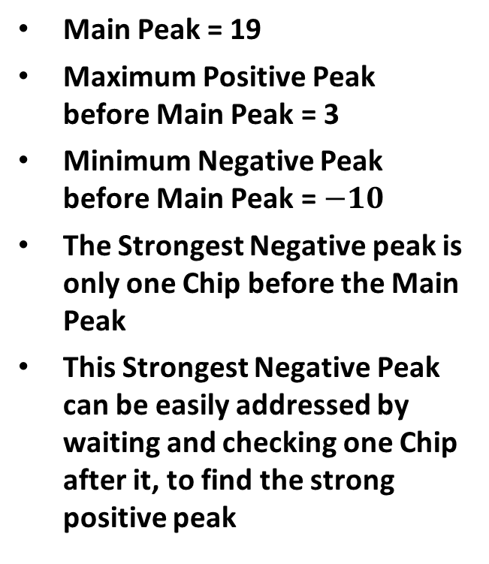
Correlation Plots – Differential Decoder Sync Field Detector
Main Peak = 19
Maximum Positive Peak before Main Peak = 3
Minimum Negative Peak before Main Peak = $−10$
The Strongest Negative peak is only one Chip before the Main Peak
This Strongest Negative Peak can be easily addressed by waiting and checking one Chip after it, to find the strong positive peak

Slide 19
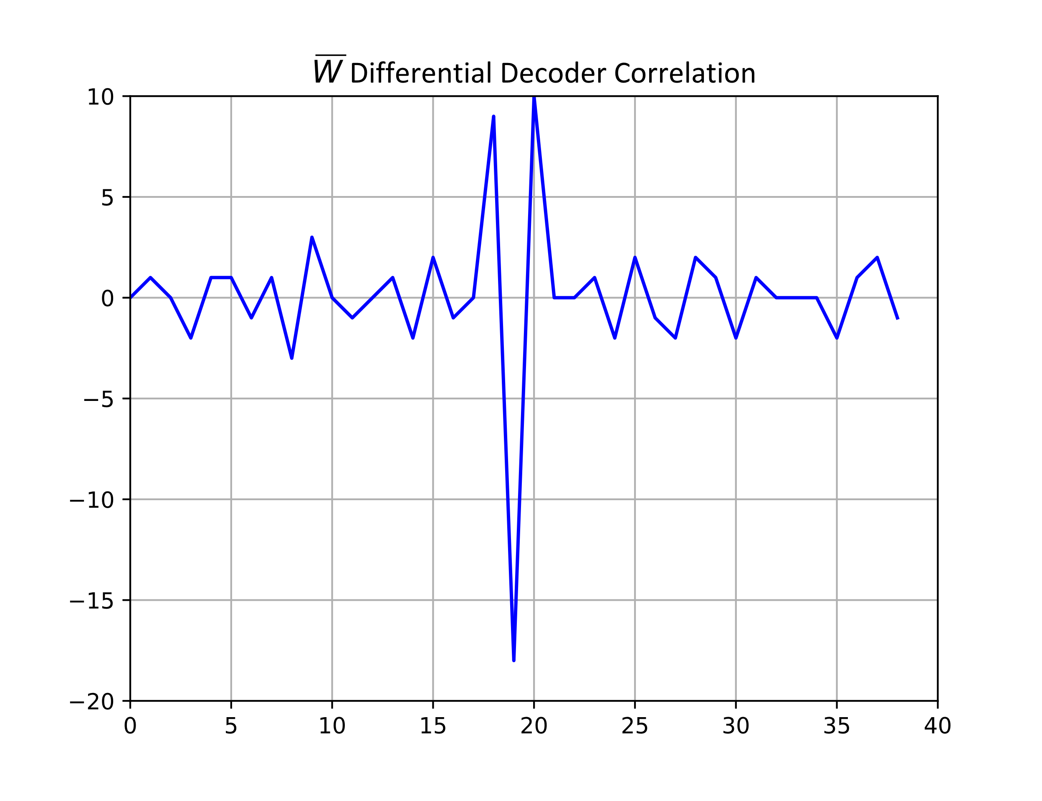
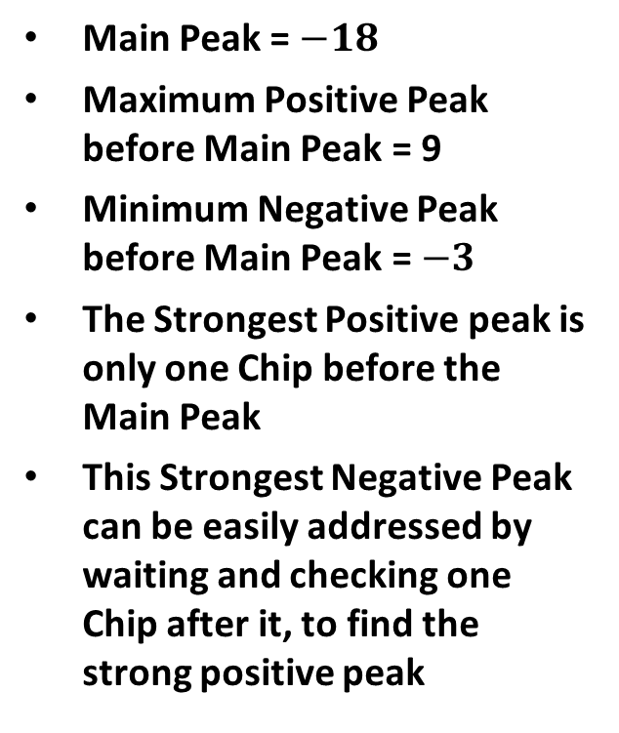
Correlation Plots – Differential Decoder Sync Field Detector
Main Peak = $−18$
Maximum Positive Peak before Main Peak = 9
Minimum Negative Peak before Main Peak = $−3$
The Strongest Positive peak is only one Chip before the Main Peak
This Strongest Negative Peak can be easily addressed by waiting and checking one Chip after it, to find the strong positive peak

Slide 20
Summary
Provided simulation results for the Sync Field Detector for different Sync Field Lengths, with and without Clock Offset
  Provided summary table of Sync Field Margin relative to Data Field target SNR
Provided our view of Sync Field Requirements and Structure
Gave two option for the Sync Field sequence (Length 24 and Length 32 Chips)
  Length 16 is provided in the Backup Slides

Slide 21
Straw Poll #1
Do you agree to add the following content to the 802.11bp SFD?
  The Chip Duration of the Downlink Sync Field Transmitted to a non-Backscatter STA shall be 2 µs

Slide 22

Straw Poll #2
Do you agree to add the following content to the 802.11bp SFD?
  The Downlink Sync Field Transmitted to a non-Backscatter STA shall use a Sequence of Chips $W$ to indicate a data rate of 250 kb/s and a Sequence of Chips $\overline{W}$ to indicate a data rate of 1 Mb/s
  Note, $\overline{W}$ is the Logical Complement of $W$

Slide 23
Straw Poll #3
Do you agree to add the following content to the 802.11bp SFD?
  The Downlink Sync Field Transmitted to a non-Backscatter STA shall have a length of 24 Chips

Slide 24
References
Steve Shellhammer, et. al., Initial Thoughts on AMP Downlink Sync Field Design, IEEE 802.11-25/794r0, May 2025
Steve Shellhammer, et. al., “Two AMP Downlink Sync Field Detectors,” IEEE 802.11-25/1221r0, July 2025
Steve Shellhammer, et. al., “AMP Downlink Special Segment,” IEEE 802.11-25/1220r0, July 2025

Slide 25
Backup Slides

Slide 26
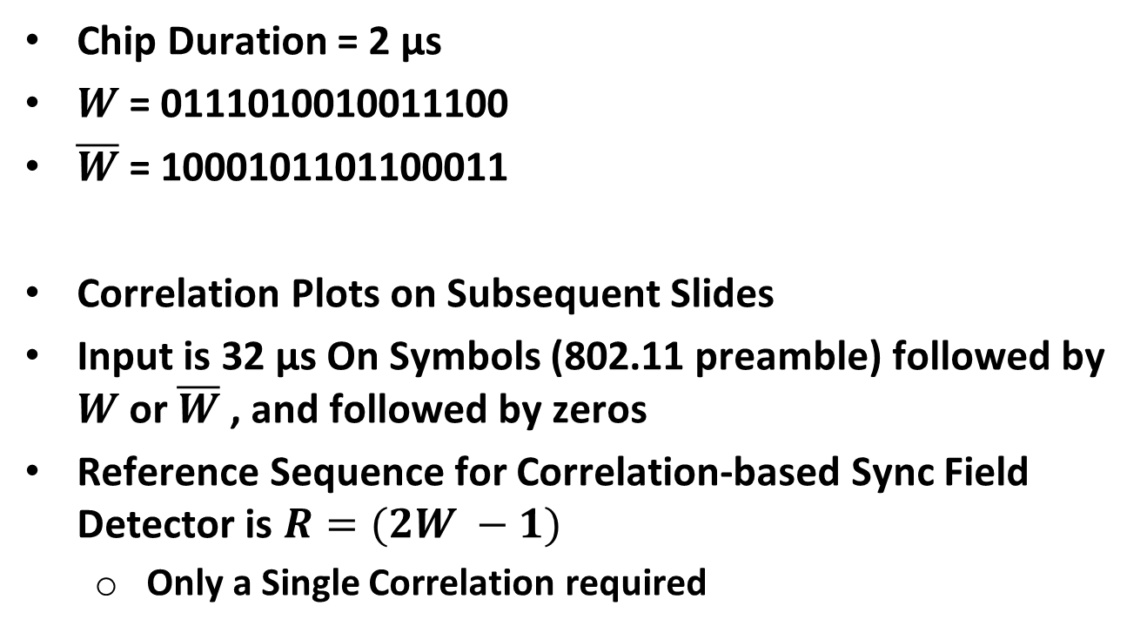
Alternate Sync Field Design (Length 16 Chips)
Chip Duration = 2 µs
$W$ = 0111010010011100
$\overline{W}$ = 1000101101100011
Correlation Plots on Subsequent Slides
Input is 32 µs On Symbols (802.11 preamble) followed by $W$ or $\overline{W}$ , and followed by zeros
Reference Sequence for Correlation-based Sync Field Detector is $R=(2W −1)$
  Only a Single Correlation required

Slide 27
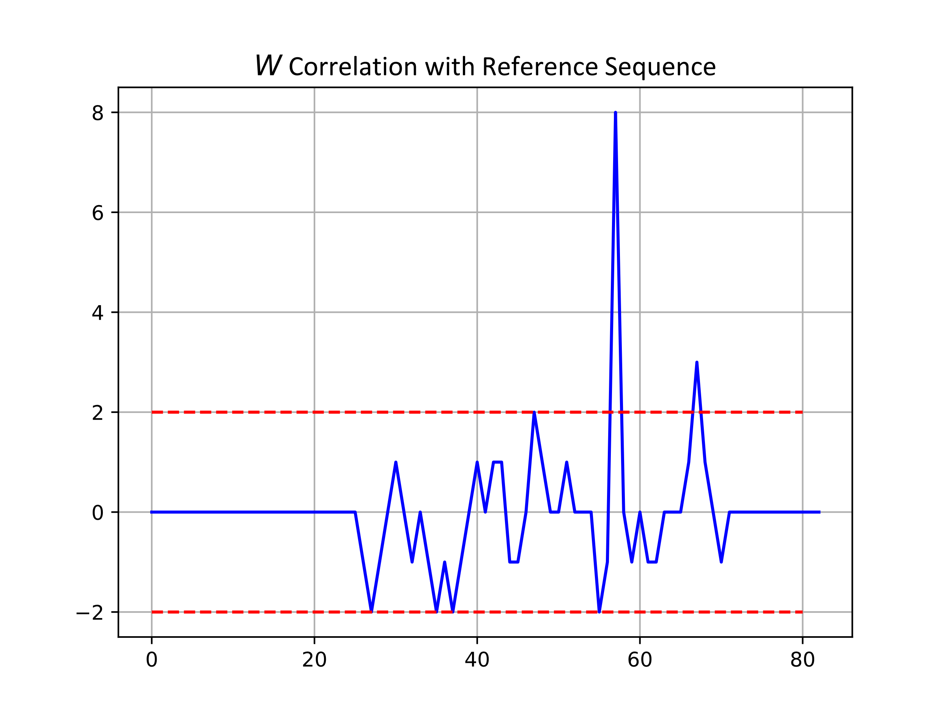

Correlation Plots – Correlation-Based Sync Field Detector
Main Peak = 8
Maximum Positive Peak before Main Peak = 2
Minimum Negative Peak before Main Peak = $−2$

Slide 28
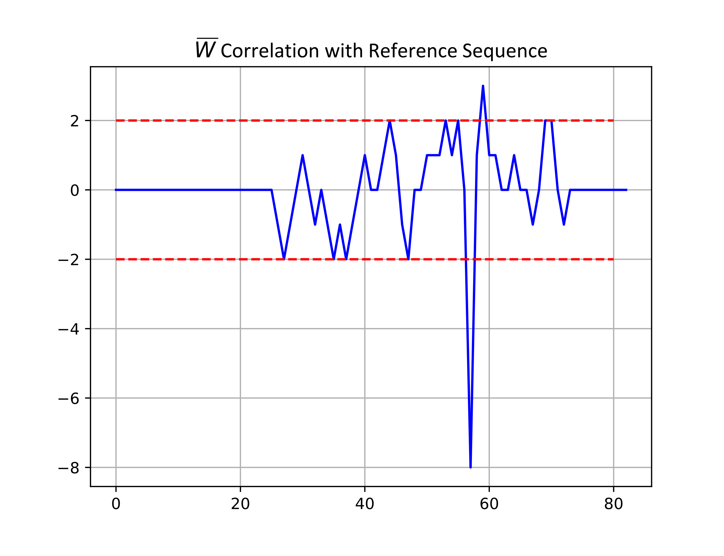

Correlation Plots – Correlation-Based Sync Field Detector
Main Peak = $−8$
Maximum Positive Peak before Main Peak = 2
Minimum Negative Peak before Main Peak = $−2$

Slide 29
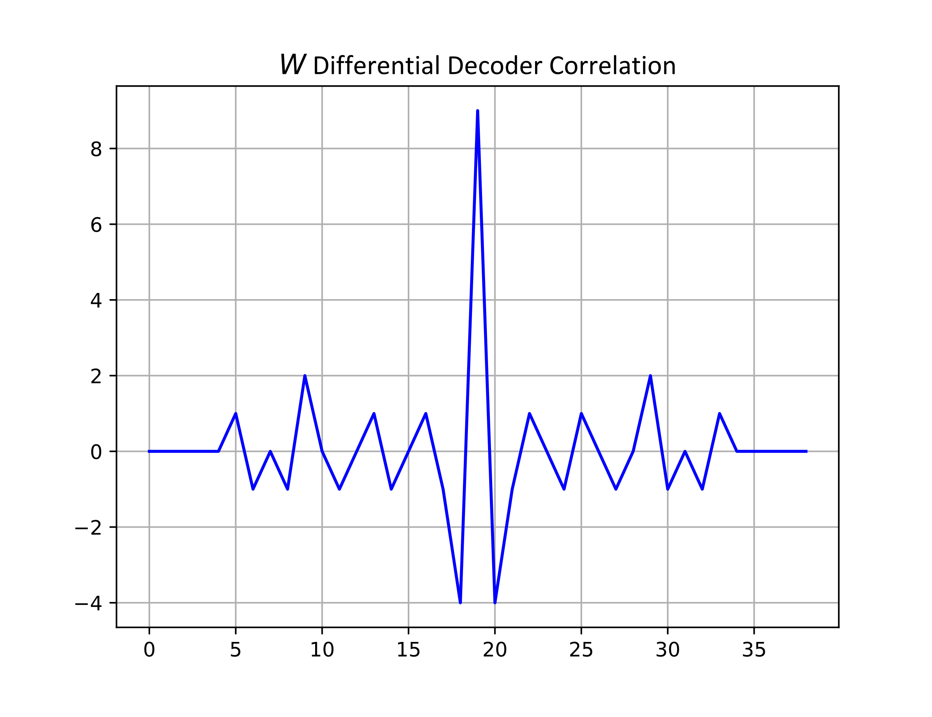
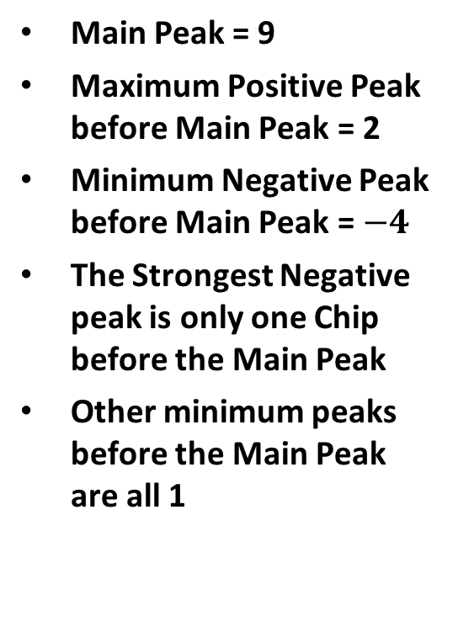
Correlation Plots – Differential Decoder Sync Field Detector
Main Peak = 9
Maximum Positive Peak before Main Peak = 2
Minimum Negative Peak before Main Peak = $−4$
The Strongest Negative peak is only one Chip before the Main Peak
Other minimum peaks before the Main Peak are all 1

Slide 30
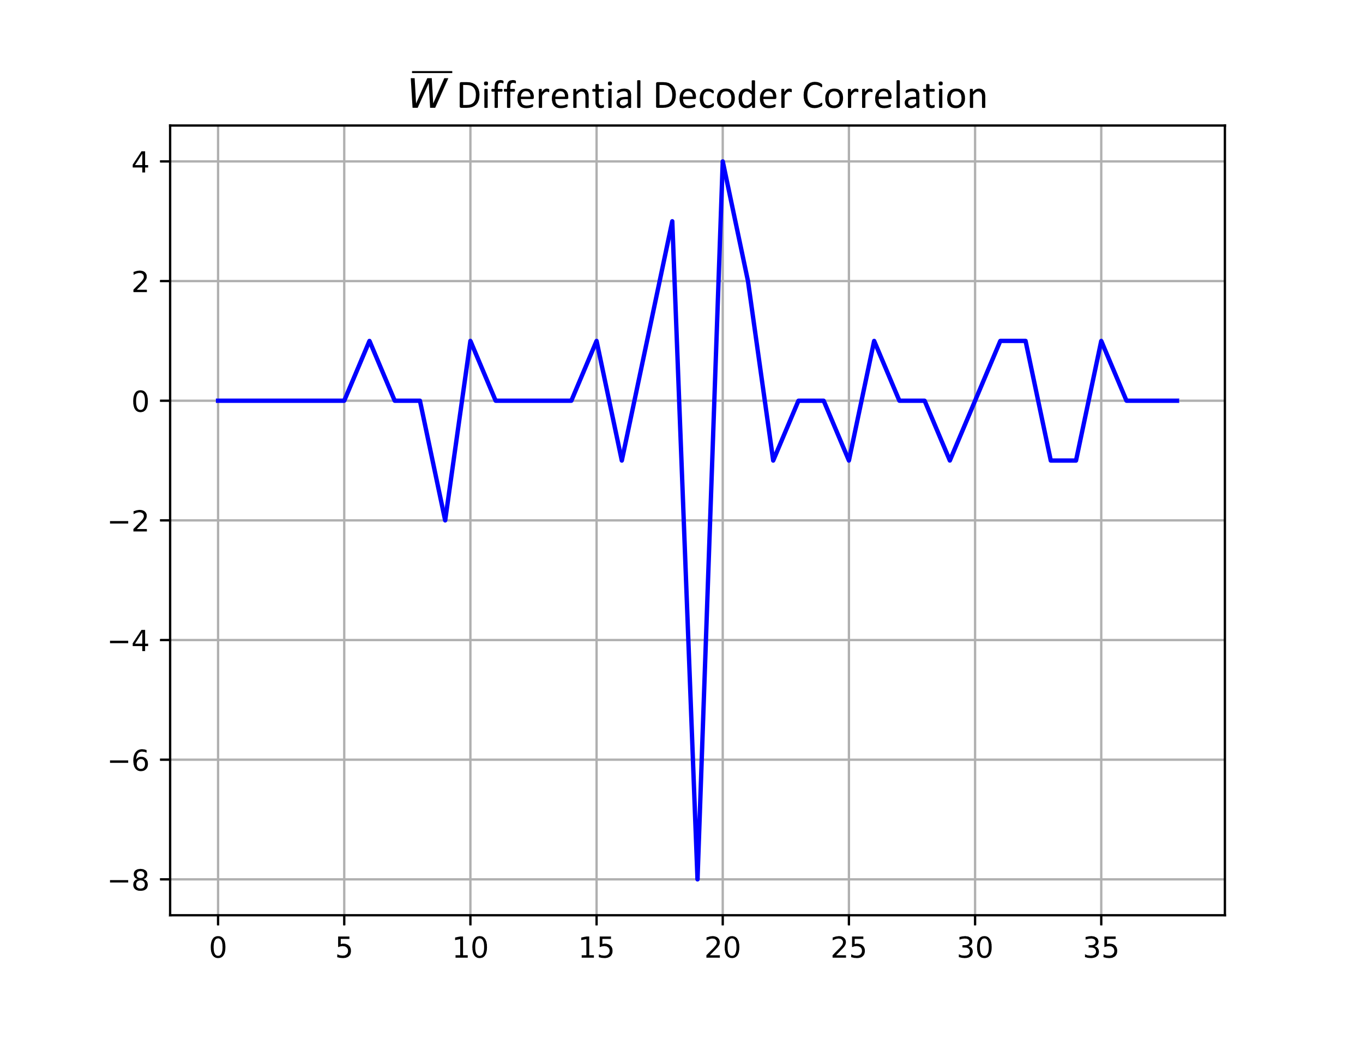
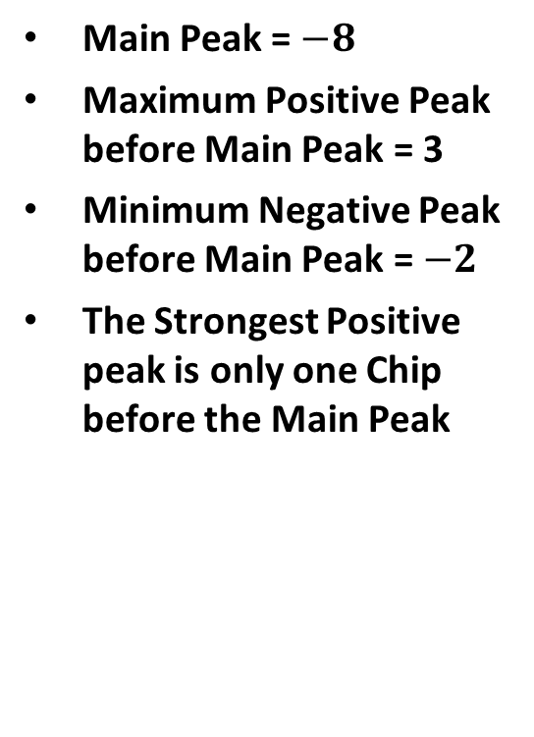
Correlation Plots – Differential Decoder Sync Field Detector
Main Peak = $−8$
Maximum Positive Peak before Main Peak = 3
Minimum Negative Peak before Main Peak = $−2$
The Strongest Positive peak is only one Chip before the Main Peak

