Slide 1
Two AMP Downlink Sync Field Detectors
Date: 2025-07-27
Authors:
Name | Affiliations | email
Steve Shellhammer | Qualcomm | shellhammer@ieee.org
Bin Tian |  | btian@qti.qualcomm.com
Pooria Pakrooh |  | ppakrooh@qti.qualcomm.com
Manideep Dunna |  | mdunna@qti.qualcomm.com
Alice Chen |  | alicel@qti.qualcomm.com

Slide 2
Introduction
Here we discuss Two possible AMP Downlink Sync Field Detectors that can be implemented in a non-Backscatter STA

Slide 3
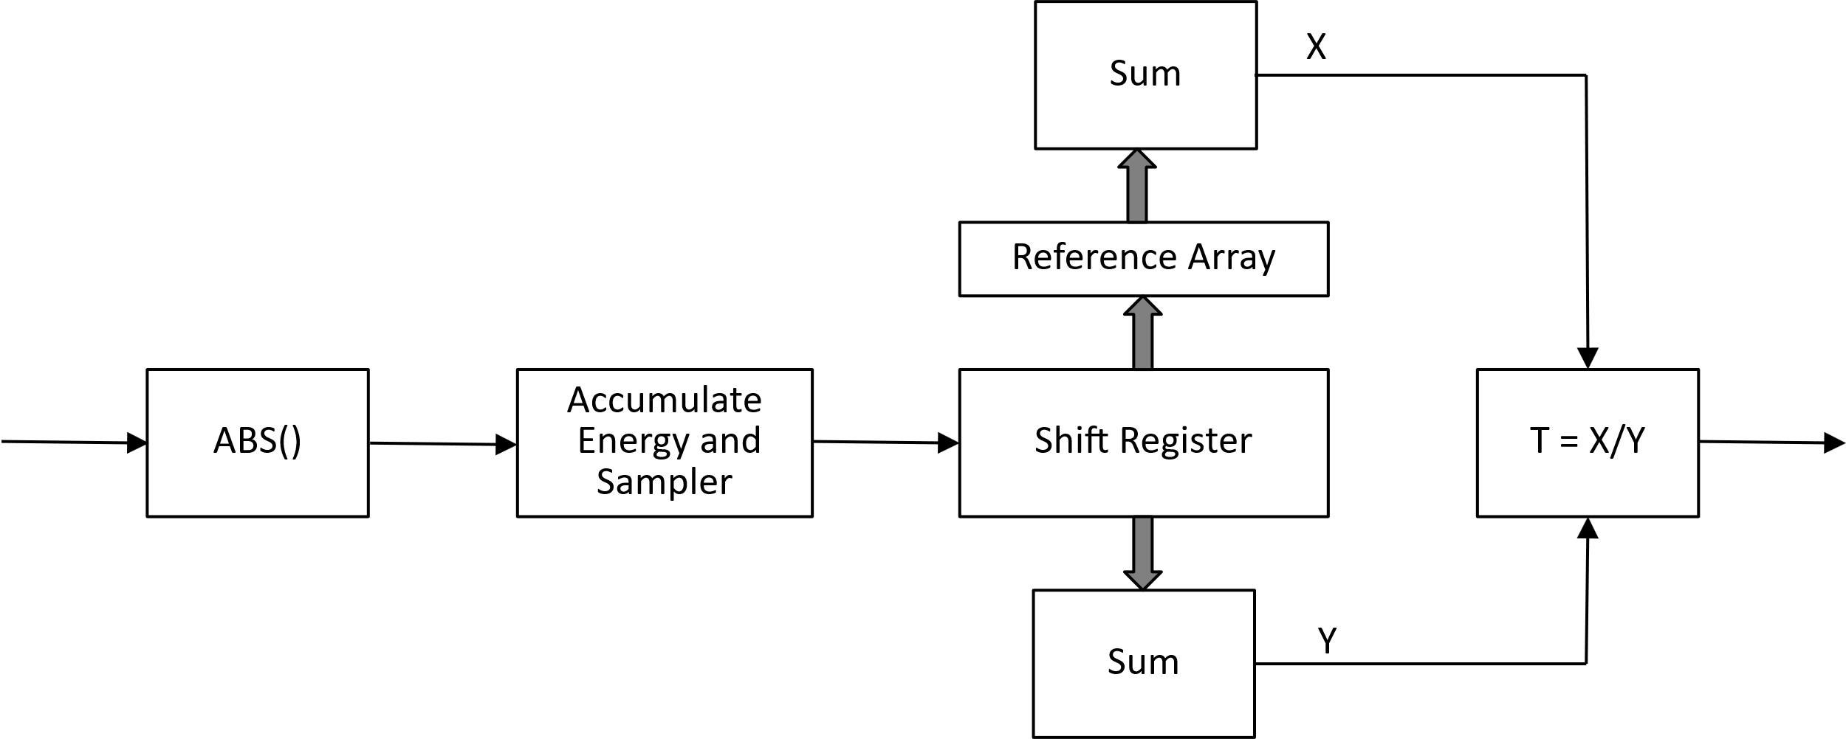
Correlation-based Sync Field Detector
This Sync Field Detector has been considered by multiple people and seems to be well understood

Slide 4
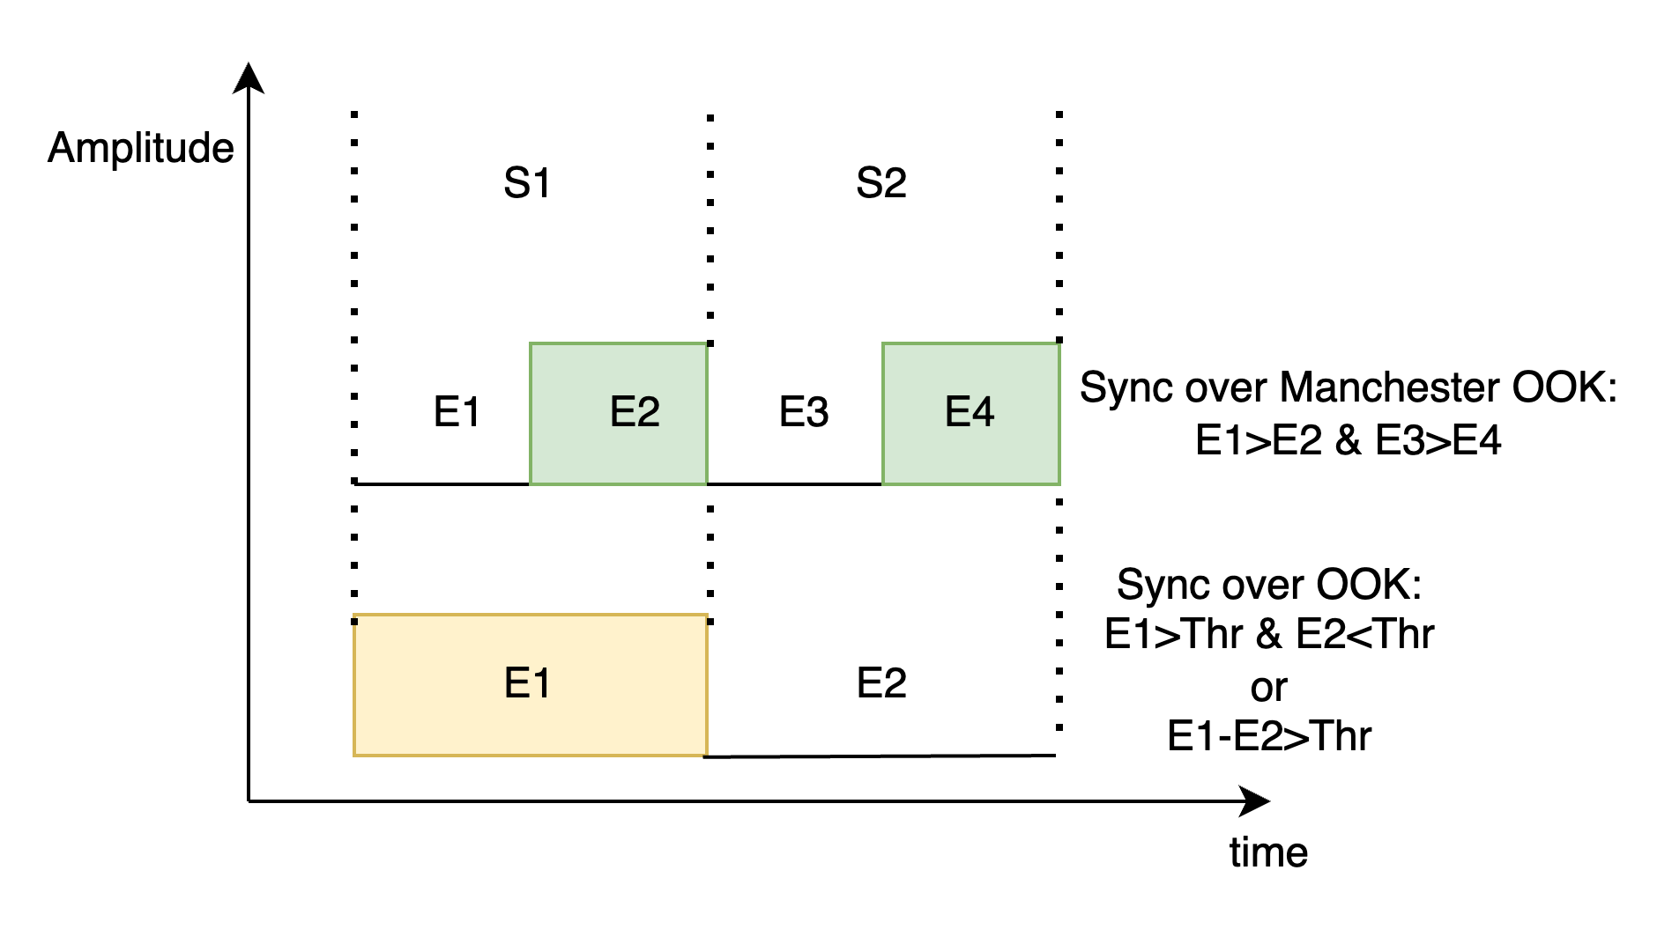
Alternative Sync Field Detector
Another Downlink Sync Field Detector was suggested in [1]
This Sync Field Detector captures energy over two periods of time and saves that energy value on an analog circuit (e.g., a capacitor)
It then can compare the energy in the first time period (e.g., E1) with the energy in the second time period (e.g., E2)

Slide 5
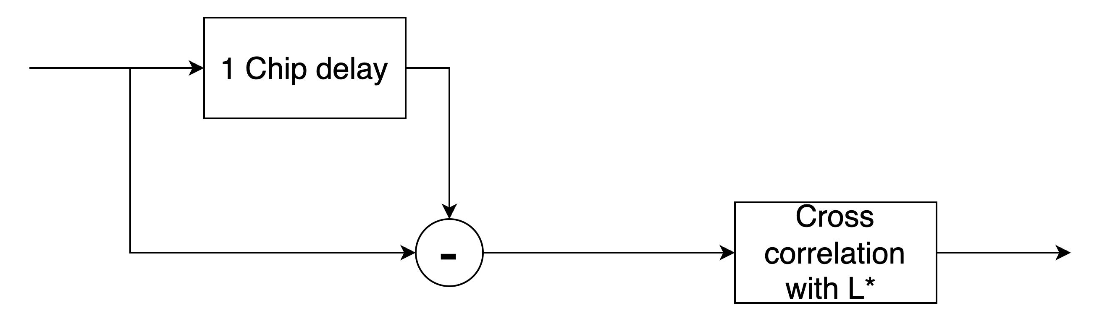
Alternative Sync Field Detector
In [2] it was proposed that the Sync Field be constructed using a Manchester-encoded Sequence
The following figure showed how the current Chip Energy is compared to the previous Chip Energy
The complexity of this Sync Field Detector is less than the Correlation-based Sync Field Detector
No ADC is required
The Chip energy comparison can be done with simple Analog circuits and then we have a stream of bits which are easy to process

Slide 6
Generalization of Concept in [1] and [2]
Restricting the Sync Field Sequence to be a Manchester-encoded sequence, as in [1] and [2], is quite restrictive
However, it we observe that the proposed detector is based on a Differential Decoder, we can generalize this Concept to a Differential Decoder Sync Field Detector

Slide 7
Chip Level Differential Decoder
Input Stream is a sequence of Zeros and Ones
Differential Decoding:
Previous Chip | Current Chip | Decoded Result | Comments
1 | 0 | 0
0 | 1 | 1
0 | 0 | X | Result Uncertain
1 | 1 | X | Result Uncertain
Example
  Input Sequence = 0001101010110110
  Differential Decoded Sequence = XX1X010101X01X0
  Here we are using Notation from [3]

Slide 8
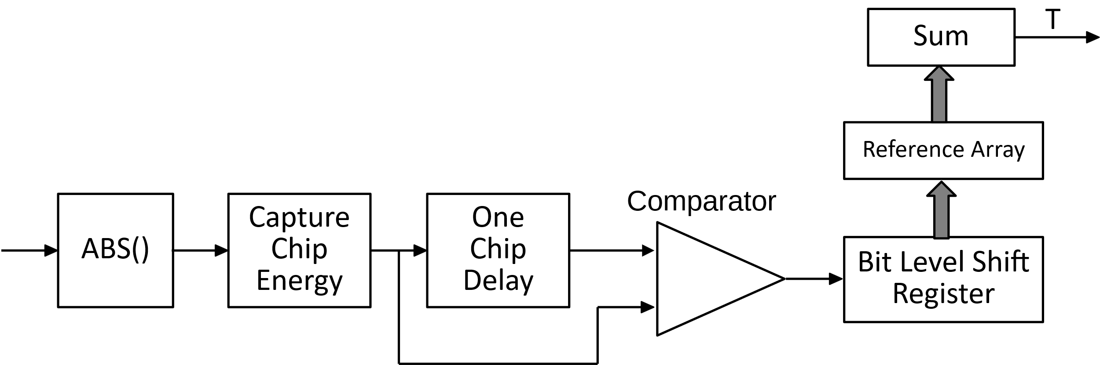
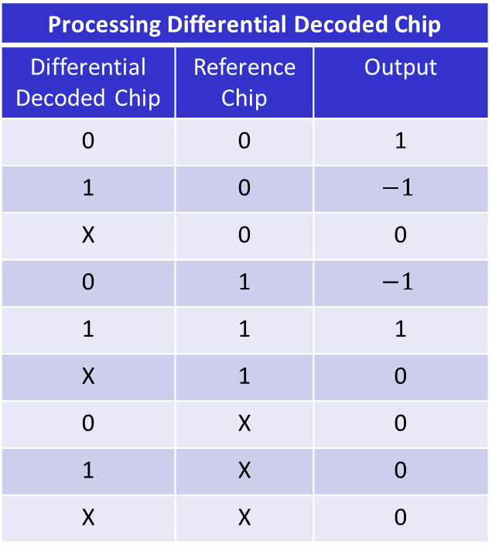
Differential Decoder Sync Field Detector
Processing Differential Decoded Chip
Differential Decoded Chip | Reference Chip | Output
0 | 0 | 1
1 | 0 | $$−1$$
X | 0 | 0
0 | 1 | $$−1$$
1 | 1 | 1
X | 1 | 0
0 | X | 0
1 | X | 0
X | X | 0

Slide 9
Proposal
We propose to design the Downlink Sync Field so that it can be detected by either a Correlation-Based Sync Field Detector or a Differential Decoder Sync Field Detector
There are advantages to each of these Sync Field Detectors
  Correlation-based Sync Field Detector can work at low SNR
  The Differential Decoder Sync Field Detector is lower complexity, and it expected to require lower power consumption
This gives the Implementer the option of which Sync Field Detector to implement

Slide 10
Summary
We summarized the Correlation-based Sync Field Detector
We reviewed the Sync Field Detector proposed in [1] and [2]
We introduced a generalization of the Sync Field Detector proposed in [1] and [2], which we call the Differential Decoder Sync Field Detector
We Proposed to design the Downlink Sync Field to support both Sync Field Detectors
  Correlation-Based Sync Field Detector
  Differential Decoder Sync Field Detector

Slide 11
Straw Poll #1
Do you agree to add the following content to the 802.11bp SFD?
  The AMP Downlink Sync Field Chip Sequence, transmitted to a non-backscatter STA, shall support both a Correlation-based Sync Field Detector and a Differential Decoder Sync Field Detector

Slide 12
References
Amichai Sanderovich, et. al., “Considerations For Sync Sequence Selection,” IEEE 802.11-24/1982r0, December 2024
Amichai Sanderovich, et. al., “An Analysis of SYNC Field for Downlink PPDU,” IEEE 802.11-25/705r0, May 2025
Bin Qian, et. al., “Discussions on DL Sync Field for Non-Backscatter STAs: Part II,” IEEE 802.11-1249r0, July 2025

