Slide 1
AMP Downlink Special Segment
Date: 2025-07-27
Authors:
Name | Affiliations | email
Steve Shellhammer | Qualcomm | shellhammer@ieee.org
Bin Tian |  | btian@qti.qualcomm.com
Pooria Pakrooh |  | ppakrooh@qti.qualcomm.com
Manideep Dunna |  | mdunna@qti.qualcomm.com
Alice Chen |  | alicel@qti.qualcomm.com

Slide 2
Introduction
We look at the Downlink Sync Field Detector False Alarms due to reception of a Data Field, which could be transmitted to another STA, and could be in a different channel
  It is expected that non-Backscatter STAs will receiver over the full 2.4 GHz band
Then we look at the idea of a Special Segment, at the end of the Downlink Sync Field, transmitted to non-Backscatter STAs
We show one example of how a Special Segment can be used to reduce False Alarms rate when receiving a Data Field

Slide 3
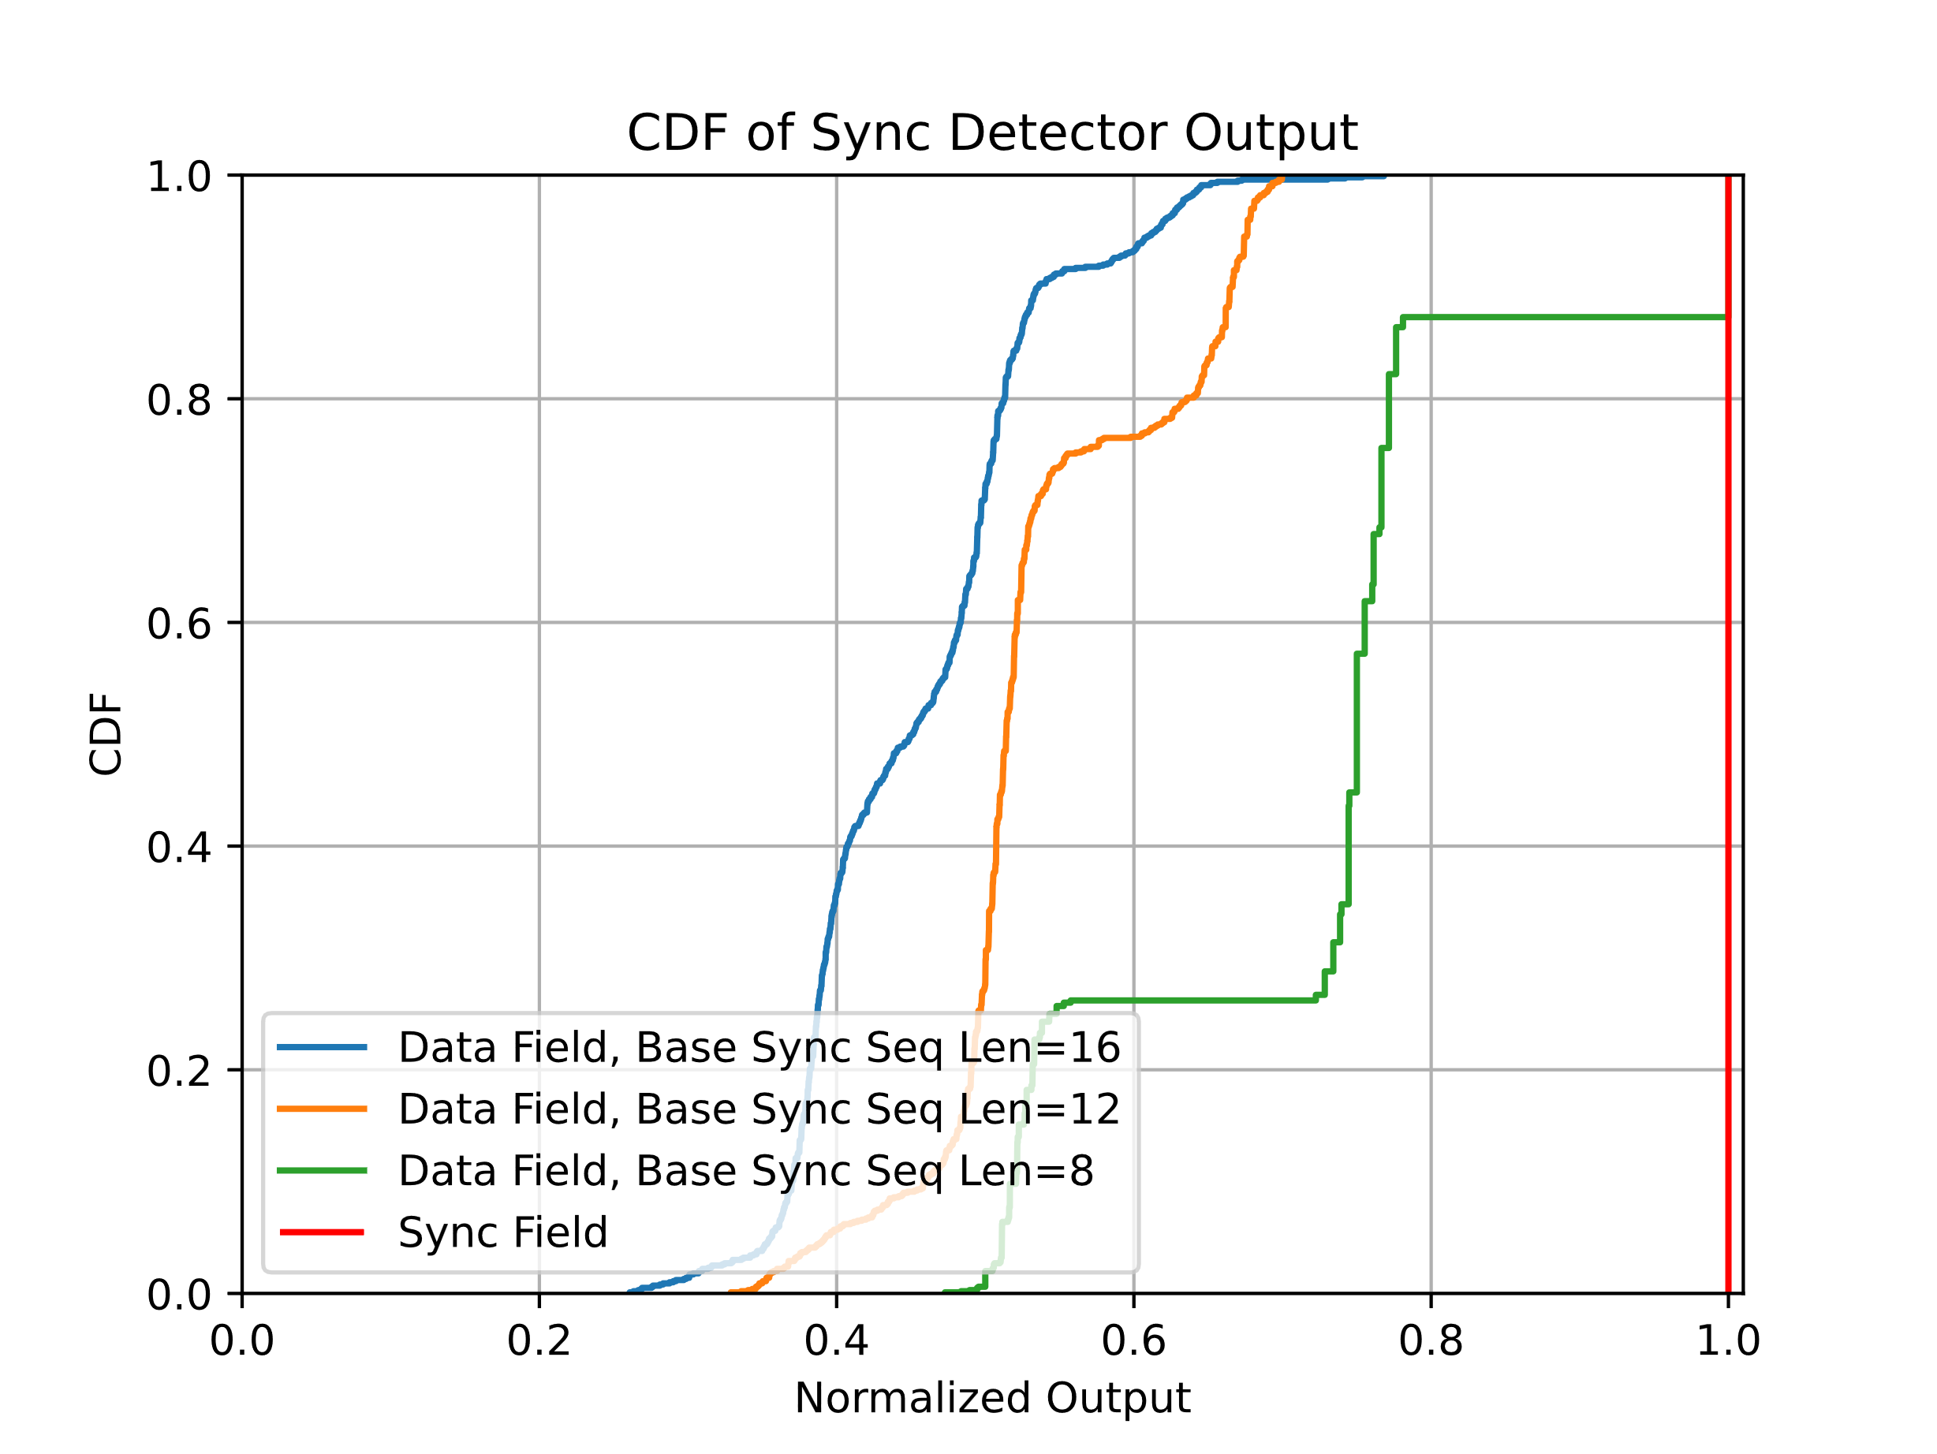
Background
Plot from [1]
We see that Sync Field Detector, with the Data Field as an input, has large outputs typically significantly larger than the Detector Threshold (typically set for low False Alarm rate in Noise)
There is a high likelihood that if a STA wakes up during a Downlink Data Field, the Sync Detector will trigger, generating a False Alarm

Slide 4
Background
Suggested in [2] for backscatter Uplink Sync Field a Special Segment is appended to the end of the Sync Field
The Special Segment is intended to distinguish from a Manchester-encoded sequence

Slide 5

Special Segment
We propose to add a Special Segment at the end of the Downlink Sync Field transmitted to non-Backscatter STAs
When the Sync Field Detector matched the Sync Field it would next check for the Presence of a Special Segment
The Special Segment would be designed to distinguish it from the Data Field, which is Manchester Encoded

Slide 6
Example Special Segment
Here we append Three 2 µs On Symbols at the end of the Sync Field
  Note, this is just an example. The actual structure of the Special Segment is TBD.
As an Example in these slides, before the Special Segment, we will use a 16-Chip sequence where each Chip has a duration of 2 µs
We will suggest one method that can be used to reduce the False Alarm Rate, while having an acceptable impact on the Sync Field Detection curve, when the Sync Field is received
Here we will focus on the 250 kb/s Downlink Data Field

Slide 7
Possible Special Segment Test
After Detecting the 16-Chip Sequence we calculate the average value of the samples during the 16-Chip Sequence (this is half of Y in the Correlation-based Sync Field Detector, and hence is easy to calculate)
We use that threshold to detect each of the Three 2 µs Symbols in the Special Segment
  If greater than the threshold it is a One, else it is a Zero
If all Three 2 µs Symbols in the Special Segment are detected as Ones, then the Special Segment is Present, if not then the Special Segment is not Present
If the Special Segment it detected then the Sync Field detection is valid, if not it is not a valid Sync Field detection

Slide 8
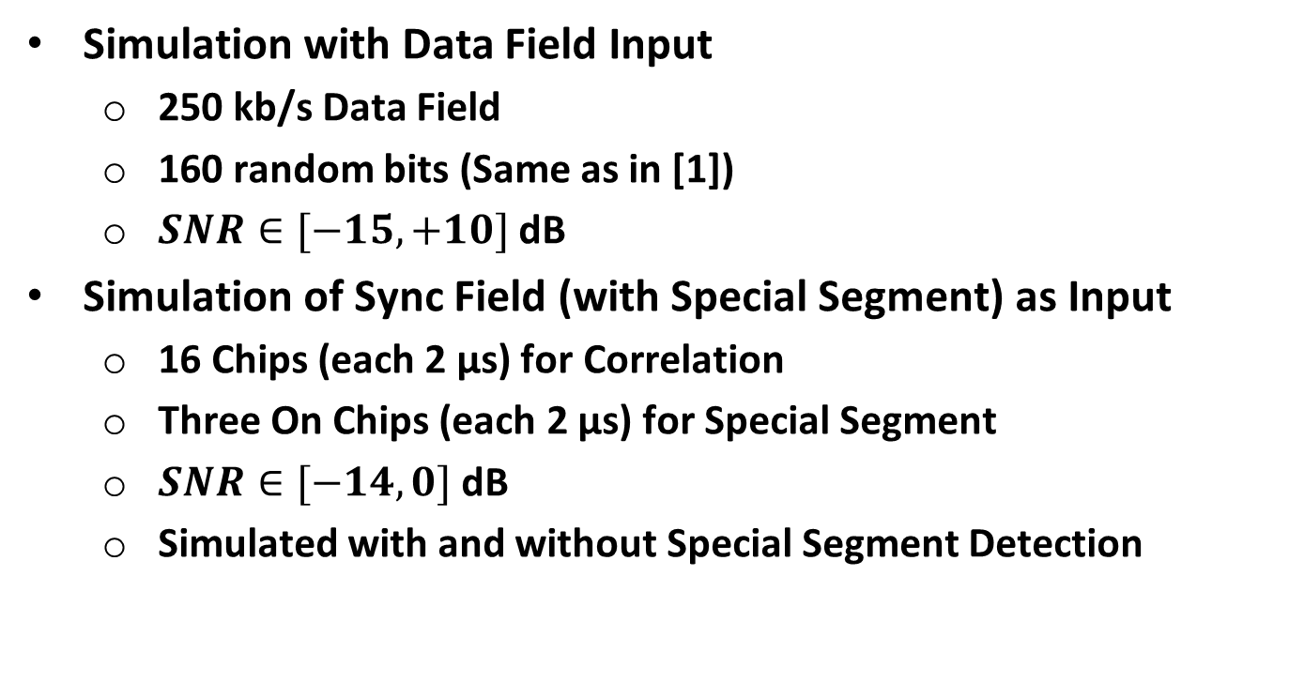
Simulation
Simulation with Data Field Input
  250 kb/s Data Field
  160 random bits (Same as in [1])
  $SNR∈[−15, +10]$ dB
Simulation of Sync Field (with Special Segment) as Input
  16 Chips (each 2 µs) for Correlation
  Three On Chips (each 2 µs) for Special Segment
  $SNR∈[−14, 0]$ dB
  Simulated with and without Special Segment Detection

Slide 9
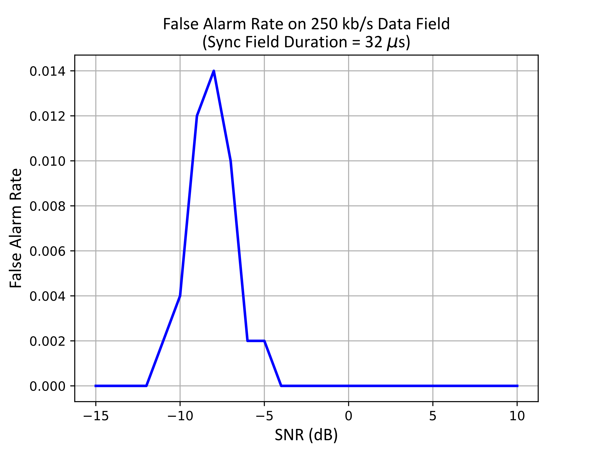
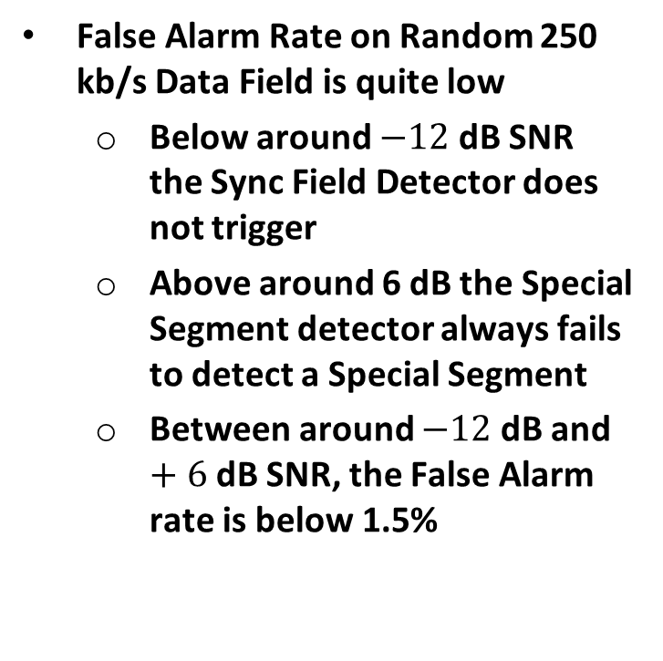
False Alarm Rate of 250 kb/s Data Field
False Alarm Rate on Random 250 kb/s Data Field is quite low
  Below around $−12$dB SNR the Sync Field Detector does not trigger
  Above around 6 dB the Special Segment detector always fails to detect a Special Segment
  Between around $−12$dB and $+6$dB SNR, the False Alarm rate is below 1.5%

Slide 10
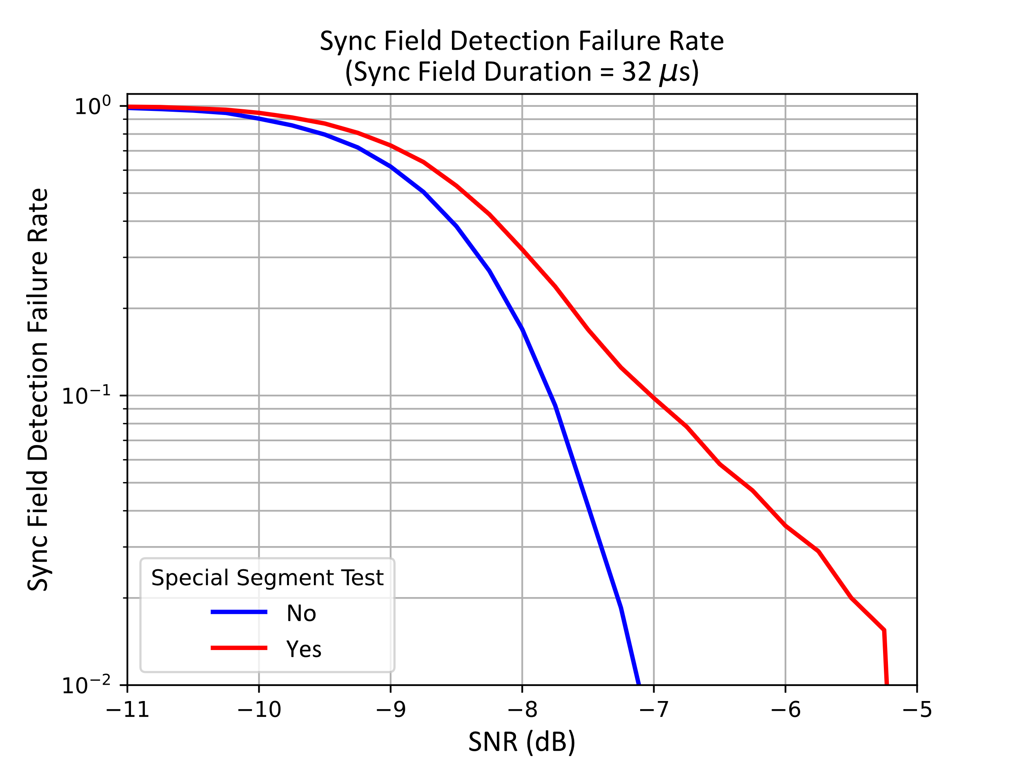
Effect of Special Segment Detection on Sync Field Detection
The addition of the Special Segment Detection increases the Required SNR by less than 1 dB

Slide 11
Next Steps
Currently investigating how to reduce the False Alarm Rate for the 1 Mb/s Data Field
Need to identify a harmonized method to reduce False Alarm Rate for both data rates

Slide 12
Straw Poll #1
Do you agree to add the following content to the 802.11bp SFD?
  The Downlink Sync Field transmitted to a non-Backscatter STA consists of two Segments
    The first Segment is a Chip Sequence designed to support Sync Field Detection and Timing alignment
    The second Segment is a “Special Segment” which is designed to distinguish it from an AMP Data Field (both 250 kb/s and 1 Mb/s) and reduce the False Alarm rate

Slide 13
References
Bin Qian, et. al., “Further Discussion on Downlink Sync Field Design,” IEEE 802.11-25/315r1, March 2025
Rui Cao, et. al., AMP Backscattering PPDU and SYNC Design, IEEE 802.11-25/306r0, March 2025

