Slide 1
Downlink Backscatter SYNC Field Design
Date: 2025-07-28
Authors:
Name | Affiliations | Email
Manideep Dunna | Qualcomm | mdunna@qti.qualcomm.com
Steve Shellhammer |  | sshellha@qti.qualcomm.com
Alice Chen |  | alicel@qti.qualcomm.com
Bin Tian |  | btian@qti.qualcomm.com

Slide 2
Background
For Monostatic backscatter, the AMP devices are close to the reader
  AMP reader sends excitation signal at 0 dBm
  The AMP tag is close to the reader and the received signal power at the AMP device is around -26 dBm
  The SNR at the AMP tag (> 50 dB) is very high and hence a simple receiver based on envelope detector and comparator can be used on the downlink

Slide 3
Downlink Receiver Architecture
AMP backscatter device require a very low power receiver because they use harvested energy for their operation
RF signal
Envelope Detector
Binary waveform
Thresholding circuit
Comp
arator
An integrator(low-pass filter) is used to compute the average power and set the dynamic threshold
Backscatter Downlink uses 2 us chips. The binary waveform is expected to be sampled at 2MHz rate on the tag to have 4 samples per chip

Slide 4
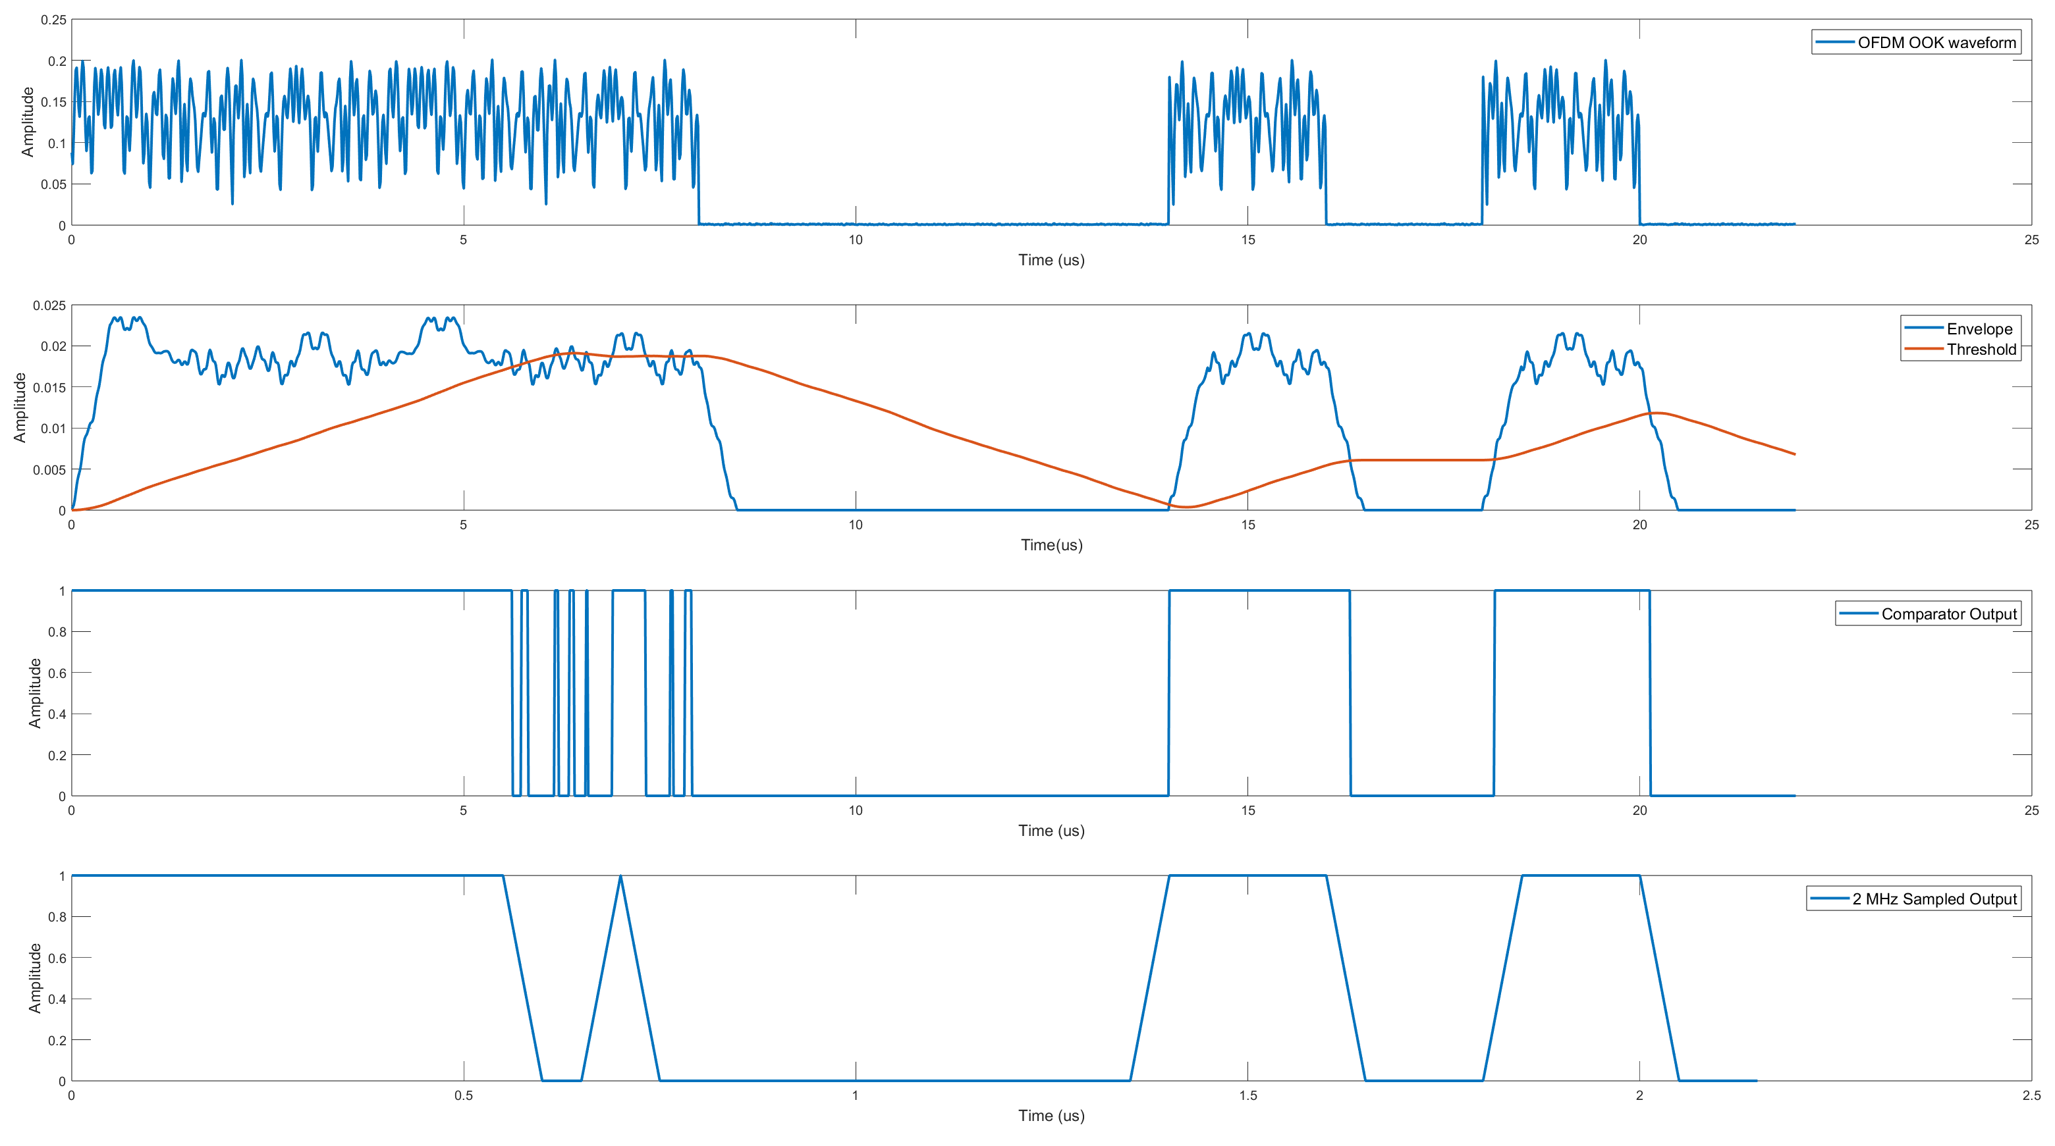
Working of Low Power Receiver
0 0 0 1 0 1 0
Thresholder settling to zero
at the beginning
Thresholder has a memory of three chips in this simulation

Slide 5
AMP SYNC Field Design considerations
AMP Downlink PPDU has excitation signals prior to the SYNC field so that the tags can harvest energy before SYNC detection
There is an advantage starting the SYNC sequence with an OFF-period delimiter so that thresholder/integrator output settles to a small value
Max OFF period permitted is 6 us i.e. 3 chips of zeros
  RFID tags use 12.5 us OFF delimiter[1]. Based on this, we can safely utilize the same RFID energy storage capacitor in AMP tags without losing power during the proposed 6 us OFF duration

Slide 6
AMP SYNC Field Design considerations(cont’d)
Following the OFF period, having at least one HIGH to LOW transition help establish the mean level of the signal and the DATA field timing
  A Manchester sequence can be used to establish the mean level of the signal
  Initial 3 chip OFF delimiter provides a Manchester violation to reduce the False alarms
[2] proposes an 8-bit SYNC sequence [0 1 1 1 1 1 0 1]. Shorter SYNC sequences are possible

Slide 7
Proposed SYNC sequences
Start with multiple zeros at the beginning, and follow it a sequence with equal number of ON and OFF chips for threshold estimation
[0 0 0 1 0] and [0 0 0 1 0 1 0] are both good candidate sequences
Proposed SYNC structure:
OFF DELIMITER
Manchester Sequence starting with 1

Slide 8
Conclusion
Demonstrated low power receiver operation for Downlink backscatter
Proposed length-5 and length-7 SYNC sequences that start with an OFF period followed by Manchester sequences

Slide 9
References
EPC Gen 2 RFID standard, “https://ref.gs1.org/standards/gen2/”
Rui Cao et.al., “Further Thoughts on AMP DL PPDU for Monostatic Backsattering,” IEEE 802.11-23/0075r2, January 2025

Slide 10
SP #1
Do you agree to add the following text to 11bp SFD?
  AMP Backscattering Downlink SYNC sequence starts with an OFF delimiter

Slide 11
SP #2
Do you agree to add the following text to 11bp SFD?
  The OFF delimiter is followed by a Manchester encoded sequence starting with ON chip in the AMP Backscattering Downlink SYNC sequence

