Slide 1
SYNC Design for AMP Active Transmission
Date: 2025-07-18
Authors:
Name | Affiliations | Address | Phone | email
Alice Chen | Qualcomm Technologies Inc. |  |  | alicel@qti.qualcomm.com
Steve Shellhammer |  |  |  | shellhammer@ieee.org
Manideep Dunna |  |  |  | mdunna@qti.qualcomm.com
Bin Tian |  |  |  | btian@qti.qualcomm.com
Pooria Pakrooh |  |  |  | ppakrooh@qti.qualcomm.com

Slide 2
Introduction
It is desirable to have a single design in Data field for each data rate
We proposed to use FEC for the Data field for 250kbps and 1Mbps in [1] to make Data field more reliable
  4Mbps is TBD but w/o FEC
We also discussed the sync field duration and structure in [1]
  Suggest to use a same length-32 sequence for different data rates, or alternatively, use a length-16 base sequence and derive longer sequences through repetition
In this presentation, we discuss more on the SYNC field design for active transmission, assuming using FEC for the Data field for 250kbps and 1Mbps in [1]
  SYNC field design
  Timing estimate and performance

Slide 3
SYNC Field Design
Assume same chip duration for both SYNC and Data fields
Propose to use a same length-32 sequence for different data rates
  SYNC field duration scaled according to chip duration
  Fixed SYNC overhead for given payload size
Sequence design criteria
  Equal number of 1s and 0s
  Starting with 1
  No more than 7 consecutive 0s (for max 1us chip duration)
  Minimize the sidelobe(s) before the main peak
  Minimize the width of the main lobe
Sidelobes before main peak

Slide 4
Proposed Length-32 SYNC Sequence
S₃₂ = [1 1 1 1 1 0 1 0 1 0 1 1 0 0 1 0 0 1 0 1 1 0 0 0 1 1 0 0 0 1 0 0]
Reference signal: X = 2*S-1
The sidelobes before the main peak have value ≤ -1
The main lobe width is within [-1, +1] chip relative to the main peak

Slide 5
Timing Estimate
A packet is detected if at least one correlator output exceeds threshold
  Threshold is determined by 1% false alarm (by pure noise)
The main peak timing is identified from correlation
  If the timing is outside of [-25%, +25%] chip duration from the main peak, it is considered a timing error
1st timing: the timing of the 1st correlator output exceeding threshold
  Sidelobes and wide main lobe may trigger 1st timing before the main peak
Proposed a practical estimated main peak algorithm: search for the timing of the maximum correlator output within a period of time starting from the 1st timing
  Consider [1 chip duration, 2 chip duration, 4 chip duration, …, length of sequence] as the period of time
Genie main peak: the timing of the maximum correlator output
  Used for comparison

Slide 6
Timing Estimate: 1us Chip Duration
With the proposed length-32 sequence, the practical estimated main peak with 1 chip duration as the period of time is as good as the genie main peak

Slide 7
Timing Estimate: 0.25us Chip Duration
With the proposed length-32 sequence, the practical estimated main peak with 1 chip duration as the period of time is as good as the genie main peak

Slide 8
Performance And Overhead Tradeoff
With a length-32 sync sequence, the SYNC field duration is 32us for 250kbps and 8us for 1Mbps. The overhead ratio is acceptable
  6.25% with 16 octets payload; 4.17% with 24 octets payload
  Same overhead as the no FEC case with a length-16 sync sequence
In our analysis [1], longer SYNC field duration can further improve SYNC+Data performance with FEC
  We’re fine with using a length-32 sync sequence, Data performance with FEC is still more robust compared to without FEC
In case even longer sync sequence is preferred, an alternative SYNC field design is to use a length-16 base sequence S₁₆, and derive longer sync sequences through repetition of [S₁₆ … S₁₆]

Slide 9
Example Length-16 SYNC Base Sequences
S_{16,1} = [1 1 1 1 0 0 1 0 0 1 0 1 0 1 0 0]
S_{16,2} = [1 1 1 1 1 0 0 0 1 0 1 0 0 1 0 0]
The sidelobes before any main peak have values ≤0
The width of the first half of each main lobe is within [-1,0] chip relative to its main peak
The sequences could also be used as standalone length-16 sync sequences without repetition, if FEC is not used
S_{16,1}
S_{16,2}

Slide 10
Brief Discussion on Timing Drift
No need to consider timing drift estimation in the SYNC field design in active transmission
  The numbers of samples for 1Mbps and 4Mbps are not large enough to estimate ±0.1% timing drift (for ±1kppm)
  Example: For 1Mbps, with a length-64 sync sequence of [S₁₆ S₁₆ S₁₆ S₁₆] (i.e., 16us SYNC field duration) and 40MHz sampling rate, the number of samples between the first and last main peaks is 48*0.25*40=480
Timing drift could be estimated and corrected by tracking loop in data processing
Discussion: if in all practical implementations, the frequency and timing clocks are derived from the same reference
  If the answer is yes, timing error could be further corrected based on frequency offset

Slide 11
Summary
Suggest to use FEC for 250kbps and 1Mbps to make Data field performance much more reliable
  FEC implementation at Tx side is very simple and almost 0 cost
Suggest to use a length-32 sync sequence for different data rates
  Our proposed sync sequence has good correlation properties

Slide 12
Reference
11-25/1215r0, Discussion on AMP Active Transmission, Alice Chen, et al.
11-25/0862r0, Discussion on uplink sync field design for active transmitters, Bin Qian, et al.

Slide 13
SP 1
Do you agree to add the following to the 11bp SFD:
  In AMP UL active transmission in 2.4 GHz, the AMP-Sync field uses a length-32 sync sequence for all data rates
    The AMP-Sync field and AMP-Data field use same chip duration for each data rate
    Note: The AMP-Sync field duration is scaled according to the chip duration of each data rate

Slide 14
appendix
More details

Slide 15
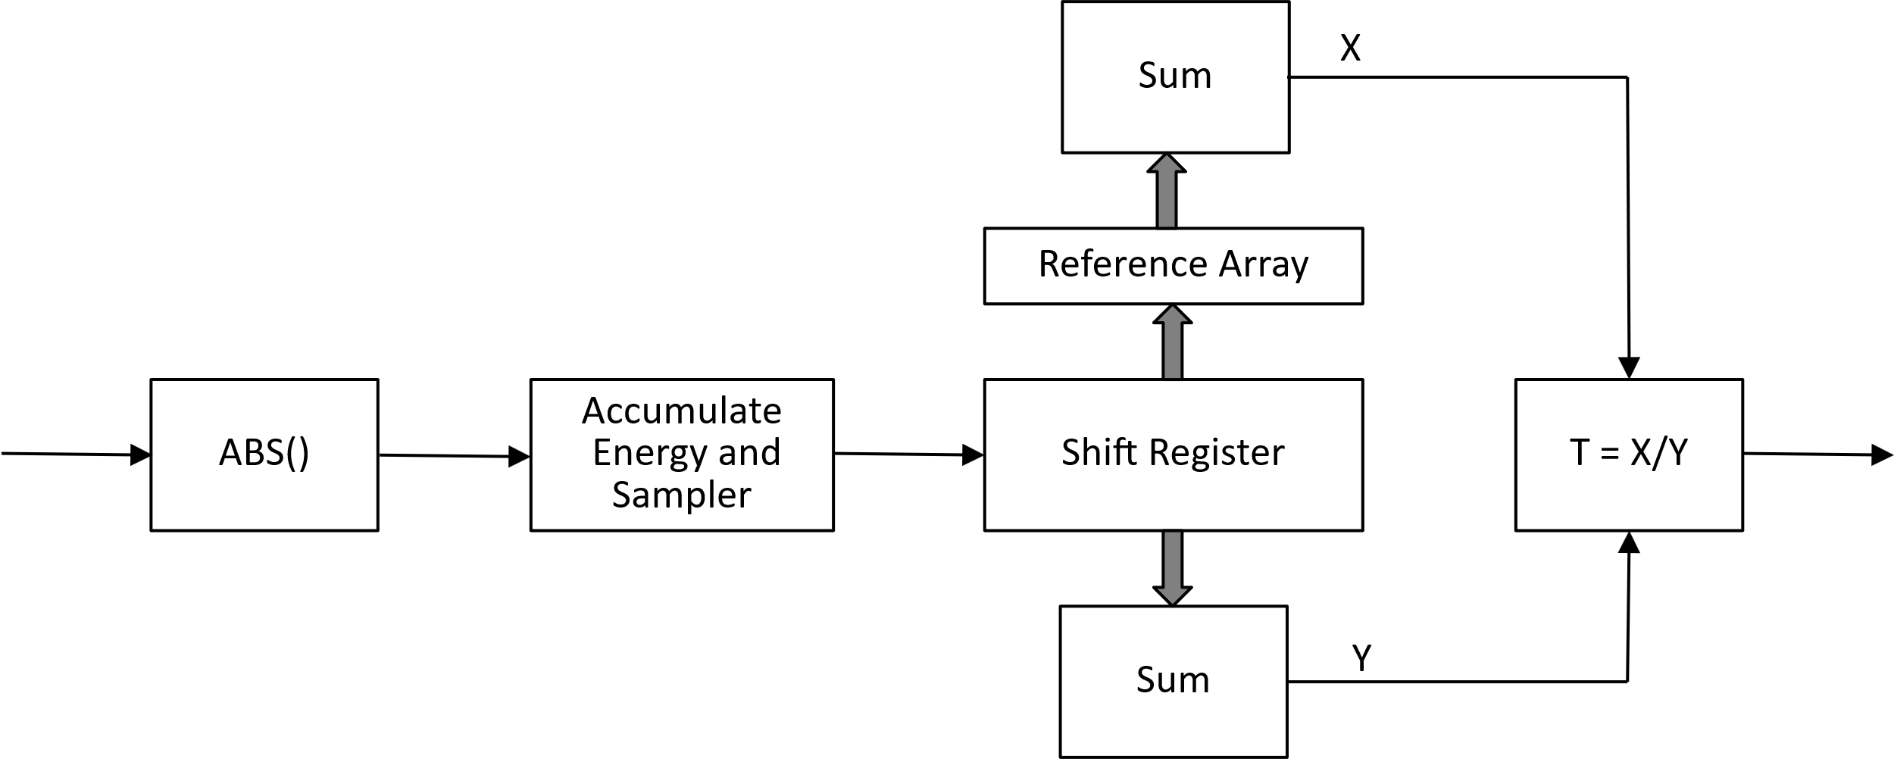
SYNC Detector
Correlation-based Sync Field Detector

Slide 16
Summary of SYNC Field Length Study
Plots in Appendix in [1]
Rows in black (resp. blue) are applicable to Data field w/o FEC (resp. w/FEC)
Case A: With 20MHz filter
Case B: With narrow BW filter
Data Rate | Chip Duration | BCC | Noise BW | Receiver | SNR(dB)@10%PER | Min Sync Sequence Length for 16us Gap Period | SYNC Field Duration
250kbps | 2us | N/A | 20MHz | Non-coherent | -3.4 | 16 | 32us
250kbps | 1us | 1/2 | 20MHz | Non-coherent | -5.8 | 48 | 48us
1Mbps | 0.5us | N/A | 20MHz | Non-coherent | 0.5 | 16 | 8us
1Mbps | 0.25us | 1/2 | 20MHz | Non-coherent | -2.3 | 64 | 16us
4Mbps | 0.125us | N/A | 20MHz | Non-coherent | 4.5 | 28 | 3.5us
Data Rate | Chip Duration | BCC | Noise BW | Receiver | SNR(dB)@10%PER | Min Sync Sequence Length for 16us Gap Period | SYNC Field Duration
250kbps | 2us | N/A | 6MHz | Non-coherent | -5.4 | 16 | 32us
250kbps | 1us | 1/2 | 7MHz | Non-coherent | -7.8 | 48 | 48us
1Mbps | 0.5us | N/A | 9MHz | Non-coherent | -0.7 | 20 | 10us
1Mbps | 0.25us | 1/2 | 13MHz | Non-coherent | -3.2 | 64 | 16us

Slide 17
Timing Estimate: 2us Chip Duration
With the proposed length-32 sequence, the practical estimated main peak with 1 chip duration as the period of time is almost as good as the genie main peak

Slide 18
Timing Estimate: 0.5us Chip Duration
With the proposed length-32 sequence, the practical estimated main peak with 1 chip duration as the period of time is almost as good as the genie main peak

Slide 19
Timing Estimate: 0.125us Chip Duration
With the proposed length-32 sequence, the practical estimated main peak with 1 chip duration as the period of time is as good as the genie main peak

