Slide 1
Uplink Backscatter SYNC Field Design
Date: 2025-07-28
Authors:
Name | Affiliations | Email
Manideep Dunna | Qualcomm | mdunna@qti.qualcomm.com
Steve Shellhammer |  | sshellha@qti.qualcomm.com
Alice Chen |  | alicel@qti.qualcomm.com
Bin Tian |  | btian@qti.qualcomm.com

Slide 2
Backscatter Uplink Constraints
AMP backscatter transmission can start anytime during the excitation signal portion
  SYNC field to indicate the beginning of the Backscatter uplink transmission
AMP backscatter clock has clock error up to +/- 100k ppm
  The large clock error causes drift in DATA field decoding
  Reader has a capable receiver with high sampling rate. It is desired to estimate the large clock offset using the SYNC field and help the DATA field decoding

Slide 3
SYNC Design Objectives
SYNC field design needs to support reliable detection at SNR lower than that of the DATA field. For example:
  1% False alarm rate over 360us of AWGN input [1]
  1% Sync Mis-Detection rate at 10% data PER SNR
Obtain the timing to find the beginning of the DATA field
Estimate the clock error and use it to correct the drift in the DATA field symbols
Notes:
(new feature compared to Manchester encoded SYNC)

Slide 4
High Level SYNC Structure
In [1], we proposed to have a certain repetition property to estimate the clock drift, like below examples:
  Two segments
  Three segments
sequence W
sequence W
sequence W
sequence W
sequence W

Slide 5
Length of Base sequence W
We propose to use length 8 for the base sequence.
  Due to large clock error (10%) in the uplink, the length of the base sequence must be small to reduce the symbol drift during the correlation operation
  An 8-chip sequence and with 100k ppm clock error, the drift will be less than 1 chip

Slide 6
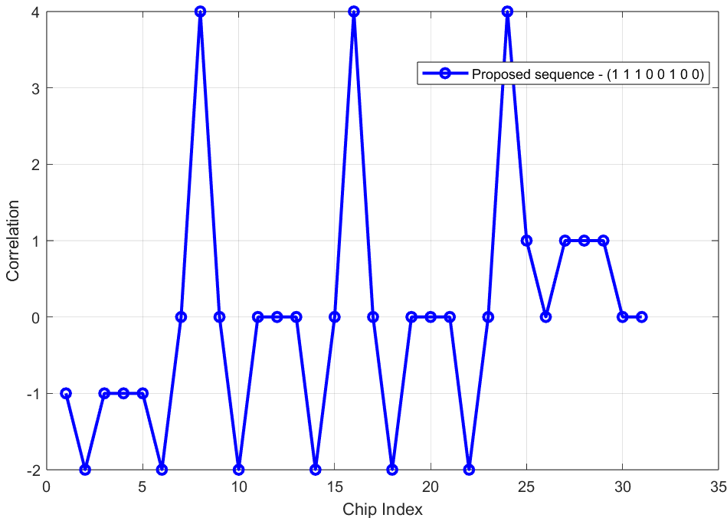
Choice of Base sequence W
The base sequence should have good auto-correlation property and low side lobes before the main peak
  [1 1 1 0 0 1 0 0] is a good candidate sequence with
  low side lobe before the main peak

Slide 7
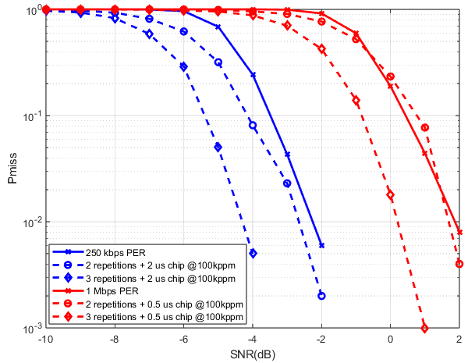
Number of base sequence repetitions
We propose to use 3 repetitions of base sequence to have good SYNC vs DATA field margin for both 2 us and 0.5 us chip durations
  More number of repetitions => Better the SYNC Pmiss performance
  Additionally, more repetitions result in better clock error estimation
Data Rate | Ideal DATA SNR for 10% PER
250 kbps | -3.5 dB
1 Mbps | 0.5 dB
Chip Duration | 1% Miss Detection SNR (100k ppm)
2 us | -4.3 dB
0.5 us | 0.2 dB

Slide 8
Conclusion
A repeated structure in the SYNC sequence is useful to estimate the large clock error(10%)
Length 8 base sequence length is chosen to have timing drift less than 1 chip.
Proposed a new 8-chip base sequence with good correlation and
side lobes
3 repetitions of base sequence is good to provide good SNR margin for SYNC Pmiss and DATA PER

Slide 9
References
Manideep et.al., “High Level Thoughts on Uplink SYNC Field Design for Backscatter STAs,” IEEE 802.11-25/799, May 2025

Slide 10
SP #1
Do you agree to add the following text to 11bp SFD?
  AMP backscattering uplink SYNC field consists of repetition structure with multiple segments each containing the same base sequence
  Note: For example [S S S] where S is the base sequence

Slide 11
SP #2
Do you agree to add the following text to 11bp SFD?
  AMP Backscattering Uplink SYNC field uses 2 us chip duration for 250 kbps data rate and 0.5 us chip duration for 1 Mbps data rate

Slide 12
SP #3
Do you agree to add the following text to 11bp SFD?
  The base sequence in the AMP Backscattering Uplink SYNC field shall have a length of 8 chips

Slide 13
SP #4
Do you agree to add the following text to 11bp SFD?
  AMP Backscattering Uplink SYNC field consists of 3 repetitions of the 8-chip base sequence

