Slide 1
Discussion on AMP Active Transmission
Date: 2025-07-18
Authors:
Name | Affiliations | Address | Phone | email
Alice Chen | Qualcomm Technologies Inc. |  |  | alicel@qti.qualcomm.com
Steve Shellhammer |  |  |  | shellhammer@ieee.org
Manideep Dunna |  |  |  | mdunna@qti.qualcomm.com
Bin Tian |  |  |  | btian@qti.qualcomm.com
Pooria Pakrooh |  |  |  | ppakrooh@qti.qualcomm.com

Slide 2
Introduction
The bandwidth, chip duration, and modulation and coding for the three data rates (250kbps, 1Mbps, 4Mbps) in UL active transmission is TBD
  Consensus was reach in Motion #78 that “the chip duration of data portion is different for different data rates. 4Mbps is TBD”
The sync field design for UL active transmission, which greatly relies on the data field design, is also TBD
  Consensus was reach in Motion #69 to use “1 base sequence, S3, for UL active transmission SYNC field”
In this presentation, we discuss our design for 250kbps and 1Mbps
  Bandwidth, chip duration, modulation and coding in Data field
  Sync field duration

Slide 3
Overview
It’s been shown that FEC [1-4, 6] provides performance gain over non-FEC scheme for the same data rate
  Our results will be shown in later slides
FEC is already implemented at APs and encoder is easy to implement at active transmitters
While FEC improves Data performance, it may require longer SYNC field
  But even with same SYNC field durations (same overhead) for non-FEC schemes, FEC is still beneficial since it makes Data performance more robust
  Same SYNC field duration means the sync sequence has 2x length w/ FEC compared to w/o FEC, since the chip duration w/ FEC is half that of the chip duration w/o FEC
Prefer to limit to only one design for each data rate

Slide 4
Data Field Design
Compare two options – focusing on two lower rates
  In option 2, suggest to use the 802.11 rate 1/2 BCC to leverage existing design
We prefer option 2
 | 250kbps | 1Mbps | 4Mbps
Option 1: No FEC | Use 2us chip duration with Manchester encoding | Use 0.5us chip duration with Manchester encoding | TBD but no FEC (one example is to use 0.125us chip duration with Manchester encoding)
Option 2: Using FEC for two lower data rates (our preference) | Use 1us chip duration with rate 1/2 FEC and Manchester encoding | Use 0.25us chip duration with rate 1/2 FEC and Manchester encoding

Slide 5
Simulation Assumptions
In the data field simulation, no packet detection is assumed. Use perfect timing
Use pulse waveform
Other parameters
Parameter | Value
Transmit Bandwidth | < 20 MHz
Transmit Waveform | Simple OOK
STA Transmitter Clock Accuracy | 0 PPM
Data Field Size | 16 Octets
Long term SNR | Average signal power divided by noise power in 20MHz
Rx Filtering | Case A: 20MHz filter Case B: Narrow BW filter of B+5MHz, where B is the signal null-to-null BW for 250kbps and 1Mbps
Sampling frequency | 40MHz
Rx Assumption | Non-coherent

Slide 6
Summary of Data Field Performance for 250kbps & 1Mbps
Consistent ~2ish dB gain of option 2 over option 1 at 10% PER
  It was shown in [3] that for the same data rate, a rate 1/2 convolutional code had 2.5dB gain over the no FEC scheme at 10% PER (I think with non-coherent detection in AWGN)
Case A: With 20MHz filter
Case B: With narrow BW filter
More plots in Appendix
Data Rate | AWGN | BLoS | BNLoS | DLoS | DNLoS
250kbps | 2.4dB gain | 2.1dB gain | 2.2dB gain | 2.0dB gain | 2.0dB gain
1Mbps | 2.7dB gain | 2.4dB gain | 2.3dB gain | No gain | No gain
Data Rate | AWGN | BLoS | BNLoS | DLoS | DNLoS
250kbps | 2.4dB gain | 2.2dB gain | 2.1dB gain | 2.2dB gain | 1.8dB gain
1Mbps | 2.5dB gain | 2.0dB gain | 2.2dB gain | No gain | No gain

Slide 7
Data Field Performance: AWGN

Slide 8
Data Field Performance: BLoS

Slide 9
SYNC Field Discussion
SYNC field design needs to support reliable detection at SNR lower than that of the DATA field. For example:
  1% False alarm rate over a gap period of AWGN input
    The gap period may be 16us (=SIFS)
  1% Sync Miss-Detection rate at 10% data PER SNR
The first high level question is about the SYNC field duration
In our simulation, assume
  AWGN channel
  40MHz sampling frequency
  Non-coherent correlation-based detector (see Appendix)
  The chip duration in SYNC field is the same as in Data field
  Sync sequence length starts from length-16

Slide 10
Summary of SYNC Field Length Study
Plots in Appendix
Rows in black (resp. blue) are applicable to Data field option 1 (resp. option 2)
Case A: With 20MHz filter
Case B: With narrow BW filter
Data Rate | Chip Duration | BCC | Noise BW | Receiver | SNR(dB)@10%PER | Min Sync Sequence Length for 16us Gap Period
250kbps | 2us | N/A | 20MHz | Non-coherent | -3.4 | 16
250kbps | 1us | 1/2 | 20MHz | Non-coherent | -5.8 | 48
1Mbps | 0.5us | N/A | 20MHz | Non-coherent | 0.5 | 16
1Mbps | 0.25us | 1/2 | 20MHz | Non-coherent | -2.3 | 64
4Mbps | 0.125us | N/A | 20MHz | Non-coherent | 4.5 | 28
Data Rate | Chip Duration | BCC | Noise BW | Receiver | SNR(dB)@10%PER | Min Sync Sequence Length for 16us Gap Period
250kbps | 2us | N/A | 6MHz | Non-coherent | -5.4 | 16
250kbps | 1us | 1/2 | 7MHz | Non-coherent | -7.8 | 48
1Mbps | 0.5us | N/A | 9MHz | Non-coherent | -0.7 | 20
1Mbps | 0.25us | 1/2 | 13MHz | Non-coherent | -3.2 | 64

Slide 11
SYNC Field Length Discussion
W/o FEC, a length-16 base sync sequence S could be used
  250kbps uses the length-16 sequence S (SYNC field duration of 32us)
  1Mbps can use the length-16 sequence S (SYNC field duration of 8us), or alternatively, a length-32 sequence of [S S] (SYNC field duration of 16us) to further improve SYNC+Data performance
  4Mbps uses the length-32 sequence of [S S]
W/ FEC, Data SNRs are lower and longer sync sequence may be needed. Our high level thoughts are
  Preferably, use a same length-32 sequence for different data rates
    FEC is still beneficial since it makes Data performance more robust
    Note that SYNC field durations are 32us for 250kbps and 8us for 1Mbps, with same overhead of the no FEC case using a length-16 sync sequence
  Alternatively, if longer SYNC field is preferred, use a length-16 base sequence, and derive longer sync sequences through repetition
    For example, derive a length-48 and length-64 sequences through 3x and 4x repetition for 250kbps and 1Mbps

Slide 12
Summary
Suggest to have a single design in Data field for each data rate
Suggest to use FEC for 250kbps and 1Mbps, because FEC makes Data field performance much more reliable
  Consistent 2ish dB gain with non-coherent receiver
High level thoughts for the sync sequence design
  W/o FEC, use a length-16 base sequence
  W/ FEC, suggest to limit to a same length-32 sequence for different data rates, so FEC is still beneficial since it makes Data performance more robust
    Keep same overhead as the no FEC case

Slide 13
Reference
11-24/1497r0, Uplink Rates for Active Transmission, Amichai Sanderovich, et al.
11-24/1794r0, Robust Method for AMP Active Uplink Multiple Data Rate Support, Steve Shellhammer, et al.
11-25/0317r0, AMP UL Transmission, Yinan Qi, et al.
11-25/0790r0, Remaining Issues of AMP PPDU Design, Yinan Qi, et al.
11-25/0862r0, Discussion on uplink sync field design for active transmitters, Bin Qian, et al.
11-25/1002r0, Comparison between FEC/no-FEC for UL of active TX AMP STA, Amichai Sanderovich, et al.

Slide 14
SP 1
Do you agree to add the following to the 11bp SFD:
  In the data field of AMP UL active transmission in 2.4 GHz, 250kbps data rate only uses 1us chip duration and rate 1/2 binary convolution code (BCC), and 1Mbps data rate only uses 0.25us chip duration and the same rate 1/2 BCC
    4Mbps doesn’t use BCC

Slide 15
appendix
More details

Slide 16
Data Field Performance: BNLoS

Slide 17
Data Field Performance: DLoS

Slide 18
Data Field Performance: DNLoS

Slide 19
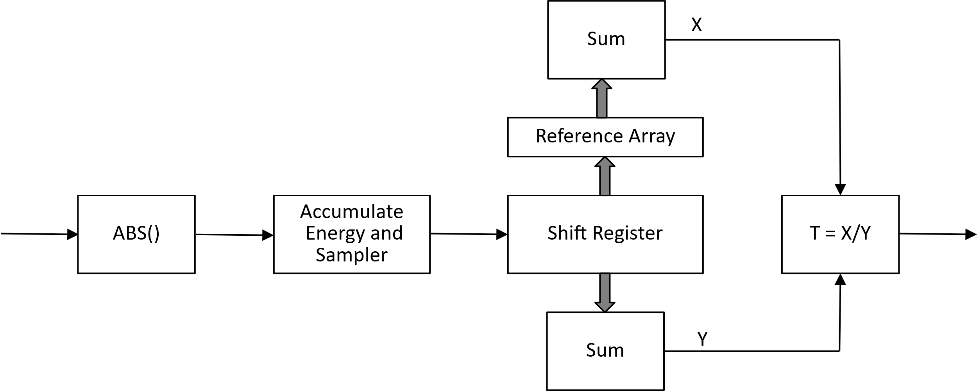
SYNC Detector
Correlation-based Sync Field Detector

Slide 20
SYNC Field Pmiss: 2us Chip Duration
250kbps Data SNR is -3.4dB and -5.4dB with a 20MHz filter and a narrow BW filter, respectively

Slide 21
SYNC Field Pmiss: 1us Chip Duration
250kbps Data SNR is -5.8dB and -7.8dB with a 20MHz filter and a narrow BW filter, respectively

Slide 22
SYNC Field Pmiss: 0.5us Chip Duration
1Mbps Data SNR is 0.5dB and -0.7dB with a 20MHz filter and a narrow BW filter, respectively

Slide 23
SYNC Field Pmiss: 0.25us Chip Duration
1Mbps Data SNR is -2.3dB and -3.2dB with a 20MHz filter and a narrow BW filter, respectively

Slide 24
SYNC Field Pmiss: 0.125us Chip Duration
4Mbps Data SNR is 4.5dB with a 20MHz filter

Slide 25
Comparison with [5]
The discussion is for the Data field design Option 1 (Scalable chip duration)
It was shown in [5] that “In AWGN, one sequence could be used for different data rates under non-coherent detector”
  E.g., length-16, 24, 32
Our results show that
  Length-16 is enough for 250kbps
  Need length-16 for 1Mbps with a 20MHz filter but length-20 for 1Mbps with a narrow BW filter
  Need length-28 for 4Mbps
Comparison
  The difference is partly due to the difference in AWGN Data SNR at 10% PER with non-coherent receiver
    The Data SNR at 10% PER in [5] were -3dB, 1dB and 6dB for 250kbps, 1Mbps and 4Mbps, respectively
    They are -3.4dB, 0.5dB and 4.5dB, respectively, with a 20MHz filter in our results
  The selection criterion is also different
    [5] compared SNR at same Pmiss and PER
    Ours requires SNR at 1% Pmiss to be smaller than Data SNR at 10% PER for sufficient margin

