Slide 1
Group Keys Delivery in Seamless Roaming
Date: 2025-07-18
Authors:

Slide 2
Abstract
Group keys and up-to-date Packet Numbers delivery are essential part of the seamless roaming.
This submission defines group key delivery signaling with the following targets:
- An SMD with Per-AP MLD PTK can isolate the STA specific PTK and BSS specific group keys.
- When roaming to target AP MLD, up-to-date PN values are used for the group keys.

Slide 3
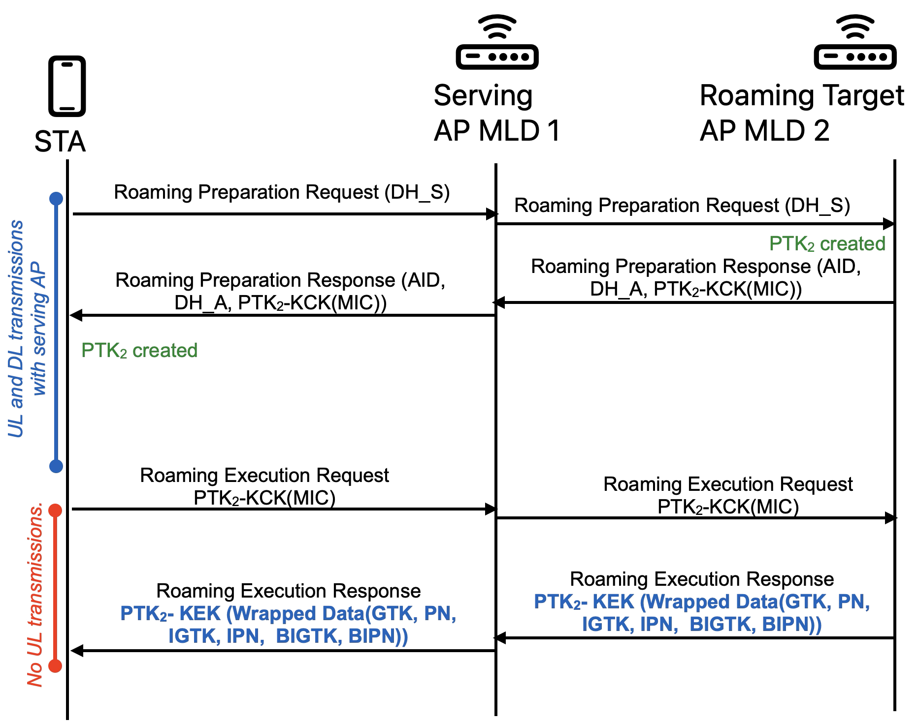
Group Key Related Security Requirements for a SMD with Per-AP-MLD PTK
PTK and Group Keys are isolated
PTK is shared only between the roaming target AP MLD₂ and the STA
Group keys are shared only between the roaming target AP MLD₂ and its associated STAs
PTK is setup before group keys delivery
PTK-KCK (Key Confirmation Key) creates an end-to-end MIC to confirms correct PTK setup
GTK, IGTK and BIGTK are encrypted by PTK-KEK (Key Encryption Key)
PTK-KEK is known only by the STA and the roaming target AP MLD₂
A roaming STA shall have updated PNs of the group keys (see slide 9)
This avoids replay attacks
SMD with Per-SMD PTK only meets the requirement 4 (updated PN). Group keys and PTK are shared to all APs in SMD, so requirements 1-3 are not met.

Slide 4
Group Key Related Timing Requirements
The roaming preparation signaling does not have strict delay limits, because STA UL and DL transmissions are not limited
The time between the roaming execution request and response messages should be short, because STA is not allowed to send UL data during this time
Lack of UL frames transmissions will impact application performance

Slide 5
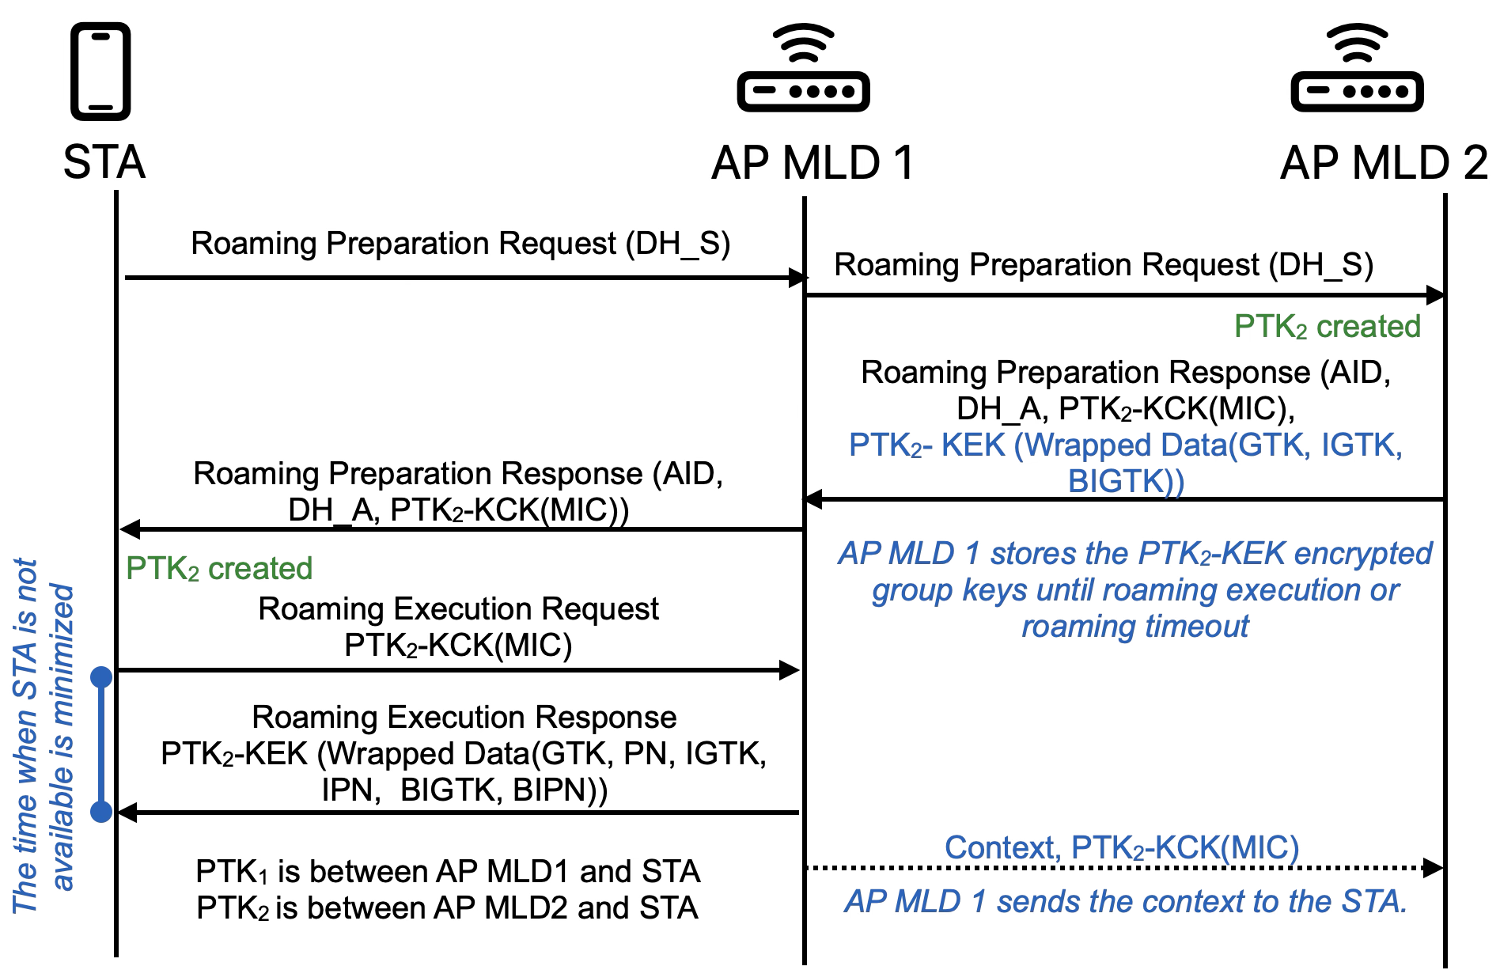
Proposal – PTK and Group Keys Setup Signaling in SMD with Per-AP-MLD PTK
At preparation phase, the AP MLD₂ configures to AP MLD₁ PTK₂-KEK encrypted group keys
The PTK₂-KEK encrypted group keys can be decrypted only by the STA
Group Keys may be transmitted together with the Roaming Preparation Response frame
AP MLD₁ can respond to roaming execution request immediately:
The PTK₂-KEK encrypted group keys are delivered immediately to the STA
The AP MLD₁ may add PTK₂-KCK(MIC) to context
AP MLD₂ verifies the PTK₂ creation and the success of the roaming by using PTK₂-KCK(MIC)

Slide 6
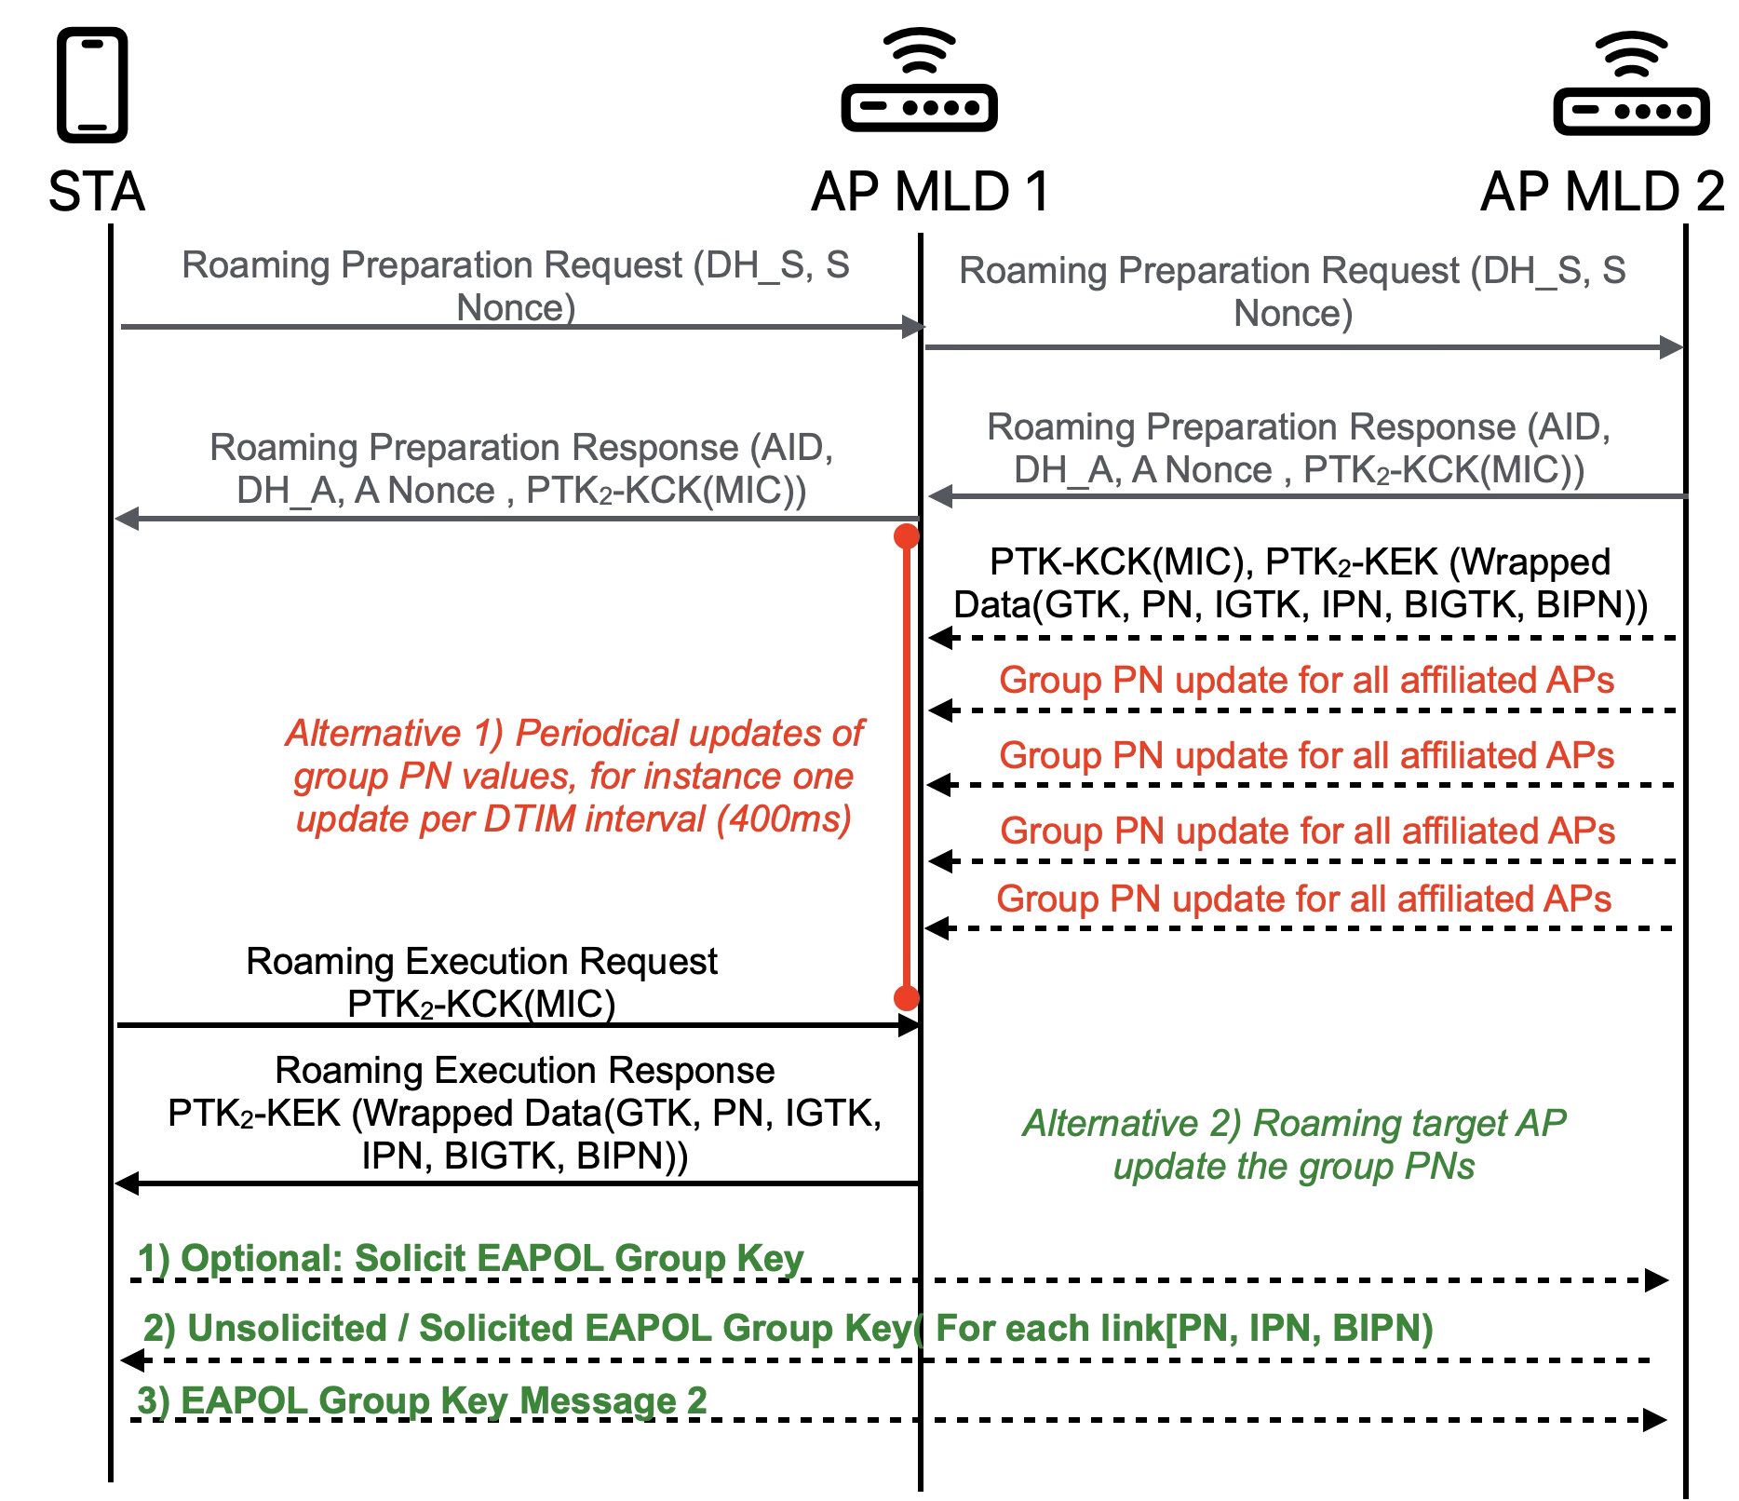
Proposal: Up-to-date Group PN Values
Currently, the last transmitted PNs and the group keys are configured at the same time
Two alternatives to update the PNs:
AP MLD₁ maintains updated PN values for AP MLD₂
Requires periodical transmissions between APs at the time between roaming preparation and execution
STA may obtain the latest PN values directly from AP MLD₂ after roaming
This operation may be skipped if there is no delay between roaming preparation and execution

Slide 7
Comparison of Group PN Update Alternatives
Group keys PN update mechanism | Alternative 1: Serving AP Provides Up-to-date PN | Alternative 2: Roaming Target AP MLD Updates PN
PN Preciseness | Good, but depends on group PN update periodicity | Exact values are provided
Management Frames Overhead | Periodical update messages create high overhead | Small / None
Additional Delays to Roaming | No additional delays | Two extra frames are added to the roaming
AP MLD Complexity | High. AP MLD needs to maintain PNs of affiliated APs of neighbor AP MLDs. | Small, Existing EAPOL group key handshake frames may be used
Non-AP MLD Complexity | No additional complexity

Slide 8
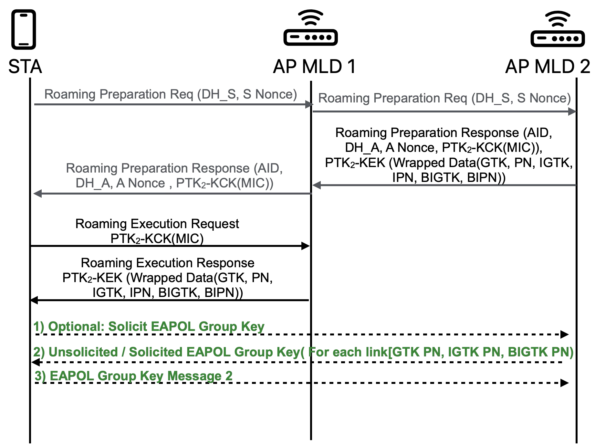
Summary
Available roaming target AP MLD₂ group keys at serving AP MLD₁ make roaming faster
The roaming target AP MLD₂ shall update the PNs of the Group Keys to the roaming STA

Slide 9
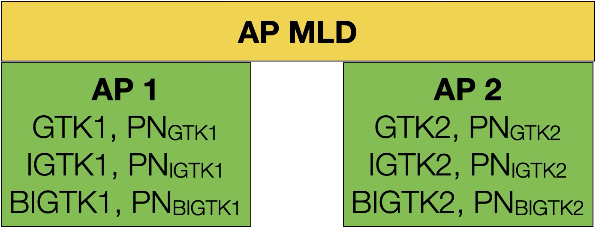
Annex: Group Keys and Group Keys PN
Each Key has independent Packet Number (PN)
Each affiliated AP has own set of GTK, IGTK, and BIGTK keys
One group addressed frame is transmitted at a time
The PN of the received group addressed data, management, or Beacon frame must be larger than the PN of previously received data, management, or Beacon frame respectively
Example, Possible replay attack if PN is not maintained

