Slide 1
Thoughts on DSO Scheduling
Date: 2025-09-10
Authors:

Slide 2
Abstract
Dynamic subband operation (DSO) have been discussed in multiple UHR and TGbn contributions [1-3].
In this presentation, we will discuss DSO non-AP STAs feedback signaling for efficient AP DSO scheduling.

Slide 3
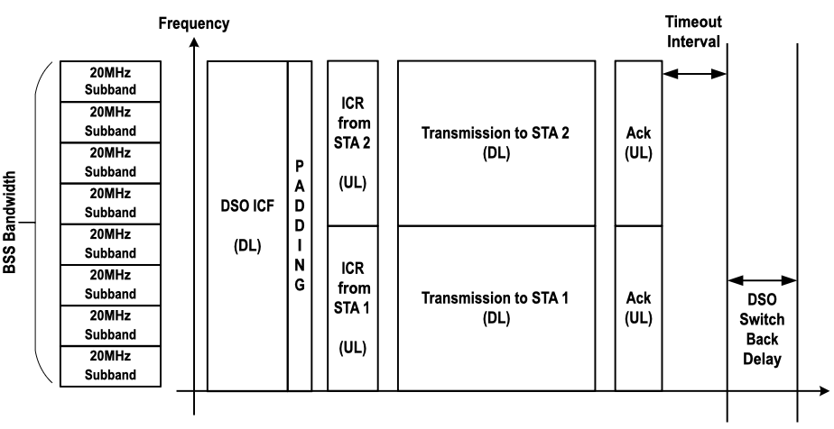
Background [1]
AP allocates resources to a non-AP STA dynamically, e.g., on a TXOP basis outside the non-AP STA operating BW.
DSO switchback rules are defined to automate the return of non-AP STAs from the DSO subband to the primary subband [2].
ICF → non-HT duplicated PPDUs/BSRP

Slide 4
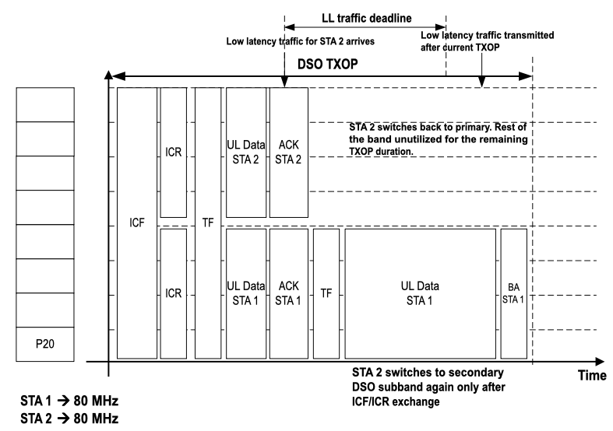
Problem Definition - Inefficient DSO scheduling due to DSO switchback rules
At the beginning of the DSO TXOP, STA 2 has small packet in tx buffer.
DSO subband switchback rule triggers after STA sends the ACK and it waits on S80 for an additional timeout interval of aSIFSTime + aSlotTime + aRxPhyStartDelay [2].
However, STA 2 expects low latency traffic may arrive during the DSO TXOP, e.g., semi-periodic LL traffic.
DSO subband may not be used if DSO switchback rule is triggered before LL traffic arrives.
ICF → non-HT duplicated PPDUs/BSRP

Slide 5
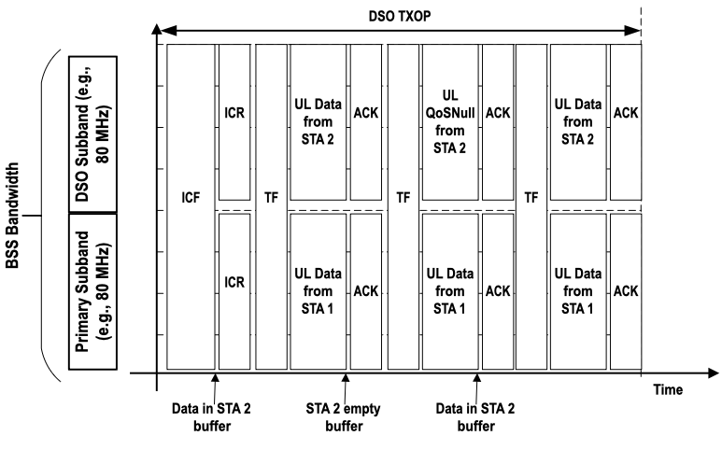
Solution
DSO STA indicates to AP that the DSO STA prefers to remain on the DSO subband for the duration of the DSO TXOP:
DSO STA indicates it prefers to remain in DSO subband in different ways:
  ICR frame.
  BSR in any UL PPDU.
Using this information, AP may send padding frames in the DL or may trigger the DSO STA even if it has no traffic to send to avoid triggering the DSO switchback rule.
ICF → non-HT duplicated PPDUs/BSRP

Slide 6
Conclusions
DSO may require some signaling from non-AP STAs to optimize AP scheduling operations.
  AP may trigger non-AP STA (e.g., UL) or transmit padding data (e.g., DL) to avoid triggering the switchback rule for the non-AP STA on receiving an indication from non-AP STA.

Slide 7
References
[1] 11-24/1553r0, DSO follow up, (Gaurang Naik, Qualcomm)
[2] 11-25/0713r7, PDT MAC for Dynamic Subband Operation (DSO, Follow Up), (Morteza Mehrnoush, Apple)
[3] 11-25/0586r0, Service Period based Dynamic Subchannel Operation (SP-based DSO), (Seongho Byeon, Samsung)

