Slide 1
Further Discussion on DSO Operation
Date: 2025-09-10
Authors:

Slide 2
Abstract
Dynamic subband operation (DSO) have been discussed in multiple UHR and TGbn contributions [1-3].
In this presentation, we will further discuss operation of DSO non-AP STAs.

Slide 3
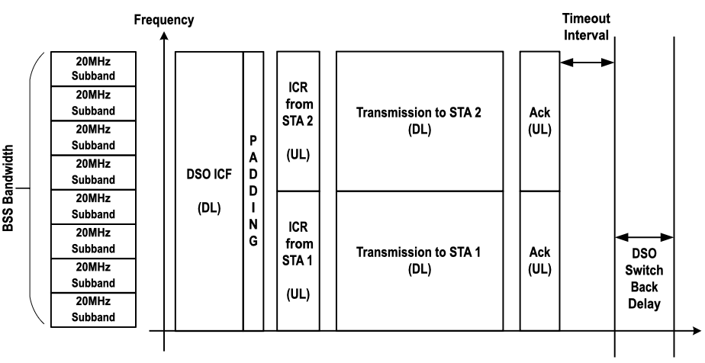
Background [1]
AP allocates resources to a non-AP STA dynamically, e.g., on a TXOP basis outside the non-AP STA operating BW.
DSO switchback rules are defined to automate the return of non-AP STAs from the DSO subband to the primary subband [2].
ICF → non-HT duplicated PPDUs/BSRP

Slide 4
Problem Definition - Operation of DSO enabled low power devices
Low power non-AP STAs may want to be more selective on when DSO is used.
Based on [2], non-AP STAs may switch to the DSO subband every TXOP if requested by DSO AP. This frequent switching may not be a desirable behavior in low power non-AP STAs (power cost of constant switching between primary subband and DSO subband).
Baseline [2]: Non-AP STAs send individually addressed management frames to the AP to indicate DSO enablement, e.g., link reconfiguration request/notify.
Using link reconfiguration request/notify frames may reduce communications efficiency if frequent enablement/disablement of DSO is required to lower energy consumption.
Example: DSO and R-TWT
Low power devices supporting R-TWT may want to prioritize use of DSO only during R-TWT SPs to increase probability of channel access and minimize power consumption, i.e., only switch to DSO channel and spend energy doing so for R-TWT SPs.
A SP approach may be followed to configure DSO operation in all STAs associated to a given R-TWT schedule during the R-TWT SPs [3].

Slide 5
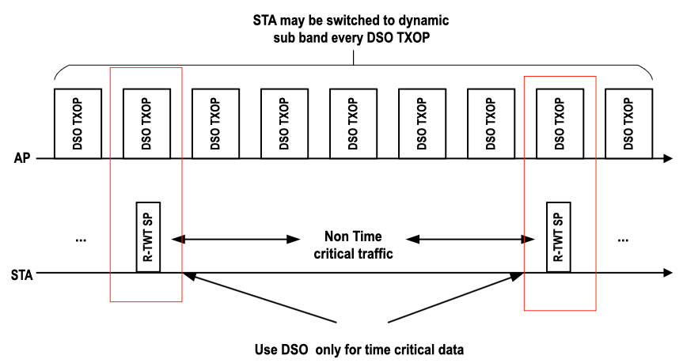
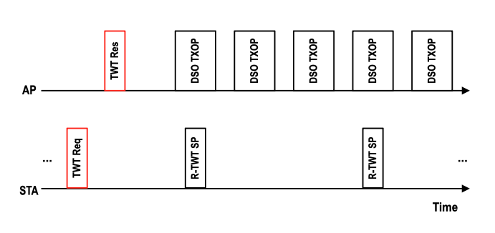
Solution 1
Operation of DSO enabled low power non-AP STAs:
Periodic behavior could be negotiated using a TWT setup frame, e.g., TWT request/response frame to match an r-TWT schedule.
TWT request indicates that DSO operation is desired only during TXOPs holding R-TWT SPs.
Notes:
Emphasize difference w.r.t. prior art [3]. Be more specific w.r.t. prior art.

Slide 6
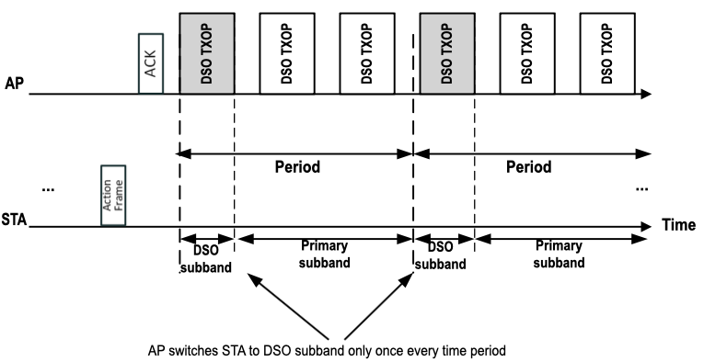
Solution 2
Operation of DSO enabled low power non-AP STAs:
DSO switch rate indicated in an action frame → Indicates how many times a STA may be switched per period.

Slide 7
Conclusions
DSO may require some signaling from non-AP STAs to optimize operations.
Frequent DSO subband switching may not be desired for low power IoT devices.
Non-AP STA may indicate to AP it does not want/require to be switched to the DSO subband.
Non-AP STA may define conditions upon which AP requests non-AP STA to switch to DSO subband, e.g., r-TWT SP.

Slide 8
References
[1] 11-24/1553r0, DSO follow up, (Gaurang Naik, Qualcomm)
[2] 11-25/0713r7, PDT MAC for Dynamic Subband Operation (DSO, Follow Up), (Morteza Mehrnoush, Apple)
[3] 11-25/0586r0, Service Period based Dynamic Subchannel Operation (SP-based DSO), (Seongho Byeon, Samsung)

