Slide 1
Further Thoughts on Co-RTWT Procedures
Date: 2025-09-10
Authors:

Slide 2
Abstract
Coordinated restricted target wake time (Co-RTWT) has been discussed in multiple UHR and TGbn contributions [1-3].
In this presentation, we will discuss how to manage multi-AP agreement teardown in Co-RTWT operation.

Slide 3
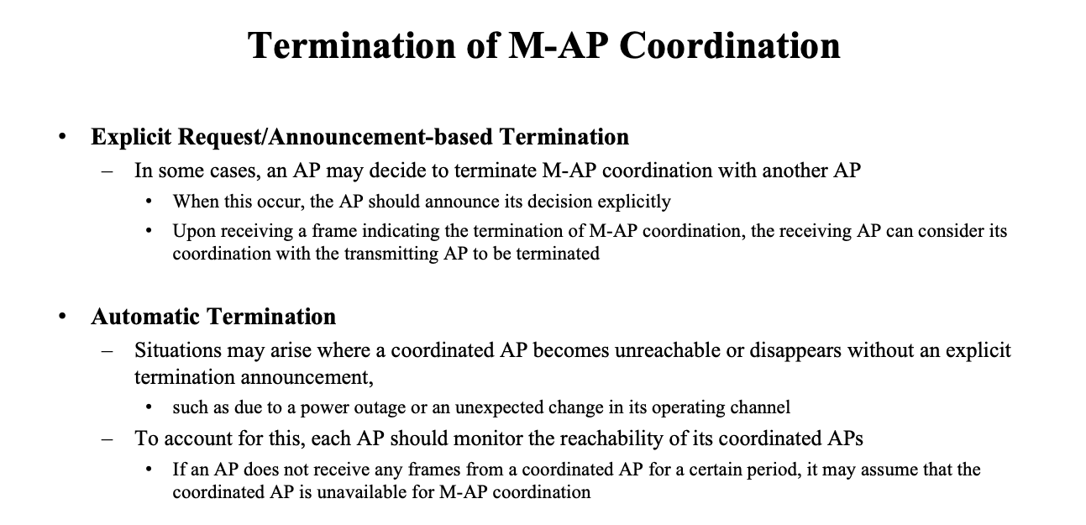
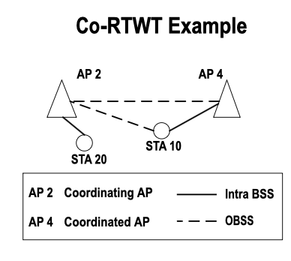
Background
Co-RTWT operation – Session teardown:
Co-RTWT enables a group of APs to coordinate their actions to protect transmission during agreed upon r-TWT schedules.
Coordinating AP announces an r-TWT schedule to be protected.
Coordinated AP (and associated STAs) agree to extend protection to the r-TWT schedule.
Coordinated AP (AP 4) extends protection for the r-TWT schedule for a number of Target Beacon Transmission Time (TBTT) or indefinitely (until agreement teardown).
Session teardown occurs using MAPC Negotiation request/response frames.
Outage of coordinating AP may cause coordinated AP to extend protection for the r-TWT schedule that may no longer exist.
[3] offers a solution to this problem using the MAPC framework.
Recap from [3]

Slide 4
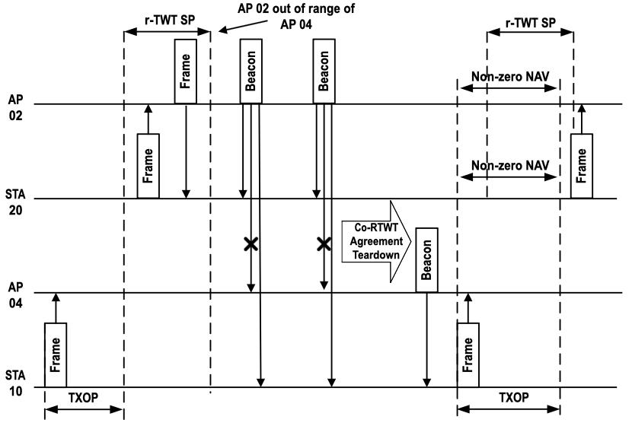
Problem Definition
Co-RTWT operation – Session teardown:
In [3] r-TWT agreement is torn down if no communications from AP 2 are received by AP 4 for a period of time (e.g., beacon frame).
Cause of outage could be multiple: AP 2 has been shut down, AP 2 is in sleep mode, AP 2 is out of range, OBSS interference.
→ According to [3] the agreement will be torn down regardless of the cause.
In the context of Co-RTWT, some of these causes should trigger r-TWT agreement teardown, e.g., AP 2 shuts down, while others should not, e.g., AP 2 is temporarily out of range.
For instance, if AP 2 is out of reach from AP 4, following procedure described in [3], AP 4 will automatically teardown the r-TWT agreement. However, some STAs (e.g., STA 10) associated to AP 4 may still be in the coverage area of AP 2. In this scenario, tearing down the r-TWT agreement would signal the STAs to stop extending protection to the r-TWT schedule, thus allowing them to potentially interfere with AP 2 during r-TWT SPs.
X

Slide 5
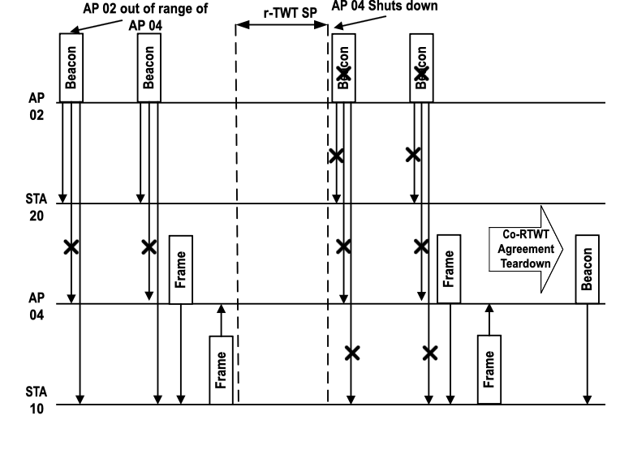
Solution 1
Co-RTWT Agreement is torn down if both coordinated AP and all associated STAs don’t receive transmissions from coordinating AP:
Coordinated AP (AP 04) monitors beacons from coordinating AP.
If coordinated AP cannot hear beacons from coordinating AP (AP 02) it probes associated stations.
Associated stations notify coordinated AP if they hear coordinating AP beacons.
Coordinated AP can probe STAs periodically until beacons from coordinated AP are heard again, or until Co-RTWT agreement is torn down.
Coordinated AP tears down agreement with coordinating AP if all STAs report that they cannot hear coordinating AP beacon.

Slide 6
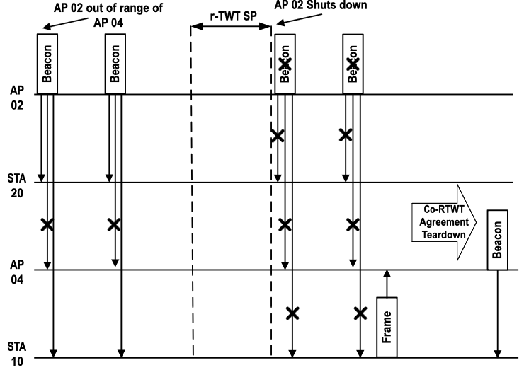
Solution 2
Co-RTWT Agreement is torn down if both coordinated AP and all associated STAs don’t receive transmissions from coordinating AP:
Coordinated AP (AP 04) monitors beacons from coordinating AP (AP 02).
Associated stations (e.g. STA 10) notify coordinated AP if they hear coordinating AP beacons.
Coordinated AP tears down agreement with coordinating AP if all STAs report that they cannot hear coordinating AP beacon, and coordinated AP cannot hear coordinating AP either.

Slide 7
Conclusion
We discuss management of multi-AP agreement teardown in Co-RTWT operations.
We discuss challenges of agreement teardown when the link between the coordinating AP and coordinated AP has a temporary outage.
Multiple solutions are proposed to correctly identify scenarios where session teardown may not be required.

Slide 8
References
[1] 11-24/626r2, Coordinated R-TWT – Follow up, (Rubayet Shafin, Samsung)
[2] 11-23/771r0, Coordinated R-TWT Protection in Multi-BSS, (SunHee Baek, LG Electronics)
[3] 11-24/1849r1, Management of the Established Multi-AP Coordination, (Shawn Sanghyun Kim, WILUS)

