Slide 1
Channel Model for Enhanced Light Communications
Date: 2025-07-30
Authors:

Slide 2
Abstract
July 2025
This contribution proposes a channel model for enhanced light communications. Our approach can operate in real environments using point cloud data captured by a LIDAR scanner. This is easier than manual definition of the environment done previously. Complexity is reduced by modelling the line-of-sight and initial diffuse reflections precisely in the frequency-domain, and the higher-order diffuse reflections by an analytical model based on the integrating sphere. The new approach allows fast and accurate modeling of mobility in large (distributed) MIMO scenarios. It has been validated by measurements in an empty room and in a conference room with typical furniture.

Slide 3
Outline
Introduction
Motivation
ELC channel modelling method
  3D environment modelling based on LIDAR data
  Enhanced modelling methodology
Validation by measurements
Conclusions

Slide 4
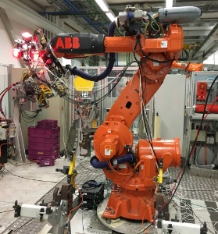
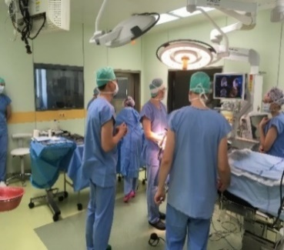
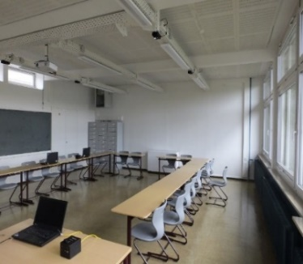
Introduction
More devices are expected to be wirelessly connected (e.g. IoT applications)
Limitations of current WLAN
  Interference from multiple access points (APs)
  Interference from other RF technologies
Enhanced Light Communictaion (ELC)
  Light remains in one room, no EMI
  Mobile communication by using the light
  Bidirectional, high-speed data
Applications
  Leverage unique properties of light (competition with WiFi)
  Industry, hospitals, offices, class- and conference rooms
Industrial OWC
Medical OWC
Class rooms

Slide 5
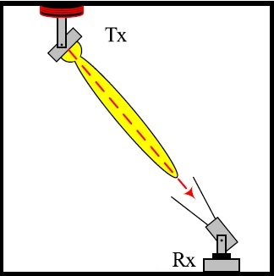
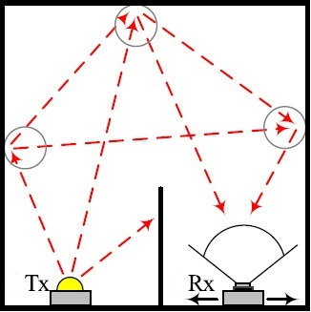
Channel modelling for ELC
Fundamental challenges
  LOS vs. NLOS, Path loss, Link blockage
  Weak multipath reflections, but measurable
Why channel modelling for ELC?
  Optimize the system performance
  Optimize the deployment
  Channel model should evolve with new requirements
Two main modeling approaches
  Deterministic : Site-Specific, highly accurate models
  Stochastic : Non-site specific, based on probability distributions
LOS Propagation
NLOS Propagation

Slide 6
Motivation
SoA: Deterministic channel models
  Manual entry of 3D environment
  Tiles, Iterative, Modified Monte Carlo, Ray tracing
Limitations of present models
  Approaches are very complex and time-consuming
  Not suitable for distributed MIMO with multiple mobile users
  Barely validated in realistic environments
New contributions
  Complete 3D modeling using LIDAR point cloud data
  Efficient modelling with significantly reduced complexity
    more efficient generation of MU-MIMO CIRs and mobility
  Experimental validation in various indoor environments
Input
Propagation Model
Output
3D model using LIDAR
New ELC channel modelling approach
Channel Response
Channel Parameters
Lightsource & detector specifications
Performance Parameters
Block Diagram

Slide 7
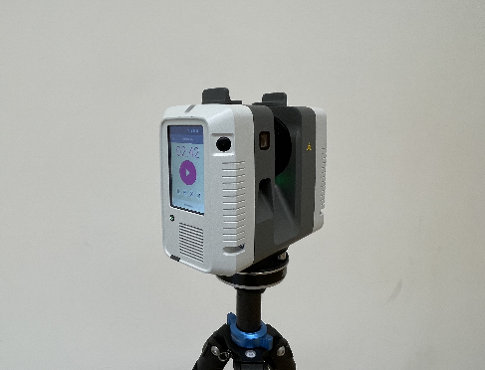
3D modelling using LIDAR
Motivation : Reduce complexity in 3D modelling
Leica RTC360 as LIDAR scanner (wavelength: 1550 nm)
Scanned at multiple positions in the room (to overcome occlusions / invisible regions)
Point cloud data from multiple scans are processed and optimized
LIDAR scanner is calibrated for reflectance estimation
output data: (x,y,z) coordinates, surface normal, and reflectance of each detected point
processing and merging of the scans is done using CloudCompare
Leica RTC360

Slide 8
Reflectance calculation
Intensity is corrected and calibrated, based on distance and angle measured in point cloud data [1]
Reflectance was calculated for Lambertian targets with known reflectance values [1]
Calibration method has been applied to 3D point cloud data of the entire room
Lambertian targets with reflectance value
Intensity correction based on angle
20%
50%
80%
Reflectance of targets before and after correction
Results in the room before and after intensity correction
99%

Slide 9
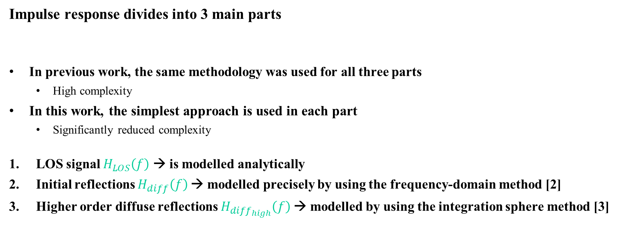
ELC channel modeling methodology
Impulse response divides into 3 main parts
In previous work, the same methodology was used for all three parts
  High complexity
In this work, the simplest approach is used in each part
  Significantly reduced complexity
LOS signal $H_{LOS}\left(f\right)$ → is modelled analytically
Initial reflections $H_{diff}\left(f\right)$→ modelled precisely by using the frequency-domain method [2]
Higher order diffuse reflections $H_{{diff}_{high}}\left(f\right)$→ modelled by using the integration sphere method [3]
Total channel model = ${H_{LOS}\left(f\right)+H}_{diff}\left(f\right)+H_{{diff}_{high}}\left(f\right)$
Typical impulse response for single link [3]

Slide 10
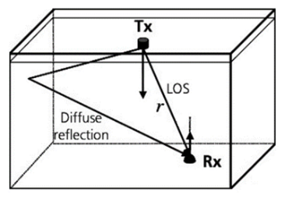
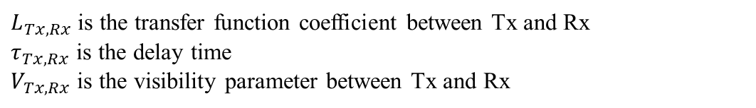
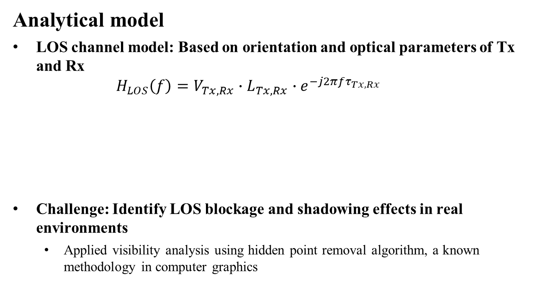
LOS channel
Analytical model
LOS channel model: Based on orientation and optical parameters of Tx and Rx
  $$H_{LOS}\left(f\right)=V_{Tx, Rx}∙L_{Tx, Rx}∙e^{−j2πfτ_{Tx, Rx}}$$
Challenge: Identify LOS blockage and shadowing effects in real environments
  Applied visibility analysis using hidden point removal algorithm, a known methodology in computer graphics
$L_{Tx,Rx}$ is the transfer function coefficient between Tx and Rx
$τ_{Tx, Rx}$ is the delay time
$V_{Tx,Rx}$ is the visibility parameter between Tx and Rx

Slide 11
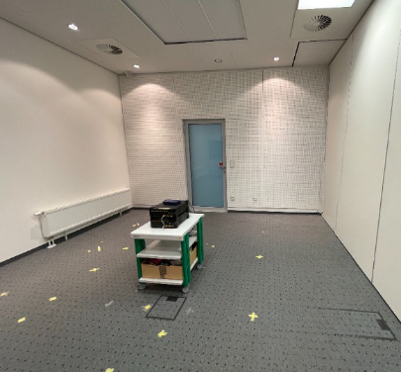

Visibility analysis
Motivation : Define link blocking and shadowing effects
Define all points in point cloud data that are visible from each Tx, Rx, and surface point position
Use hidden point removal algorithm: Visibility Radius = ${10}^{R}$, optimal value for $R=$ 1.5 [4]
Position of Tx1(looking towards the corner)
Variation of visible points for different R values
R = 1
R = 3
R = 4

Slide 12
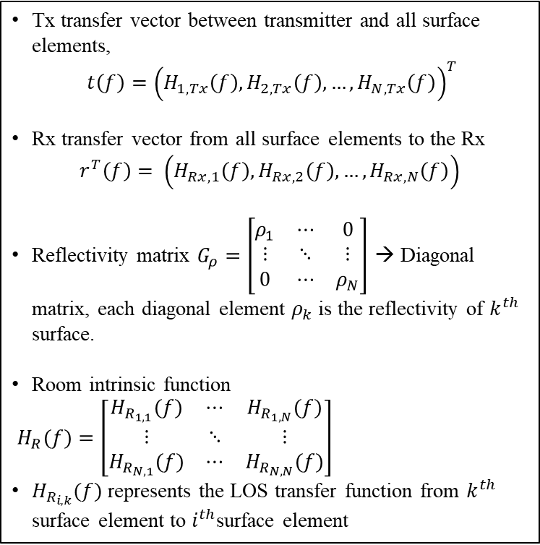
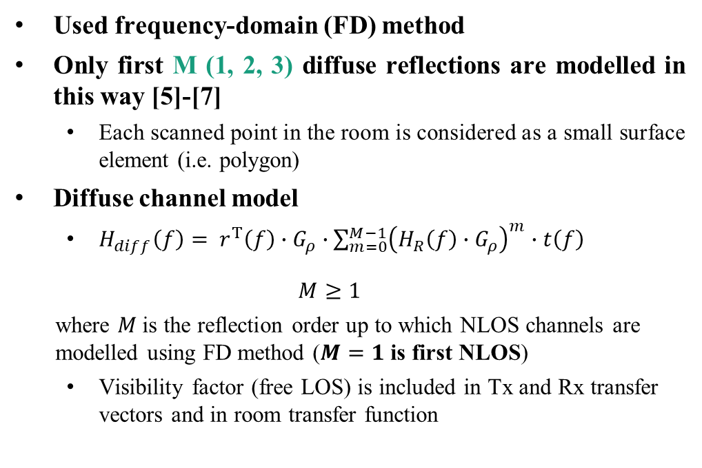
NLOS with initial reflections
Tx transfer vector between transmitter and all surface elements,
$t\left(f\right)={\left(H_{1, Tx}\left(f\right),H_{2, Tx}\left(f\right),…,H_{N, Tx}\left(f\right)\right)}^{T}$
Rx transfer vector from all surface elements to the Rx
$$r^{T}\left(f\right)= \left(H_{Rx, 1}\left(f\right),H_{Rx, 2}\left(f\right),…,H_{Rx, N}\left(f\right)\right)$$
Reflectivity matrix $G_{ρ}=\left[\begin{matrix}ρ_{1} & ⋯ & 0 \\ ⋮ & ⋱ & ⋮ \\ 0 & ⋯ & ρ_{N}\end{matrix}\right]$ → Diagonal matrix, each diagonal element $ρ_{k}$ is the reflectivity of $k^{th}$ surface.
Room intrinsic function
$H_{R}(f)=\left[\begin{matrix}H_{R_{1,1}}(f) & ⋯ & H_{R_{1,N}}(f) \\ ⋮ & ⋱ & ⋮ \\ H_{R_{N,1}}(f) & ⋯ & H_{R_{N,N}}(f)\end{matrix}\right]$
$H_{R_{i,k}}(f)$ represents the LOS transfer function from $k^{th}$ surface element to $i^{th}$surface element
Used frequency-domain (FD) method
Only first M (1, 2, 3) diffuse reflections are modelled in this way [5]-[7]
  Each scanned point in the room is considered as a small surface element (i.e. polygon)
Diffuse channel model
  $H_{diff}\left(f\right)= r^{T}\left(f\right)∙G_{ρ}∙\sum_{m=0}^{M−1}{{\left(H_{R}\left(f\right)∙G_{ρ}\right)}^{m}}∙t\left(f\right)$
  $$M≥1$$
  where $M$is the reflection order up to which NLOS channels are modelled using FD method ($M=1$ is first NLOS)
  Visibility factor (free LOS) is included in Tx and Rx transfer vectors and in room transfer function

Slide 13
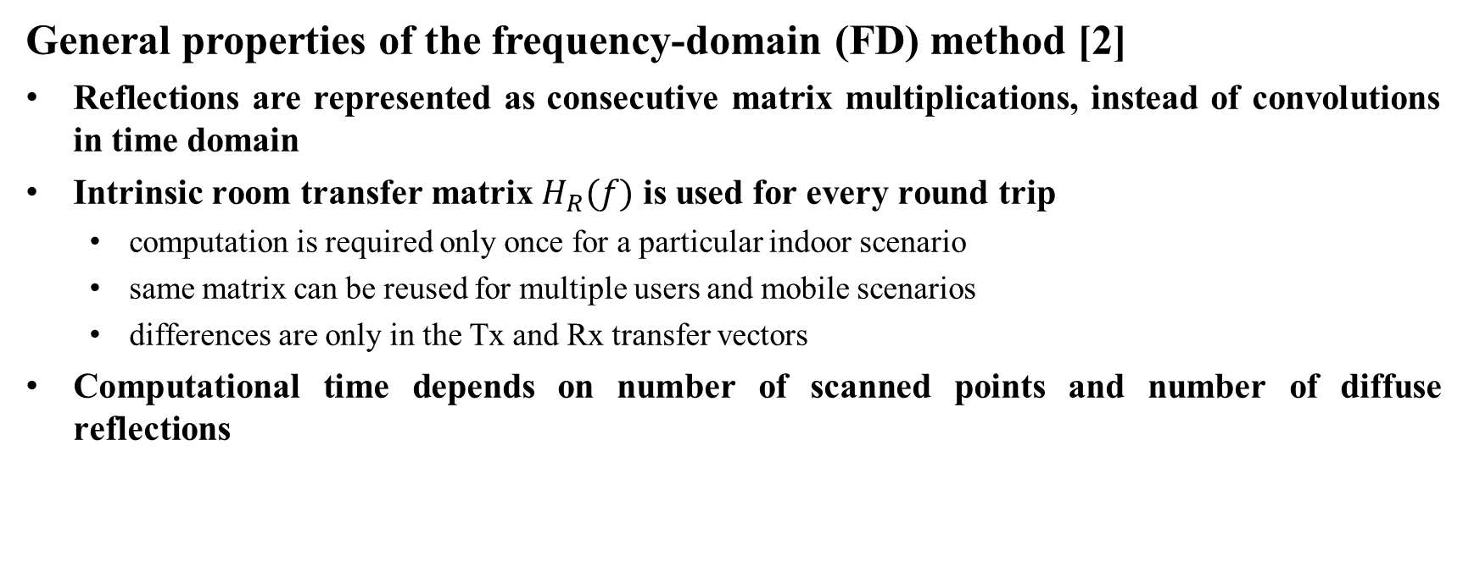
Frequency domain method
General properties of the frequency-domain (FD) method [2]
Reflections are represented as consecutive matrix multiplications, instead of convolutions in time domain
Intrinsic room transfer matrix $H_{R}(f)$ is used for every round trip
  computation is required only once for a particular indoor scenario
  same matrix can be reused for multiple users and mobile scenarios
  differences are only in the Tx and Rx transfer vectors
Computational time depends on number of scanned points and number of diffuse reflections

Slide 14
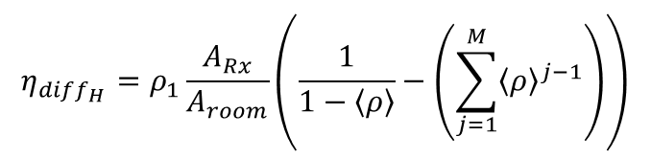
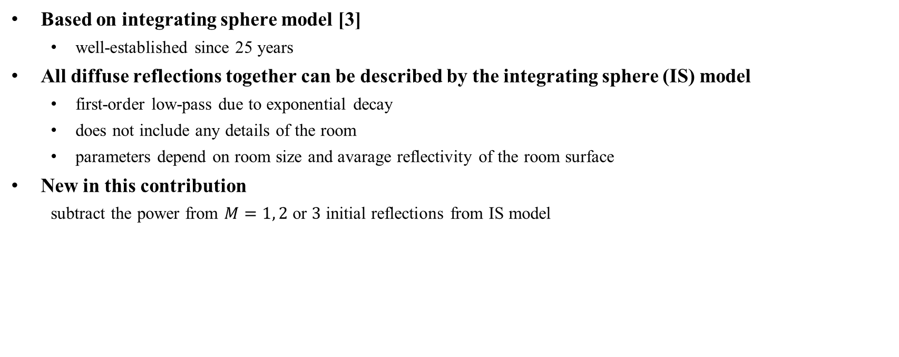

Higher order diffuse reflections
Based on integrating sphere model [3]
  well-established since 25 years
All diffuse reflections together can be described by the integrating sphere (IS) model
  first-order low-pass due to exponential decay
  does not include any details of the room
  parameters depend on room size and avarage reflectivity of the room surface
New in this contribution
  subtract the power from $M=1, 2$ or $3$ initial reflections from IS model
$$H_{{diff}_{high}}=\frac{η_{{diff}_{H}}}{1+j2πfτ}e^{j2πf∆T}$$
$$η_{{diff}_{H}}=ρ_{1}\frac{A_{Rx}}{A_{room}}\left(\frac{1}{1−\left\langle ρ\right\rangle }−\left(\sum_{j=1}^{M}{{\left\langle ρ\right\rangle }^{j−1}}\right)\right)$$

Slide 15
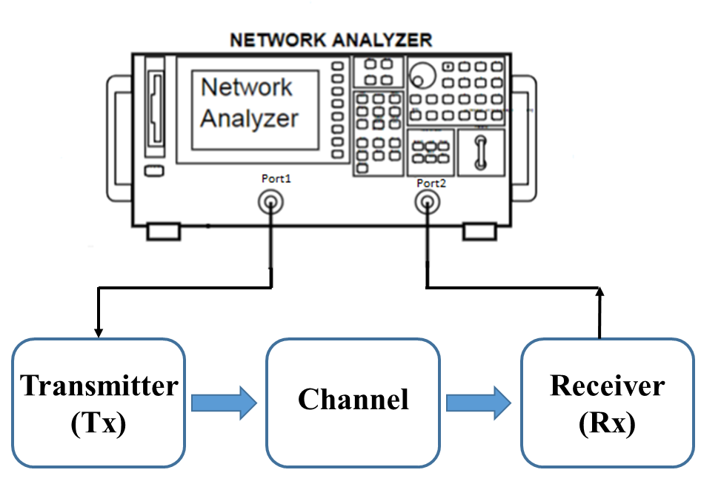
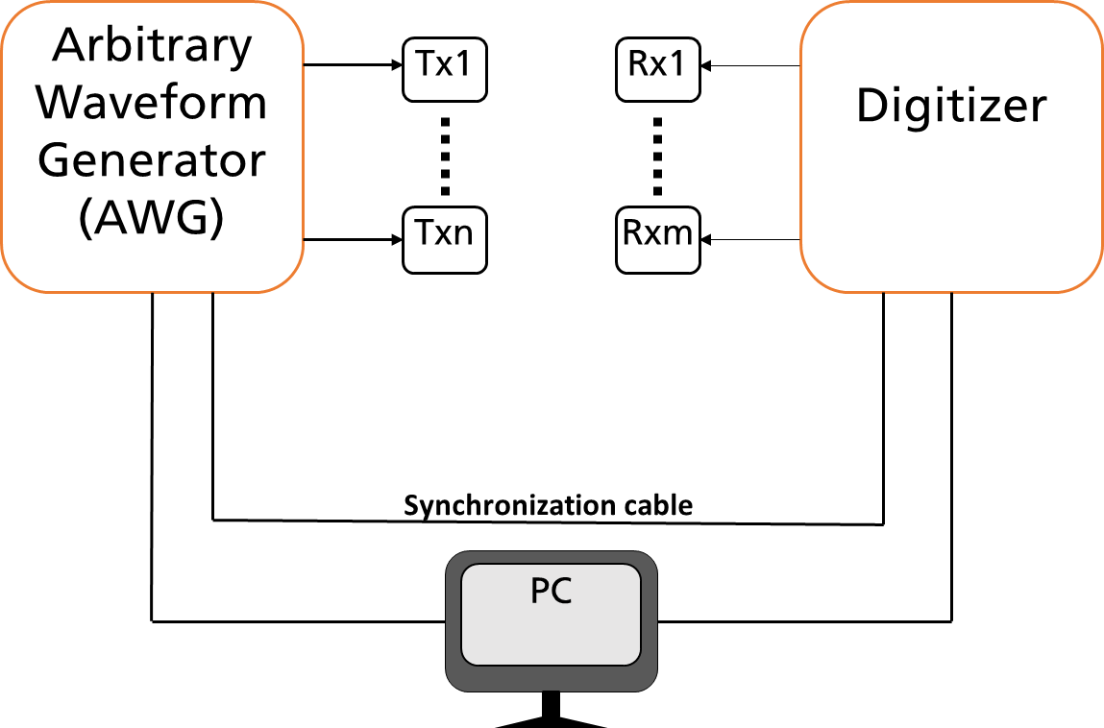
Validation by measurements
SISO scenarios
  Frequency sweep technique using VNA, narrowband
MIMO scenarios
  8x8 channel sounder, OFDM-based, wideband
Performed all three steps
  3D environment modelling using LIDAR
  Channel modelling
  Measurements using VNA/MIMO channel sounder
Metrics used
  Mean-square error (MSE) between measured and modelled channel
  Singular values
  Throughput
SISO measurement using VNA
MIMO channel sounder

Slide 16
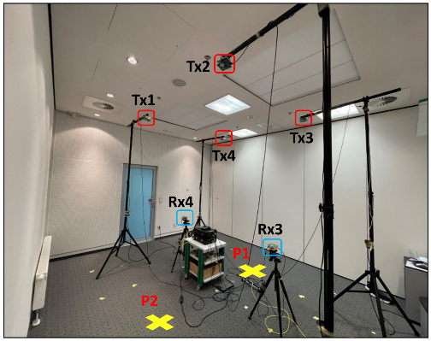
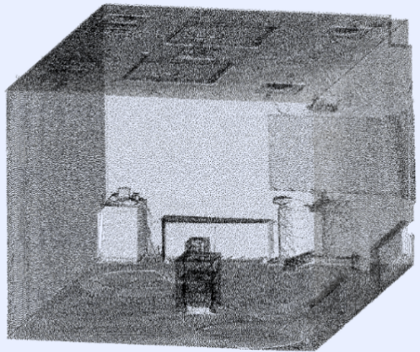
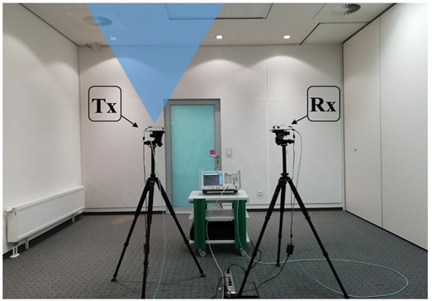
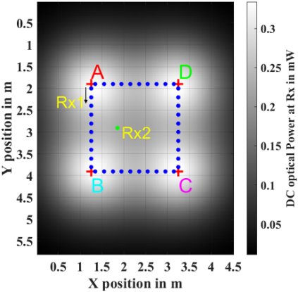
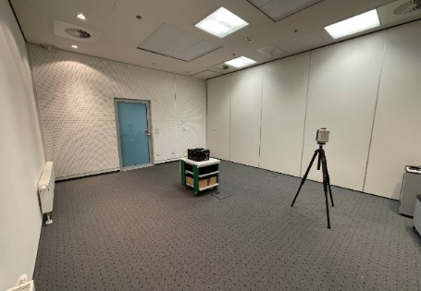
Empty room
MIMO Measurements
Simple scenario for testing all steps
  LIDAR scan and reflectivity calculation
  SISO & MIMO measurements
  Performance evaluation
LIDAR scanning
Point cloud data of the room
SISO Measurements
Mobile scenario
d

Slide 17
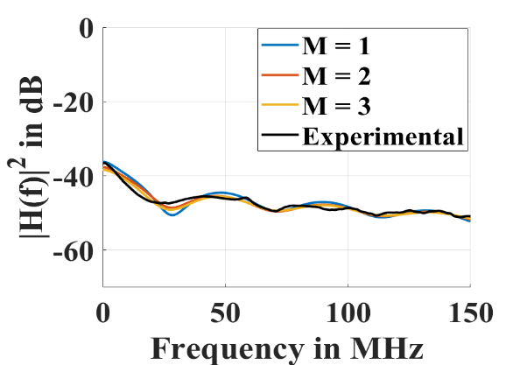
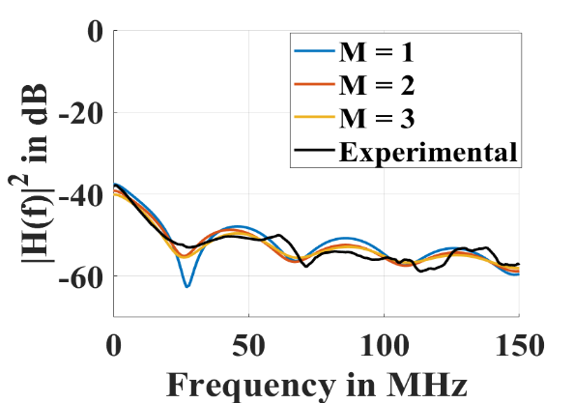
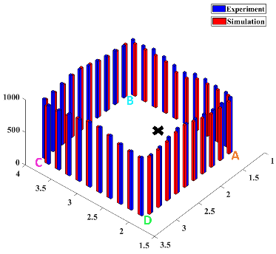
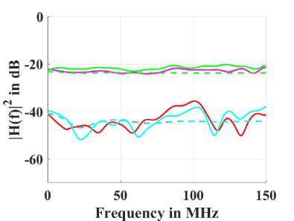
Empty room
SISO Scenario
Amplitude response of the channel for d = 2.5 m
Amplitude response of the channel for d = 3 m
Results
Simulation results compared to measurements
  good agreement between measured and simulated channels
  MSE < 5% for LOS signals with sufficient signal strength
  MSE is higher for distant links, due to limited sensitivity of broadband MIMO channel sounder
Throughput results matched very well
  Mostly determined by strong signals
  Weak signals contribute less
  Throughput is lower if users are nearer to each other
MIMO Scenario
Mobile Scenario
Amplitude Responses at Rx1
Throughput result

Slide 18
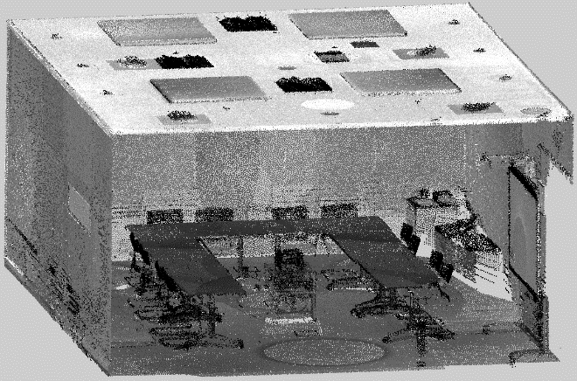
Conference room
Distributed MU-MIMO scenario
6 x 12 MIMO Measurements
  LOS, downlink scenario, Tx infrastructure is always the same, 3 Rx configurations
    Scenario 1: Rxs are far from each other
    Scenario 2: 2 Rx pairs
    Scenario 3: 4/6 Rxs are at one position
LIDAR scanning
Point cloud data of the room
6x12 MIMO Measurement Scenario

Slide 19
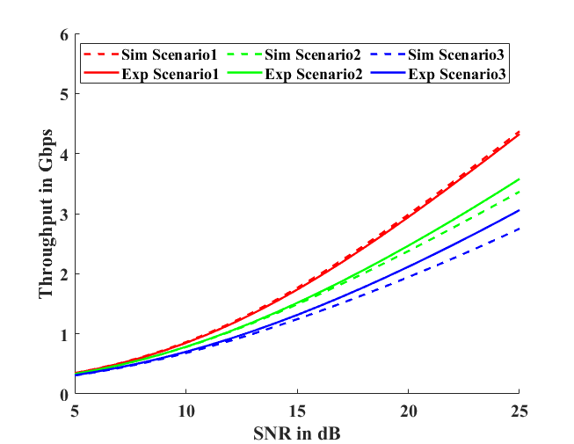
Conference room
Results
Channel responses
  MSE < 5% for the signals with sufficient signal strength
Throughput results
  average MSE < 1 % for all scenarios at low SNR
  usual “fake capacity” for low-rank scenarios due to the noise in our measurements
Throughput results

Slide 20
Conclusions
Introduced new method for ELC channel modelling
  LIDAR based 3D scan and reflectance estimation
  accurate, low complexity and efficient approach
  useful for large distributed MU-MIMO scenarios
  useful in mobile scenarios
Validation by measurements
  good agreement between the results
  MSE < 5% error for signals with sufficient signal strength
  throughput results : MSE < 1 % for all scenarios at low SNR

Slide 21
References
V. Jungnickel et al. “A physical model of the wireless infrared communication channel”, In: IEEE Journal on Selected Areas in Communications 20.3 (2002), pp. 631–640.
H. Schulze, “Frequency-Domain Simulation of the Indoor Wireless Optical Communication Channel”. In: IEEE Transactions on Communications 64.6 (2016), pp. 2551–2562.
S. Katz et al. “Direct visibility of point sets”, ACM Trans. Graph. 26, 3 (July 2007), 24–es.
K. Tan and X. Cheng. “Surface reflectance retrieval from the intensity data of a terrestrial laser scanner”. In: Journal of the Optical Society of America A 33.4 (2016), pp. 771–778.
S. M. Mana et al., "An Efficient Multi-Link Channel Model for LiFi," PIMRC 2021, pp. 1-6.
S. M. Mana et al., "LIDAR-assisted Channel Modelling for LiFi”, 2022 OFC, San Diego, CA, USA, 2022.
S. M. Mana et al., "LIDAR-Assisted Channel Modelling for LiFi in Realistic Indoor Scenarios", IEEE Access, vol. 10, 2022.
S. M. Mana et al., “Experiments in Non-Line-of-Sight Li-Fi Channels”, GLC 2019.
S. M. Mana et al., "Distributed MIMO Experiments for LiFi in a Conference Room," CSNDSP 2020.
S. M. Mana et al., "LiFi Experiments in a Hospital," 2020 OFC, San Diego, CA, USA, 2020.
S. M. Mana et al,, "Distributed Multiuser MIMO for LiFi: Experiments in an Operating Room," JLT, vol. 39, no. 18, Sept.15, 2021.

Slide 22
Straw Polls
Do you support using the proposed channel modeling method for ELC?
Y / N / A
What scenarios should be made available (type preferred numbers in the chat)
  Conference room (data are available)
  Medical (LIDAR+LiFi measurements available)
  Industry (Crossing in manufacturing hall, forklift at storage shelf, TBD)
  Underwater (?, TBD)
  In what form data should be made accessible?
    Raw data versus time on Mentor
    Incl. an interpolation routine
    Documentation

Slide 23
Complexity of the method
Results
As the number of reflections modelled using FD method increases, the complexity of the matrix multiplications increases
Use m = 1 to 2 for link-level (SU-MIMO) and m = 0 for system level (distributed MU-MIMO)
m=0
No. of Reflections, m | Computational time | Data rate (Mbps)
0 | 20 seconds | 438
1 | 1.1 hours | 439
2 | 1.8 hours | 441

Slide 24
Future Work
Validation in NLOS scenarios
  Increase the number of reference scenarios e.g. medical and industrial IoT
Integration with RF channel model
  same users in same environment
  multi-link operation (MLO) including mm-wave and optical bands
Wi-Fi network planning
  Optimized site selection for Wi-Fi and LiFi access points (APs)
  3D coverage modelling based on AP placement
  Multilink operation for sub-7 GHz and ELC
  2D capacity analysis
  Cost analysis

