Slide 1
Measurement for Coordinated Spatial Reuse (Co-SR) TX Power Control
Date: 2025-07-18
Authors:

Slide 2
Introduction
Motion 429 on Co-SR TX power control was passed and included in SFD [1][2]
  In Coordinated Spatial Reuse, the following information shall be carried in the Trigger frame that initiates concurrent CSR transmissions:
    The transmit power limit of the shared AP
      The shared AP Tx power limitation indicated by the sharing AP should not be lower than the minimum TX power indicated by the shared AP in its request.
    The transmit power of the sharing AP
The motion implies that absolute TX power values need to be specified for concurrent Co-SR transmissions
This contribution discusses the interference power measurement procedure that enables the sharing AP to perform TX power control on the shared AP

Slide 3
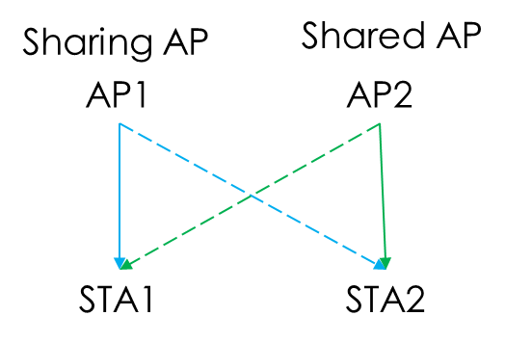
Co-SR TX Power Control
Information needed for the sharing AP to control the shared AP’s TX power
  The maximum tolerable interference level at STA1
    Determined by the transmission scheme used by AP1 for STA1
  The interference from AP2 to STA1
    If only an AP2->STA1 RSSI value is known, a relative TX power adjustment can be calculated for TX power control
      AP2 to lower its TX power by the difference between the measured RSSI and the maximum tolerable interference level at STA1
    If further an AP2->STA1 pathloss value is known, an absolute TX power value can be calculated for TX power control
      AP2 to limit its TX power as no larger than the AP2->STA1 pathloss plus the maximum tolerable interference level at STA1

Slide 4
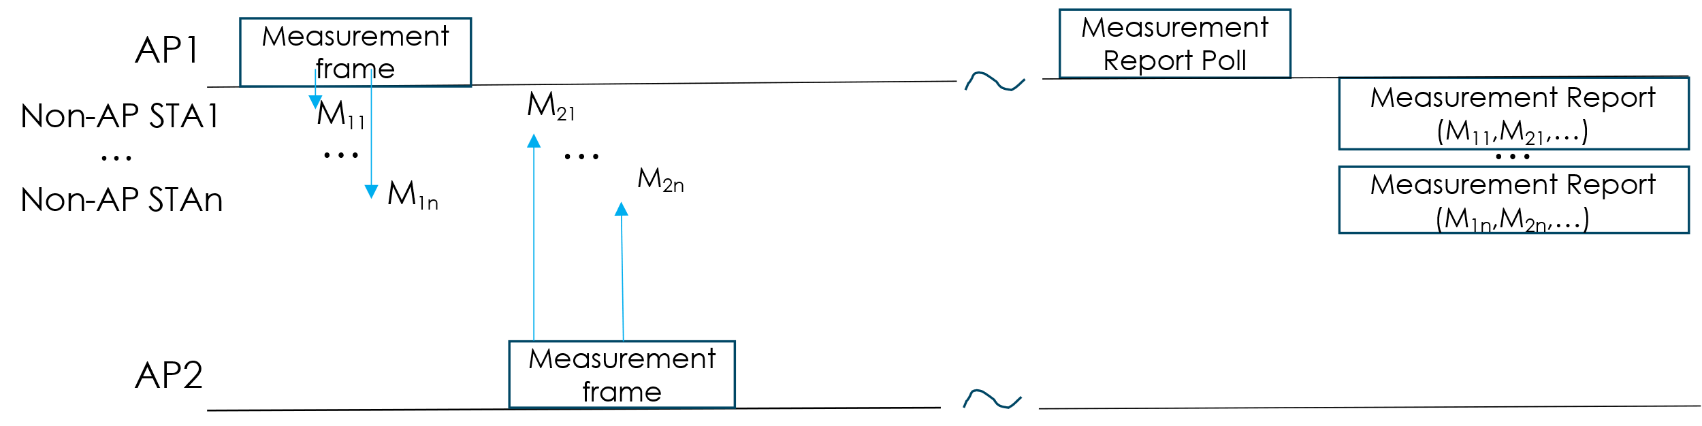
Measurement and Report
A Measurement and Report phase is used for the sharing AP to gather formation on the interference from the potential shared APs to the sharing AP’s potential receiving non-AP STAs [3]
  Direct measurement: RSSI
  Derived measurement: Pathloss, if the TX Power of the Measurement frame is known

Slide 5
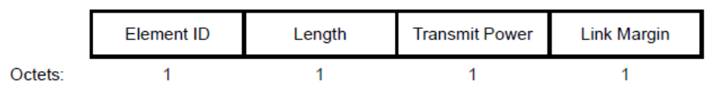
Measurement Frames: Option 1
Beacon/Measurement Pilot frames as Measurement frames
  Existing management frames
  Periodically available every Beacon interval
    A smaller Measurement Pilot frame could be transmitted more often
To derive the pathloss
  Method 1: include the TPC Report element
    The non-AP STAs need to decode the Transmit Power, get the difference between the Transmit Power and the measured RSSI as the pathloss, and report the pathloss back to their associated AP
  Method 2: default TX power for Beacon/Measurement Pilot frames
    APs pre-agree on their TX power for Beacon/Measurement Pilot frames during Co-SR MAPC agreement negotiation. The sharing AP calculates the pathloss as the difference between the default TX power and the RSSI reported by the non-AP STAs

Slide 6
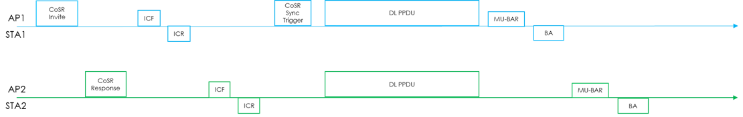
Measurement Frames: Option 2
Co-SR Invite/Response and ICF/ICR frames as Measurement frames
  Similar TXOP level frame exchange sequence proposed for eMLSR/DPS clients participating in Co-BF [4]
  Instant measurement
To derive the pathloss
  The TX power of the Co-SR Response frame is indicated by AP2 in the frame, or specified by AP1 in the Co-SR Invite frame, or pre-agreed during the MAPC agreement negotiation
  STA1 measures the RSSI of the Co-SR Response frame from AP2 and calculates the pathloss to report in its ICR to AP1, or STA1 reports the RSSI in its ICR to AP1 and AP1 calculates the pathloss
  STA2 measures the RSSI of the ICF from AP1 and reports the AP1-> STA2 pathloss to AP2, or AP2 calculates the pathloss for STA2 in a similar fashion

Slide 7
Summary
To set an absolute TX power for a shared AP during the concurrent Co-SR transmissions, a sharing AP needs to know the pathloss from the shared AP to the sharing AP’s receiving STA
  Explicit TX power indication or a default TX power understanding is needed for measurement frames from the shared AP to the non-AP STAs of the sharing AP
  Such measurement frames can be
    Beacon/Measurement Pilot frames sent with the TPC Report element included or with a default TX power
    Co-SR Invite/Response and ICR/ICF frames in a TXOP level frame exchange sequence

Slide 8
References
IEEE 802.11-25/0254r0, “Co-SR Power Control Considerations,” January 2025.
IEEE 802.11-24/0209r16, “Specification Framework for TGbn,” July 2025.
IEEE 802.11-24/0640r0, “Consideration on C-SR Types,” May 2024.
IEEE 802.11-25/0412r3, “CoBF Frame Sequences and Signaling Details,” March 2025.

Slide 9
SP #1
Do you support that the 11bn Beacon/Measurement Pilot frames should include the TPC Report element if the transmitting AP has an active Co-SR MAPC agreement?

