Slide 1
Rate Splitting Multiple Access for 802.11
Date: 2025-07-29
Authors:

Slide 2
Abstract
Rate Splitting Multiple Access (RSMA) is a physical layer generalized downlink multiplexing scheme
  Flexible architecture that can extend the current beamforming architecture to support unicast, multicast, a combination of unicast and multicast beamforming
RSMA enables novel use-cases at the application level like broadcasting complementing 802.11bc
RSMA can be integrated well into the 802.11 standards

Slide 3
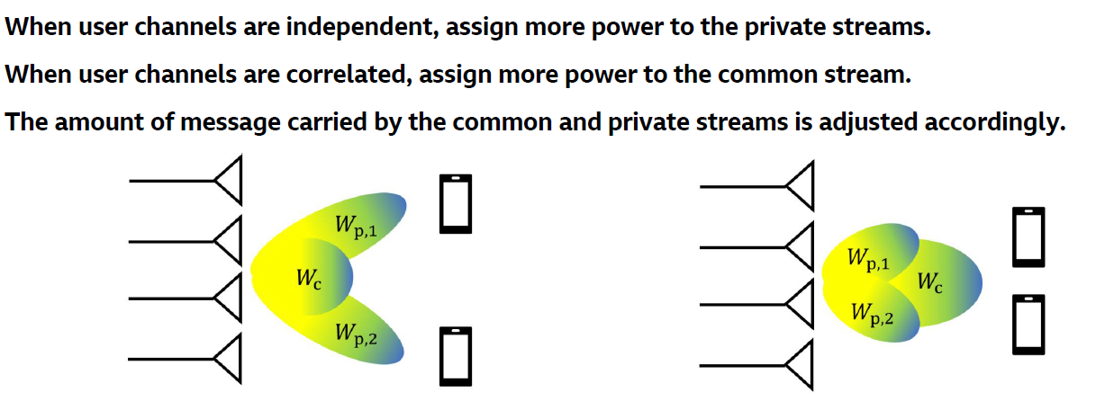
RSMA: Introduction
Dynamically switch between unicast dominated and multicast dominated beamforming based on user channels
The common stream can be used for multicasting or for transmitting unicast bits of both users (encrypted)
  Enhanced spectral efficiency
Unicast dominated
Multicast dominated
RSMA supports an arbitrary number of unicast users

Slide 4
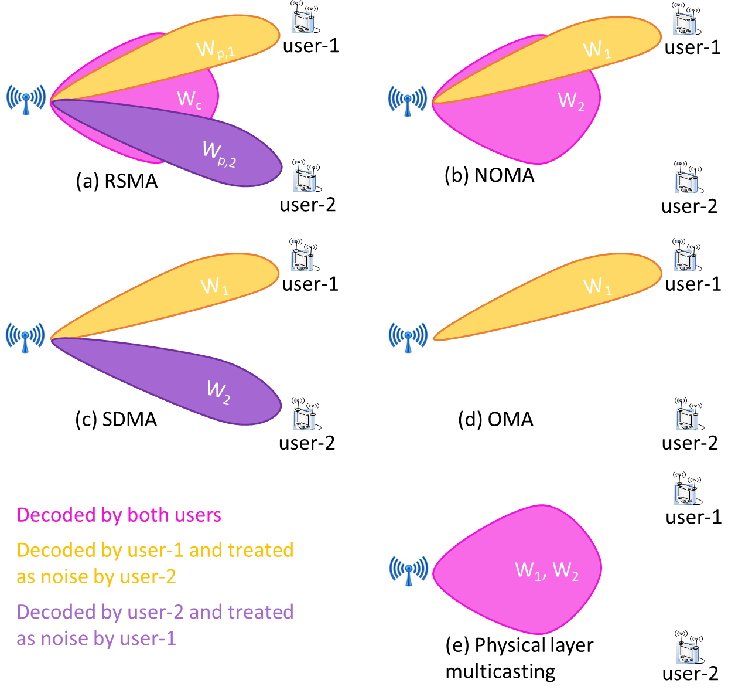
RSMA: Flexibility and Generality
RSMA subsumes several well-known multiplexing schemes
  NOMA, SDMA, and OMA
  Therefore, an AP supporting RSMA also supports these schemes as “RSMA modes”
RSMA modes can be dynamically switched based on user requirements and CSI

Slide 5
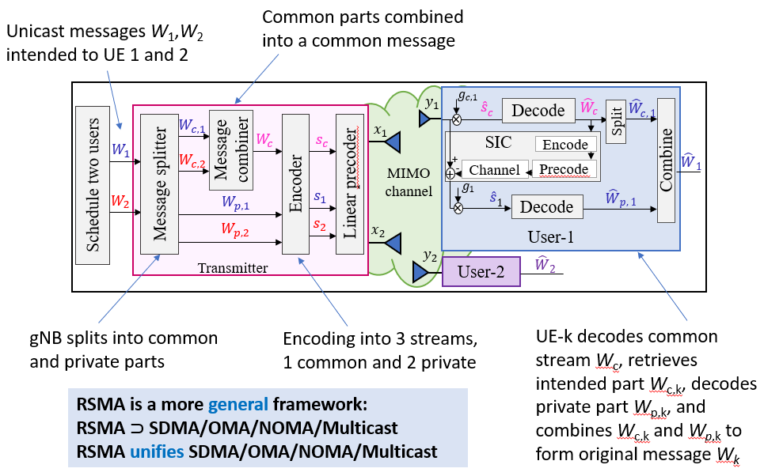
RSMA: PHY Architecture
RSMA integrates well with existing MIMO architecture of 802.11
RSMA is a generalization of multicast and unicast support in 802.11

Slide 6
RSMA: Integration with 802.11
RSMA enables seamless combination of unicast and multicast beamforming in 802.11be, enabling novel application scenarios
  The combination overcomes poor spectral efficiency observed in 802.11 broadcasting
Optical multicast (common) and unicast beamformers along with bit allocations can be computed based on the beamforming reports from STAs with CSI
  Resource allocation must be made more flexible
Primary challenges
  Low complexity, latency, and high-performance receivers at the STAs
  Retransmission techniques for multicast information

Slide 7
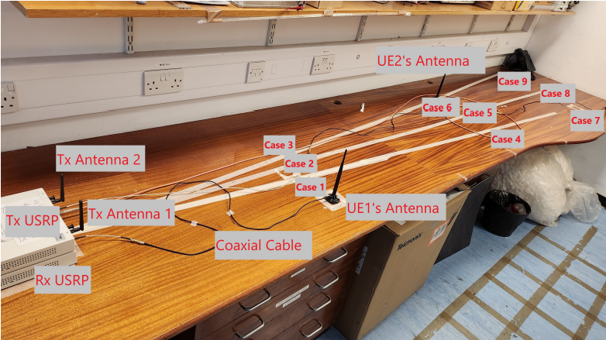
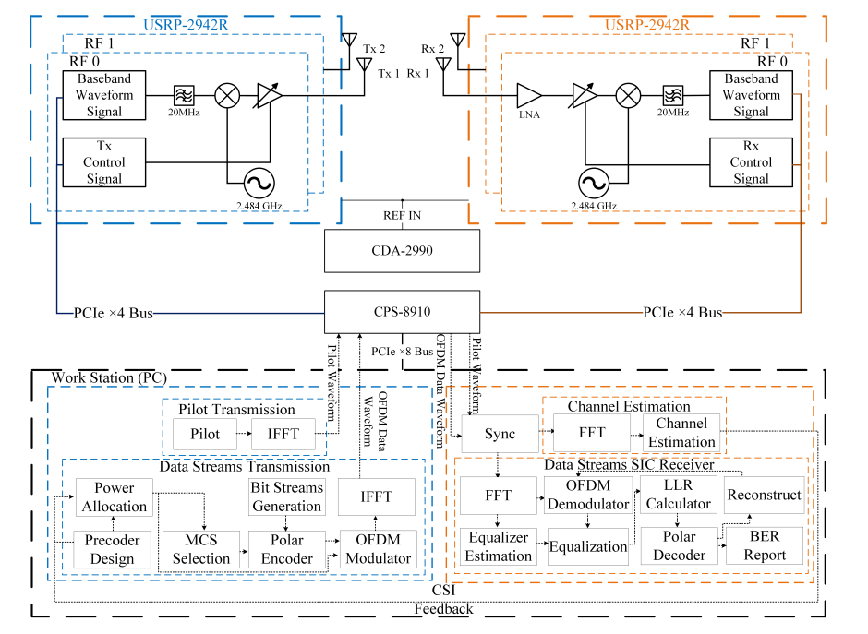
RSMA: Demonstrator
RSMA demonstrator for two users employing SIC¹
¹ Successive Interference Cancellation

Slide 8
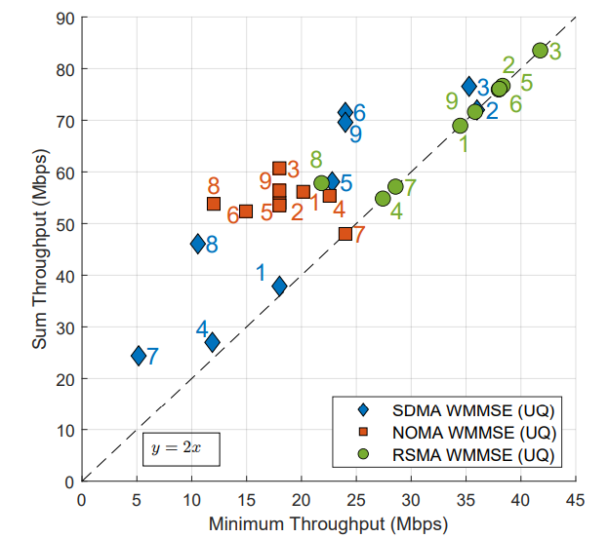
RSMA: Demonstrator Results
RSMA with a combination of unicast and multicast has the best performance
RSMA can be adapted to NOMA or SDMA on need basis

Slide 9

References
[1] | B. Clerckx et al., "A Primer on Rate-Splitting Multiple Access: Tutorial, Myths, and Frequently Asked Questions," in IEEE Journal on Selected Areas in Communications, vol. 41, no. 5, pp. 1265-1308, May 2023
[2] | Y. Mao, O. Dizdar, B. Clerckx, R. Schober, P. Popovski and H. V. Poor, "Rate-Splitting Multiple Access: Fundamentals, Survey, and Future Research Trends," in IEEE Communications Surveys & Tutorials, vol. 24, no. 4, pp. 2073-2126, Q4 2022
[3] | D. Vargas, ETSI ISG MAT, Recap on Motivation, ToR, and 3GPP 6G timelines, January 2025
Industry Specifications Group (ISG)
Multiple Access Techniques (MAT)
30+ companies

Slide 10
Thank You

