Slide 1
Rate Splitting Multiple Access for 802.11
Date: 2025-07-18
Authors:

Slide 2
Abstract
Rate Splitting Multiple Access (RSMA) is a physical layer generalized downlink multiplexing scheme
  Flexible architecture that can extend the current beamforming architecture to support unicast, multicast, a combination of unicast and multicast beamforming
RSMA enables novel use-cases at the application level like broadcasting complementing 11bc
RSMA can be integrated well into the 802.11 standards

Slide 3
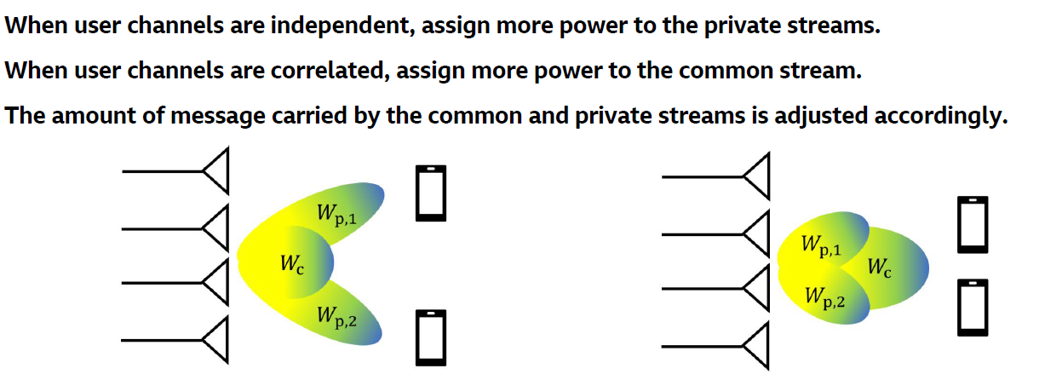
RSMA: Introduction
Dynamically switch between unicast dominated and multicast dominated beamforming based on user channels
Multicast-dominated precoding can be used for broadcasting or for transmitting (encrypted) bits of both users via the common stream
Unicast dominated
Multicast dominated

Slide 4
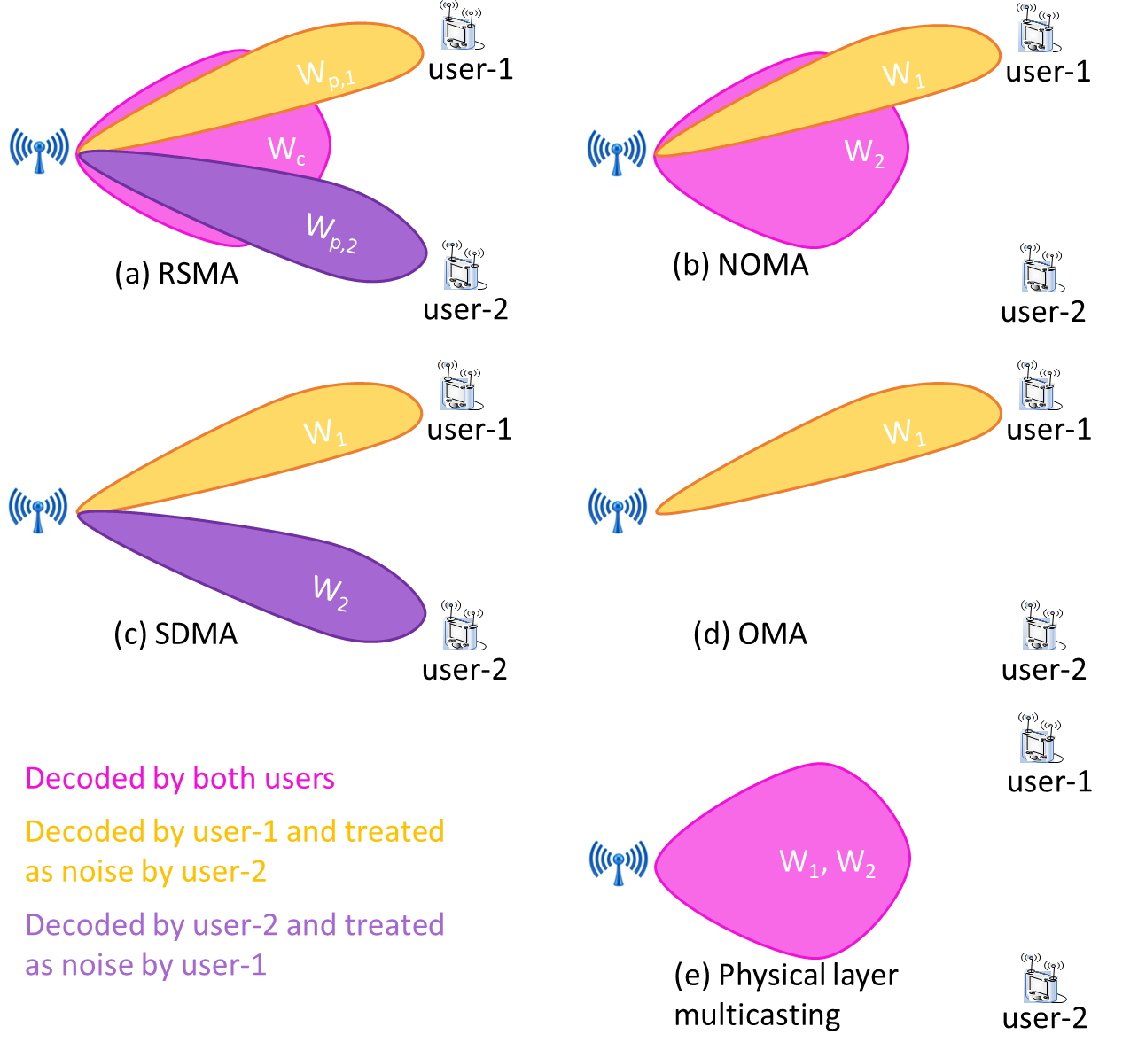
RSMA: Flexibility and Generality
RSMA subsumes several well-known multiplexing schemes: NOMA, SDMA, and OMA
  Therefore, an AP supporting RSMA also supports these schemes as “RSMA modes”
RSMA modes can be dynamically switched based on user requirements

Slide 5
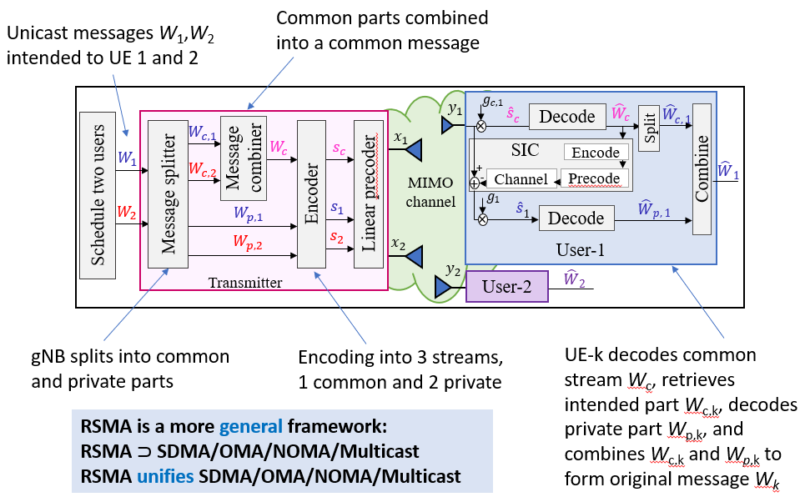
RSMA: PHY Architecture
RSMA integrates well with existing MIMO architecture

Slide 6
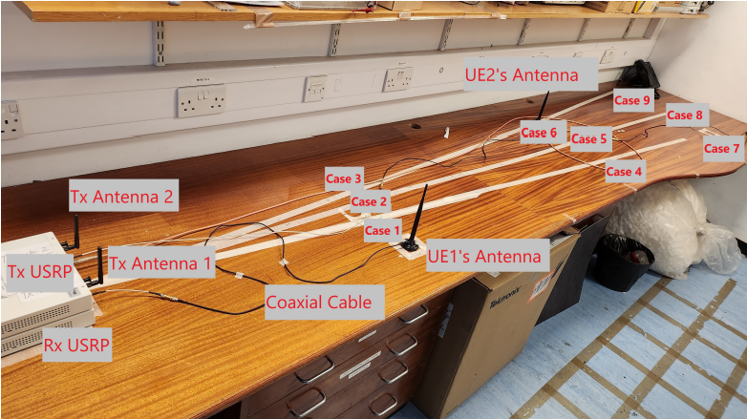
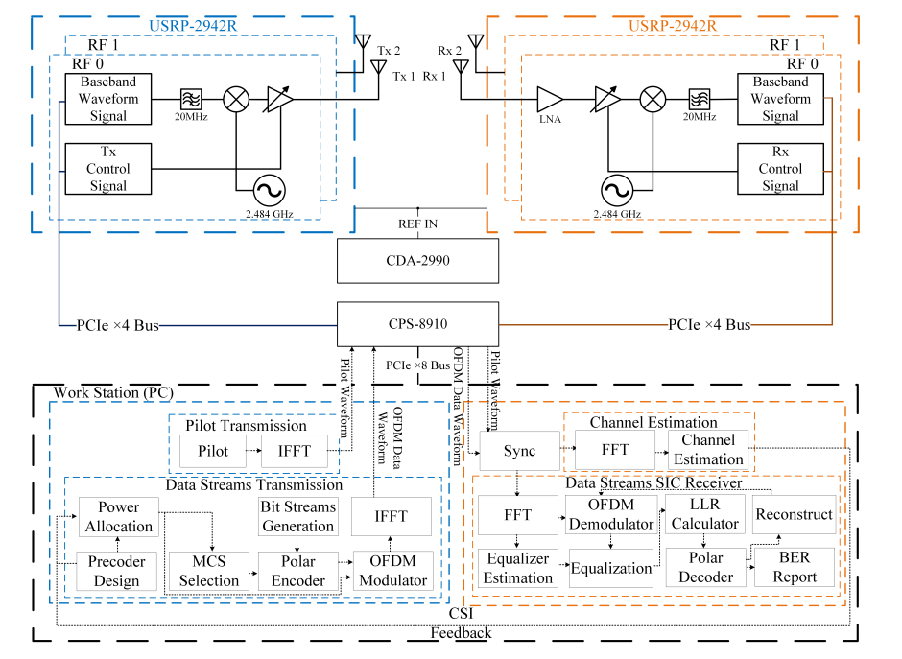
RSMA: Demonstrator
RSMA demonstrator for two users

Slide 7
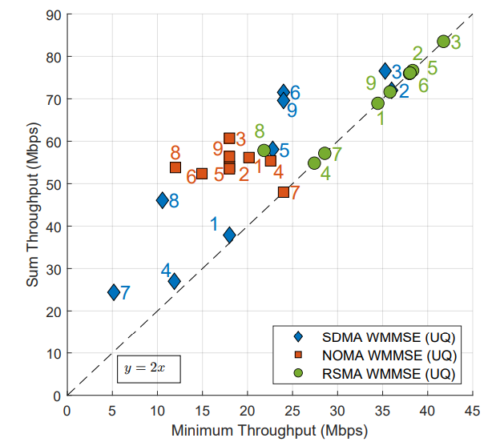
RSMA: Demonstrator Results
RSMA with a combination of unicast and multicast has the best performance
RSMA can be adapted NOMA or SDMA on need basis

Slide 8
References
[1] | B. Clerckx, Slides on “Rate Splitting Multiple Access”, June 2025
[2] | D. Vargas, ETSI ISG MAT, Recap on Motivation, ToR, and 3GPP 6G timelines, January 2025

Slide 9
Thank You

