Slide 1
Signal Design for Sensing Security/Privacy in ISAC
July 2025
Date: 2025-07-29
Authors:
Slide 1
Christos Masouros, University College London
Notes:
doc.: IEEE 802.11-yy/xxxxr0
Month Year
John Doe, Some Company
Page 1

Slide 2
Abstract
July 2025
The improvement of sensing performance from WiFi systems, opens up entirely new vulnerabilities to adversary sensing. This is the ability of entities outside the network to employ passive sensing and exploit the WiFi signals illuminating targets, for illegitimate localization, estimation or environment mapping. This presentation discusses a technology to enable legitimate sensing form the WiFi Network, while obstructing sensing from external, malicious or otherwise adversary entities.
Slide 2
Christos Masouros, University College London
Notes:
doc.: IEEE 802.11-yy/xxxxr0
Month Year
John Doe, Some Company
Page 2

Slide 3
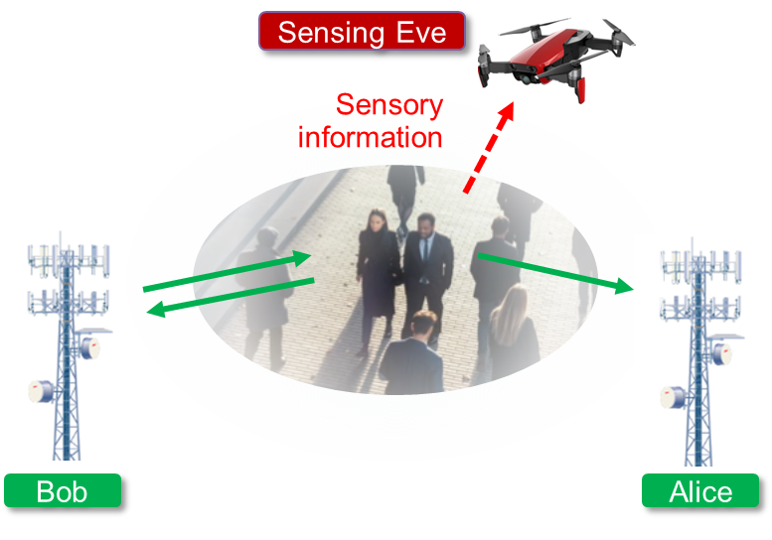
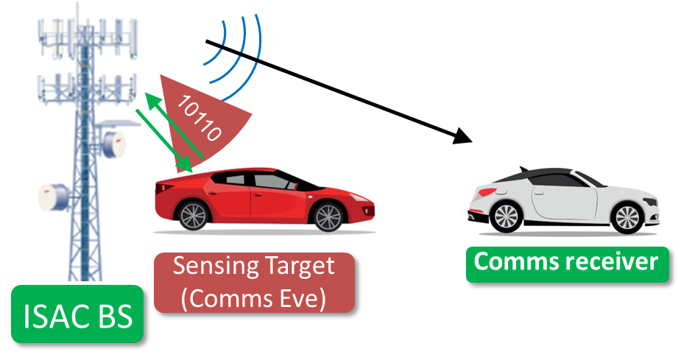
ISAC Subject to Security threats?
July 2025
Challenge: Data Confidentiality
Challenge: Sensing Privacy
No data link to encrypt!
Sensing with data-carrying signals opens up the opportunity for data eavesdropping from malicious targets.
What stops an adversary sensor from doing passive sensing of people / assets / critical infrastructure?
N. Su, F. Liu, J. Zou, C. Masouros, G. Alexandropoulos, A. Mourad, J. L. Hernando, Q. Zhang, T. Chan, “Integrating Sensing and Communications in 6G? Not until it is Secure to do so”, IEEE Wireless Comms., under review
Slide 3
Christos Masouros, University College London
Notes:
3

Slide 4
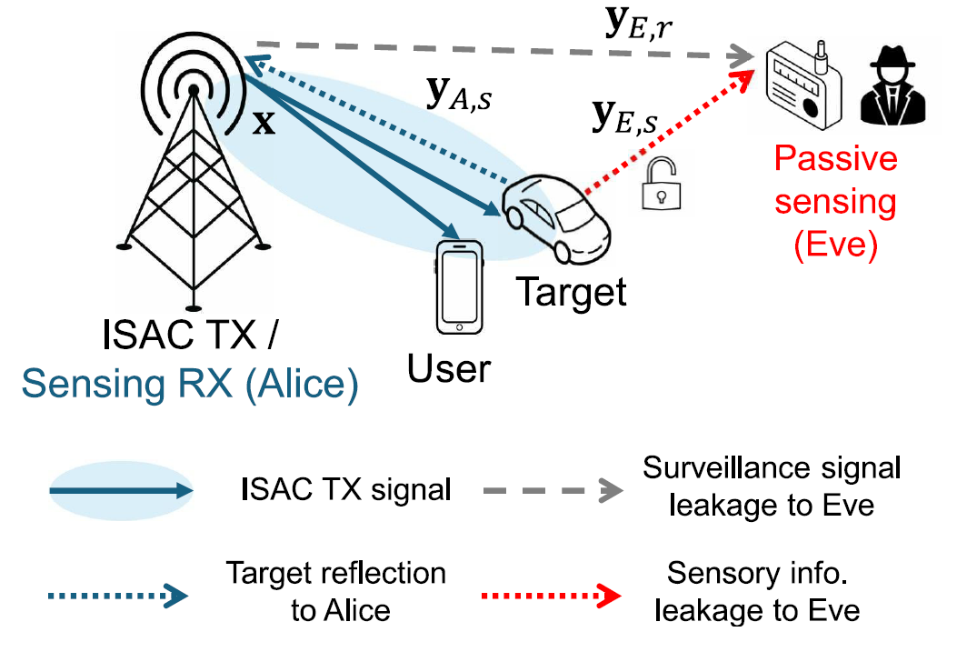
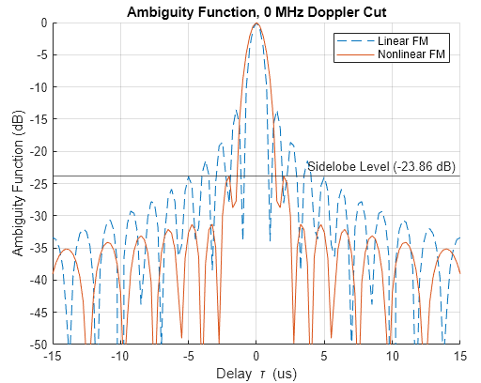
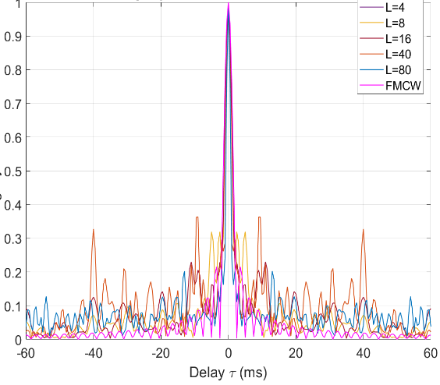
Ambiguity Function ‘engineering’
July 2025
Adversary sensing scenario
Target
Engineer artificial sidelobes into the AF that:
Create ‘ghost’ targets at the Sensing Eve and obstruct adversary / unauthorised sensing
Are resolvable at the legitimate sensor by simple techniques such as Reciprocal Filtering
True target
Artificial sidelobes
Artificial (ghost) targets
Slide 4
Christos Masouros, University College London
Notes:
4

Slide 5

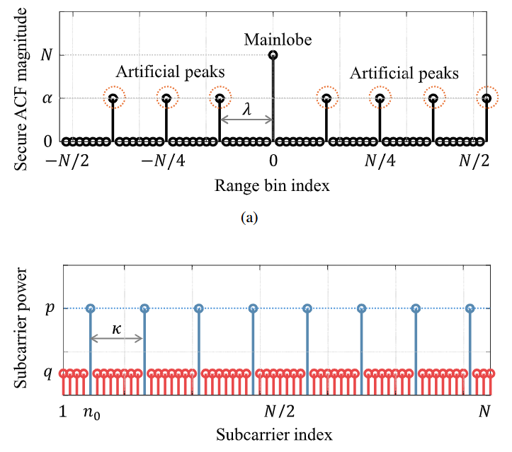

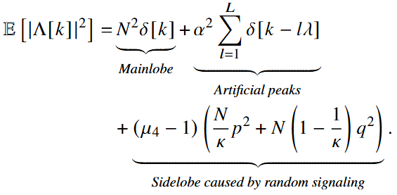
Change the OFDM subcarrier power allocation
July 2025
Idea: design an OFDM power allocation approach to create artificial AF sidelobes
OFDM Subcarrier power allocation, W
Ambiguity function,
K. Han, C. Masouros, “methods and apparatus for preventing unauthorized sensing”, PATENT filed
K. Han, K. Meng, C. Masouros, “Sensing-Secure ISAC: Ambiguity Function Engineering for Impairing Unauthorized Sensing” IEEE Trans Wireless Comm, under review
Slide 5
Christos Masouros, University College London

Slide 6
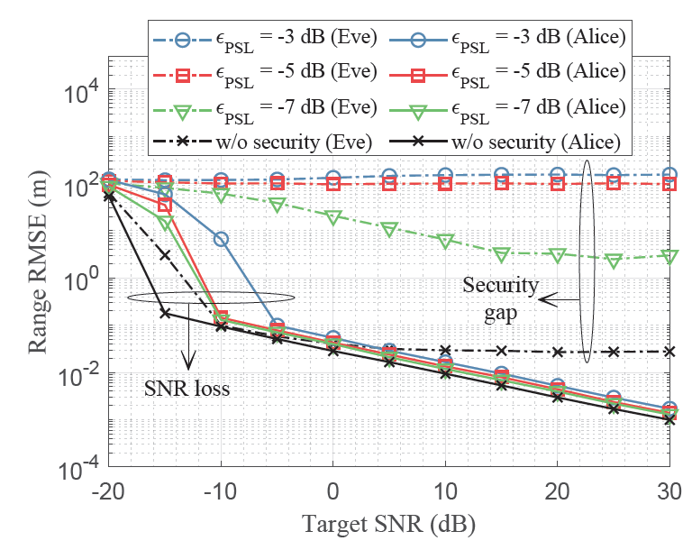
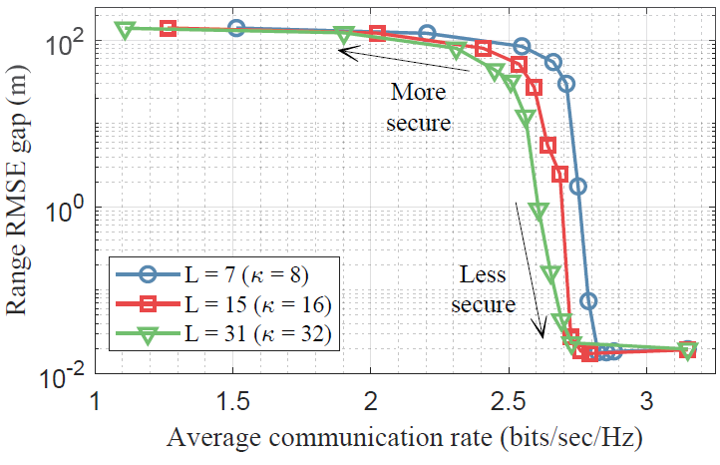
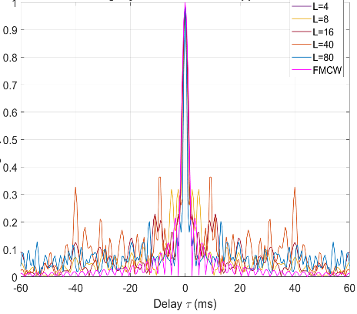
Simulation results
July 2025
Sensing Security
Sensing Security vs Comms trade-off
𝐿: #artificial peaks in AF
Є_{PSL}: AF peak sidelobe level
RMSE Gap increases with PSL level
RMSE Gap increases with #artificial peaks in AF
Trade-off between Secure Sensing vs Comms performance
Slide 6
Christos Masouros, University College London

Slide 7
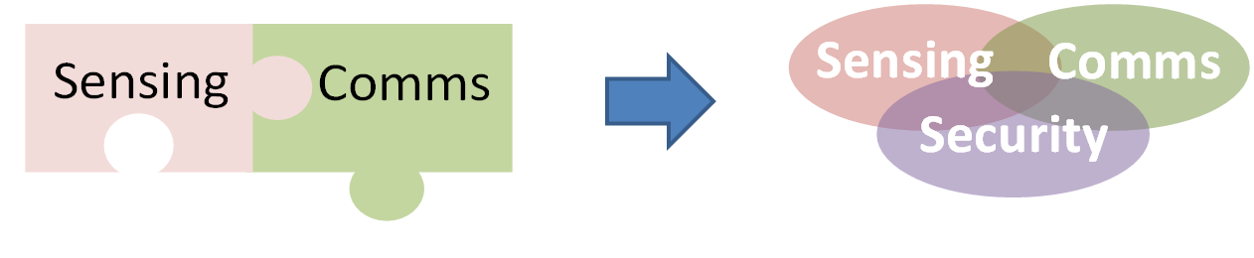

Take Away
Need for 802.11 community to consider moving forward
Risks of ISAC not making it commercially if it is not (perceived to be) secure for its users
Put security at the core of ISAC research
Consider counter measures for adversary / unauthorised sensing
Other security risks include:
  Data security
  Jamming / Spoofing
  Injection of false data
ISAC ISG (90+ industries)
WI4: Security, Trustworthiness,
Sustainability

Slide 8
References
July 2025
N. Su, F. Liu, J. Zou, C. Masouros, G. Alexandropoulos, A. Mourad, J. L. Hernando, Q. Zhang, T. Chan, “Integrating Sensing and Communications in 6G? Not until it is Secure to do so”, IEEE Wireless Comms., under review
K. Han, K. Meng, C. Masouros, “Sensing-Secure ISAC: Ambiguity Function Engineering for Impairing Unauthorized Sensing” IEEE Trans Wireless Comm, under review
Slide 8
Christos Masouros, University College London
Notes:
doc.: IEEE 802.11-yy/xxxxr0
Month Year
John Doe, Some Company
Page 8

