Slide 1
DLMuC: AI-driven Dirty Paper Coding for Multiuser MIMO
July 2025
Authors:
Date: 2025-07-07
Slide 1
Mathini Sellathurai, Heriot-Watt University
Notes:
doc.: IEEE 802.11-yy/xxxxr0
Month Year
John Doe, Some Company
Page 1

Slide 2
Abstract
Contribution (DLMuC): We present a new design of MU-MIMO (Multi-User Multiple Input Multiple Output) systems for Wi-Fi using AI-driven dirty paper coded-modulation.
The proposed solution, DLMuC (Deep Learning Multi-user Coding), introduces a deep-learning–based approach to dirty paper coding. The model is trained offline to learn optimal precoding strategies across varying user configurations and transmission rates. These learned codes can then be computed in real time during deployment, enabling scalable and efficient multi-user scheduling with minimal overhead.
Slide 2
Name, Affiliation
Notes:
doc.: IEEE 802.11-yy/xxxxr0
Month Year
John Doe, Some Company
Page 2

Slide 3
Why DLMuC?
Traditional Wi-Fi operating in the 2.4 GHz and 5 GHz bands faces significant congestion, particularly in enterprise environments with high device density, for example, offices and public venues, with a large number of connected devices or IoTs. This results in increased interference, reduced throughput, and inconsistent performance, limiting the scalability and reliability of wireless networks.
To address these challenges, the development of practical Dirty Paper Coding (DPC) schemes for multi-user MIMO environments is highly beneficial. DPC allows multiple users to be served simultaneously within the same time-frequency resources while effectively mitigating known interference.

Slide 4
Conventional Multiuser Schemes
NOMA vs. OMA (Compressed Overview): OMA suffers from poor spectral efficiency, while NOMA—despite its potential advantages—is highly sensitive to user channel conditions (CSI), power allocation factors (PAF), and the successive interference cancellation (SIC) order. Effective NOMA deployment requires a minimum SNR gap of ~8 dB between strong and weak users, and SIC introduces added complexity and risk of error propagation, especially when multiple users are decoded sequentially.

Slide 5
Proposed Technology
The approach leverages AI models to overcome conventional complexity and channel dependency challenges in DPC. The methodology comprises:
Training an AI-based encoder network at the transmitter to map aggregate input streams from multiple users into a set of transmission symbols. This encoder learns to embed interference-aware signals optimized for downstream recovery.
Training multiple AI-based decoder networks, each associated with an individual user equipment (UE), to decode the received signal and reconstruct the intended user-specific input stream.
The system requires only the user’s ordering information for decoding, eliminating the need for conventional power allocation, interference alignment, or assumptions of strong vs. weak signal relationships.
The training framework is designed such that Channel State Information (CSI) at the transmitter is not required. We offer robust decoding solutions for both receiver-side CSI availability and CSI-free scenarios, enabling flexible deployment under practical constraints.

Slide 6
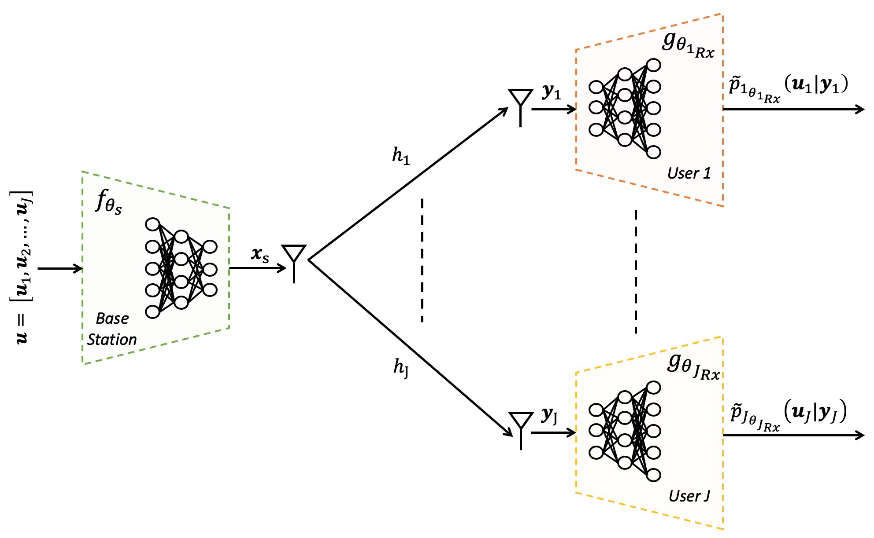
The Technology (AI driven Design)
allows dirty paper coding designs for MU-MIMO using deep learning, end-to-end training and deployment, non-orthogonal multiple access, downlink communications by AI. The CSI is not required at the AP.
allows AP to multiplex a large number of users' signals in a frequency band at the same time.
allows CSI at the receivers or no-CSI at the receivers (differential)
Once trained, there is no need for additional training.
At the same time-frequency block, we can pack at least twice the number of user equipment (UE) at much higher rates in a beam or sector compared to currently supported WiFI, 5G base station (BS) or Satellites using the proposed Ai driven designs.

Slide 7
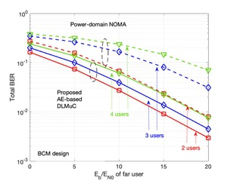
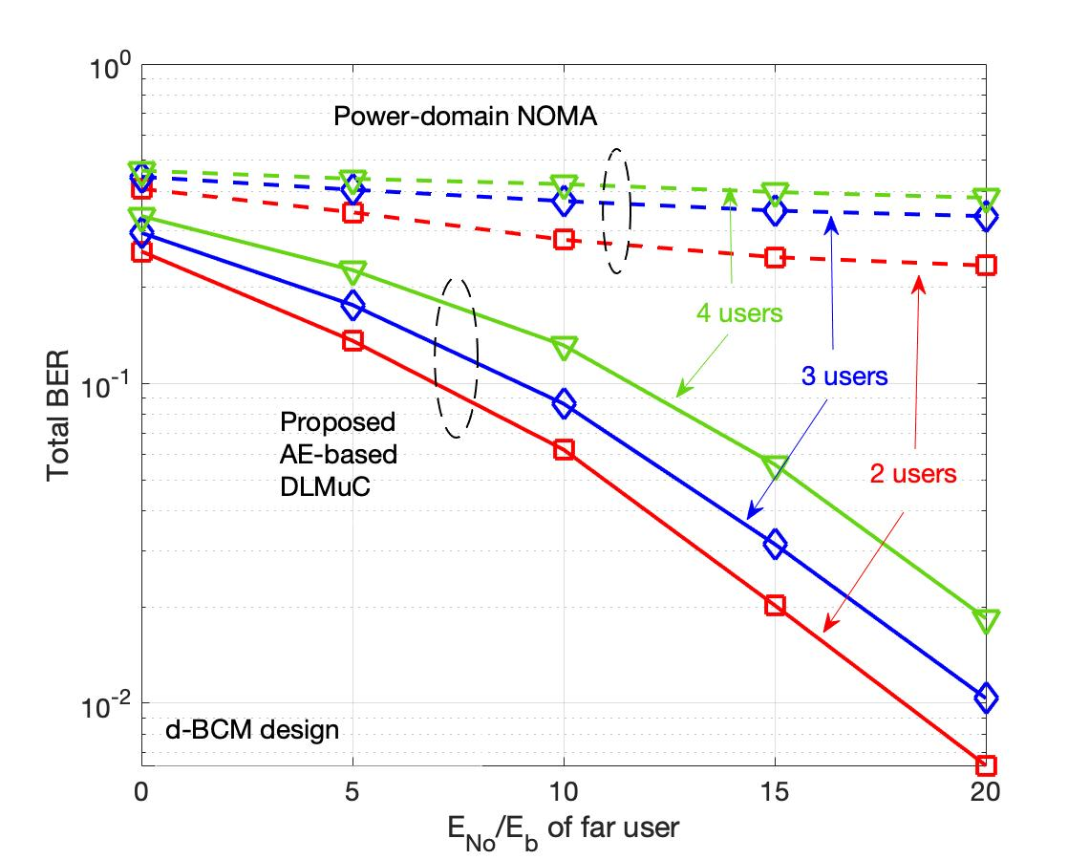
Results of with and without CSI at the transmitter and receiver
BER performance of the proposed designs without CSI (differential designs) compared to Power-Domain NOMA. Power Domain NOMA is not functional without CSI
BER performance of the proposed designs with CSI at the receiver compared to Power-Domain NOMA

Slide 8
Gains over power domain NOMA for two users Physical Layer Contribution
SNR Gaps Between Users
=0 dB and 6dB
SNR Gaps Between Users
=0 dB and 6dB
Trial 2

Slide 9
Industrial Interest
AI-driven encoding and decoding — provides a more robust and scalable solution by using the best possible separation between users and eliminates the need for successive Interference Cancellation (SIC) Receivers. It is less sensitive to CSI inaccuracies. It aligns well with multi-antenna systems (which NOMA has no straightforward/easy solution), offering better multiplexing gains and rate performance.
Industries such as telecommunications Cellular and WiFi Chip developers, defense, industrial automation, and smart infrastructure are increasingly interested in DPC-based solutions for: High-capacity downlink scheduling, Interference-aware transmission in dense networks, Secure and reliable communication in mission-critical systems

Slide 10
What would you like to achieve with the presentation?
Inclusion in Standards: AI-driven Dirty Paper Coding (DPC) is conceptually supported through advanced precoding but lacks standardized implementation. It could be adopted via PHY-layer extensions in Wi-Fi 9, especially where cloud-base radio access solutions enables offline training.
What Further Development is Needed?
Standardized training protocols (e.g., CSI assumptions, user ordering)
Defined complexity and interoperability thresholds for real-time decoding
Alignment with existing channel models and feedback mechanisms
Engagement with standard bodies to establish benchmarks and performance targets

Slide 11
References
[1] A. Gupta, M. Sellathurai and T. Ratnarajah, End-to-End Learning-Based Full-Duplex Amplify -and-Forward Relay Networks, in IEEE Transactions on Communications, vol. 71, no. 1, pp. 199-213, Jan. 2023.
[2] N. M. Balasubramanya, A. Gupta and M. Sellathurai, “Combining Code-Domain and Power-Domain NOMA for Supporting Higher Number of Users,” 2018 IEEE Global Communications Conference (GLOBECOM),Abu Dhabi, United Arab Emirates, 2018, pp. 1-6, doi: 10.1109/GLOCOM.2018.8647770.
[3] A. Gupta, A. Bishnu, T. Ratnarajah, A. Adeel, A. Hussain and M. Sellathurai, "Deep Learning-Based Receiver Design for IoT Multi-User Uplink 5G-NR System," GLOBECOM 2023 - 2023 IEEE Global Communications Conference, Kuala Lumpur, Malaysia, 2023, pp. 4110-4115, doi: 10.1109/GLOBECOM54140.2023.10437776.
Slide 11
Notes:
doc.: IEEE 802.11-yy/xxxxr0
Month Year
John Doe, Some Company
Page 11

