Slide 1
EVM Definition for UHR DRU TB PPDU Followup
Date: 2025-07-19
Authors:

Slide 2
Introduction
In the May meeting, the transmit constellation error requirement of UHR TB PPDU using RRU is defined in Draft P802.11bn_D0.3 [1, 2] for new MCSs.
In this contribution, we proposed the requirements of UHR TB PPDU using DRU:
    Transmit constellation error (TxEVM)
    Unused tone error (unused tone EVM)

Slide 3
Recap: Transmit Constellation Error Definition
MCS | Transmit Constellation Error in an UHR MU (dB) | Relative constellation error in an UHR RRU TB PPDU when transmit power is larger than the maximum power of UHR-MCS 7 (dB) | Relative constellation error in an UHR RRU TB PPDU when transmit power is less than or equal to the maximum power of UHR-MCS 7 (dB)
BPSK 1/2 | -5 | -13 | -27
QPSK 1/2 | -10 | -13 | -27
QPSK 2/3 | -12 | -13 | -27
QPSK 3/4 | -13 | -13 | -27
16QAM 1/2 | -16 | -16 | -27
16QAM 2/3 | -18 | -18 | -27
16QAM 3/4 | -19 | -19 | -27
16QAM 5/6 | -20 | -20 | -27
64QAM 2/3 | -22 | -22 | -27
64QAM 3/4 | -25 | -25 | -27
64QAM 5/6 | -27 | -27 | -27
256QAM 2/3 | -29 | -29 | -29
256QAM 3/4 | -30 | -30 | -30
256QAM 5/6 | -32 | -32 | -32
1024QAM 3/4 | -35 | -35 | -35
1024QAM 5/6 | -35 | -35 | -35
4096QAM 3/4 | -38 | -38 | -38
4096QAM 5/6 | -38 | -38 | -38

Slide 4
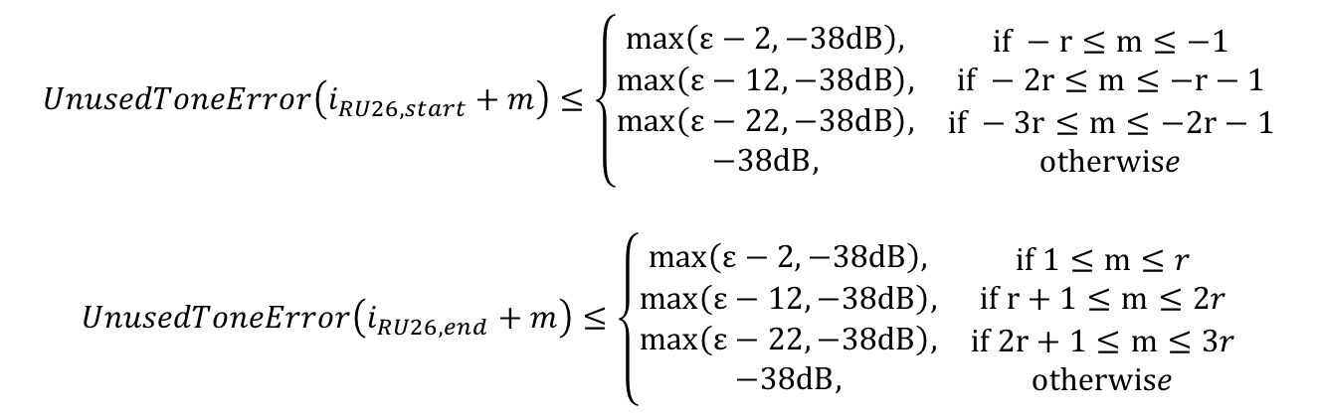
Recap: Unused Tone EVM for RRU
EHT unused tone error is defined as follows:
  The profile reflects the effect of physical RU separation/distance
$$UnusedToneError\left(i_{RU26, start}+m\right)≤\left\{\begin{matrix}\begin{matrix}max\left(ε−2, −38dB\right), \\ max\left(ε−12, −38dB\right),\end{matrix} & \begin{matrix}if −r≤m≤−1 \\ if −2r≤m≤−r−1\end{matrix} \\ \begin{matrix}max\left(ε−22, −38dB\right), \\ −38dB,\end{matrix} & \begin{matrix}if −3r≤m≤−2r−1 \\ otherwise\end{matrix}\end{matrix}\right.$$
$$UnusedToneError\left(i_{RU26, end}+m\right)≤\left\{\begin{matrix}\begin{matrix}max\left(ε−2, −38dB\right), \\ max\left(ε−12, −38dB\right),\end{matrix} & \begin{matrix}if 1≤m≤r \\ if r+1≤m≤2r\end{matrix} \\ \begin{matrix}max\left(ε−22, −38dB\right), \\ −38dB,\end{matrix} & \begin{matrix}if 2r+1≤m≤3r \\ otherwise\end{matrix}\end{matrix}\right.$$
UHR TB PPDU using RRU adopts the same unused tone error definition and requirement as EHT TB PPDU [2].

Slide 5
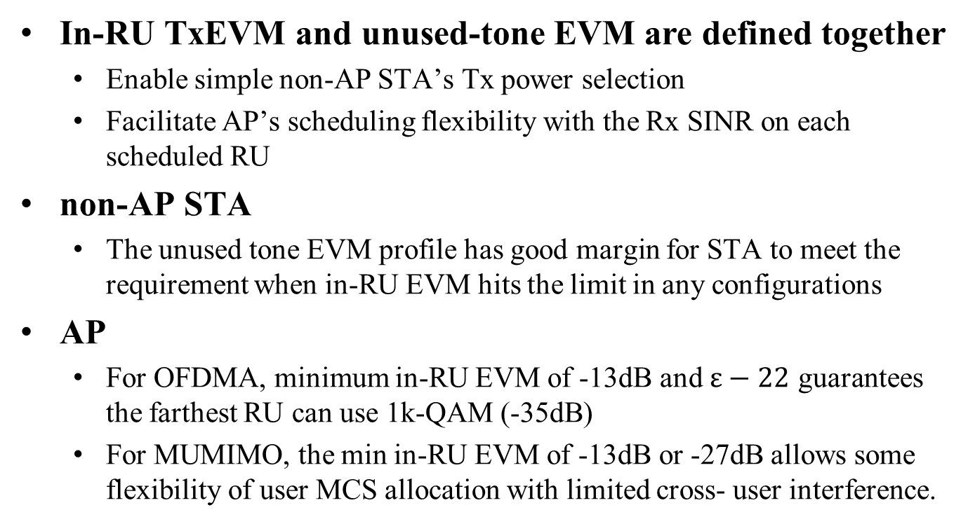
RRU TxEVM and unused tone EVM
In-RU TxEVM and unused-tone EVM are defined together
  Enable simple non-AP STA’s Tx power selection
  Facilitate AP’s scheduling flexibility with the Rx SINR on each scheduled RU
non-AP STA
  The unused tone EVM profile has good margin for STA to meet the requirement when in-RU EVM hits the limit in any configurations
AP
  For OFDMA, minimum in-RU EVM of -13dB and $ε−22$ guarantees the farthest RU can use 1k-QAM (-35dB)
  For MUMIMO, the min in-RU EVM of -13dB or -27dB allows some flexibility of user MCS allocation with limited cross- user interference.

Slide 6
DRU TxEVM and unused tone EVM
DRU is proposed for OFDMA only without MUMIMO
Same philosophy as RRU can be followed
  Tx EVM: adopt the same transmit constellation error definition as RRU: two levels of min TxEVM based on MCS7 Tx power
  Unused tone EVM: should give some margin so that the non-AP STA can meet the requirement for various scenarios when in-band EVM meets

Slide 7
Table of Transmit Constellation Error Definition
MCS | Transmit Constellation Error in an UHR MU (dB) | Relative constellation error in an UHR TB PPDU using RRU when transmit power is larger than the maximum power of UHR-MCS 7 (dB) | Relative constellation error in an UHR TB PPDU using RRU when transmit power is less than or equal to the maximum power of UHR-MCS 7 (dB)
BPSK 1/2 | -5 | -13 | -27
QPSK 1/2 | -10 | -13 | -27
QPSK 2/3 | -12 | -13 | -27
QPSK 3/4 | -13 | -13 | -27
16QAM 1/2 | -16 | -16 | -27
16QAM 2/3 | -18 | -18 | -27
16QAM 3/4 | -19 | -19 | -27
16QAM 5/6 | -20 | -20 | -27
64QAM 2/3 | -22 | -22 | -27
64QAM 3/4 | -25 | -25 | -27
64QAM 5/6 | -27 | -27 | -27
256QAM 2/3 | -29 | -29 | -29
256QAM 3/4 | -30 | -30 | -30
256QAM 5/6 | -32 | -32 | -32
1024QAM 3/4 | -35 | -35 | -35
1024QAM 5/6 | -35 | -35 | -35
4096QAM 3/4 | -38 | -38 | -38
4096QAM 5/6 | -38 | -38 | -38

Slide 8
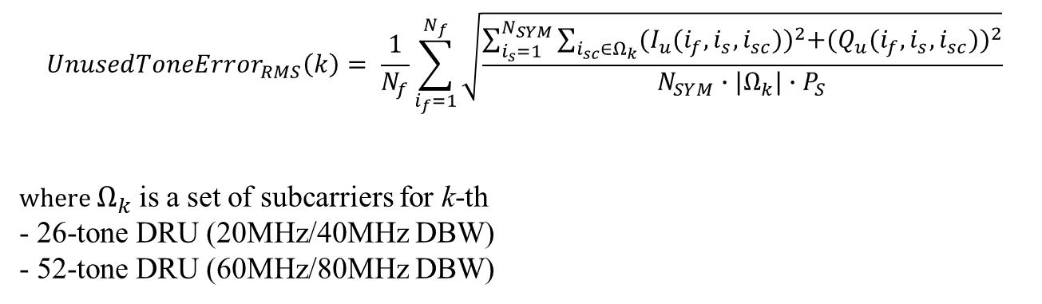
Unused Tone Error Definition for DRU
For UHR DRU, the unused tone error can be defined similar to RRU as follows:
$${UnusedToneError}_{RMS}\left(k\right)= \frac{1}{N_{f}}\sum_{i_{f}=1}^{N_{f}}{\sqrt{\frac{\sum_{i_{s}=1}^{N_{SYM}}{\sum_{i_{sc}∈Ω_{k}}{{(I_{u}(i_{f},i_{s},i_{sc}))}^{2}+{(Q_{u}(i_{f},i_{s},i_{sc}))}^{2}}}}{N_{SYM}∙|Ω_{k}|∙P_{S}}}}$$
where $Ω_{k}$is a set of subcarriers for k-th
- 26-tone DRU (20MHz/40MHz DBW)
- 52-tone DRU (60MHz/80MHz DBW)

Slide 9
DRU Unused tone EVM Analysis
Simulation setup
  Rapp PA model with P=3
  IBO: PA input backoff w.r.t. saturation power
  MCS = 0
  Ntx=Nss=1
  num_of_packets = 100
  Init_sym = 16
Detailed unused tone EVM test results in the appendix

Slide 10
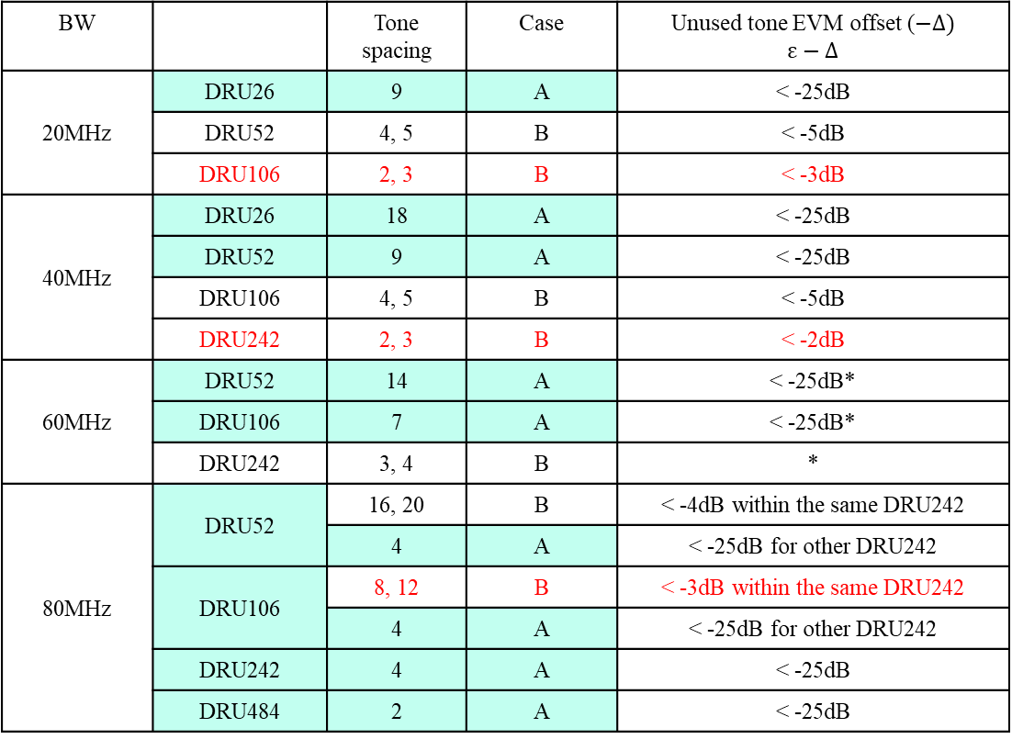
DRU unused tone EVM results
BW |  | Tone spacing | Case | Unused tone EVM offset ($−Δ)$ $$ε−Δ$$
20MHz | DRU26 | 9 | A | < -25dB
 | DRU52 | 4, 5 | B | < -5dB
 | DRU106 | 2, 3 | B | < -3dB
40MHz | DRU26 | 18 | A | < -25dB
 | DRU52 | 9 | A | < -25dB
 | DRU106 | 4, 5 | B | < -5dB
 | DRU242 | 2, 3 | B | < -2dB
60MHz | DRU52 | 14 | A | < -25dB*
 | DRU106 | 7 | A | < -25dB*
 | DRU242 | 3, 4 | B | *
80MHz | DRU52 | 16, 20 | B | < -4dB within the same DRU242
 |  | 4 | A | < -25dB for other DRU242
 | DRU106 | 8, 12 | B | < -3dB within the same DRU242
 |  | 4 | A | < -25dB for other DRU242
 | DRU242 | 4 | A | < -25dB
 | DRU484 | 2 | A | < -25dB
  * currently under testing

Slide 11
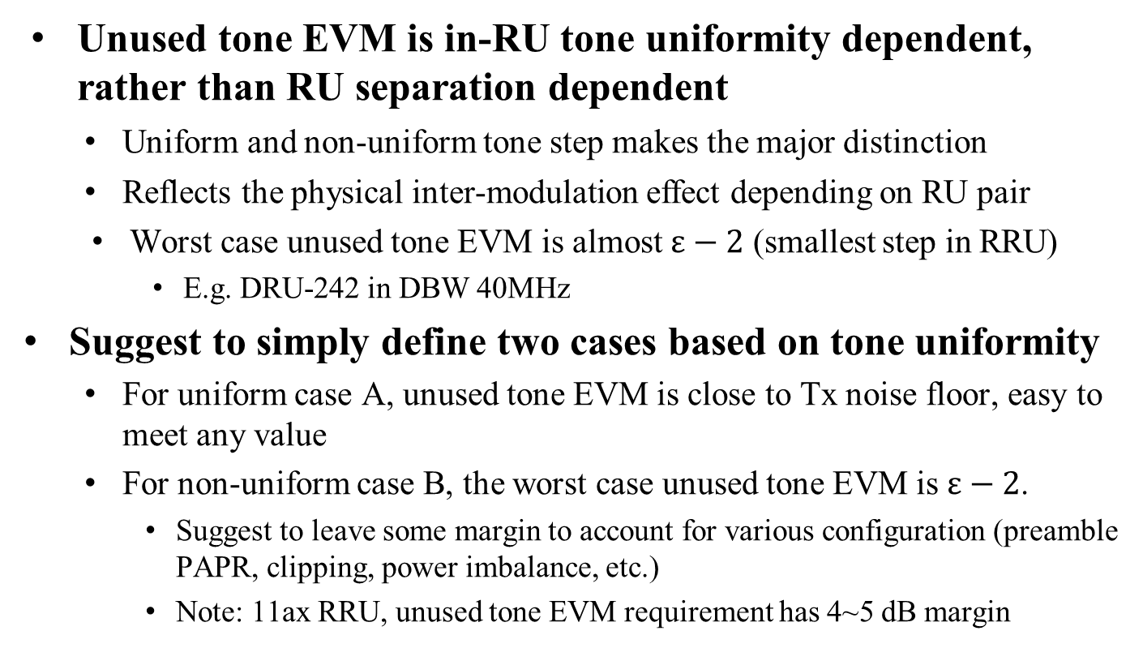
Discussions of Observation
Unused tone EVM is in-RU tone uniformity dependent, rather than RU separation dependent
  Uniform and non-uniform tone step makes the major distinction
  Reflects the physical inter-modulation effect depending on RU pair
  Worst case unused tone EVM is almost $ε−2$ (smallest step in RRU)
    E.g. DRU-242 in DBW 40MHz
Suggest to simply define two cases based on tone uniformity
  For uniform case A, unused tone EVM is close to Tx noise floor, easy to meet any value
  For non-uniform case B, the worst case unused tone EVM is $ε−2$.
    Suggest to leave some margin to account for various configuration (preamble PAPR, clipping, power imbalance, etc.)
    Note: 11ax RRU, unused tone EVM requirement has 4~5 dB margin

Slide 12
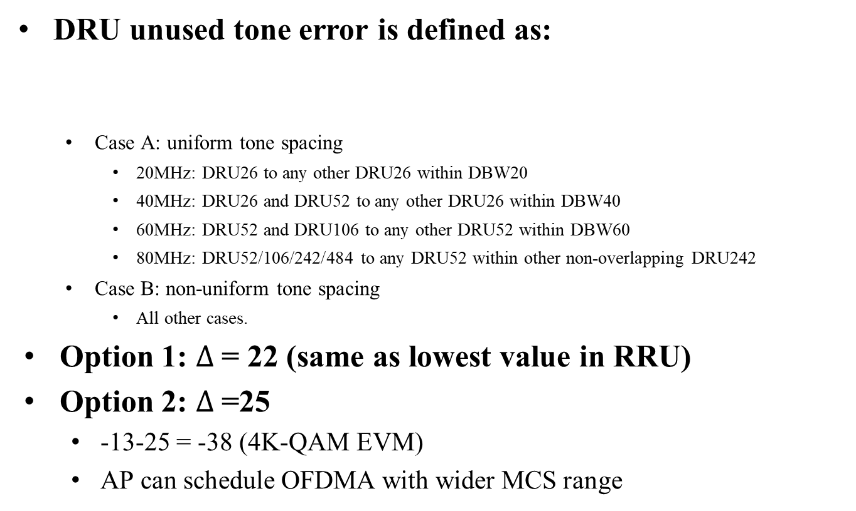
DRU Unused tone EVM Proposal
DRU unused tone error is defined as:
  Case A: uniform tone spacing
    20MHz: DRU26 to any other DRU26 within DBW20
    40MHz: DRU26 and DRU52 to any other DRU26 within DBW40
    60MHz: DRU52 and DRU106 to any other DRU52 within DBW60
    80MHz: DRU52/106/242/484 to any DRU52 within other non-overlapping DRU242
  Case B: non-uniform tone spacing
    All other cases.
Option 1: $Δ$= 22 (same as lowest value in RRU)
Option 2: $Δ$=25
  -13-25 = -38 (4K-QAM EVM)
  AP can schedule OFDMA with wider MCS range
$$UnusedToneError\left(i_{DRU26/52}\right)≤\left\{\begin{matrix}max\left(ε−Δ,−38dB\right), & case A \\ ε & case B\end{matrix}\right.$$

Slide 13
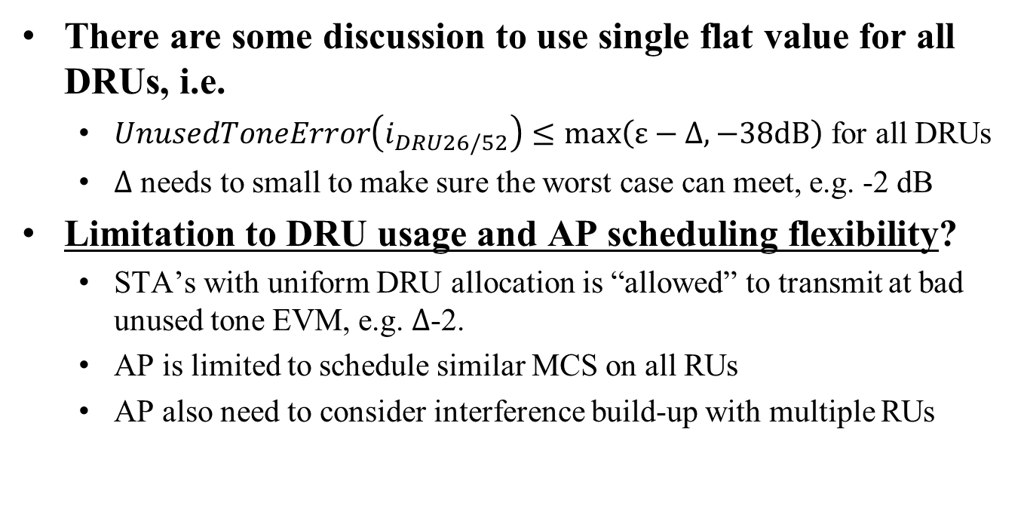
Discussions on single EVM value
There are some discussion to use single flat value for all DRUs, i.e.
  $UnusedToneError\left(i_{DRU26/52}\right)≤max\left(ε−Δ,−38dB\right)$ for all DRUs
  $Δ$ needs to small to make sure the worst case can meet, e.g. -2 dB
Limitation to DRU usage and AP scheduling flexibility?
  STA’s with uniform DRU allocation is “allowed” to transmit at bad unused tone EVM, e.g. $Δ$-2.
  AP is limited to schedule similar MCS on all RUs
  AP also need to consider interference build-up with multiple RUs
-13 | -15 | -15 | -15 | -13 | -15 | -15 | -15 | -13 | -15 | -15 | -15 | -13 | -15 | -15 | -15
-13 | -38 | -38 | -38 | -13 | -38 | -38 | -38 | -13 | -38 | -38 | -38 | -13 | -38 | -38 | -38

Slide 14
Summary
DRU in-RU EVM and unused tone EVM specification are discussed
Same in-RU EVM is suggested as RRU
Unused tone EVM is simulated and the value is highly tone-step dependent
Suggest to simply define two EVM values, one for DRUs with uniform step and one for DRUs with non-uniform step
  AP has more flexibility and confidence to schedule MCSs

Slide 15
Reference
[1] 11-25-0843-00-00bn-transmit-constellation-error-definition-uhr-rru.pptx
[2] 802.11bn D0.3

Slide 16
SP1
Do you agree to add the following to 11bn SFD?
  The transmit constellation error requirement for UHR TB PPDU using DRU is the same as UHR RRU?

Slide 17
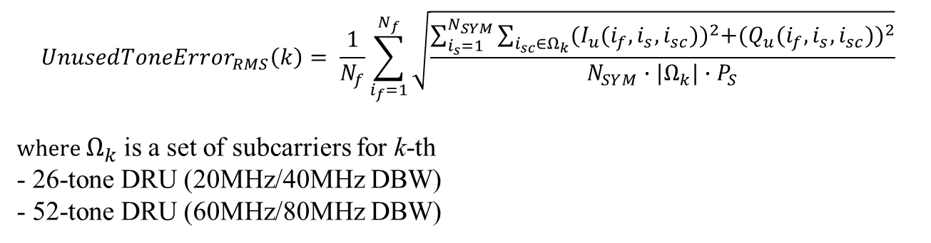
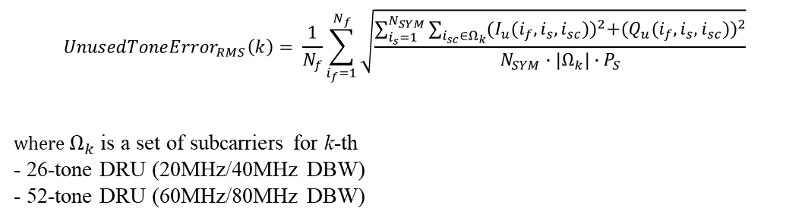
SP2
Do you agree to add the following to 11bn SFD?
  The unused constellation error in an UHR DRU TB PPDU is define as:
$${UnusedToneError}_{RMS}\left(k\right)= \frac{1}{N_{f}}\sum_{i_{f}=1}^{N_{f}}{\sqrt{\frac{\sum_{i_{s}=1}^{N_{SYM}}{\sum_{i_{sc}∈Ω_{k}}{{(I_{u}(i_{f},i_{s},i_{sc}))}^{2}+{(Q_{u}(i_{f},i_{s},i_{sc}))}^{2}}}}{N_{SYM}∙|Ω_{k}|∙P_{S}}}}$$
where $Ω_{k}$is a set of subcarriers for k-th
- 26-tone DRU (20MHz/40MHz DBW)
- 52-tone DRU (60MHz/80MHz DBW)
$${UnusedToneError}_{RMS}\left(k\right)= \frac{1}{N_{f}}\sum_{i_{f}=1}^{N_{f}}{\sqrt{\frac{\sum_{i_{s}=1}^{N_{SYM}}{\sum_{i_{sc}∈Ω_{k}}{{(I_{u}(i_{f},i_{s},i_{sc}))}^{2}+{(Q_{u}(i_{f},i_{s},i_{sc}))}^{2}}}}{N_{SYM}∙|Ω_{k}|∙P_{S}}}}$$
where $Ω_{k}$is a set of subcarriers for k-th
- 26-tone DRU (20MHz/40MHz DBW)
- 52-tone DRU (60MHz/80MHz DBW)

Slide 18
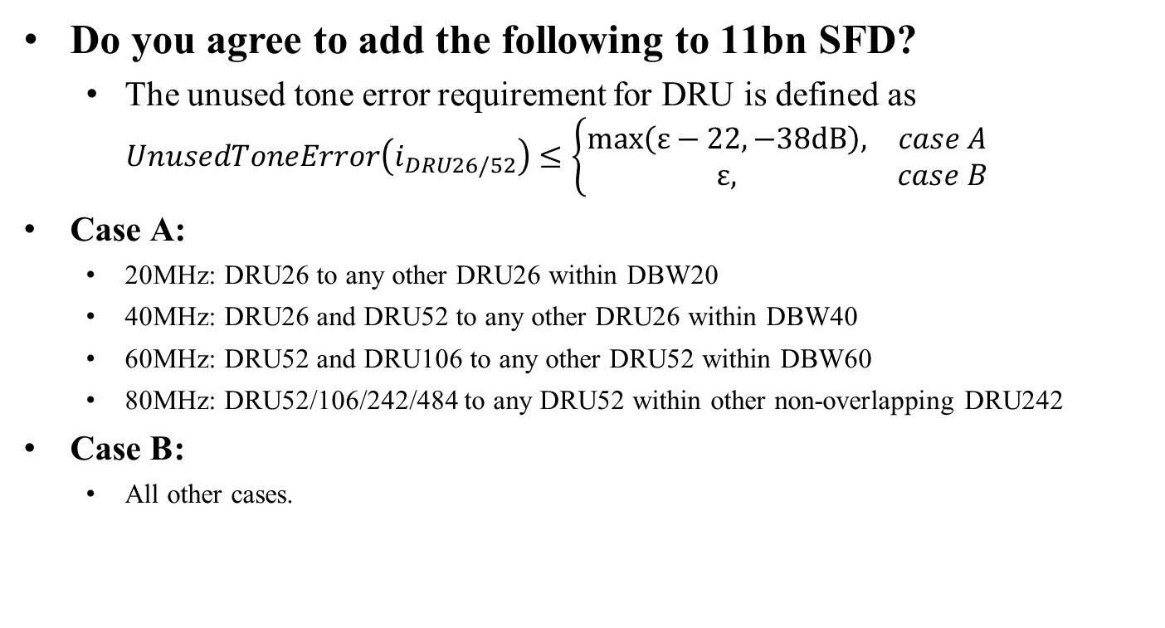
SP3
Do you agree to add the following to 11bn SFD?
  The unused tone error requirement for DRU is defined as
  $$UnusedToneError\left(i_{DRU26/52}\right)≤\left\{\begin{matrix}max\left(ε−22, −38dB\right), & case A \\ ε, & case B\end{matrix}\right.$$
Case A:
  20MHz: DRU26 to any other DRU26 within DBW20
  40MHz: DRU26 and DRU52 to any other DRU26 within DBW40
  60MHz: DRU52 and DRU106 to any other DRU52 within DBW60
  80MHz: DRU52/106/242/484 to any DRU52 within other non-overlapping DRU242
Case B:
  All other cases.

Slide 19
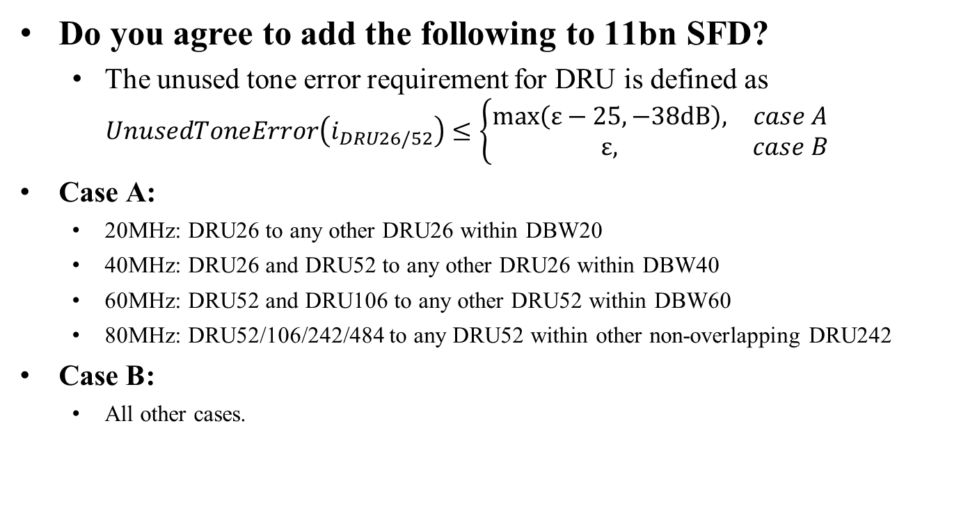
SP3-1
Do you agree to add the following to 11bn SFD?
  The unused tone error requirement for DRU is defined as
  $$UnusedToneError\left(i_{DRU26/52}\right)≤\left\{\begin{matrix}max\left(ε−25, −38dB\right), & case A \\ ε, & case B\end{matrix}\right.$$
Case A:
  20MHz: DRU26 to any other DRU26 within DBW20
  40MHz: DRU26 and DRU52 to any other DRU26 within DBW40
  60MHz: DRU52 and DRU106 to any other DRU52 within DBW60
  80MHz: DRU52/106/242/484 to any DRU52 within other non-overlapping DRU242
Case B:
  All other cases.

Slide 20
Appendix

Slide 21
Recap [1, 2]: Transmit Constellation Error for UHR RRU TB PPDU
The transmit constellation error for MCS0-15 should follow the same definition as EHT.
For the new MCSs, we proposed the values as shown in red below.
MCS | Transmit Constellation Error in an UHR MU PPDU (dB) | Relative constellation error in an UHR TB PPDU using RRU when transmit power is larger than the maximum power of UHR-MCS 7 (dB) | Relative constellation error in an UHR TB PPDU using RRU when transmit power is less than or equal to the maximum power of UHR-MCS 7 (dB)
QPSK 2/3 | -12* | -13 | -27
16QAM 2/3 | -18* | -18 | -27
16QAM 5/6 | -20* | -20 | -27
256QAM 2/3 | -29* | -29 | -29

Slide 22
20MHz
Tx on DRU26-1
IBO (dB)\DRU26 idx | 1 | 2 | 3 | 4 | 5 | 6 | 7 | 8 | 9
0 | -13.6 | -71.7 | -71.8 | -71.7 | -71.7 | -71.7 | -71.8 | -71.7 | -71.8
6 | -24.1 | -72.0 | -72.0 | -71.9 | -71.9 | -72.0 | -72.0 | -71.8 | -71.9
10 | -38.0 | -71.9 | -72.1 | -71.9 | -71.9 | -71.9 | -72.0 | -71.9 | -72.0
Tx on DRU52-1
IBO (dB)\DRU26 idx | 1 | 2 | 3 | 4 | 5 | 6 | 7 | 8 | 9
0 | -15.6 |  | -51.6 | -48.7 | -20.9 | -37.6 | -21.0 | -37.7 | -48.7
6 | -27.9 |  | -67.1 | -61.4 | -33.8 | -49.9 | -33.7 | -50.0 | -61.5
10 | -44.3 |  | -68.7 | -68.7 | -50.1 | -60.9 | -49.6 | -61.4 | -68.7
Tx on DRU106-1
IBO (dB)\DRU26 idx | 1 | 2 | 3 | 4 | 5 | 6 | 7 | 8 | 9
0 | -15.6 |  |  |  | -19.2 | -21.9 | -21.9 | -23.2 | -19.2
6 | -27.8 |  |  |  | -31.9 | -34.6 | -34.6 | -35.9 | -31.9
10 | -44.9 |  |  |  | -48.5 | -50.8 | -50.8 | -52.0 | -48.6

Slide 23
40MHz
Tx on DRU26-1 and DRU52-1 for IBO=0dB
DRU26 idx | 1 | 2 | 3 | 4 | 5 | 6 | 7 | 8 | 9 | 10 | 11 | 12 | 13 | 14 | 15 | 16 | 17 | 18
DRU26-1 | -13.5 | -82.0 | -72.1 | -82.0 | -81.3 | -72.3 | -81.9 | -72.3 | -81.9 | -81.3 | -72.2 | -82.0 | -72.3 | -72.3 | -81.9 | -72.3 | -82.0 | -72.2
DRU52-1 | -13.9 |  | -71.8 | -71.8 | -71.8 | -71.8 | -71.9 | -71.8 | -71.9 | -71.7 | -71.7 | -71.9 | -71.8 | -71.8 | -71.9 | -71.9 | -71.9 | -71.8
Tx on DRU106-1
IBO (dB)\DRU26 idx | 1 | 2 | 3 | 4 | 5 | 6 | 7 | 8 | 9 | 10 | 11 | 12 | 13 | 14 | 15 | 16 | 17 | 18
0 | -15.1 |  |  |  | -20.6 | -51.4 | -51.4 | -48.6 | -48.5 | -37.4 | -37.4 | -20.7 | -20.7 | -20.9 | -37.3 | -37.3 | -48.6 | -48.5
6 | -27.7 |  |  |  | -33.6 | -67.2 | -67.2 | -61.1 | -61.1 | -49.9 | -49.9 | -33.7 | -33.7 | -33.6 | -49.9 | -49.9 | -61.0 | -61.0
10 | -44.8 |  |  |  | -50.3 | -68.8 | -68.9 | -68.7 | -68.7 | -61.4 | -61.3 | -50.4 | -50.3 | -50.4 | -61.3 | -61.4 | -68.7 | -68.7
Tx on DRU242-1
IBO (dB)\DRU26 idx | 1 | 2 | 3 | 4 | 5 | 6 | 7 | 8 | 9 | 10 | 11 | 12 | 13 | 14 | 15 | 16 | 17 | 18
0 | -15.5 |  |  |  |  |  |  |  |  | -19.5 | -19.5 | -20.3 | -20.0 | -17.9 | -20.5 | -20.4 | -18.8 | -18.8
6 | -28.2 |  |  |  |  |  |  |  |  | -32.4 | -32.3 | -33.0 | -33.0 | -30.7 | -33.4 | -33.4 | -31.5 | -31.5
10 | -45.1 |  |  |  |  |  |  |  |  | -48.9 | -48.9 | -49.4 | -49.4 | -47.6 | -49.7 | -49.7 | -48.3 | -48.2

Slide 24
80MHz
Tx on DRU52-1
IBO (dB)\DRU26 idx | 1 | 2 | 3 | 4 | 5 | 6 | 7 | 8 | 9-32
0 | -15.7 |  | -41.4 | -31.2 | -25.6 | -20.3 | -25.5 | -30.2 | <-70
6 | -27.9 |  | -54.1 | -44.0 | -38.3 | -32.9 | -38.3 | -43.0 | <-70
10 | -43.3 |  | -65.2 | -59.5 | -53.8 | -48.7 | -53.9 | -58.6 | <-70
Tx on DRU106-1
IBO (dB)\DRU26 idx | 1 | 2 | 3 | 4 | 5 | 6 | 7 | 8 | 9-32
0 | -15.7 |  |  |  | -20.0 | -20.0 | -20.5 | -18.7 | <-70
6 | -28.3 |  |  |  | -32.6 | -32.7 | -33.1 | -31.4 | <-70
10 | -44.2 |  |  |  | -48.6 | -48.6 | -49.1 | -47.6 | <-70
Tx on DRU242-1 and DRU484-1 for IBO=0dB
DRU26 idx | 1 | 2 | 3 | 4 | 5 | 6 | 7 | 8 | 9-16 | 17-32
DRU242-1 | -13.0 |  |  |  |  |  |  |  | <-70 | <-70
DRU484-1 | -13.1 |  |  |  |  |  |  |  |  | <-70

Slide 25
PA’s Impact on Subcarrier Power
Simulation for IBO = 0dB
Observations:
  For Case A, PA only has impact on the uniformly distributed subcarriers.
  For Case B, PA impacts all the subcarriers, with more impact on the neighboring subcarriers of the transmit DRU.

