Slide 1
COBF Misc
Date: 2025-07-28
Authors:
Name | Affiliations | Address | Phone | Email
You-Wei Chen | Mediatek | 2840 Junction Ave. San Jose, CA, 95134 |  | You-Wei.Chen@mediatek.com
Jianhan Liu
Eric Pc
Thomas Pare

Slide 2
Introduction
  In this presentation, we will discuss the following topics:
    SS configuration and NDPA signaling
    unavailable STA in a transmission frame exchange

Slide 3
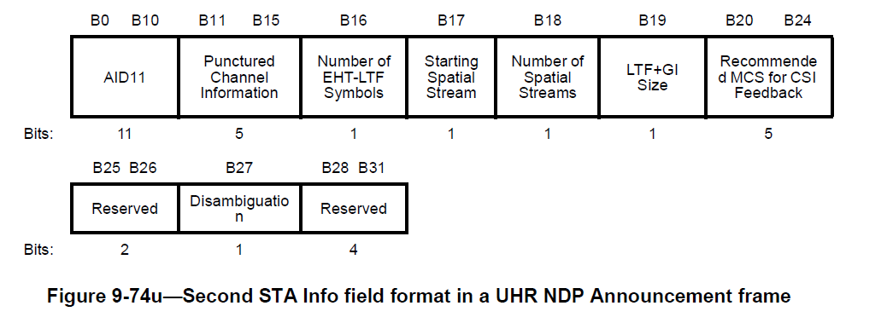
SS configuration and NDPA signaling
There are some clarification questions about the SS allocation when doing Co-BF joint NDP sounding.
we proposed to add a clarification sentence in 37.12.3 (Rules for UHR Co-BF sounding protocol sequences) (see next page). This provide no change in current NDPA and signaling desgin in D0.3.

Slide 4
Proposed text for clarification
37.12.3 (Rules for UHR Co-BF sounding protocol sequences)
…
[P128L1] (#79)A UHR Co-BF beamformer that transmits a UHR NDP Announcement frame shall set the AID11 field of the first STA Info field to 2047 and the AID11 field of the second STA Info field to the responding AP identifier (see 9.3.1.19.6 (UHR NDP Announcement frame format)).
In a UHR Co-BF sounding sequence, the Starting Spatial Streams field in the UHR NDP Announcement shall be set to 0 in a UHR Co-BF sequential NDP sounding sequence and set to 1 in a UHR Co-BF joint NDP sounding sequence.
[P128L6] A UHR Co-BF beamformer that transmits a UHR (#2983)NDP Announcement frame to one or more UHR Co-BF beamformees shall set the AID11 field to the 11 LSBs of the AID of each UHR Co-BF beamformee (#79)starting from the third STA Info field. A UHR (#2983)NDP Announcement frame shall not include multiple STA Info fields that have the same value in the AID11 field.
…

Slide 5
Unavailable STA during ICF/ICR
There are some discussion about if STAs associated with the sharing AP does not response ICF1 during the CBF transmission phase.
We proposed no change to the current frame exchange design in D0.3 and keep the unavailable STA still in the COBF sync frame. Corresponding parameters keep the same:
  Nss for each user in the Invite/Response frame and the corresponding number of spatial streams for the same user interpreted from the spatial configuration in the Sync frame is consistent, i.e., the spatial stream allocation does not change.
  The MCS and 2xLDPC bit for each user in the Sync frame should be consistent with these in the Response frame
STA1, STA2
STA1, STA2
STA1, STA2, STA3, STA4
Sharing AP STA
AP1
Invite
ICF1
Sync
COBF PPDU
Shared AP STA
AP2
Response
ICF2
COBF PPDU
STA3, STA4
ICR1
non-AP STA1
non-AP STA2
ICR2

Slide 6
Straw Poll #1
Do you agree to include the following text in the most updated 11bn draft in 37.12.3 (Rules for UHR Co-BF sounding protocol sequences) page 128 line 4 in D0.3?
In a UHR Co-BF sounding sequence, the Starting Spatial Streams field in the UHR NDP Announcement shall be set to 0 in a UHR Co-BF sequential NDP sounding sequence and set to 1 in a UHR Co-BF joint NDP sounding sequence.

Slide 7
Straw Poll #2
Do you agree to include the following into the 11bn SFD?
In the Co-BF transmission frame exchange, the set of STAs remains the same between Co-BF Invite/Response and Co-BF Sync, regardless of whether any STAs of sharing/shared AP failed to respond to the intervening ICFs.
  Nss for each user in the Invite/Response frame and the corresponding number of spatial streams for the same user interpreted from the spatial configuration in the Sync frame is consistent, i.e., the spatial stream allocation does not change.
  The MCS and 2xLDPC bit for each user in the Sync frame should be consistent with these in the Response frame

