Slide 1
HT Control field of CoBF DL PPDU for the indication of non-scheduled STA
Date: 2025-07-21
Authors:
Name | Affiliation | Address | Phone | Email
Junghoon Suh | Huawei | Ottawa, ON Canada |  | junghoon.suh@huawei.com
Mahmoud Hasabelnaby
Yan Xin
Osama AboulMagd
Abdalla Hussein

Slide 2
Background: Scheduling in the CBF Trigger (Sync) frame
During the ICF/ICR exchange between the AP and the intended scheduled STAs, the ICR from some intended STAs may not be sent to the AP
Since the Sync frame is prepared, based on the Invite/Response and ICF/ICR exchanges, and is transmitted from the AP1 to the AP2, the AP1 recognizes the actual scheduled information based on the received ICR1 without knowing the responses in the ICR2.
The Sync frame may list the scheduled STAs with the STAs which have not responded in the ICR1 removed, while all the STAs listed in the Response frame may still be listed in the Sync frame without regards to the ICR2 information
The Figure below shows an example with STA1&2 scheduled in Invite frame and STA3&4 scheduled in Response frame
STA2 has not responded in ICR1 and STA4 has not responded in ICR2
UHR-SIG User Specific field
(STA1,STA3,STA4)
ICF1
(STA1,
STA2)
CoBF DL PPDU 1
Sharing
AP1
Invite
(STA1,
STA2)
Sync
(STA1, STA3, STA4)
ICF2
(STA3,
STA4)
Shared
AP 2
Response
(STA3,STA4)
STAs
Associated
With AP1
ICR1
(STA1,
STA2)
CoBF DL PPDU 2
ICR2
(STA3,
STA4)
STAs
Associated
With AP2

Slide 3
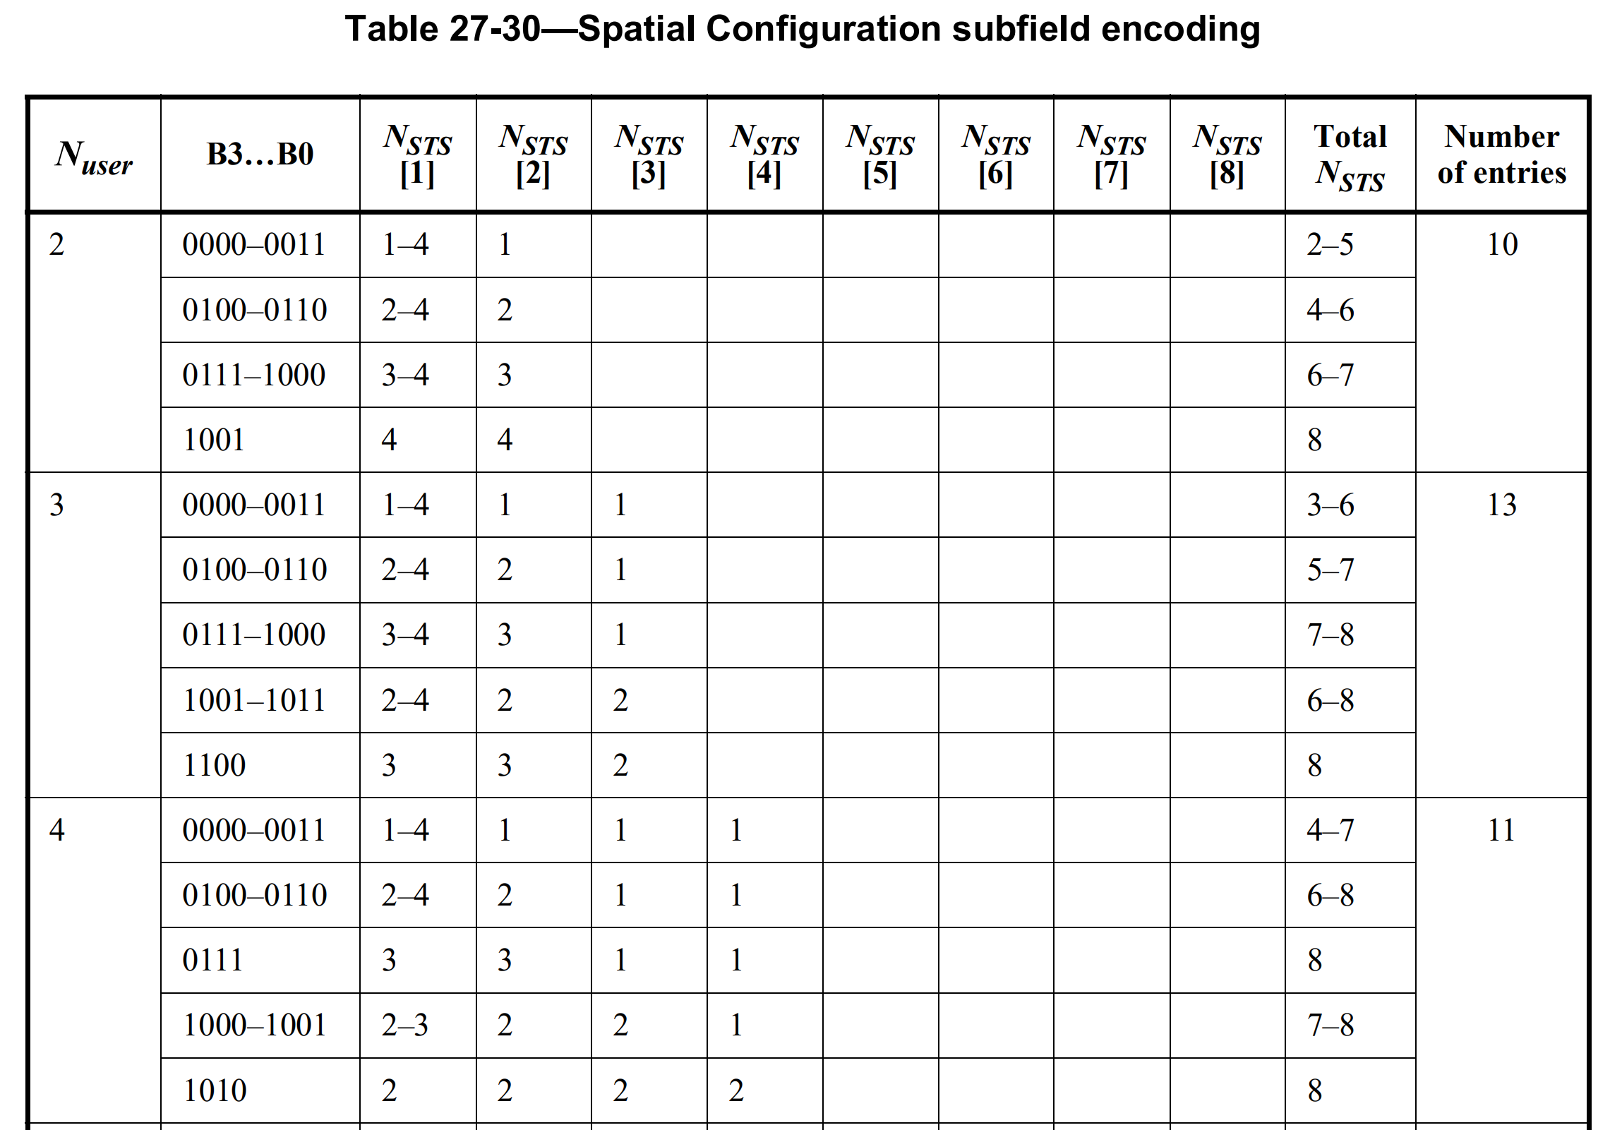
Issues
Processing time for the interference nulling based CoBF Precoder computation is too tight
The earliest time for the Shared AP2 to begin the computation of CoBF Precoder is when it receives the Sync frame
The number of non-OFDMA users in the Common field of the UHR-SIG and its corresponding Spatial Configuration subfield in the User Specific field of UHR-SIG are determined, upon receiving the Sync frame
Wrong parsing of Spatial Configuration Table if CoBF Precoder were computed before the Sync frame
Ex. N_Users is 3 in the previous slide, but the Precoder is computed based on the original 4 STAs (STA1,2,3&4 as in Invite/Response), then, the STA3&4 are reading the differently beamformed columns in the Spatial Configuration Table
The LTFs still need to be beamformed as in 4 streams and transmitted in 4 streams of LTFs regardless of the Data not being scheduled for the STA2
UHR-SIG
Common
field
1st Content
Channel
STA1
STA3
Common
field
STA4
2nd Content
Channel

Slide 4
Scheduling in the Sync frame and UHR-SIG of CoBF DL PPDU
Since the Shared AP cannot have enough processing time to compute the CoBF Precoder upon receiving the Sync frame, the CoBF scheduling information in the Sync frame and in the UHR-SIG of CoBF DL PPDU should be aligned with the scheduling information in the Invite and Response frames [1,2]
The Number of non-OFDMA users in the Common field of the UHR-SIG should be the same as the Sum of the number of scheduled users in the Invite frame and the number of scheduled users in the Response frame
UHR-SIG User Specific field
(STA1,STA2,STA3,STA4)
N_Users in UHR-SIG is 4
ICF1
(STA1,
STA2)
CoBF DL PPDU 1
Sharing
AP1
Invite
(STA1,
STA2)
Sync
(STA1,STA2,STA3,STA4)
ICF2
(STA3,
STA4)
Shared
AP 2
Response
(STA3,STA4)
STAs
Associated
With AP1
ICR1
(STA1,
STA2)
CoBF DL PPDU 2
ICR2
(STA3,
STA4)
STAs
Associated
With AP2

Slide 5
HT Control field in CoBF DL PPDU
Octets:
2
2
6
0 / 6
0 / 6
0 / 2
0 / 6
0 / 2
0 / 4
Variable
4
UHR-
STF/
LTF
Frame
Control
Duration
/ ID
Add-
ress1
Add-
ress2
Add-
ress3
Sequence
Control
Add-
ress4
QoS
Control
HT
Control
Frame
Body
Preamble
FCS
MAC Header
The HT Control field is present in Data, or Management frames as determined by the +HTC subfield of the Frame Control field
The format of the HT Control field is defined as follows
Beginning from HE, the A-Control field carries 13 different modes of control fields including the Link Adaptation (LA) and the remaining 3 modes of control fields are Reserved for future indications
Variant | B0 | B1 | B2-B29 | B30 | B31
HT | 0 | HT Control Middle |  | AC Constraint | RDG/More PPDU
VHT | 1 | 0 | VHT Control Middle | AC Constraint | RDG/More PPDU
HE | 1 | 1 | A-Control

Slide 6
HT Control field proposed for the Indication of non-scheduled STA(s) in CBF DL PPDU
Option 1: Repurposing TRS Control field
The A-Control subfield is 30 bits in length
When the Control ID in the A-Control field of HT Control field is set to 0000, the Control Information indicates the TRS (Triggered Response Scheduling) Control field
We propose to set the Control ID to 0000 in the A-Control field in the MAC header of CBF DL PPDU (the U-SIG indicates the CoBF/CoSR frame) and repurpose the subfields in the TRS Control field for the indication of Non-scheduled STA
The B4-B8, B17-B21 and B22-B26 may be used for TB-Ack scheduling
The EHT TRS Control field is given above, and if we set the Length of TB-Ack parameter to 5 bits, AP TX Power to 5 bits and UL Target RX Power to 5 bits (Common to all the scheduled STA), then, the 5 bit UL Data Symbols, 5 bit AP TX Power and 5 bit UL Target RX Power in the EHT TRS Control field can be repurposed to Length of TB-Ack, AP TX Power and UL Target RX Power while the RU Allocation and UL MCS subfields can be set to Reserved [3]
B0
B3
Control ID | Control Information
Bits:
4
Variable
B4
B8
B9
B16
B17
B21
B22
B26
B27
B28
B29
UL Data
Symbols
RU Allocation
AP TX Power
UL Target
RX Power
UL MCS
Reserved
Bits:
5
8
5
5
2
1

Slide 7
Option 1 continues
We propose to repurpose B9 in the EHT TRS Control field to indicate the Non-Scheduled STA information and B10 as the Parity Check bit, while other Bits in the RU Allocation and UL MCS can be set as Reserved
We set the B9 to indicate the Status of CoBF Scheduling
E.g. B9 set to 0 for “Not being scheduled”, and to 1 for “Being scheduled”
B10 is set as a Parity Check bit, that is, B9 B10 needs to be 0 for correct detection and 1 for otherwise
B11 to B16 and B27 to B29 are Reserved
is an XOR operation

Slide 8
Option 2: Using the existing Extension Control ID (15)
B4
B7
B8
B9
B10
B29
Extended Control ID | Status of CoBF Scheduling | Parity Check | Reserved
Bits:
4
1
1
20
Control Information when the Control ID is set to all ONES
Control ID set to all ONES (15) introduces automatic Extension subfield according to the Extended Control ID
We can set the first 4 bits as the Extended Control ID among the available 26 bit Control Information when the Control ID is set to all ONES
One of the Extended Control ID (e.g. 0001) may indicate the Non-scheduled STA
We set the B8 to indicate the Status of CoBF Scheduling
E.g. B8 set to 0 for “Not being scheduled”, and to 1 for “Being scheduled”
B9 is set as a Parity Check bit, that is, B8 B9 needs to be 0 for correct detection and 1 for otherwise
B10 to B29 are Reserved

Slide 9
Option 3: Using one of the Reserved Control ID
The A-Control subfield is 30 bits in length
Control ID indicates 13 different Control fields, and the remaining 3 Control ID are Reserved for future indications.
Some Control IDs do not require all the remaining 26 bits for the Control Information
The remaining bits not used for Control Information shall be padded with zero as Reserved
We propose to use one of the 3 Reserved Control IDs, 12 ~ 14 for the indication of non-scheduled STA
We can set B0 to B3 to 12 for example as CoBF Non-scheduled STA
We set the B4 to indicate the Status of CoBF Scheduling
E.g. B4 set to 0 for “Not being scheduled”, and to 1 for “Being scheduled”
B5 is set as a Parity Check bit, that is, B4 B5 needs to be 0 for correct detection and 1 for otherwise
B6 to B29 are Reserved
B0
B3
Control ID | Control Information
Bits:
4
Variable

Slide 10
Summary
We proposed to use the HTC in the MAC header for the indication of scheduling status of each STA scheduled
MAC header is a User Specific information area and appropriate for the indication of scheduling status of each user

Slide 11
Reference
[1] J. Suh, et. al., “25/1186r0 CoBF Scheduled Users in the CoBF Trigger Frame”
[2] Y. Chen, et. al., “25/1192r0 COBF Misc”
[3] J. Suh, et. al., “25/903r0 HT Control field of CoBF DL PPDU for TB-Ack Scheduling”

