Slide 1
CBF Scheduled Users in the CBF Trigger Frame
Date: 2025-07-19
Authors:
Name | Affiliation | Address | Phone | Email
Junghoon Suh | Huawei |  |  | junghoon.suh@huawei.com
Ross Jian Yu
Mahmoud Hasabelnaby
Abdalla Hussein
Osama AboulMagd
Yan Xin

Slide 2
Background: Scheduling in the CBF Trigger (Sync) frame
During the ICF/ICR exchange between the AP and the intended scheduled STAs, the ICR from some intended STAs may not be sent to the AP
Since the Sync frame is prepared, based on the Invite/Response and ICF/ICR exchanges, and is transmitted from the AP1 to the AP2, the AP1 recognizes the actual scheduled information based on the received ICR1 without knowing the responses in the ICR2.
The Sync frame may list the scheduled STAs with the STAs which have not responded in the ICR1 removed, while all the STAs listed in the Response frame may still be listed in the Sync frame without regards to the ICR2 information
The Figure below shows an example with STA1&2 scheduled in Invite frame and STA3&4 scheduled in Response frame
STA2 has not responded in ICR1 and STA4 has not responded in ICR2
UHR-SIG User Specific field
(STA1,STA3,STA4)
ICF1
(STA1,
STA2)
CoBF DL PPDU 1
Sharing
AP1
Invite
(STA1,
STA2)
Sync
(STA1, STA3, STA4)
ICF2
(STA3,
STA4)
Shared
AP 2
Response
(STA3,STA4)
STAs
Associated
With AP1
ICR1
(STA1,
STA2)
CoBF DL PPDU 2
ICR2
(STA3,
STA4)
STAs
Associated
With AP2

Slide 3
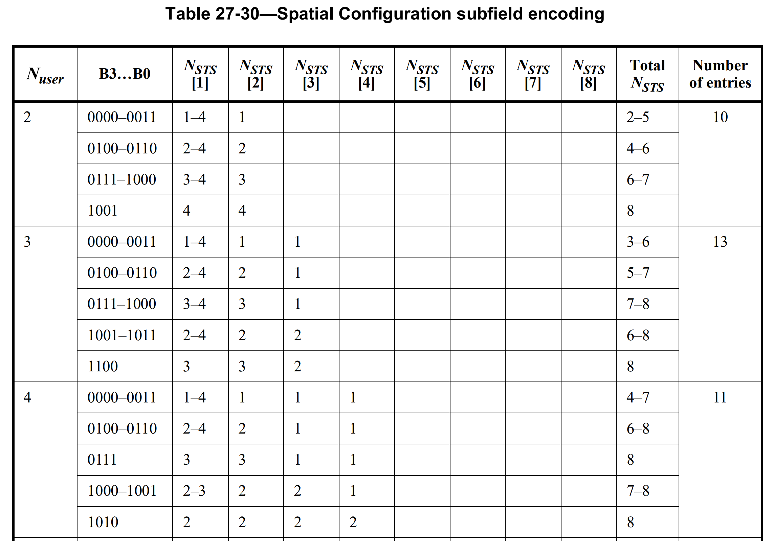
Issues
Processing time for the interference nulling based CoBF Precoder computation is too tight
The earliest time for the Shared AP2 to begin the computation of CoBF Precoder is when it receives the Sync frame
The number of non-OFDMA users in the Common field of the UHR-SIG and its corresponding Spatial Configuration subfield in the User Specific field of UHR-SIG are determined, upon receiving the Sync frame
Wrong parsing of Spatial Configuration Table if CBF Precoder were computed before the Sync frame
Ex. N_Users is 3 in the previous slide, but the Precoder is computed based on the original 4 STAs (STA1,2,3&4 as in Invite/Response), then, the STA3&4 are reading the differently beamformed columns in the Spatial Configuration Table
The LTFs still need to be beamformed as in 4 streams and transmitted in 4 streams of LTFs regardless of the Data not being scheduled for the STA2
UHR-SIG
Common
field
1st Content
Channel
STA1
STA3
Common
field
STA4
2nd Content
Channel

Slide 4
Scheduling in the Sync frame and UHR-SIG of CoBF DL PPDU
Since the Shared AP cannot have enough processing time to compute the CoBF Precoder upon receiving the Sync frame, the CoBF scheduling information in the Sync frame and in the UHR-SIG of CoBF DL PPDU should be aligned with the scheduling information in the Invite and Response frames
The Number of non-OFDMA users in the Common field of the UHR-SIG should be the same as the Sum of the number of scheduled users in the Invite frame and the number of scheduled users in the Response frame
UHR-SIG User Specific field
(STA1,STA2,STA3,STA4)
N_Users in UHR-SIG is 4
ICF1
(STA1,
STA2)
CoBF DL PPDU 1
Sharing
AP1
Invite
(STA1,
STA2)
Sync
(STA1,STA2,STA3,STA4)
ICF2
(STA3,
STA4)
Shared
AP 2
Response
(STA3,STA4)
STAs
Associated
With AP1
ICR1
(STA1,
STA2)
CoBF DL PPDU 2
ICR2
(STA3,
STA4)
STAs
Associated
With AP2

Slide 5
Summary
The CoBF scheduling information should be indicated in the Sync frame and in the UHR-SIG of CoBF DL PPDU according to the Invite and Response frame exchange, that is, the Number of CoBF Scheduled STAs, Number of UHR-LTF, and the Spatial Configuration (including the number of streams per user) are determined upon exchanging the Invite and Response frames

Slide 6
SP 1
Do you agree to include the following to the 11bn SFD?
The user information in the Sync frame and in the UHR-SIG of CoBF DL PPDU corresponds to all the users that were listed, in the Invite as well as the Response frames
Nss for each user in the Invite/Response frame and the corresponding number of spatial streams for the same user interpreted from the spatial configuration in the Sync frame is consistent, i.e., the spatial stream allocation does not change.
The MCS and 2xLDPC bits for each user in the Sync frame should be consistent with these in the Response frame
Reference doc. 25/1186r0, 25/1191r0

Slide 7
Reference
[1] Y. Chen et. al., “25/1192r0 COBF Misc”

