Slide 1
CSI Process in a Joint Sounding
Date: 2025-07-19
Authors:
Name | Affiliation | Address | Phone | Email
Junghoon Suh | Huawei | Ottawa, ON Canada |  | junghoon.suh@huawei.com
Mahmoud Hasabelnaby
Yan Xin
Osama AboulMagd
Abdalla Hussein

Slide 2
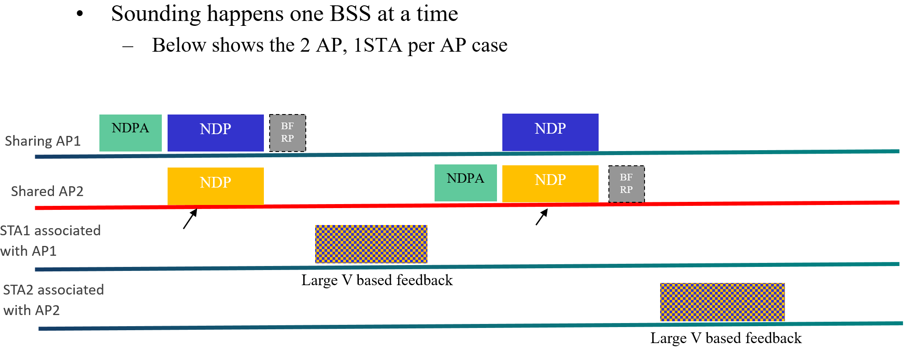
Background
During a Joint Sounding, each STA associated with either Sharing or Shared AP needs to compute the CSI information based on the received NDPs sent from both the BSS and the OBSS APs
The CSI information is computed based on the estimated channel between the STA and the Sharing AP + the Shared AP
The amplitude of the estimated channel with the OBSS AP can be likely to be much smaller than those with the BSS AP
The angle quantization of the Givens-Rotation based CSI matrix may experience the Near-Far effect and may result in near-zero quantized angle (Psi) due to the large amplitude difference which may ends up sending the Quantization-noise only CSI feedback

Slide 3
Actual Baseband Processor
Round( $\frac{U}{M_{U}}\left(2^{N_{U}−1}−1\right)$ )
Round( $\frac{D}{M_{D}}\left(2^{N_{D}−1}−1\right)$ )
U
D
GI Removal and
Channel Estimation
H
N_{P}
AGC
ADC
FFT
N_{U}
N_{D}
Maximum of the amplitude of U, M_{U}
Maximum of the amplitude of D, M_{D}
Maximum of the amplitude of H, M_{H}, where H is the channel parameter
$Round( \frac{H}{M_{H}}\left(2^{N_{P}−1}−1\right)$ )
Simple representation of a baseband processor above shows how the data can be passed between each function block, and the N_{U}, N_{D} and N_{P} are the datapath size (unit: bits) between the function blocks
All the data are being represented in a fixed-point resolution beyond the ADC function block
For the estimated channels, the normalization with an amplitude of the estimated channel (real and imaginary components are separately done) is necessary to be represented in N_{P} bits

Slide 4
Recommended Process in the Channel Estimation function block
The N_SS in the Common field of EHT-SIG of NDP in the CoBF Joint Sounding is supposed to be 8, and the second 4 streams correspond to the streams of OBSS AP
The size of MIMO channel matrix estimated at each STA is N_{RX} X 8, and the second four columns (5th to 8th columns of channel matrix) of the estimated MIMO channel matrix correspond to the channel between the OBSS AP and the STA
Within the Baseband processor, we may need to apply a different normalization to the MIMO channel matrix portion corresponding to the channel with OBSS AP, from the channel with In-BSS AP

Slide 5
Recommended Process in the Baseband
Round( $\frac{U}{M_{U}}\left(2^{N_{U}−1}−1\right)$ )
Round( $\frac{D}{M_{D}}\left(2^{N_{D}−1}−1\right)$ )
AGC
ADC
U
FFT
D
N_{U}
N_{D}
Maximum of the amplitude of U, M_{U}
Maximum of the amplitude of D, M_{D}
Maximum of the amplitude of H_{i}, M_{Hi}, where H_{i} is the channel estimation output with In-BSS AP
Maximum of the amplitude of H_{o}, M_{Ho}, where H_{o} is the channel estimation output with OBSS AP
CSI
Quantization
H
N_{P}
H_{i}
$$\hat{H_{i}}$$
GI Removal, Channel Estimation and Smoothing
$Round( \frac{H_{i}}{M_{Hi}}\left(2^{N_{P}−1}−1\right)$ )
SVD is applied
to $H$
$$\hat{H_{o}}$$
H_{o}
N_{P}
$Round( \frac{H_{o}}{M_{Ho}}\left(2^{N_{P}−1}−1\right)$ )
$$H=\left[\begin{matrix}\hat{\text{H}\text{i}} : & \hat{\text{H}\text{o}} \end{matrix}\right]$$

Slide 6
Joint Sounding Indication for STA
The figure above shows the STA Info field format of the EHT NDPA.
Option 1: We propose to set B20 (or any Reserved subfield such as B29 to B31) above to “Joint Sounding” so that the receiving STA may know the following NDPs are transmitted from two coordinating APs
That is, the UHR STA needs to check the Joint Sounding for the CoBF using B20, and B20 set to 0 may indicate the following NDP to be a Single AP Sounding regardless of Cross-BSS or In-BSS Sounding
B20 set to 1 may indicate the following NDP coming from two separate APs in a Joint Sounding
Option 2: Repurpose one of the bit from Nc Index such as B24 to indicate the Joint Sounding, since the Nc parameter cannot be bigger than 8, and three bits may be enough for Nc parameter and the remaining one bit can be repurposed to indicate the Joint Sounding
Option 3: Each STA can choose to parse the 1st STA Info field and the 2nd STA Info field upon seeing the AID11 2047 from the 1st STA Info field, and the “Number of Spatial Streams” subfield in the 2nd STA Info field may imply the Joint/Sequential Sounding
1st STA Info field
(2047)
2nd STA Info field

Slide 7
Ind. Normalization vs. Joint Normalization
4 TX per each AP
2 RX per each STA
Full Nulling based Precoder [1] based on Joint Sounding
Joint Normalization for In-BSS and OBSS Channel portions VS. Individual Normalization for In-BSS and OBSS Channel portions (Our Proposal)
SVD is applied to the 2X8 Big Channel
Perfect quantization assumed
20 MHz/BCC/MCS 7
X dB : 10 and 20 dB lower in OBSS link than In-BSS link
AP 1
AP 2
0 dB
0 dB
-X dB
-X dB
STA 0
STA 2
Precoder computed based on 2 STS but only a single stream is transmitted to each STA
2 Streams based 4 LTFs per AP
Random data is transmitted for the 1st stream
Zero-energy constellation of data is transmitted for the 2nd stream

Slide 8
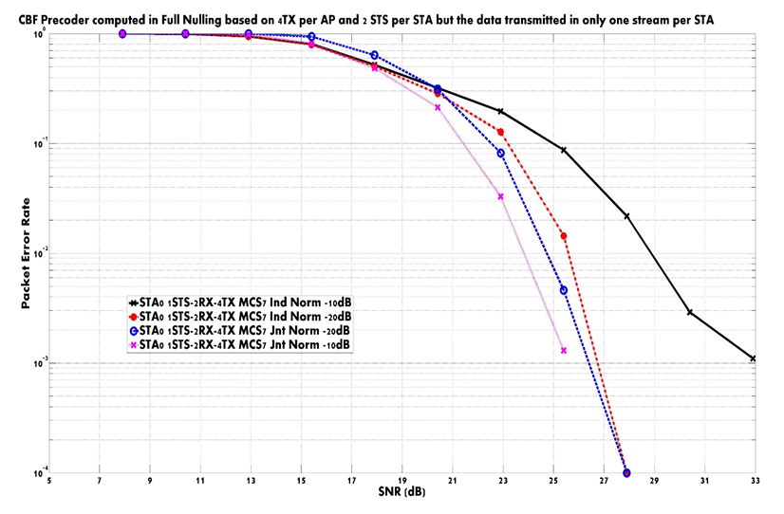

Slide 9
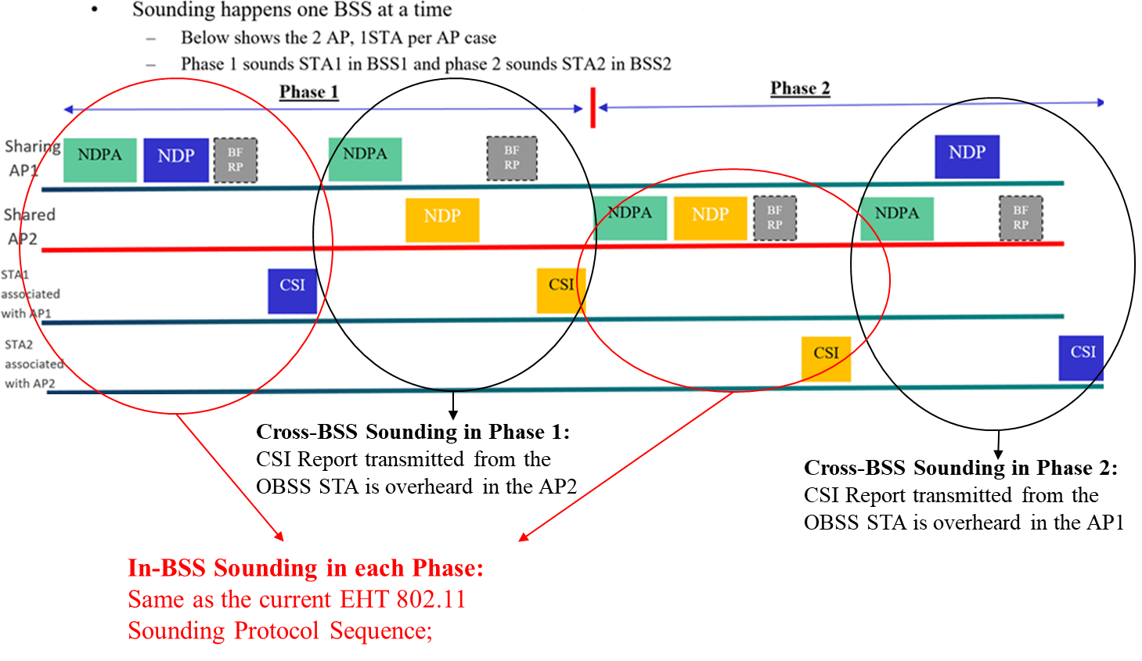
In a Sequential Sounding, the Estimated Channel is normalized before the CSI Quantization, individually for the In-BSS Channel or the Cross-BSS Channel
The same amplitude of Channels are quantized regardless of In-BSS or OBSS Channel in a Sequential Sounding → Supposed not to impact on the Nulling based Beamforming Performance

Slide 10
DL MU-MIMO
STA0
STA1
H₁
$$P=\left(Pseudo\right)Inverse\left(\left[\begin{matrix}\tilde{H_{0}} \\ \tilde{H_{1}} \\ \tilde{H_{2}}\end{matrix}\right]\right)$$
H₀
AP
H₂
STA2
$$where P is the ZFBF based Precoder$$
$and \tilde{H}$ is reconstructed based on
CSI Feedback for $H$
Each STA prepares the CSI report based on its own estimated and normalized channel parameters
Precoder is computed based on the CSI report from each STA regardless of the distance from the AP or how it normalized
In AP side, there has been no need to know the ratio of the amplitude of the estimated channel from each STA for any MU-MIMO precoder computation
Precoder element is normalized again with the Frobenius norm of the Precoder matrix

Slide 11
Summary
We proposed to separately process the fixed-point normalization in the Baseband processor for the channel matrix with In-BSS AP and for the channel matrix with OBSS AP
The Near-Far effect in the CSI Quantization is minimized
Each STA needs to know the Joint Sounding, so it separates the In-BSS or OBSS portion of Channel matrix before the fixed-point normalization

Slide 12
Reference
[1] I. Jung, et. al., “24/1204r0 Coordinated Beamforming for 11bn”

Slide 13
SP 1
Do you agree to have an option of individually processing the fixed-point normalization to the Estimated Channel in In-BSS portion and OBSS portion in case of Joint Sounding?

Slide 14
SP 2
Do you support to let each STA know the Joint Sounding in the UHR NDPA?
How to indicate the Joint Sounding is TBD

