Slide 1
Scrambler seed used in DS-CTS frame
Date: 2025-07
Authors:
Name | Affiliations | Address | Phone | email
Hari Ram Balakrishnan | NXP | 350 Holger Way, San Jose, CA 95134 |  | hariram.balakrishnan@nxp.com
Liwen chu |  |  |  | liwen.chu@nxp.com
Rui Cao |  |  |  | rui.cao_2@nxp.com
Hongyuan Zhang |  |  |  | hongyuan.zhang@nxp.com
Sudhir Srinivasa |  |  |  | sudhir.srinivasa@nxp.com

Slide 2
Introduction
Prioritized EDCA (P-EDCA) is an enhancement of the EDCA mechanism that reduces the access delay distribution tail for AC_VO traffic.
To start the P-EDCA contention, the P-EDCA STA shall transmit a Defer Signal CTS (DS-CTS) frame.
The DS-CTS frame shall be transmitted in,
a non-HT PPDU or non-HT PPDU duplicate format
using 6 Mb/s data rate
SCRAMBLER_INITIAL_VALUE is fixed
the Duration field shall be set to the value of the P-EDCA contention duration in Table 37-1
P-EDCA contention duration = 97 us
the RA field shall be set to the unicast MAC address with OUI 00:0F:AC and the remaining bits set by <ANA>

Slide 3
Design criteria
The following three criteria for the selection of SCRAMBLER_INITIAL_VALUE
Hamming distance between LSIG & 1st Data symbol
PAPR of the DS-CTS PPDU
Sensitivity evaluation

Slide 4
Design criteria: Hamming distance
HEW/EHT/UHR: RLSIG – a time domain copy of LSIG.
Repetition detection for classification.
Highest Hamming distance between LSIG content and 1st data symbol is preferred to avoid false detection as RLSIG symbol.
Note: Hamming distance was computed for all seed value.
SCRAMBLER_INITIAL_VALUE | 33 | 67 | 109 | 23 | 49 | 91
Hamming distance | 33 | 33 | 31 | 31 | 31 | 31

Slide 5
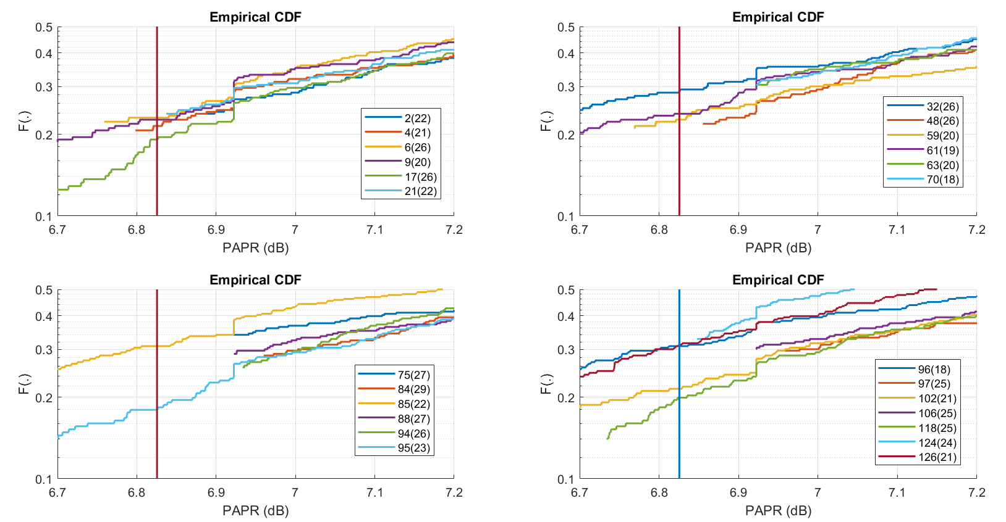
Design criteria: PAPR
CDF of the PAPR of the data symbol across all possible RA values for each seed value.
Chosen plots are such that 30 percentile of the data symbol PAPR is within 0.2 dB of LSIG-PAPR.
Provides more option for the selection of RA address.
If we select the Hamming distance threshold as 26, then the following seed values have a comparable or better PAPR than LSIG.
Note: The plot is for BW = 20 MHz. The seed values selected are based on the similar criteria across BW = 40 & 80 MHz.
Seed values = {17, 32, 48, 75, 84, 88, 94}

Slide 6
Design criteria: Sensitivity evaluation
For each seed value, RA is chosen such that best PAPR is possible.
Sensitivity is computed for that pair of combination.
Realizations considered for simulations = 1000.
AWGN & ‘D’ channel is considered.
The top sensitivities varies within 0.1 dB. The order of the performance w.r.t seed values is as follows:
90 125 109 7 103 26 1 23, …

Slide 7
Summary
Seed | 17 | 32 | 48 | 75 | 84 | 88 | 94 | 90 | 125 | 109 | 7 | 103 | 26 | 1 | 23 | 112
Hamming dist | 26 | 26 | 26 | 27 | 29 | 27 | 26 | 28 | 29 | 31 | 27 | 24 | 22 | 28 | 31 | 24
20 MHz non-HT
LSIG PAPR | 6.8255
Data symbol @ 30%ile among RA | 7.0129 | 6.8601 | 7.0130 | 6.9224 | 7.0088 | 6.9623 | 7.0069 | 7.1414 | 8.2058 | 8.6761 | 7.8197 | 7.9454 | 7.2232 | 7.3104 | 7.6122 | 7.0258
40 MHz non-HT DUP
LSIG PAPR | 9.8358
Data symbol @ 30%ile among RA | 9.8667 | 9.7284 | 9.8796 | 9.7421 | 9.8854 | 9.8175 | 9.8387 | 9.9946 | 11.2161 | 11.6864 | 10.8300 | 10.9116 | 10.2335 | 10.1383 | 10.6225 | 9.8783
80 MHz non-HT DUP
LSIG PAPR | 9.0216
Data symbol @ 30%ile among RA | 9.1113 | 9.0809 | 9.1582 | 9.1126 | 9.1347 | 9.0880 | 9.3955 | 9.2811 | 10.3600 | 10.9206 | 9.9998 | 10.2575 | 9.5404 | 9.6297 | 9.8728 | 9.1754
Sensitivity
AWGN Referenced @ seed value = 17 | 0 | -0.04 | 0.05 | -0.03 | -0.01 | 0.04 | 0.06 | -0.1 | -0.03 | -0.02 | -0.05 | -0.08 | -0.01 | -0.06 | -0.04 | 0.01
D Channel Referenced @ seed value = 17 | 0 | -0.03 | 0.08 | -0.06 | 0.06 | 0.02 | 0.07 | -0.02 | -0.2 | -0.16 | -0.16 | -0.15 | -0.13 | -0.12 | -0.11 | 0.07
 | Negative number means better than sensitivity with seed = 17 and positive number means poorer than sensitivity with seed = 17.

Slide 8
SP 1
Do you agree to include the following into the 11bn SFD
SCRAMBLER_INITIAL_VALUE used in DS-CTS frame is [1, 1, 0, 1, 0, 0, 1]?
Note: seed value corresponds to 75.

