Slide 1
DRU Transmit Modulation Accuracy (EVM) Requirement
Date: 2025-07-08
Authors:
Name | Affiliations | Address | Phone | email
Yan Zhang | Apple
Wook Bong Lee
Anuj Batra

Slide 2
Background
DRU tone plan spreads the data tones using either an even spacing, semi-even spacing, or spacing with a fixed pattern over the entire PPDU BW, where the closest unused DRU tone is always 1 tone away from the occupied DRU tones [2]
In this presentation, we examine:
  Impact of DRU tone plan spacing on unused tone EVM measurements
  Unused tone EVM requirements to minimize inter-RU interference
DBW (MHz) | DRU 26 | DRU 52 | DRU 106 | DRU 242 | DRU 484
20 | Even tone spacing | Semi-evenly, alternate between 4 and 5 tones | With [2 2 2 3] pattern | N/A | N/A
40 | Even tone spacing | Even tone spacing | Semi-evenly, alternate between 4 and 5 tones | [3 2 2 2 2 1 2 2 2] pattern | N/A
60 | N/A | Even tone spacing | Even tone spacing | Semi-evenly, alternate between 3 and 4 tones | N/A
80 | N/A | Semi-evenly, alternate between 16 and 20 tones | With [12 8 8 8] pattern | Even tone spacing | Even tone spacing

Slide 3
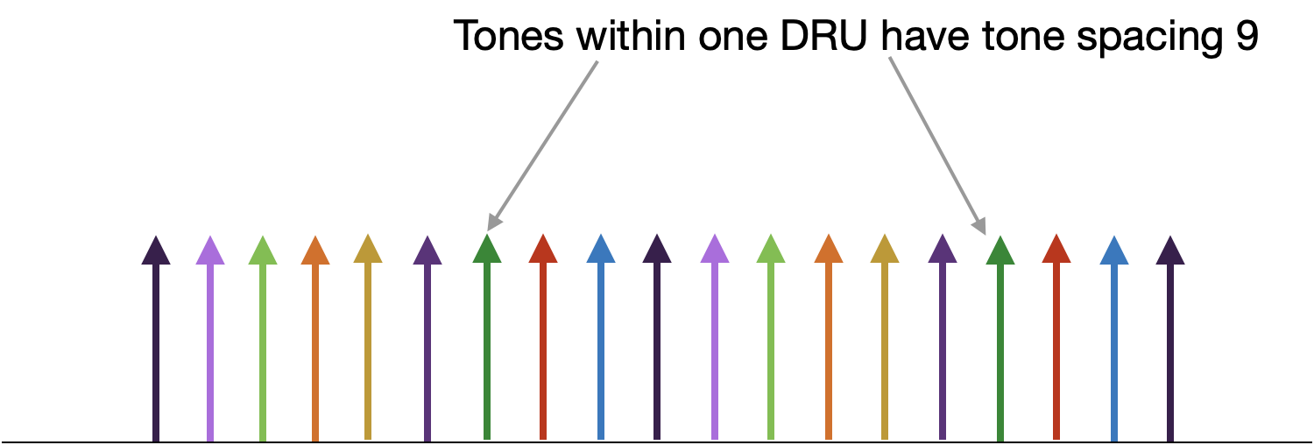
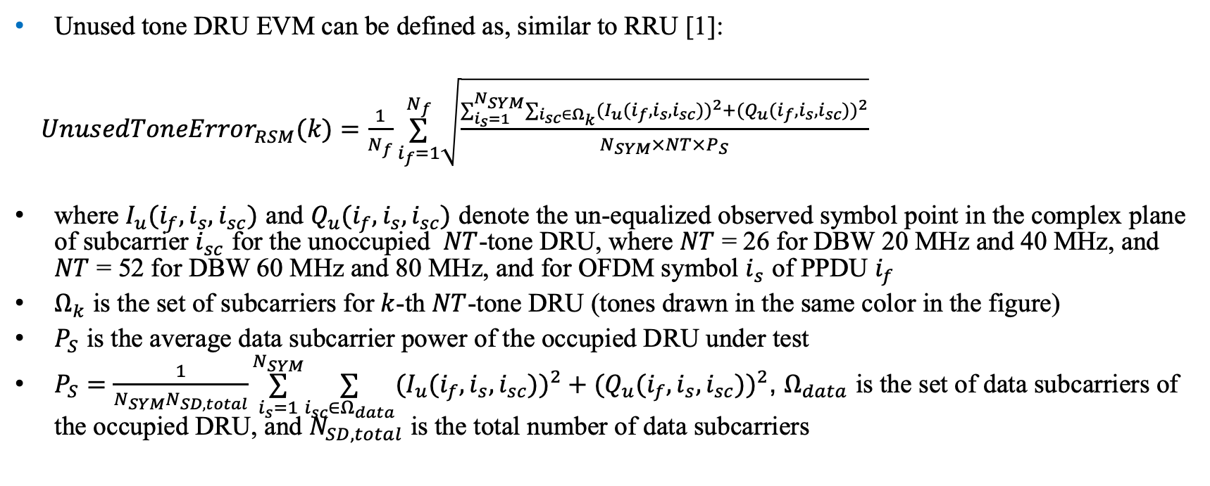
Definition: DRU Unused Tone EVM
Unused tone DRU EVM can be defined as, similar to RRU [1]:
￼$UnusedToneError_{RSM}(k)=\frac{1}{N_{f}}\overset{N_{f}}{\underset{i_{f}=1}{∑}}\sqrt{\frac{∑_{i_{s}=1}^{N_{SYM}}∑_{i_{sc}∈Ω_{k}}(I_{u}(i_{f},i_{s},i_{sc}))^{2}+(Q_{u}(i_{f},i_{s},i_{sc}))^{2}}{N_{SYM}×NT×P_{S}}}$
where $I_{u}(i_{f},i_{s},i_{sc})$ and $Q_{u}(i_{f},i_{s},i_{sc})$ denote the un-equalized observed symbol point in the complex plane of subcarrier $i_{sc}$ for the unoccupied $NT$-tone DRU, where $NT$ = 26 for DBW 20 MHz and 40 MHz, and $NT$ = 52 for DBW 60 MHz and 80 MHz, and for OFDM symbol $i_{s}$ of PPDU $i_{f}$
$Ω_{k}$ is the set of subcarriers for $k$-th $NT$-tone DRU (tones drawn in the same color in the figure)
$P_{S}$ is the average data subcarrier power of the occupied DRU under test
$P_{S}=\frac{1}{N_{SYM}N_{SD,total}}\overset{N_{SYM}}{\underset{i_{s}=1}{∑}}\underset{i_{sc}∈Ω_{data}}{∑}(I_{u}(i_{f},i_{s},i_{sc}))^{2}+(Q_{u}(i_{f},i_{s},i_{sc}))^{2}$, $Ω_{data}$ is the set of data subcarriers of the occupied DRU, and $N_{SD,total}$ is the total number of data subcarriers

Slide 4
DRU Tone Plan Impact on Unused Tone EVM (1)
Tx modulation errors on unused tones are mainly due to leakage from PA nonlinearity and ICI caused by CFO
For DRU, impact of PA nonlinearity leakage depends on how tones are spread over DBW
Even-tone spacing:
  Leakage to neighboring tones is negligible
  Unused tone EVM is largely due to ICI caused by CFO
  DRUs with tones next to occupied tones have the worst unused tone EVM (WUT-EVM)
Semi-evenly tone spacing:
  Leakage mostly affects certain set of tones depending on the two-tone spacing values of the occupied DRU
  CFO affects DRUs with tones next to the occupied tones, bigger impact on unused tone EVM when power backoff is large
Tone spacing with fixed patterns:
  Leakage may affect all the unused tones
  CFO also affects DRUs with tones next to the occupied tones

Slide 5
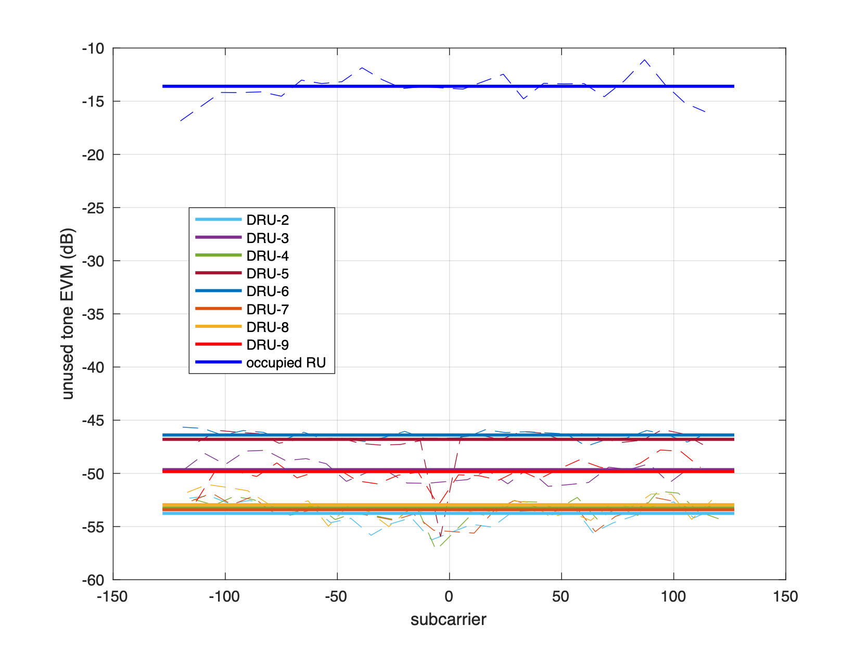
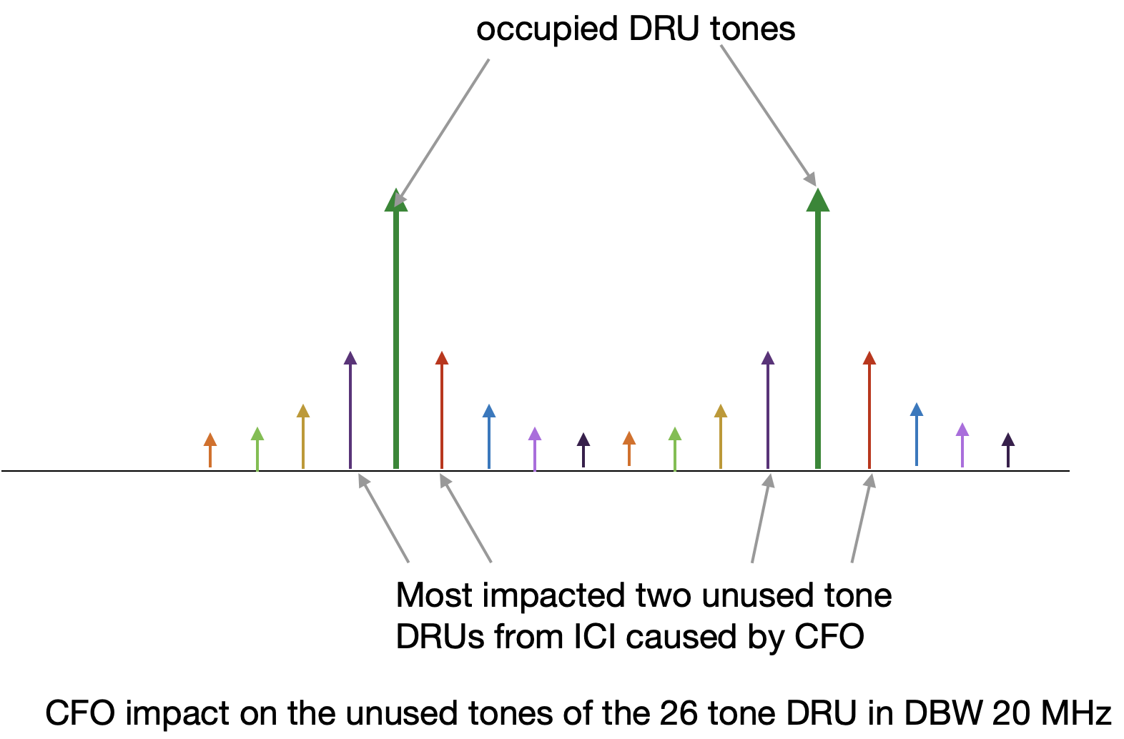
DRU Tone Plan Impact on Unused Tone EVM (2)
Assumption for simulation results: PA model [3] with RAPP = 3 and CFO = 350 Hz, AWGN1x1, MCS0
Even-tone spacing:
  PA nonlinearity affects mostly the occupied tones and has much lower impact on the unused tones
  CFO dominates unused tone EVM measurements
  26 tone DRU in DBW 20 MHz: DRU-5 and DRU-6 have WUT-EVM from Tx on DRU-1, because unused tones of DRU-5 and DRU-6 are next to occupied tone of DRU-1
Similar observations hold for others DRUs with even-spaced tones:
  26-tone and 52-tone DRU in DBW 40 MHz
  242-tone and 484-tone DRU in DBW 80 MHz

Slide 6
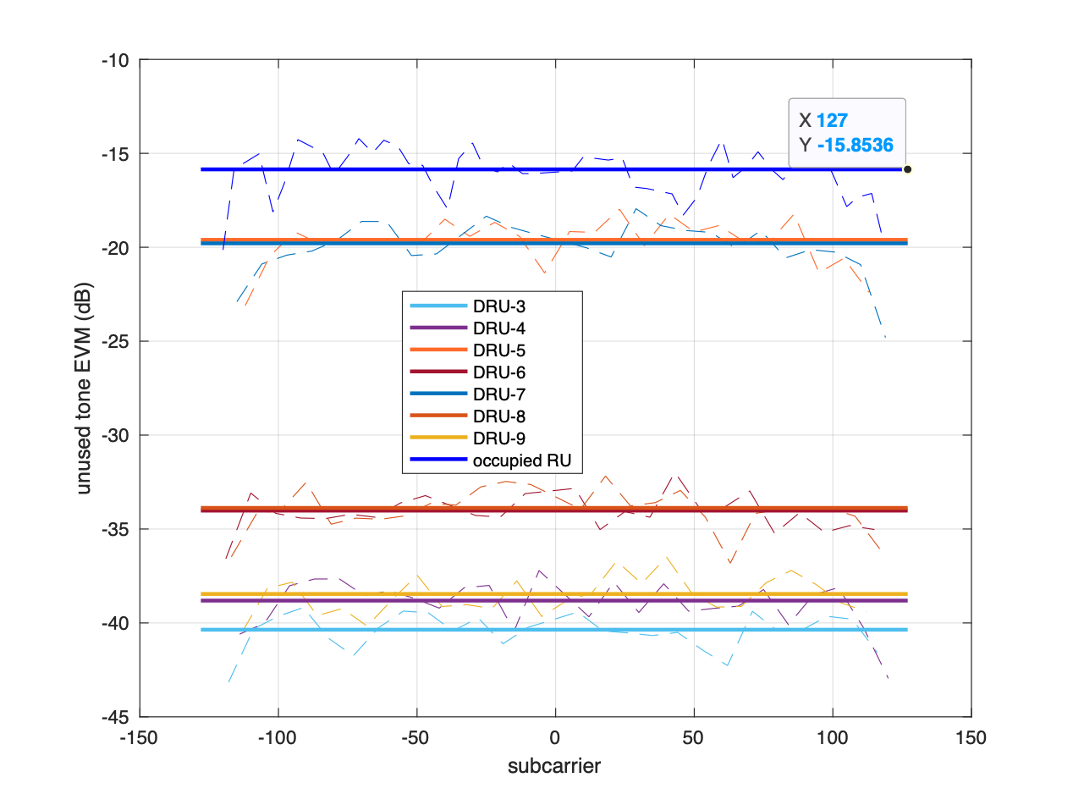
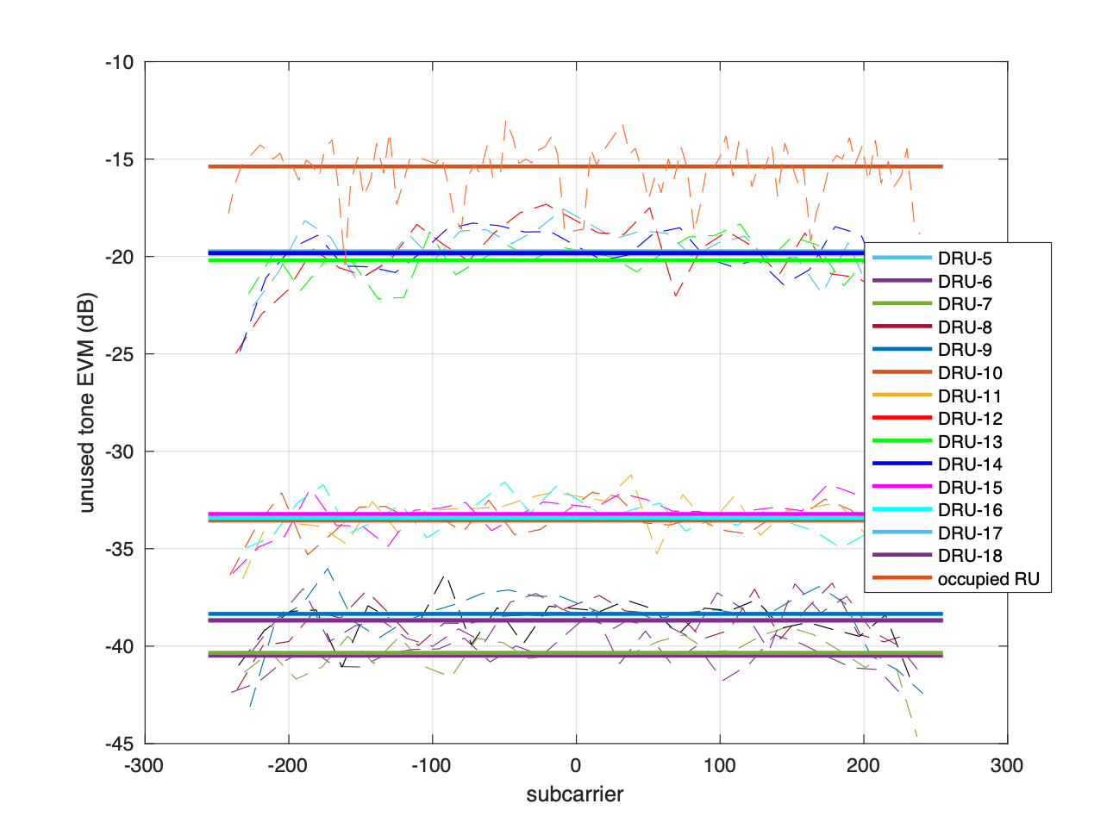
DRU Tone Plan Impact on Unused Tone EVM (3)
Semi-even tone spacing:
  When tones spacing alternates between two values 𝑃_1 and 𝑃_2, PA nonlinearity mostly affects the occupied tones and tones with distance of |𝑃_1−𝑃_2 | away from the occupied tones
  52-tone DRU in DBW 20 MHz and 106-tone DRU in DBW 40 MHz have a tone spacing that alternates between 4 and 5
  26-tone DRU-5 and DRU-7 have WUT-EVM due to 52 tone DRU-1 consisting of 26-tone DRU1-2, which are 1 tone away
  26-tone DRU-12, DRU-13, and DRU14 have WUT-EVM due to 106 tone DRU-1 consisting of 26-tone DRU1-4, which are 1 tone away

Slide 7
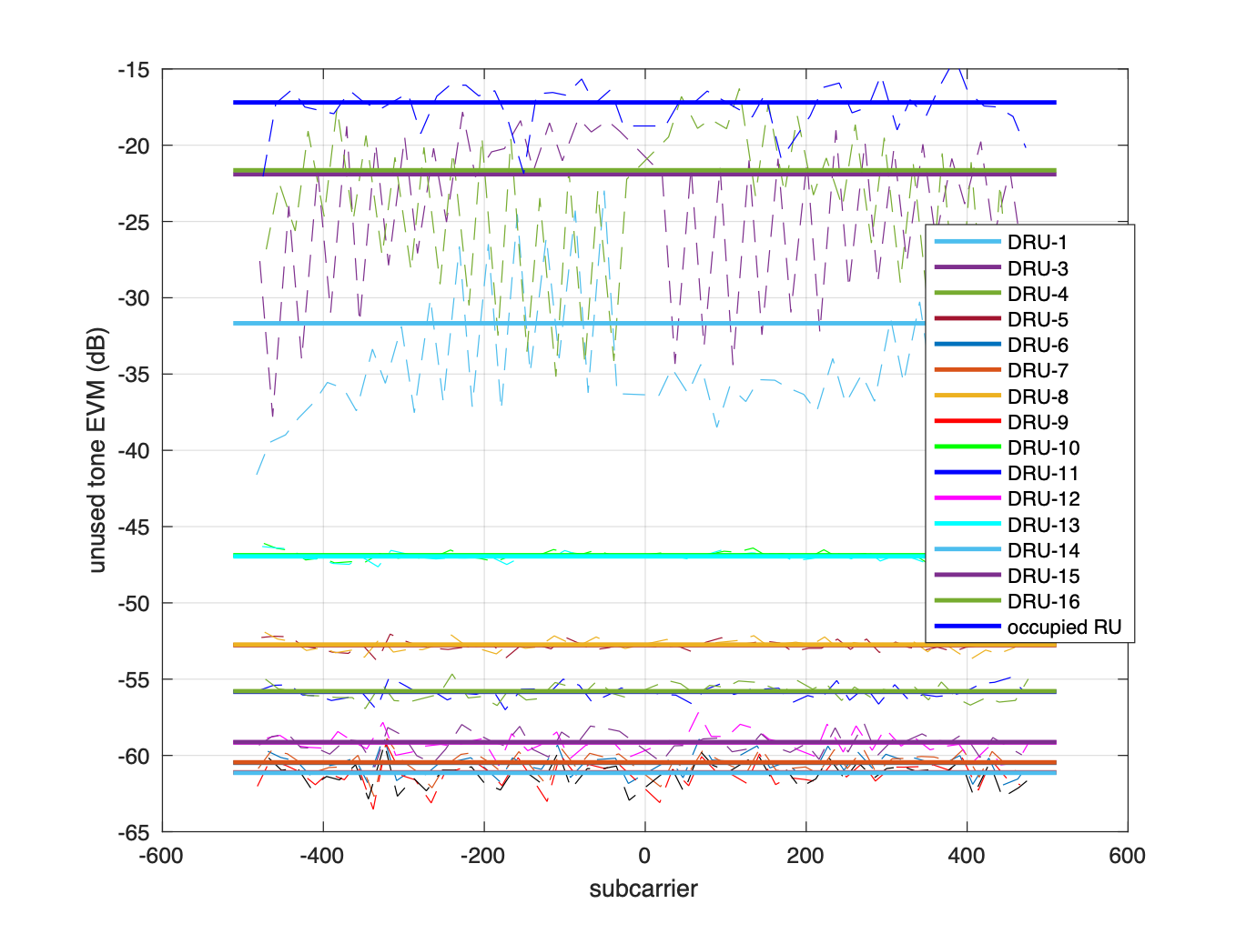
DRU Tone Plan Impact on Unused Tone EVM (4)
Semi-even tone spacing:
  52-tone DRU in DBW 80MHz has a tone spacing that alternates between 16 and 20
  52-tone DRU-3 and DRU-4 have WUT-EVM due to 52-tone DRU-2, which are 4 tones away

Slide 8
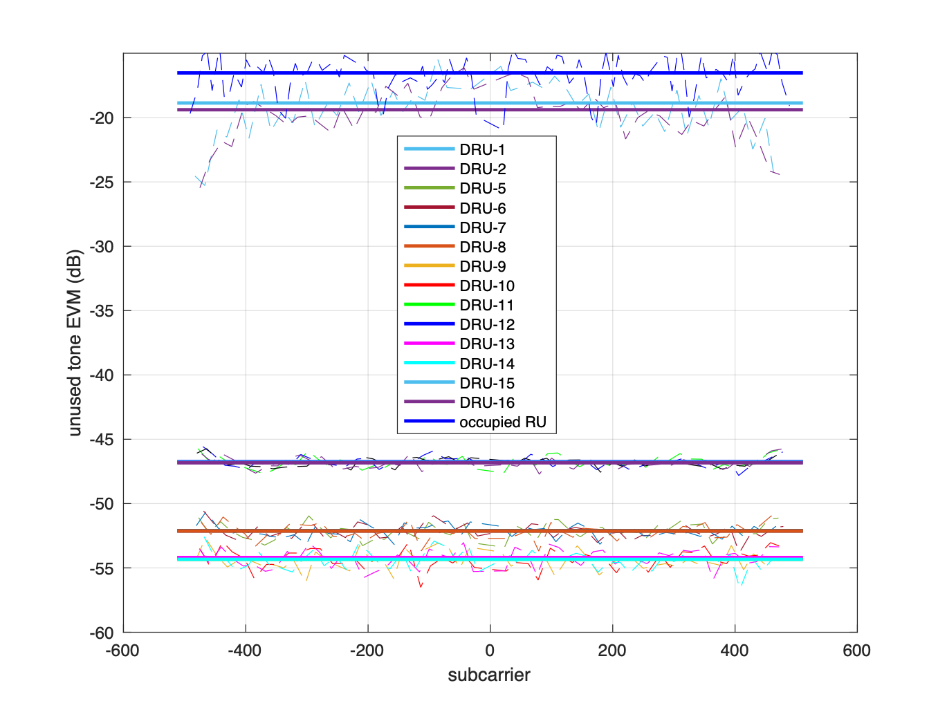
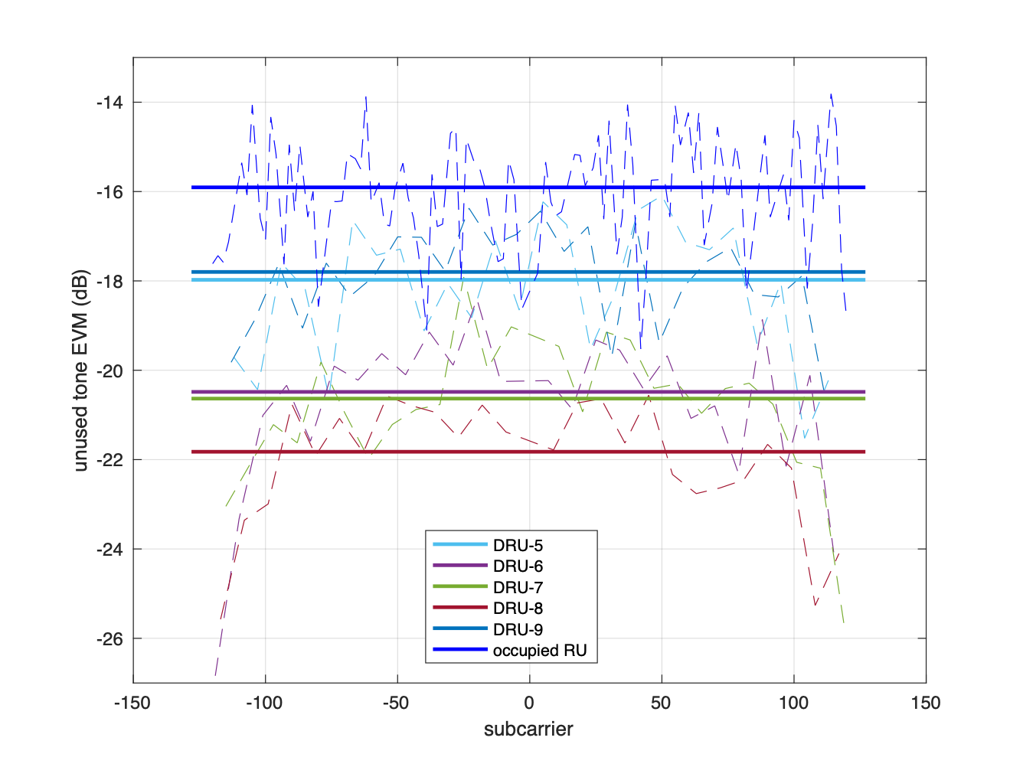
DRU Tone Plan Impact on Unused Tone EVM (5)
Tone spacing with fixed patterns:
  106-tone DRU in DBW 80 MHz has a tone spacing pattern that is [12 8 8 8]
  52-tone DRU-1 and DRU-2 have WUT-EVM due to 106-tone DRU-2 consisting of DRU3-4, which which are 4 tones away
  106-tone DRU in DBW 20 MHz has a tone spacing pattern that is [2 2 2 3]
  all the unused DRUs are impacted by the PA nonlinearity. The occupied tone (106 tone DRU-1 consisting of 26-tone DRU1-4) EVM measurement is only a few dB (2-6dB) higher than unused tone EVM of DRU5-9.

Slide 9
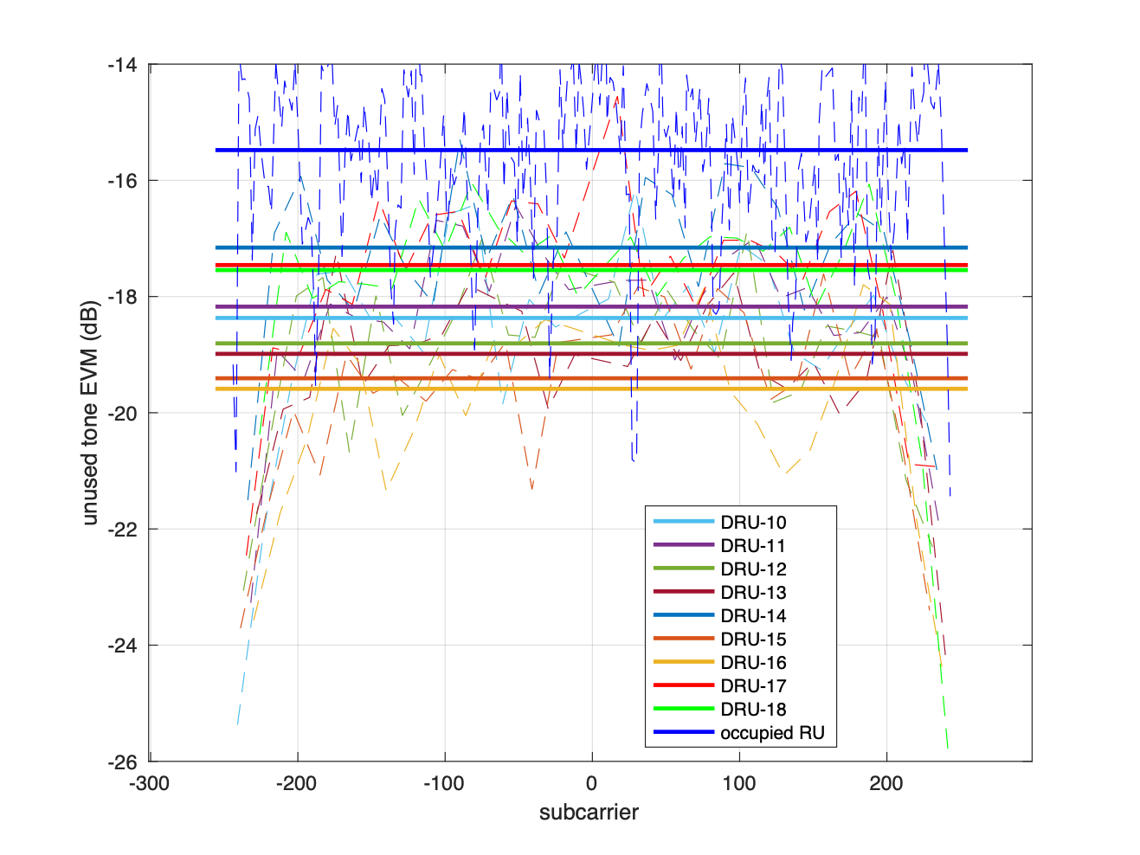
DRU Tone Plan Impact on Unused Tone EVM (6)
Tone spacing with fixed patterns:
  242-tone DRU in DBW 40 MHz has a tone spacing pattern that is [3 2 2 2 2 1 2 2 2]
  all the unused DRUs are largely affected by the PA nonlinearity. The occupied tone (242 tone DRU-1 consisting of 26-tone DRU1-9) EVM measurement is only a few dB (1.5~4dB) higher than unused tone EVM measurements of DRU10-18.

Slide 10
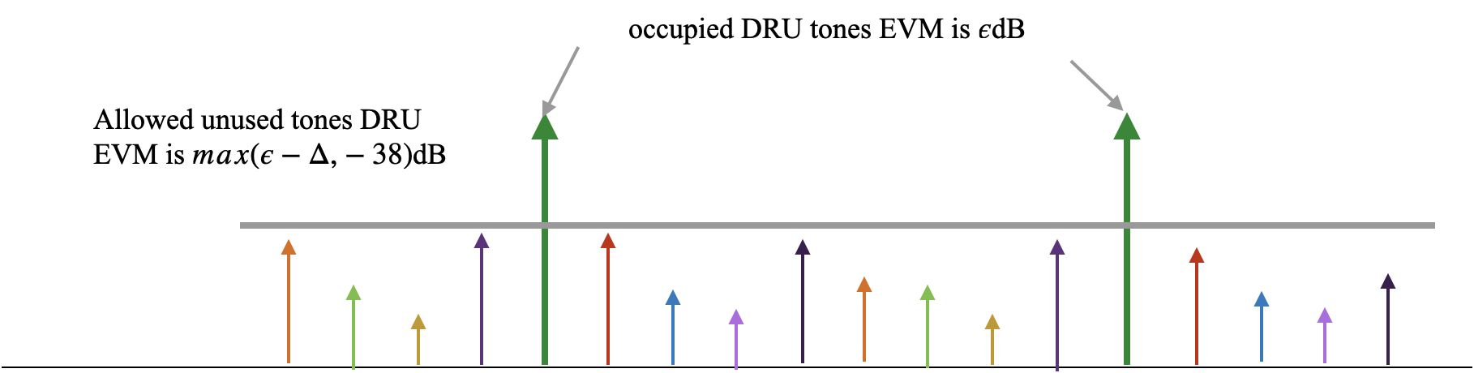
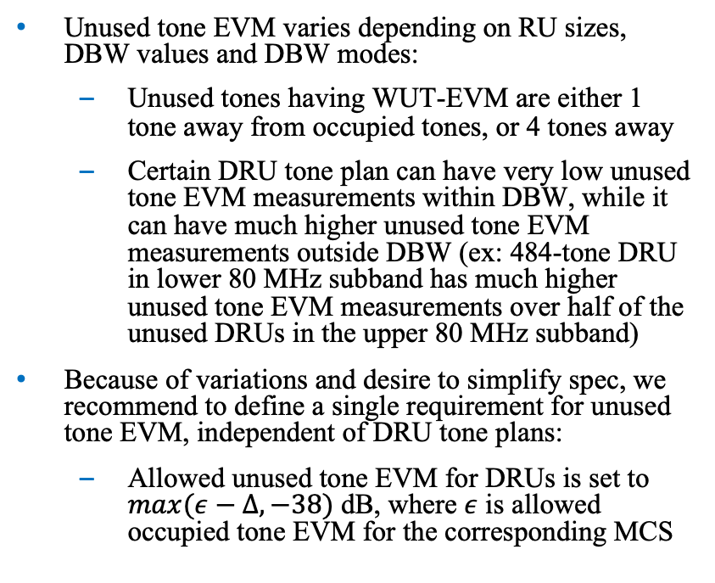
DRU Unused Tone EVM Requirement (1)
Unused tone EVM varies depending on RU sizes, DBW values and DBW modes:
  Unused tones having WUT-EVM are either 1 tone away from occupied tones, or 4 tones away
  Certain DRU tone plan can have very low unused tone EVM measurements within DBW, while it can have much higher unused tone EVM measurements outside DBW (ex: 484-tone DRU in lower 80 MHz subband has much higher unused tone EVM measurements over half of the unused DRUs in the upper 80 MHz subband)
Because of variations and desire to simplify spec, we recommend to define a single requirement for unused tone EVM, independent of DRU tone plans:
  Allowed unused tone EVM for DRUs is set to $max(ε−Δ,−38)$ dB, where $ε$ is allowed occupied tone EVM for the corresponding MCS

Slide 11
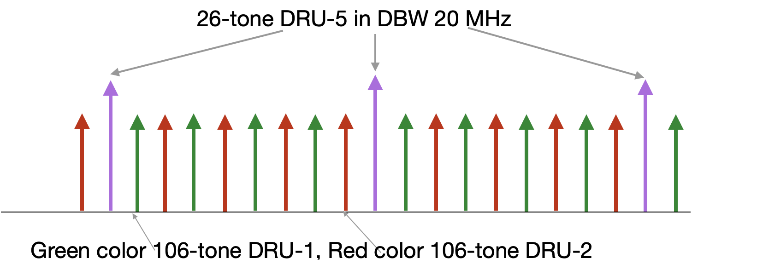
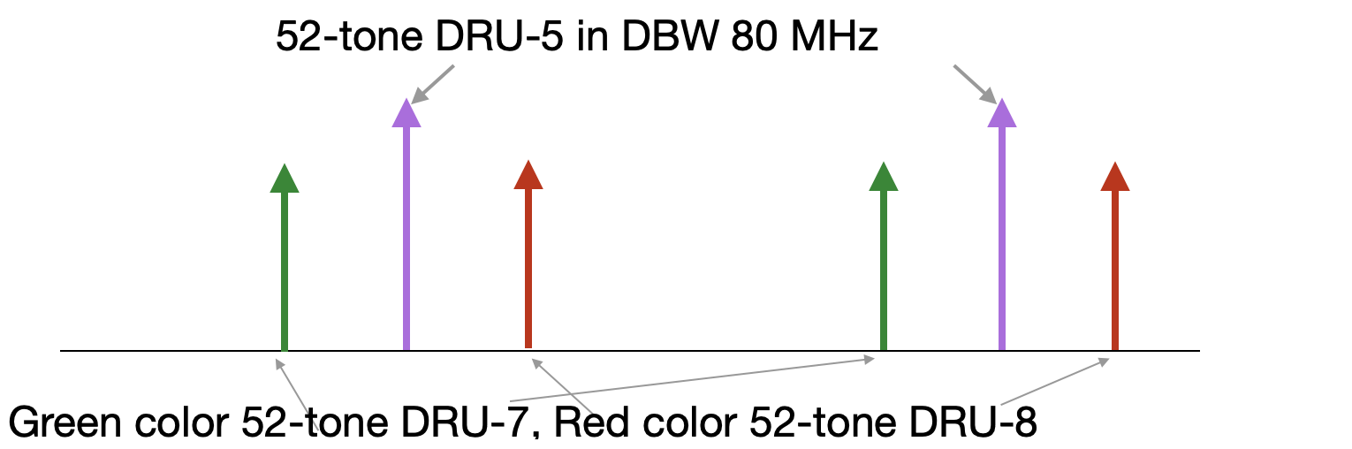
DRU unused tone EVM requirement (2)
For DBW 20 MHz, WUT-EVM occurs on 26-tone DRU-5 when two 106-tone DRU are transmitting:
  All tones within 26-tone DRU-5 are impacted at same level → unused tone EVM measurement shall be at least 3dB lower than occupied tone EVM
For DBW 80 MHz, WUT-EVM occurs on a 52-tone DRU when two 52-tone DRUs that are 4 tones away are transmitting:
  All tones within 52-tone DRU are impacted at same level → unused tone EVM measurement shall be at least 3dB lower than occupied tone EVM

Slide 12

Proposal: DRU unused tone EVM requirement
Proposal:
  For DRU transmission, the average unused tone EVM for each unoccupied 26-tone (DBW 20/40 MHz) or 52-tone (DBW 60/80 MHz) DRUs shall meet the requirement $UnusedToneEVM(m)≤max(ε−3,−38)$ dB within DBW, where $ε$ is allowed occupied tone EVM for the corresponding MCS, $m$ is the unoccupied 26-tone or 52-tone DRU index

Slide 13
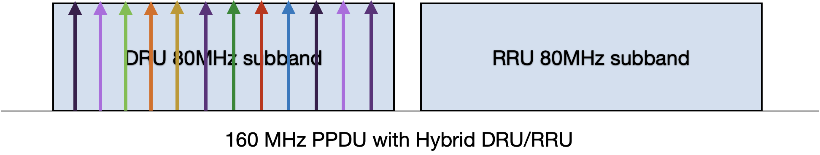
DRU Unused Tone EVM outside DBW
In hybrid mode transmission or DBW is less than PPDU BW, DRU unused tone EVM outside DBW requirement are needed:
  Since DRUs are spread over entire DBW, unused tone EVM requirement outside DBW can be defined similar to largest size RRU within the DRU DBW
  For DRUs with 20/40/60/80 MHz DBW, can use similar requirements for 242-tone, 484-tone, 484+242-tone and 996-tone RRU in 80/160/320 MHz TB PPDU, respectively
  Ex: DRU-484 MCS0 unused tone EVM measurements over adjacent RRU subband
Unused tone EVM in adjacent RRU subband from DRU-484 Tx, MCS0

Slide 14
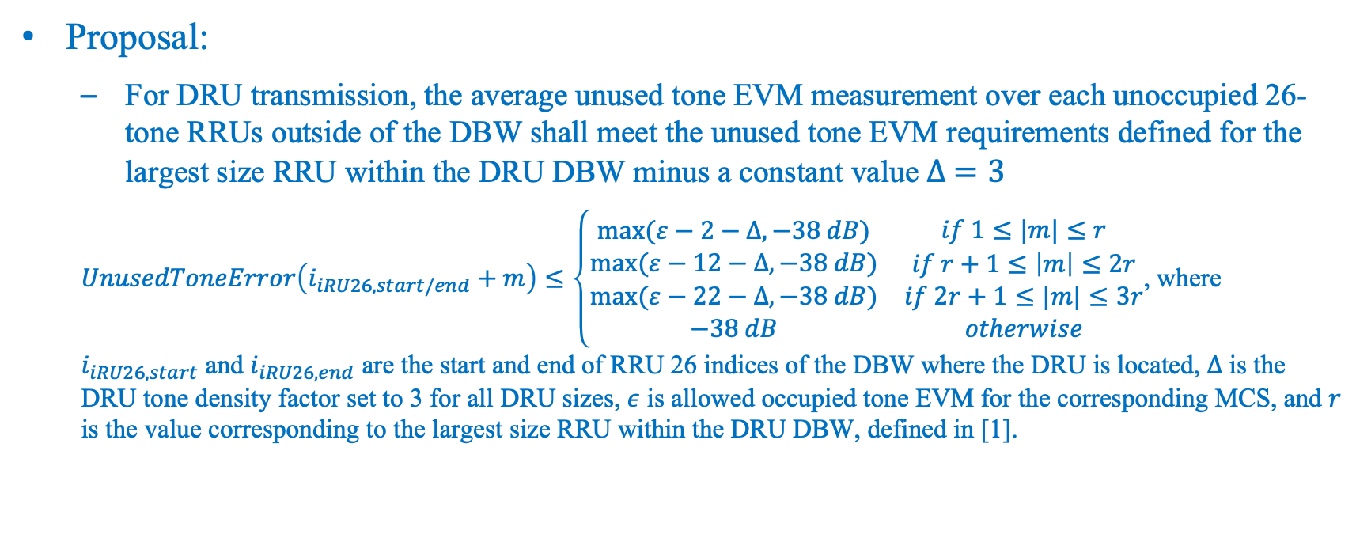
Proposal DRU Unused Tone EVM outside DBW Requirement
Proposal:
  For DRU transmission, the average unused tone EVM measurement over each unoccupied 26-tone RRUs outside of the DBW shall meet the unused tone EVM requirements defined for the largest size RRU within the DRU DBW minus a constant value $∆ =3$
  $UnusedToneError\left(i_{iRU26,start/end}+m\right)≤\left\{\begin{matrix}\begin{matrix}max⁡(ε−2−∆,−38 dB) \\ max⁡(ε−12−∆,−38 dB)\end{matrix} & \begin{matrix}if 1≤|m|≤r \\ if r+1≤\left|m\right|≤2r\end{matrix} \\ \begin{matrix}max⁡(ε−22−∆,−38 dB) \\ −38 dB\end{matrix} & \begin{matrix}if 2r+1≤|m|≤3r \\ otherwise\end{matrix}\end{matrix}\right.$, where $i_{iRU26,start}$ and $i_{iRU26,end}$ are the start and end of RRU 26 indices of the DBW where the DRU is located, $∆$ is the DRU tone density factor set to 3 for all DRU sizes, $ε$ is allowed occupied tone EVM for the corresponding MCS, and $r$ is the value corresponding to the largest size RRU within the DRU DBW, defined in [1].

Slide 15
RRU Unused Tone EVM for Hybrid Mode
For RRU242, RRU484, or RRU996 transmission in the hybrid mode:
  Unused tone EVM requirement for each unoccupied 26-tone RRU within RRU subband(s) shall follow the staircase requirement defined in [1]
  Unused tone EVM is evaluated for each unoccupied 26-tone or 52-tone DRUs over 80 MHz DRU subband(s) depending on DBW modes
Unoccupied 26-tone or 52-tone DRU EVM measurement is equivalent to sampling tones among all 26-tone RRUs within the DBW, and average unused tone EVM will be lower than that of 26-tone RRU within the DRU subband(s) which is closest to occupied RRU
  RRU transmission meeting unused tone RRU EVM requirement guarantees that it meets unused tone DRU EVM requirements defined for DRU subband
  Ex: unused tone EVM measurements over DBW 80 MHz from adjacent RRU-242 is shown here
Unused tone EVM measurements in DRU subband from adjacent RRU-242 Tx, MCS0

Slide 16
Proposal: RRU Unused Tone EVM for Hybrid Mode
Proposal:
  For RRU transmission in hybrid mode, no additional unused tone EVM requirements over DRU subband(s) is needed if it meets RRU unused tone EVM requirements.

Slide 17
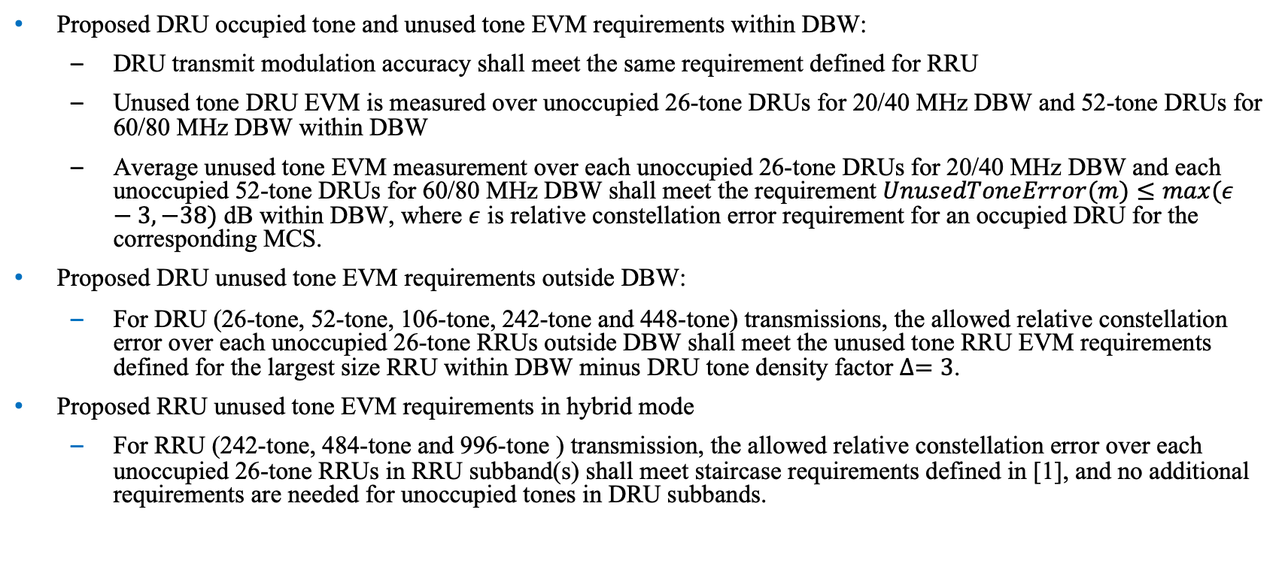
Summary
Proposed DRU occupied tone and unused tone EVM requirements within DBW:
  DRU transmit modulation accuracy shall meet the same requirement defined for RRU
  Unused tone DRU EVM is measured over unoccupied 26-tone DRUs for 20/40 MHz DBW and 52-tone DRUs for 60/80 MHz DBW within DBW
  Average unused tone EVM measurement over each unoccupied 26-tone DRUs for 20/40 MHz DBW and each unoccupied 52-tone DRUs for 60/80 MHz DBW shall meet the requirement $UnusedToneError(m)≤max(ε−3,−38)$ dB within DBW, where $ε$ is relative constellation error requirement for an occupied DRU for the corresponding MCS.
Proposed DRU unused tone EVM requirements outside DBW:
  For DRU (26-tone, 52-tone, 106-tone, 242-tone and 448-tone) transmissions, the allowed relative constellation error over each unoccupied 26-tone RRUs outside DBW shall meet the unused tone RRU EVM requirements defined for the largest size RRU within DBW minus DRU tone density factor $∆=3$.
Proposed RRU unused tone EVM requirements in hybrid mode
  For RRU (242-tone, 484-tone and 996-tone ) transmission, the allowed relative constellation error over each unoccupied 26-tone RRUs in RRU subband(s) shall meet staircase requirements defined in [1], and no additional requirements are needed for unoccupied tones in DRU subbands.

Slide 18
Reference
[1] 11be Draft 7.0.
[2] 11bn Draft 0.3.
[3] Suggested PA Model for 802.11 HRb, IEEE 802.11-00/294

Slide 19
SP1: DRU EVM Requirement
Do you support to add the following to 11bn SFD?
  DRU transmit modulation accuracy shall meet the same requirement defined for RRU

Slide 20
SP2: DRU unused EVM definition
Do you support to add the following to 11bn SFD?
  The unused tone DRU EVM is measured over unoccupied 26-tone DRUs for 20/40 MHz DBW, and unoccupied 52-tone DRUs for 60/80 MHz DBW within DBW

Slide 21
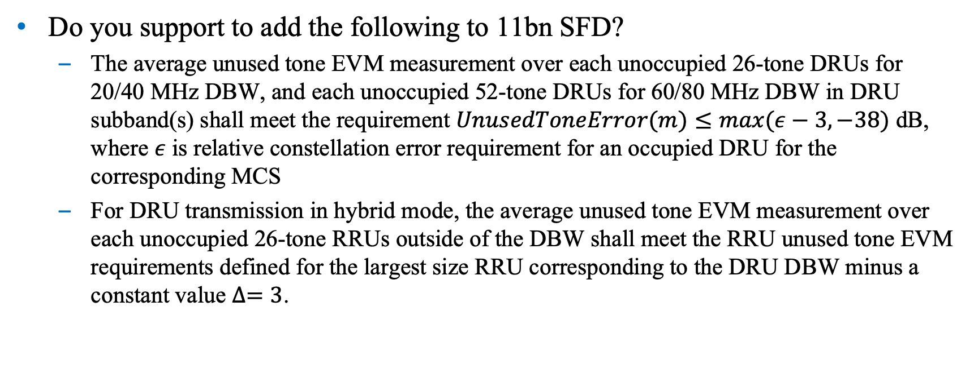
SP3: DRU unused tone EVM Requirement
Do you support to add the following to 11bn SFD?
  The average unused tone EVM measurement over each unoccupied 26-tone DRUs for 20/40 MHz DBW, and each unoccupied 52-tone DRUs for 60/80 MHz DBW in DRU subband(s) shall meet the requirement $UnusedToneError(m)≤max(ε−3,−38)$ dB, where $ε$ is relative constellation error requirement for an occupied DRU for the corresponding MCS
  For DRU transmission in hybrid mode, the average unused tone EVM measurement over each unoccupied 26-tone RRUs outside of the DBW shall meet the RRU unused tone EVM requirements defined for the largest size RRU corresponding to the DRU DBW minus a constant value $∆=3$.

