Slide 1
Used and Unused Tone EVM for DRU
Date: 2025-07-xx
Authors:
Name | Affiliations | Address | Phone | Email
Lin Yang | Qualcomm
Chih-Yuan Chu
Qifan Chen
Youhan Kim
Bin Tian
Notes:
September 2012

Slide 2
Introduction
DRU was adopted as a new feature to 11bn. Its TxEVM requirements, on both used tone and unused tones, need to be specified.
In this presentation, we summarize our study results and propose requirements for the used tone EVM and unused tone EVM within and outside of DBW (but within PPDU BW) for DRU

Slide 3
Used Tone EVM for DRU
Propose for DRU to use same used tone TxEVM requirement as RRU in TB PPDU
  Note that unused tone EVM is tied to used tone EVM. Prefer not to relax EVM requirement to control the interference to other OFDMA user
LO leakage impact is more complicated in DRU, since more DRUs may be affected. Propose to follow the existing practice of handling LO leakage in EVM computation for DRU
  Local oscillator leakage and its within ±3 neighboring subcarriers shall be excluded from the computation of the transmitter modulation accuracy test

Slide 4
Proposed allowed relative constellation error versus constellation size and coding rate
MCS | Transmit Constellation Error in an UHR MU (dB) | Relative constellation error in an UHR RRU and DRU TB PPDU when transmit power is larger than the maximum power of UHR-MCS 7 (dB) | Relative constellation error in an UHR RRU and DRU TB PPDU when transmit power is less than or equal to the maximum power of UHR-MCS 7 (dB)
BPSK 1/2 | -5 | -13 | -27
QPSK 1/2 | -10 | -13 | -27
QPSK 2/3 | -12 | -13 | -27
QPSK 3/4 | -13 | -13 | -27
16QAM 1/2 | -16 | -16 | -27
16QAM 2/3 | -18 | -18 | -27
16QAM 3/4 | -19 | -19 | -27
16QAM 5/6 | -20 | -20 | -27
64QAM 2/3 | -22 | -22 | -27
64QAM 3/4 | -25 | -25 | -27
64QAM 5/6 | -27 | -27 | -27
256QAM 2/3 | -29 | -29 | -29
256QAM 3/4 | -30 | -30 | -30
256QAM 5/6 | -32 | -32 | -32
1024QAM 3/4 | -35 | -35 | -35
1024QAM 5/6 | -35 | -35 | -35
4096QAM 3/4 | -38 | -38 | -38
4096QAM 5/6 | -38 | -38 | -38

Slide 5
Unused Tone Scenarios for DRU Transmission
Different from RRU transmission, a DRU transmission has impact on unused tones both within and outside its DBW (distribution BW)
  Unused tones within DBW
    A DRU transmission only takes on some distributed tones in its DBW, it has impact to other DRUs using tones in between its DRU tones
  Unused tones outside of DBW but within PPDU BW
    Case 1: when PPDU BW=80MHz, more than one DBW allowed; DRU transmission in one DBW will impact DRU tones in other DBWs
    Case 2: when PPDU BW>80MHz, hybrid DRU+RRU transmission is allowed, where each 80MHz subblock can be either DRU mode or RRU mode, a DRU transmission may impact other DRU or RRU transmission in the neighboring 80MHz subblocks

Slide 6
Unused Tones Within of DBW

Slide 7
Unused Tone Within DBW
Simulation setup
  Ntx=Nrx=1, MCS=0
  Rapp PA model with P=3
    IBO: PA input backoff w.r.t saturation power
  IQ imbalance
  Phase noise
  Tx LO leakage
Observations
  Within DBW, unused tone EVM offsets (w.r.t. used tone EVM) depend on DRU size and tone spacing, but not RU index
  Similar trend as in [1] that unused tone EVM performance depends on the following two cases
    Case A (uniform tone spacing): unused tone EVM values are close to EVM floor (depending on impairments), do not change with used tone EVM
    Case B (non-uniform tone spacing): worst case unused tone EVM values have -5dB to -2dB offset from used tone EVM

Slide 8
Summary of EVM Results for Unused Tones within DBW
BW | Transmitted DRU size | Tone spacing | Case | Unused tone EVM offset (Measured DRU location: all the DRU26/52s except the transmitted DRU, unless otherwise indicated)
20MHz | DRU26 | 9 | A | abs below -58dB (-38dB)
 | DRU52 | 4, 5 | B | Up to -5dB
 | DRU106 | 2, 3 | B | Up to -3dB
40MHz | DRU26 | 18 | A | abs below -58dB (-41dB)
 | DRU52 | 9 | A | abs below -58dB (-40dB)
 | DRU106 | 4, 5 | B | Up to -5dB
 | DRU242 | 2, 3 | B | Up to -2dB
60MHz | DRU52 | 14 | A | *
 | DRU106 | 7 | A | *
 | DRU242 | 3, 4 | B | *
80MHz | DRU52 | 16, 20 | B | Up to -4dB (DRU52s within the same DRU242)
 |  | 4 | A | abs below -61dB (-43dB), (for DRU52s within other DRU242)
 | DRU106 | 8, 12 | B | Up to -3dB (DRU52s within the same DRU242)
 |  | 4 | A | abs below -59dB (-41dB), (for DRU52s within other DRU242)
 | DRU242 | 4 | A | abs below -56dB (-38dB)
 | DRU484 | 2 | A | abs below -53dB (-36dB)

Slide 9
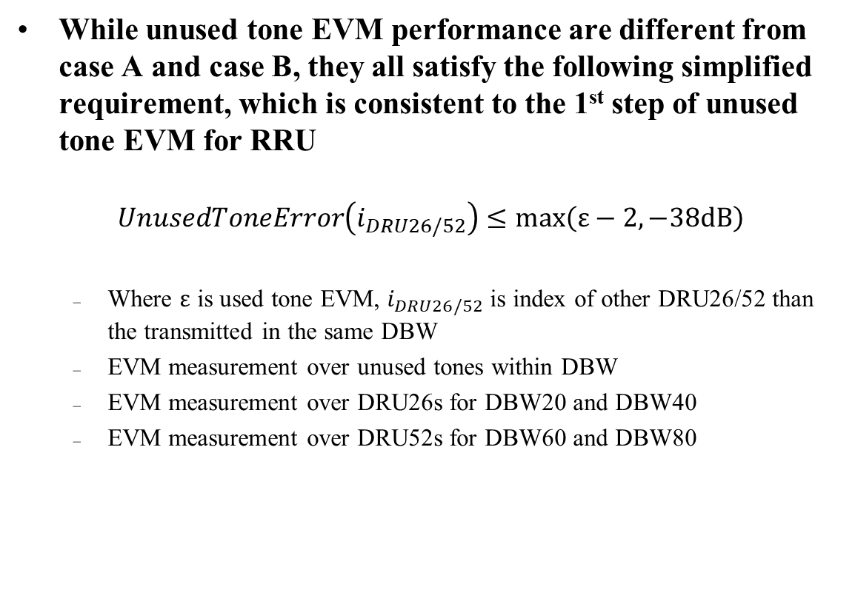
Within DBW Unused Tone EVM Requirement for DRU
While unused tone EVM performance are different from case A and case B, they all satisfy the following simplified requirement, which is consistent to the 1st step of unused tone EVM for RRU
$$UnusedToneError\left(i_{DRU26/52}\right)≤max\left(ε−2, −38dB\right)$$
  Where $ε$ is used tone EVM, $i_{DRU26/52}$is index of other DRU26/52 than the transmitted in the same DBW
  EVM measurement over unused tones within DBW
  EVM measurement over DRU26s for DBW20 and DBW40
  EVM measurement over DRU52s for DBW60 and DBW80

Slide 10
Unused Tones Outside of DBW but Within PPDU BW

Slide 11
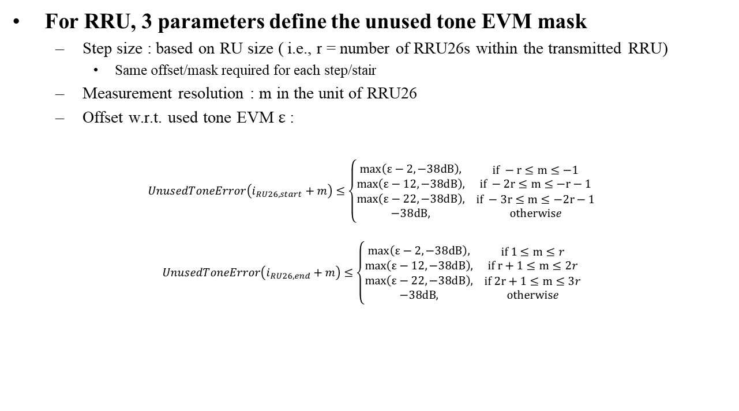
Review on Unused tone EVM Requirement for RRU Transmission
For RRU, 3 parameters define the unused tone EVM mask
  Step size : based on RU size ( i.e., r = number of RRU26s within the transmitted RRU)
    Same offset/mask required for each step/stair
  Measurement resolution : m in the unit of RRU26
  Offset w.r.t. used tone EVM $ε$ :
$$UnusedToneError\left(i_{RU26, start}+m\right)≤\left\{\begin{matrix}\begin{matrix}max\left(ε−2, −38dB\right), \\ max\left(ε−12, −38dB\right),\end{matrix} & \begin{matrix}if −r≤m≤−1 \\ if −2r≤m≤−r−1\end{matrix} \\ \begin{matrix}max\left(ε−22, −38dB\right), \\ −38dB,\end{matrix} & \begin{matrix}if −3r≤m≤−2r−1 \\ otherwise\end{matrix}\end{matrix}\right.$$
$$UnusedToneError\left(i_{RU26, end}+m\right)≤\left\{\begin{matrix}\begin{matrix}max\left(ε−2, −38dB\right), \\ max\left(ε−12, −38dB\right),\end{matrix} & \begin{matrix}if 1≤m≤r \\ if r+1≤m≤2r\end{matrix} \\ \begin{matrix}max\left(ε−22, −38dB\right), \\ −38dB,\end{matrix} & \begin{matrix}if 2r+1≤m≤3r \\ otherwise\end{matrix}\end{matrix}\right.$$

Slide 12
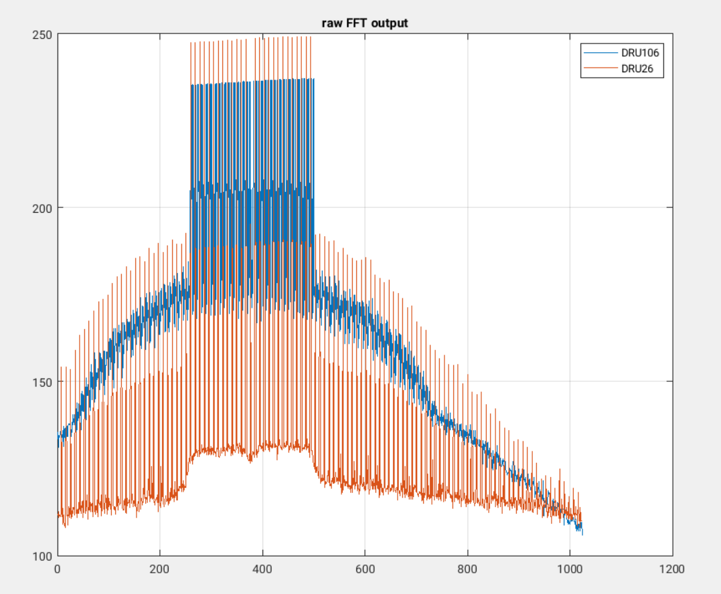
Unused tone EVM Step Size for DRU
The decay pattern of unused tone EVM outside of DBW depends on DBW
Propose to use DBW as step size to define DRU unused tone EVM outside of DBW
  E.g. for a DRU in DBW20/DBW40 when PBW is 80MHz, the requirement for unused tone EVM outside of the DBW20/DBW40 can be defined on each neighboring 20MHz/40MHz (= RRU242/RRU484 in the 80MHz)

Slide 13
Unused tone EVM Measurement Resolution for DRU
Measurement resolution should depend on RRU or DRU sizes that are potentially located adjacent to the DBW
The min allowed RRU size in hybrid mode is RRU242
For DRU, different DRU sizes are possible, with DBW>=20MHz
  Even for the same DRU size, DRU with different DBW has different tone plan. So difficult to find a consistent set of tones to measure unused tone EVM for given DRU size
Therefore, we propose to use RRU242 as resolution
  E.g. for a DRU in DBW40 when PBW is 80MHz, the requirement for unused tone EVM outside of the DBW40 can be defined on neighboring 40MHz and EVM is measured over each 20MHz (or RRU242)

Slide 14
EVM Offset Required for Each Step in DRU
Due to the tone spreading nature of DRU, interference to the unused tones outside of DBW is also concentrated on subset of tones, the harmonics of the populated tones
When measurement averaging over entire DBW20 or RRU242, the results level is generally x dB down, where x is the spreading gain defined as 10*log10(DRU_tone_spacing)
Considering that used tone EVM is computed only on populated tones, while the unused tone EVM outside of DBW is averaging over RRU242, the EVM offset needs to be adjected to account for spreading gain difference
  This also ensures when DBW is fully occupied by multiple DRUs, the aggregated unused tone EVM outside of DBW is comparable to RRU case

Slide 15
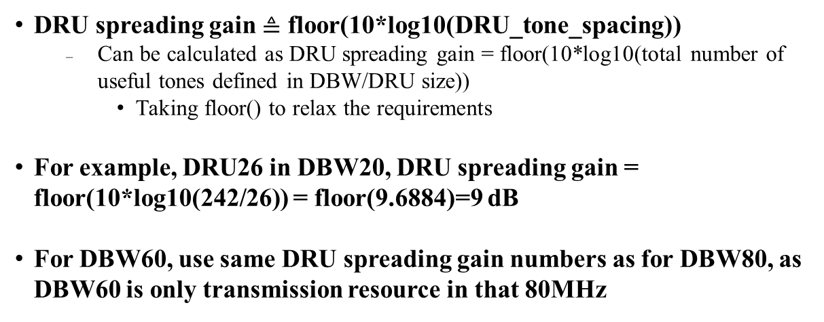
DRU Spreading Gain
DRU spreading gain $≜$ floor(10*log10(DRU_tone_spacing))
  Can be calculated as DRU spreading gain = floor(10*log10(total number of useful tones defined in DBW/DRU size))
    Taking floor() to relax the requirements
For example, DRU26 in DBW20, DRU spreading gain = floor(10*log10(242/26)) = floor(9.6884)=9 dB
For DBW60, use same DRU spreading gain numbers as for DBW80, as DBW60 is only transmission resource in that 80MHz
 | DRU Spreading Gain in dB
 | DRU26 | DRU52 | DRU106 | DRU242 | DRU484
DBW20 | 9 | 6 | 3 | N/A | N/A
DBW40 | 12 | 9 | 6 | 3 | N/A
DBW80 | N/A | 12 | 9 | 6 | 3
DBW60 | N/A | 12 | 9 | 6 | N/A

Slide 16
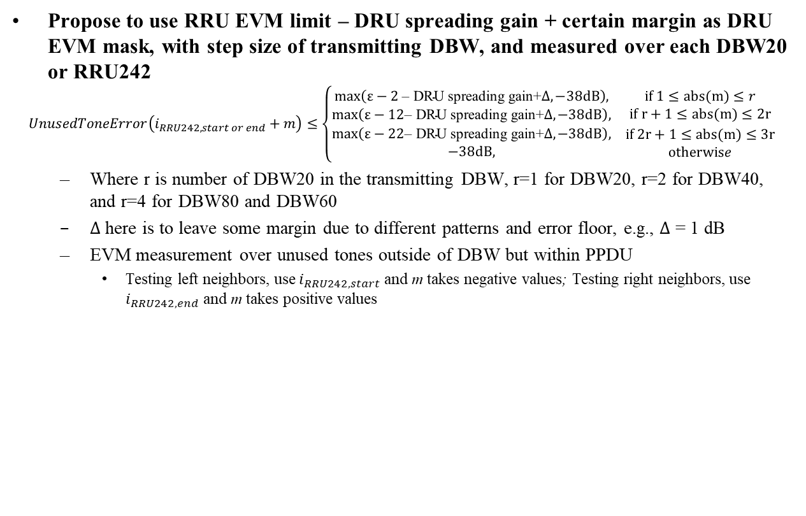
Outside of DBW Unused Tone EVM Requirement for DRU
Propose to use RRU EVM limit – DRU spreading gain + certain margin as DRU EVM mask, with step size of transmitting DBW, and measured over each DBW20 or RRU242
$$UnusedToneError\left(i_{RRU242, start or end}+m\right)≤\left\{\begin{matrix}\begin{matrix}max\left(ε−2 \text{– }\text{DRU} \text{spreading} \text{gain}\text{+}∆, −38dB\right), \\ max\left(ε−12\text{– }\text{DRU} \text{spreading} \text{gain}\text{+}∆, −38dB\right),\end{matrix} & \begin{matrix}if 1≤abs(m)≤r \\ if r+1≤abs(m)≤2r\end{matrix} \\ \begin{matrix}max\left(ε−22\text{– }\text{DRU} \text{spreading} \text{gain}\text{+}∆, −38dB\right), \\ −38dB,\end{matrix} & \begin{matrix}if 2r+1≤abs(m)≤3r \\ otherwise\end{matrix}\end{matrix}\right.$$
  Where r is number of DBW20 in the transmitting DBW, r=1 for DBW20, r=2 for DBW40, and r=4 for DBW80 and DBW60
  $∆$ here is to leave some margin due to different patterns and error floor, e.g., $∆$ = 1 dB
  EVM measurement over unused tones outside of DBW but within PPDU
    Testing left neighbors, use $i_{RRU242, start}$ and m takes negative values; Testing right neighbors, use $i_{RRU242, end}$ and m takes positive values

Slide 17
Summary
We proposed used tone EVM requirement for DRU to be the same as RRU with TB PPDU, to reduce the interference to other OFDMA users
We also proposed DRU unused tone EVM requirement for unused tone within DBW and outside of DBW
  Within DBW: a simplified EVM mask for all DRU with a single offset
  Outside of DBW: use RRU EVM limit – DRU spreading gain + certain margin as DRU EVM mask

Slide 18
SP 1
Do you agree to include the following into the 11bn SFD
Define the transmit constellation error in an UHR DRU TB PPDU for all MCSs to be the same as in an UHR RRU TB PPDU

Slide 19
SP 2
Do you agree to include the following into the 11bn SFD
Local oscillator leakage and its within ±3 neighboring subcarriers shall be excluded from the computation of the transmitter modulation accuracy test for DRU

Slide 20

SP 3
Do you agree to include the following into the 11bn SFD
DRU unused tone EVM requirement for the unused tones within DBW is given by
  $$UnusedToneError\left(i_{DRU26/52}\right)≤max\left(ε−2, −38dB\right)$$
  Where $ε$ is used tone EVM, $i_{DRU26/52}$is index of other DRU26/52 than the transmitted in the same DBW
  For all DRUs

Slide 21
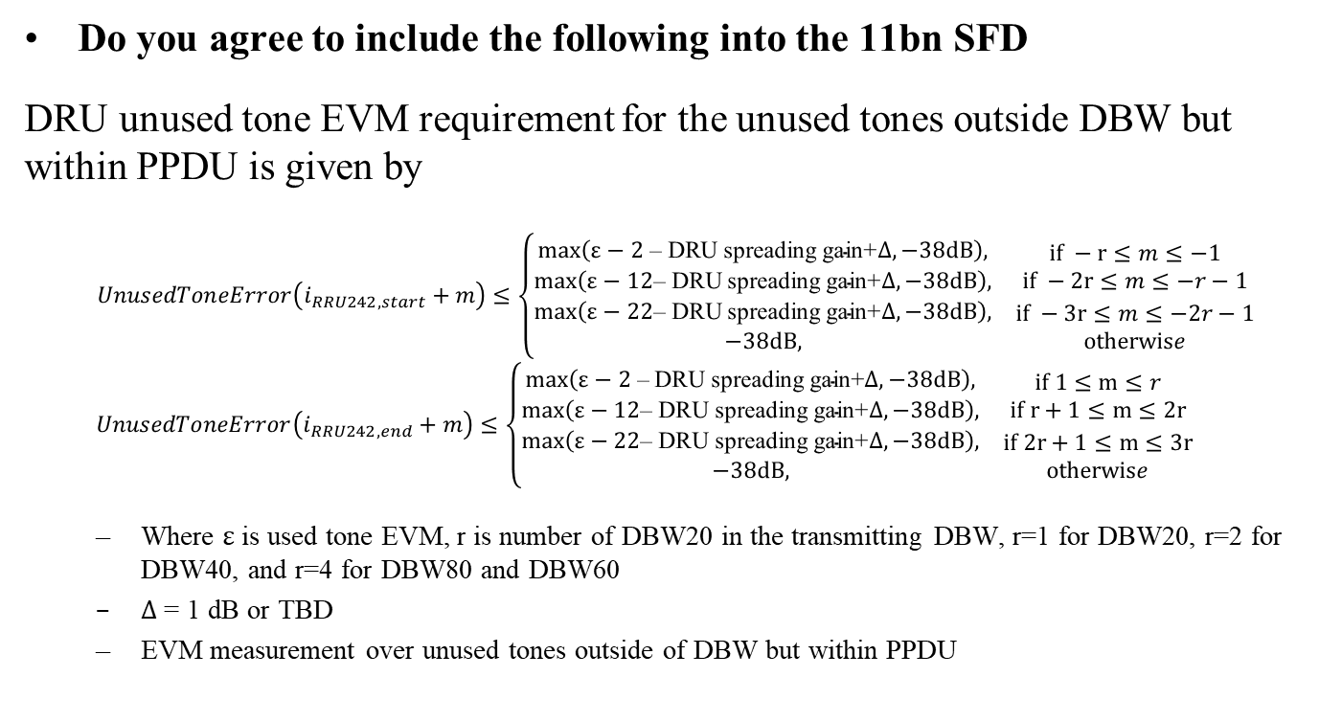
SP 4
Do you agree to include the following into the 11bn SFD
DRU unused tone EVM requirement for the unused tones outside DBW but within PPDU is given by
$$UnusedToneError\left(i_{RRU242, start}+m\right)≤\left\{\begin{matrix}\begin{matrix}max\left(ε−2 \text{– }\text{DRU} \text{spreading} \text{gain}\text{+}∆, −38dB\right), \\ max\left(ε−12\text{– }\text{DRU} \text{spreading} \text{gain}\text{+}∆, −38dB\right),\end{matrix} & \begin{matrix}if −r≤m≤−1 \\ if −2r≤m≤−r−1\end{matrix} \\ \begin{matrix}max\left(ε−22\text{– }\text{DRU} \text{spreading} \text{gain}\text{+}∆, −38dB\right), \\ −38dB,\end{matrix} & \begin{matrix}if −3r≤m≤−2r−1 \\ otherwise\end{matrix}\end{matrix}\right.$$
  $$UnusedToneError\left(i_{RRU242, end}+m\right)≤\left\{\begin{matrix}\begin{matrix}max\left(ε−2 \text{– }\text{DRU} \text{spreading} \text{gain}\text{+}∆, −38dB\right), \\ max\left(ε−12\text{– }\text{DRU} \text{spreading} \text{gain}\text{+}∆, −38dB\right),\end{matrix} & \begin{matrix}if 1≤m≤r \\ if r+1≤m≤2r\end{matrix} \\ \begin{matrix}max\left(ε−22\text{– }\text{DRU} \text{spreading} \text{gain}\text{+}∆, −38dB\right), \\ −38dB,\end{matrix} & \begin{matrix}if 2r+1≤m≤3r \\ otherwise\end{matrix}\end{matrix}\right.$$
  Where $ε$ is used tone EVM, r is number of DBW20 in the transmitting DBW, r=1 for DBW20, r=2 for DBW40, and r=4 for DBW80 and DBW60
  $∆$ = 1 dB or TBD
  EVM measurement over unused tones outside of DBW but within PPDU

Slide 22
Reference
[1] 11-25/1195 EVM Definition for UHR DRU TB PPDU followup

Slide 23
Appendix

