Slide 1
Scrambling Seed Design for DS-CTS
Date: 2025-07-xx
Authors:
Name | Affiliations | Address | Phone | Email
Lin Yang | Qualcomm
Bin Tian
Youhan Kim
Alfred Asterjadhi
Giovanni Chisci
Alice Chen
Notes:
September 2012

Slide 2
Introduction
11bn adopted DS-CTS as Defer Signal to start protected short contention for the pending LL data, with the following specified in D0.3
Shall be transmitted in a non-HT or non-HT duplicate format
Using 6 Mbps data rate
SCRAMBLER_INITIAL_VALUE shall be set to the fixed value defined in the spec
Carry the protected duration in the Duration field and set the duration to be the default value that equals to AIFSN[2] + 7 slots (total 97 us)
RA field of DS-CTS is set to a unique Unicast MAC address with OUI 00:0F:AC and remaining bits set by ANA
To make overlapping DS-CTS frames decodable, we need to further fix “SCRAMBLER_INITIAL_VALUE” and “ANA” that are highlighted above
The following slides discuss how to select an optimal scrambling seed (i.e., scrambler initial value) for DS-CTS

Slide 3
Design Consideration for Scrambling Seed Selection
Scrambling seed has the following impacts to DS-CTS frame
RL-SIG detection for 11ax/11be/11bn PPDU classification, which compares similarity of L-SIG and next symbol after L-SIG
L-SIG has fixed content in DS-CTS
Rate is 6Mbps, Length is 14 bytes
1st data symbol after L-SIG carries service field and part of frame control field in DS-CTS
Content of frame control field is also fixed for any CTS frame, including DS-CTS
Coded bits in the 1st data symbol change with the scrambling seed only
PAPR of data symbols in DS-CTS
Smaller PAPR can reduce the required power backoff and/or improve EVM
So the optimal scrambling seed selection should be based on
Avoid triggering RL-SIG detection by ensuring large hamming distance between L-SIG and its next symbol, also suggested in [1]
Lower worst case PAPR
Use PAPR of L-SIG as reference

Slide 4
DS-CTS

Slide 5
Scrambling Seed Testing on DS-CTS
Assumptions
L-SIG is fixed (Rate is 6Mbps, Length is 14 bytes)
Field contents fixed as specified
RA = 00:0F:AC:ANA
ANA is set to 47:43:00 as announced, other value 47:43:FF is also explored
Per 20MHz rotation applied in non-HT DUP, as specified in spec
20/40/80/160/320MHz
All possible scrambling seed value tested
Seeds with the top Hamming distances are used for PAPR study
00-0F-AC-47-43-00000-0F-AC-47-43-000-0F-AC-47-43-00

Slide 6
Scrambling Seed Optimization (RA= 00-0F-AC-47-43-00)
Hamming distance |  | HD | 33 | 33 | 31 | 31 | 31 | 31
Scrambling seed |  | seed | 33 | 67 | 23 | 49 | 91 | 109
PAPR in dB | 20MHz non-HT | L-SIG | 6.8255
 |  | sym1 | 4.9176 | 5.7234 | 6.5666 | 8.3643 | 7.036 | 8.6761
 |  | sym2 | 8.3122 | 6.2735 | 7.6122 | 6.7011 | 6.9934 | 6.9476
 |  | sym3 | 7.9289 | 7.4435 | 5.6553 | 7.5464 | 5.9151 | 7.4184
 |  | sym4 | 6.6235 | 6.5634 | 6.2391 | 6.4028 | 7.9178 | 6.4022
 |  | sym5 | 7.0924 | 9.3711 | 6.1657 | 5.7625 | 5.5602 | 5.7625
 |  | sym6 | 6.0764 | 5.526 | 6.7506 | 7.9454 | 6.3398 | 6.828
 | 40MHz Non-HT DUP | L-SIG | 9.8358
 |  | sym1 | 7.9279 | 8.7337 | 9.5769 | 11.1436 | 10.0463 | 11.6864
 |  | sym2 | 11.3225 | 9.1557 | 10.6225 | 9.406 | 10.0037 | 9.4135
 |  | sym3 | 10.9392 | 10.4538 | 8.3452 | 10.5567 | 8.6699 | 10.4287
 |  | sym4 | 9.3761 | 9.1387 | 8.8432 | 9.3513 | 10.9281 | 9.3578
 |  | sym5 | 10.0194 | 12.3019 | 9.176 | 8.2375 | 8.5705 | 8.2133
 |  | sym6 | 9.0867 | 8.5363 | 8.8858 | 10.1475 | 9.2394 | 9.8383
 | 80MHz Non-HT DUP | L-SIG | 9.0216
 |  | sym1 | 6.8593 | 7.7729 | 8.7635 | 10.0768 | 9.2536 | 10.9206
 |  | sym2 | 10.7241 | 8.6043 | 9.8728 | 8.979 | 9.1147 | 9.2001
 |  | sym3 | 10.02 | 9.455 | 7.9165 | 9.7754 | 8.1448 | 9.4427
 |  | sym4 | 8.2333 | 8.0458 | 8.242 | 8.7533 | 10.4067 | 8.3394
 |  | sym5 | 9.5228 | 11.291 | 8.5796 | 8.0015 | 7.7314 | 7.9471
 |  | sym6 | 8.3626 | 7.8479 | 7.7769 | 10.0689 | 8.1916 | 9.2236
If limiting the Hamming distance must be >=30, scrambling seed value of 23 is the best with excellent Hamming distance and least PAPRs
The corresponding SCRAMBLER_INITIAL_VALUE is [1, 1, 1, 0, 1, 0, 0]
Note that some higher PAPRs appear in the last 3 symbols, which potentially can be optimized by changing the last octet in ANA of RA field

Slide 7
Scrambling Seed Optimization (RA= 00-0F-AC-47-43-FF)
Hamming distance |  | HD | 33 | 33 | 31 | 31 | 31 | 31
Scrambling seed |  | seed | 33 | 67 | 23 | 49 | 91 | 109
PAPR in dB | 20MHz non-HT | L-SIG | 6.8255
 |  | sym1 | 4.9176 | 5.7234 | 6.5666 | 8.3643 | 7.036 | 8.6761
 |  | sym2 | 8.3122 | 6.2735 | 7.6122 | 6.7011 | 6.9934 | 6.9476
 |  | sym3 | 7.9289 | 7.4435 | 5.6553 | 7.5464 | 5.9151 | 7.4184
 |  | sym4 | 6.2905 | 5.8557 | 5.7628 | 7.4428 | 6.6392 | 6.9439
 |  | sym5 | 8.2382 | 7.0223 | 4.9439 | 7.62 | 5.86 | 7.5313
 |  | sym6 | 6.5385 | 6.4851 | 7.4419 | 7.0709 | 6.1459 | 5.3626
 | 40MHz Non-HT DUP | L-SIG | 9.8358
 |  | sym1 | 7.9279 | 8.7337 | 9.5769 | 11.1436 | 10.0463 | 11.6864
 |  | sym2 | 11.3225 | 9.1557 | 10.6225 | 9.406 | 10.0037 | 9.4135
 |  | sym3 | 10.9392 | 10.4538 | 8.3452 | 10.5567 | 8.6699 | 10.4287
 |  | sym4 | 9.1426 | 8.743 | 8.7731 | 10.4531 | 9.4183 | 9.9542
 |  | sym5 | 11.2485 | 9.9047 | 7.9502 | 10.6303 | 8.8703 | 10.3763
 |  | sym6 | 9.1682 | 9.4123 | 10.205 | 9.8381 | 8.8617 | 7.9299
 | 80MHz Non-HT DUP | L-SIG | 9.0216
 |  | sym1 | 6.8593 | 7.7729 | 8.7635 | 10.0768 | 9.2536 | 10.9206
 |  | sym2 | 10.7241 | 8.6043 | 9.8728 | 8.979 | 9.1147 | 9.2001
 |  | sym3 | 10.02 | 9.455 | 7.9165 | 9.7754 | 8.1448 | 9.4427
 |  | sym4 | 8.0249 | 7.6607 | 8.0745 | 9.5311 | 8.3556 | 9.1929
 |  | sym5 | 10.2821 | 9.3551 | 7.041 | 10.0472 | 8.0636 | 9.8981
 |  | sym6 | 8.0827 | 8.6831 | 9.4231 | 8.8192 | 8.4099 | 6.9316
Assuming Hamming distance must be >=30
By setting the last octet of ANA to “FF”, the PAPR of the last 3 symbols is no longer the bottleneck.
Note that many octet values other than “FF” can also remove the last three symbol PAPR bottleneck, they all lead to the same seed selection results which now just depend on the first three symbols.
Scrambling seed values of 91 or 67 offer optimized hamming distance and PAPR performance
Seed value of 91: The corresponding SCRAMBLER_INITIAL_VALUE is [1, 1, 0, 1, 1, 0, 1]
Seed value of 67: The corresponding SCRAMBLER_INITIAL_VALUE is [1, 1, 0, 0, 0, 0, 1]

Slide 8
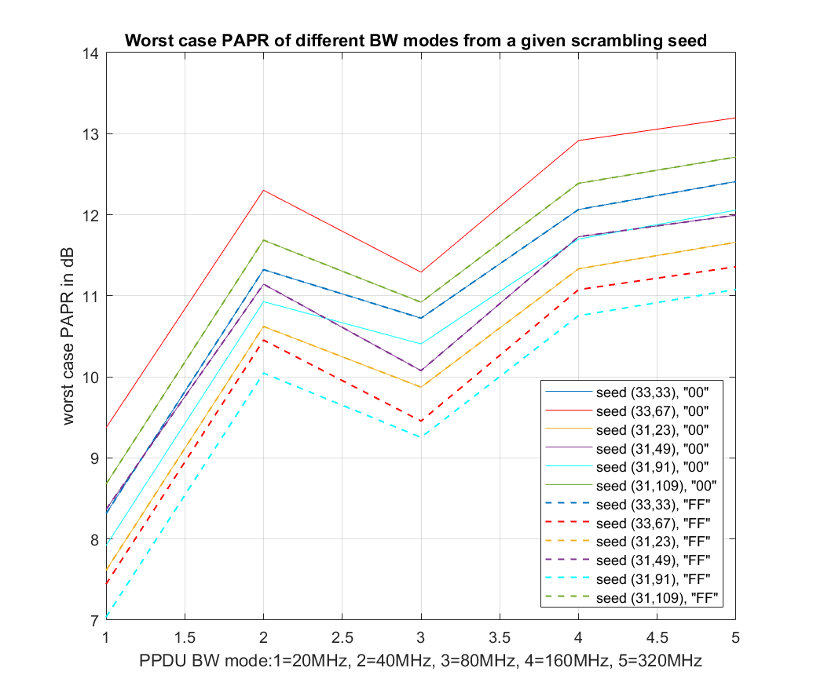
Summarize Results for All BWs (Assuming HD≥30)
Legend:
seed(a,b)=seed(HD, seed value)
Optimal selection is about consistent across all BW modes
If the last octet of ANA is “00”, the best seed is 23
If the last octet of ANA is “FF”, PAPR can be further optimized. The best seed candidate is either 91 or 67

Slide 9
Scrambling Seed Optimization (updated) (RA= 00-0F-AC-47-43-00)
Expect RL-SIG detect performance can be maintained even with HD=29, scrambling seed value of 84 is the best with good hamming distance and least PAPRs
The corresponding SCRAMBLER_INITIAL_VALUE is [0, 0, 1, 0, 1, 0, 1]
Hamming distance |  | HD | 33 | 33 | 31 | 31 | 31 | 31 | 29 | 29 | 29 | 29 | 29
Scrambling seed |  | seed | 33 | 67 | 23 | 49 | 91 | 109 | 54 | 84 | 101 | 117 | 125
PAPR in dB | 20MHz non-HT | L-SIG | 6.8255
 |  | sym1 | 4.9176 | 5.7234 | 6.5666 | 8.3643 | 7.036 | 8.6761 | 8.1807 | 4.9404 | 6.9224 | 7.5303 | 8.2058
 |  | sym2 | 8.3122 | 6.2735 | 7.6122 | 6.7011 | 6.9934 | 6.9476 | 7.039 | 6.9599 | 6.5724 | 5.7625 | 6.5882
 |  | sym3 | 7.9289 | 7.4435 | 5.6553 | 7.5464 | 5.9151 | 7.4184 | 6.8725 | 4.8791 | 6.0605 | 6.1004 | 6.4553
 |  | sym4 | 6.6235 | 6.5634 | 6.2391 | 6.4028 | 7.9178 | 6.4022 | 7.4687 | 5.5773 | 5.6607 | 5.6531 | 6.32
 |  | sym5 | 7.0924 | 9.3711 | 6.1657 | 5.7625 | 5.5602 | 5.7625 | 8.8938 | 5.9289 | 7.2831 | 7.3745 | 6.8864
 |  | sym6 | 6.0764 | 5.526 | 6.7506 | 7.9454 | 6.3398 | 6.828 | 7.3923 | 6.1063 | 6.1541 | 5.1825 | 4.5561
 | 40MHz Non-HT DUP | L-SIG | 9.8358
 |  | sym1 | 7.9279 | 8.7337 | 9.5769 | 11.1436 | 10.0463 | 11.6864 | 10.4162 | 7.6905 | 9.7778 | 10.4452 | 11.2161
 |  | sym2 | 11.3225 | 9.1557 | 10.6225 | 9.406 | 10.0037 | 9.4135 | 9.5725 | 9.5522 | 9.5827 | 7.9294 | 9.5985
 |  | sym3 | 10.9392 | 10.4538 | 8.3452 | 10.5567 | 8.6699 | 10.4287 | 9.837 | 7.8599 | 9.0708 | 9.1107 | 8.8804
 |  | sym4 | 9.3761 | 9.1387 | 8.8432 | 9.3513 | 10.9281 | 9.3578 | 10.479 | 8.5876 | 8.671 | 8.6634 | 9.012
 |  | sym5 | 10.0194 | 12.3019 | 9.176 | 8.2375 | 8.5705 | 8.2133 | 11.4215 | 8.9379 | 10.2934 | 10.0593 | 9.6186
 |  | sym6 | 9.0867 | 8.5363 | 8.8858 | 10.1475 | 9.2394 | 9.8383 | 10.4026 | 9.1166 | 8.8434 | 8.008 | 7.5664
 | 80MHz Non-HT DUP | L-SIG | 9.0216
 |  | sym1 | 6.8593 | 7.7729 | 8.7635 | 10.0768 | 9.2536 | 10.9206 | 9.1374 | 6.9004 | 9.0356 | 9.3798 | 10.46
 |  | sym2 | 10.7241 | 8.6043 | 9.8728 | 8.979 | 9.1147 | 9.2001 | 8.559 | 8.9511 | 8.7603 | 7.877 | 8.8293
 |  | sym3 | 10.02 | 9.455 | 7.9165 | 9.7754 | 8.1448 | 9.4427 | 9.3617 | 7.2986 | 8.07 | 8.5238 | 7.6538
 |  | sym4 | 8.2333 | 8.0458 | 8.242 | 8.7533 | 10.4067 | 8.3394 | 9.7769 | 7.8882 | 7.7149 | 7.7426 | 7.9547
 |  | sym5 | 9.5228 | 11.291 | 8.5796 | 8.0015 | 7.7314 | 7.9471 | 10.248 | 7.9299 | 9.6852 | 9.6609 | 8.5451
 |  | sym6 | 8.3626 | 7.8479 | 7.7769 | 10.0689 | 8.1916 | 9.2236 | 9.8485 | 8.3136 | 8.5195 | 7.4802 | 6.9657

Slide 10
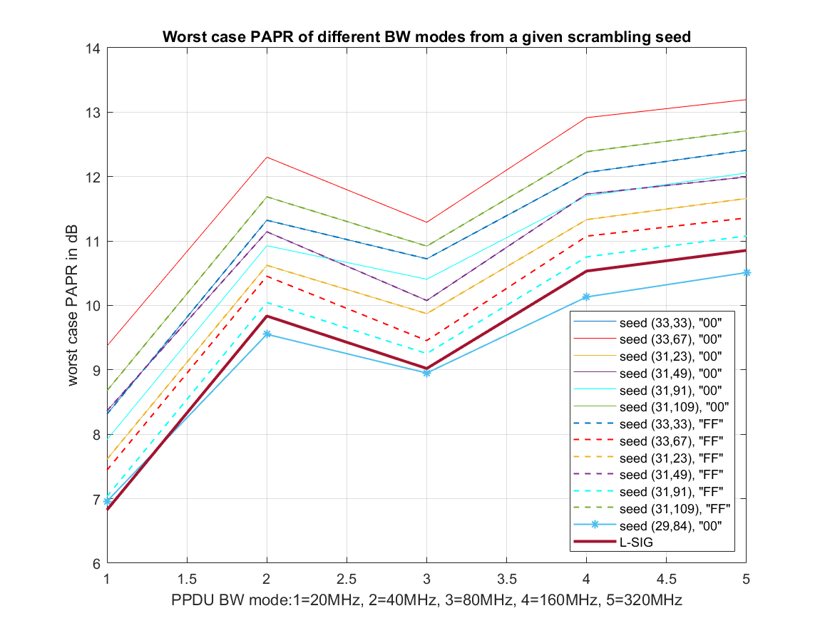
Summarize Results for All BWs (updated with HD=29)
With existing ANA value (47:43:00), scrambling seed 84 with HD=29 can achieve even lower PAPR
PAPR dropped below L-SIG
The last 3 symbols are no longer bottleneck
We recommend using scrambling seed of 84 in DS-CTS

Slide 11
SP
Do you agree to include the following into the 11bn SFD
SCRAMBLER_INITIAL_VALUE used in DS-CTS frame is [0, 0, 1, 0, 1, 0, 1]
Scrambling seed value = 84
Note RA is set to 00:0F:AC:47:43:00

Slide 12
Reference
[1]11-25/1181 Scrambler seed used in DS-CTS frame

Slide 13
Appendix

