Slide 1
Consideration on the scrambler initialization value for DS-CTS
Date: 2025-07
Authors:
Name | Affiliation | Address | Phone | Email
Chenchen Liu | Huawei Technologies Co., Ltd | Huawei Base, Bantian, Shenzhen |  | liuchenchen1@huawei.com
Yunbo Li
Jian Yu
Ming Gan

Slide 2
Introduction
A Defer Signal CTS (DS-CTS) frame is transmitted to start the P-EDCA contention
The DS-CTS may be transmitted by multiple STA simultaneously, so the scrambler initialization value shall be fixed

Slide 3

Initialization Value Selection criteria
Reduce the risk of the first data symbol being detection as RL-SIG
Reduce the PAPR of the data symbol
  Since the PAPR of the L-SIG is fixed, the data symbol better have a less or equal PAPR than L-SIG
196
97
00:0F:AC:47:43:00
HE, EHT,UHR

Slide 4
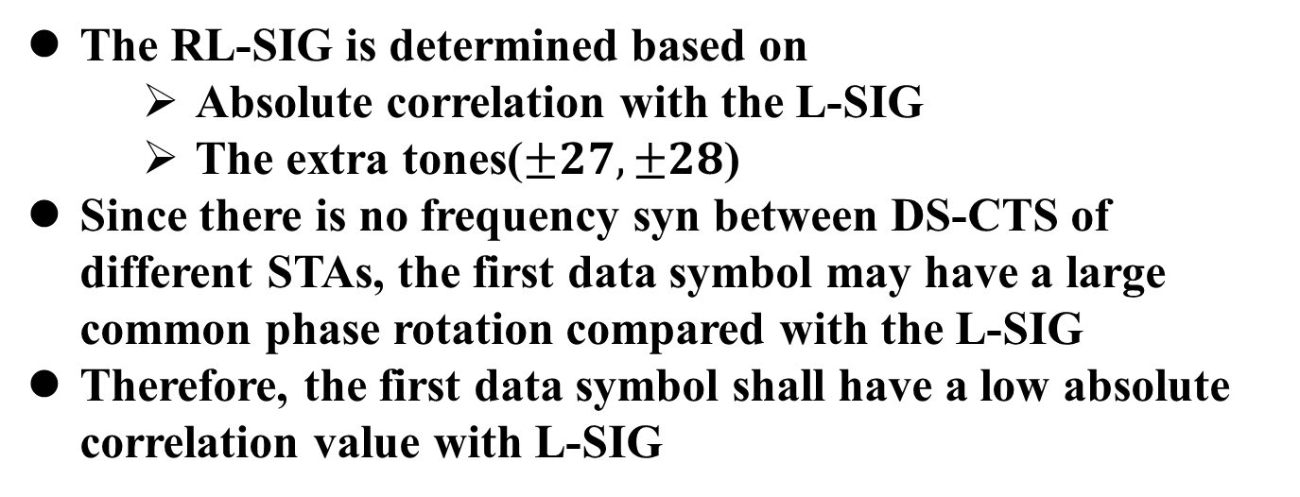
Detection of RL-SIG
The RL-SIG is determined based on
  Absolute correlation with the L-SIG
  The extra tones($±27,±28$)
Since there is no frequency syn between DS-CTS of different STAs, the first data symbol may have a large common phase rotation compared with the L-SIG
Therefore, the first data symbol shall have a low absolute correlation value with L-SIG

Slide 5
Proposed Initialization Value
Initi Value | Corr with L-SIG | Worst PAPR(dB)
Initi Value | Corr | BW20 | BW40 | BW80 | BW160 | BW320
112 | 0 | 6.75 | 9.76 | 8.7 | 10.35 | 10.62
17 | -4 | 6.43 | 9.44 | 8.41 | 10.04 | 10.32
23 | -14 | 7.61 | 10.62 | 9.87 | 11.33 | 11.66
33 | -18 | 8.31 | 11.32 | 10.72 | 12.06 | 12.41
BW20 | BW40 | BW80 | BW160 | BW320
6.83 | 9.84 | 9.02 | 10.53 | 10.85
PAPR of L-SIG

Slide 6
Conclusion
The scrambler initialization value shall make the first data symbol orthogonal with the L-SIG and the data symbols have smaller PAPR than the L-SIG.

Slide 7
SP1
Do you agree to include the following into the 11bn SFD
SCRAMBLER_INITIAL_VALUE used in DS-CTS frame is [0, 0, 0, 0, 1, 1, 1]
  Scrambling seed value = 112

Slide 8
SP2
Do you agree to include the following into the 11bn SFD
The SCRAMBLER_INITIAL_VALUE used in DS-CTS frame is [1, 0, 0, 0, 1, 0, 0]
  Scrambling seed value = 17

Slide 9
Appendix

