Slide 1
AP management in MAPC framework
Date: 2025-07-17
Authors:

Slide 2
Introduction
The current TGbn SFD does not provide the mechanism to protect the current coordinated state of a MAPC pair of APs.
Further, it does not provide the insight about 'when & how' to reach a SUCCESS/FAILURE conclusion for a MAPC Negotiation Request frame either for a new agreement establishment(join) or teardown(leave).
37.13.1.3 MAPC agreement negotiation
37.13.1.3.1 General
  This subclause defines procedures for MAPC agreement negotiation. An AP shall follow the rules defined in this subclause to establish, update or tear down agreements for MAPC through negotiation, in addition to the specific rules for multi-AP coordination schemes defined in 37.13.2 (Procedures for specific multi-AP coordination schemes).
  …The Status Code field shall be set to SUCCESS if the MAPC responding AP accepts all the requests carried in the received MAPC Negotiation Request frame. Otherwise, the MAPC responding AP shall set the corresponding Status field to indicate an appropriate rejection status code as per Table 9-80 (Status codes).
37.13.1.3.2 MAPC agreement establishment
…To accept, reject, or suggest alternative parameters for a MAPC agreement establishment, the MAPC responding AP shall follow the rules defined in 37.13.1.3.1 (General).
37.13.1.3.4 MAPC agreement teardown
…The MAPC responding AP shall accept the request to teardown an existing MAPC agreement by following the rules defined in 37.13.1.3.1 (General).

Slide 3
Motivation
MAPC is performed to minimize the channel interference and maximize channel utilization efficiency to meet the UHR KPIs.
MAPC procedure includes various pre-coordination steps including discovery, negotiation, agreement, pre-ops. followed by post-coordination steps including coordinated transmission, re-negotiation, agreement teardown and related signalling per step.
In summary, a whole lot of signal processing is involved in achieving any kind of coordination. With this insight:
  it seems only fair to allow the participating APs to enjoy the benefit of coordination for at least a 'defined wait period' before a new/ external AP can try to join the already formed MAPC pair and thus causing disruption to ongoing coordinated transmission followed by another set of signalling procedure
  it seems only fair to ensure that any participating AP does not leave (teardown agreement) in MAPC pair abruptly and rather considers a "defined wait period’ and thus help to minimizing the below, otherwise, foreseen problems:
    while operating independently, the abruptly left AP can cause interference and resource crunch to rest of the participating APs
    remaining participating APs might continue to operate under limited negotiated resources until a new (re-)negotiation is performed
Hence, it is important to define a standard suggested 'wait period' to allow the participating APs to enjoy the benefit of coordination for a minimum duration of time and accordingly, also to define 'when & 'how’ (1) to handle a new/ external AP to join an existing MAPC pair of APs & (2) to handle a participating AP leaving the MAPC pair of APs for efficient usage of negotiated resources.

Slide 4
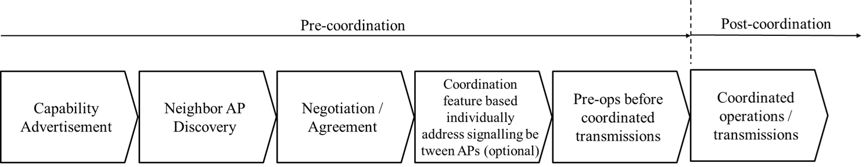
Abstract
When an MAPC pair is formed (comprising at least two participating APs coordinating for one or more MAPC scheme),
MAPC pair information and individual AP’s participated scheme related indication to be broadcasted.
MAPC pair applies a standard defined ‘wait period’ herein called as Guard Window(GW) (and its associated policies) whose value depends on the 'type' of MAPC scheme(s) active amidst the MAPC pair of APs.
An external AP trying to join the pair to benefit from coordination, based on MAPC pair broadcast, and accordingly its mapc-joining-request handling by any participating or coordinating AP on the basis of GW policy.
A participating AP trying to leave the pair due to its personal condition (e.g. low battery level) during the pre- or post-coordination steps, and accordingly its mapc-leaving-request handling by the coordinating AP on the basis of GW policy.
Further, addressing cases needing leniency and urgency in handling.
Fig. Unified MAPC framework

Slide 5
Guard Window & related policy
Guard Window(GW) is a time duration (in the post-coordination phase) before the end of which, no new AP joining/ leaving to MAPC pair shall be allowed. MAPC pair info broadcast shall include GW_time_info whose value can be configured as per below policy:
# | GW policy | Description
1 | Short term | Coordination schemes which are valid for short duration such as TXOP (which is typically 3-4ms) are referred as short term coordination (e.g. Co-BF). If the MAPC pair of APs consists of 'only short term coordination schemes', then 'joining of an external AP' OR 'leaving of a participating AP' is allowed after ending of the last TXOP schedule of the pair.
2 | Long term | Coordination schemes which are valid for long duration such as SP (which are typically 16ms long) durations are termed as long term coordination (e.g. Co-RTWT). If the MAPC pair of APs consists of ‘only long term coordination schemes’, then 'joining of an external AP' OR 'leaving of a participating AP' is allowed after ending of the last SP schedule of the pair.
3 | Mixed term | Its possible that there are both type of schemes coordinated amidst the pair of APs i.e. comprising short term as well as long terms schemes. If the MAPC pair of APs consists of ‘both short term & long term coordination schemes’, then 'joining of an external AP' OR 'leaving of a participating AP' is allowed after ending of the “last schedule” of the pair.
4 | *Per coordination scheme (only for joining) | If the participating APs decide to broadcast GW information per coordinated scheme, then an external AP is allowed to join the pair if the last GW duration belonging to the specific scheme for which external AP asks to join, has elapsed or expired since MAPC pair formation.

Slide 6
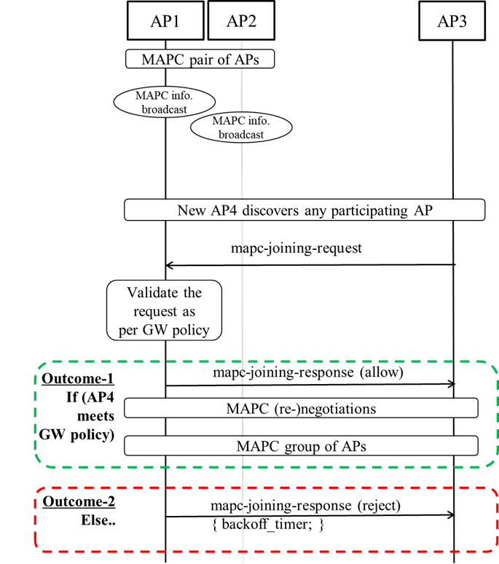
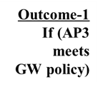

Handling – joining existing MAPC pair
MAPC pair info broadcast (by participating APs):
  GW_time_info, indicator whether GW has a single value or value per scheme, MAPC scheme bitmask
  GW_time_info shall be decremented at each successive broadcast as per time elapsed.
Purpose: Intent is to share that the pair/AP wants to hold its coordinated state for at least GW_time_info duration before getting ‘interrupted by’ and ‘allowing’ a new AP to join. For a new AP, the GW_time_info actually serves as an input towards making an informed and fair decision whether to initiate a communication towards already coordinated pair with the intention to join considering at least:
  to minimize the disturbance to already coordinated pair and
  to prioritize handling of any hampering situation to new AP’s data traffic
Implementation options:
  Type I implementation: the participating APs does not broadcast MAPC support for any of the coordinated schemes until the end of the GW_time_info value.
  Type II implementation: all the participating APs include a common single value for GW_time_info in its BSS broadcasts along with support for (corresponding AP’s) coordination schemes in their management frames.
  Type III implementation: the participating APs broadcast GW_time_info(s) per coordination scheme for that corresponding AP e.g. Co-TDMA, Co-RTWT, Co-SR, Co-BF etc.) in their management frames.
Note: Inline with above, even a participating AP shall not initiate a new coordination agreement with an external AP until corresponding pair’s or scheme’s GW duration has expired.

Slide 7
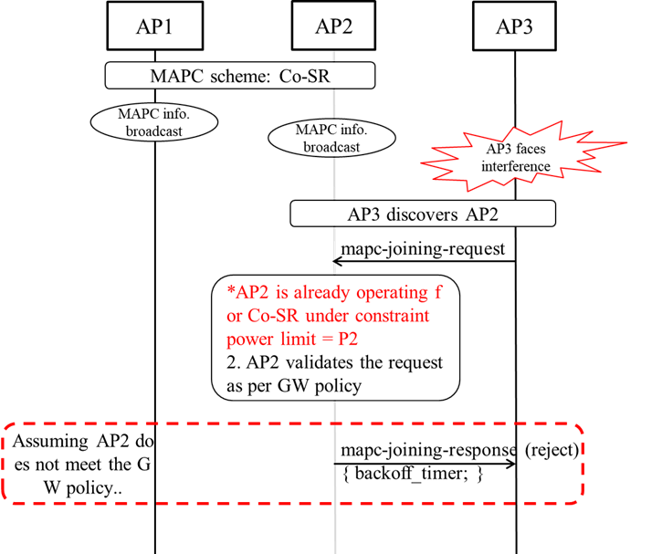
An illustration!
In this example, AP1 and AP2 are coordinating for Co-SR scheme and operating under constraint transmission power limits of P1 and P2 respectively.
An AP3 is introduced in the system in vicinity of AP2, and AP3 is facing interference from AP2.
AP3 detects the participating AP2 by reading its MAPC broadcasts (or via discovery frame).
Since AP3 is facing interference, it initiates a mapc-joining-request to AP2.
But AP2 is already operating under constraint power limit P2 and does not want to perform another Co-SR agreement with a new AP3 until the ongoing Co-SR finishes, say, within current TXOP.
Above rationale shall reflect in related GW policy and accordingly AP3 fails to meet the GW policy.
Hence, AP2 rejects AP3’s request with a backoff timer value.

Slide 8
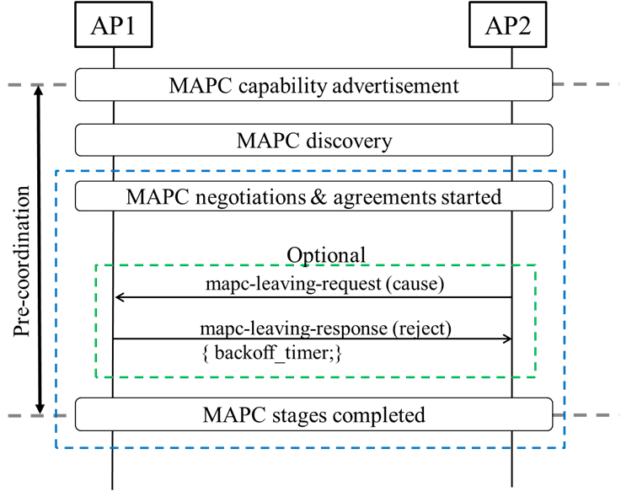
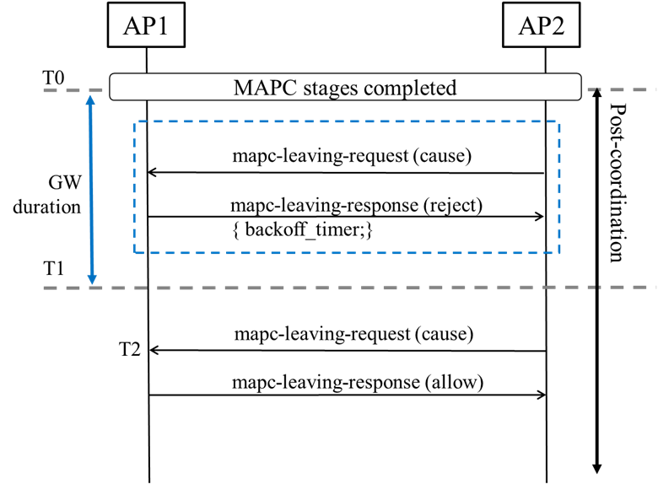
Handling – leaving existing MAPC pair
GW window duration 'value' is set according to the logic defined under Guard Window policy in slide5.
Before MAPC negotiation-agreement step has started, an AP2 can leave without any indication.
After MAPC negotiation-agreement step has started,
  an AP2 shall not try to leave the pair until completion of pre-coordination phase
  optionally, an AP2 may send a mapc-leaving-request to check the feasibility of the same including a cause value to indicate termination of partial/all schemes
In response to mapc-leaving-request, an AP2 is rejected with a back off timer until completion of pre-coordination phase. Such optional signalling will help to achieve leniency factor as well.
An AP2 trying to leave the MAPC pair in the post-coordination phase is handled according to the GW policy (pair or scheme specific).

Slide 9
GW policy – further enhancements
Proposed solutions are strict in nature mainly to safeguard the channel and processing resources and to maintain ongoing benefits of coordination to participating APs but there can be exceptional cases which may require a lenient/ urgent handling of the request, e.g.
  an AP facing sudden high interference causing disruption to its operation may need quick coordination
  a battery powered AP may need to terminate coordination owing to its power consumption threshold
  an unexpected high priority LL traffic forcing AP to - hold TXOP longer OR move from LCM to HCM, may need to terminate coordination
  a roaming AP about to go beyond the reachability of the pair, hence needing urgent departure, etc.
For each GW policy type, an additional standard parameter can be defined as to 'how much time is left before GW duration ends (hereby termed as GW_offset)’ whose value(s) can be defined per sub_cause based on traffic type, AC, UP, PS need, LLI, urgency etc.
  where sub_cause can be included in joining/ leaving request itself
Accordingly, if a joining/ leaving request is received when:
actual time left for GW duration to expire <= GW_offset corresponding to sub_cause,
then that AP can be allowed to join/ leave before actual GW duration expiry - followed
by necessary (re-negotiations) within rest of the MAPC participants.
GW_offset(us/ms) | sub_cause
Value[0] //TBD | Data_type[0] //for joining
Value[1] //TBD | Data_type[1] //for joining
Value[2] //TBD | Power_saving //for leaving
Value[3] //TBD | LLI //for leaving
… | …
Infinity | Urgent //for leaving

Slide 10
Summary
This contribution,
highlights the need to define a considerate system to handle MAPC pair joining and leaving event
defines the concept of Guard Window & related policy based on the characteristics of MAPC coordination scheme(s) present amidst MAPC pair of APs including:
  GW_time_info and other parameters broadcast
  implementation options
  update to successive broadcasted values
  further enhancements
defines the handling of an external AP trying to join the MAPC pair based on GW policy
defines the handling of a participating AP trying to leave the MAPC pair based on GW policy
further considers the handling of the scenarios according to strict, lenient and urgent basis.

Slide 11
Specification support
Definition, purpose and usage of Guard Window, GW policy, GW_time_info, GW_offset, cause, sub_cause, backoff_timer.
Modification in broadcast mechanisms such as Beacon, Probe Request/Response or MAPC Discovery Request/Response frame to indicate presence of a single/per scheme GW_time_info parameter.
Modification of MAPC Negotiation Request frame to include cause and sub_cause parameters.
Modification of MAPC Negotiation Response frame to include appropriate backoff_timer parameter along with appropriate Status Code.

Slide 12
References
[1] 11-25-0599-15-00bn-pdt-mac-mapc-signaling-and-protocol-aspects
[2] Draft P802.11bn_D0.3
[3] 11-25-0014-24-00bn-tgbn-motions-list-part-2
[4] 11-24-0171-26-00bn-tgbn-motions-list-part-1

Slide 13
SP#1
Do you agree that TGbn SFD defines a Guard Window (and related parameters), according to the coordinated schemes, in MAPC related broadcasts to protect the coordinated state of the MAPC pair of APs ?
Yes
No
Abstain

Slide 14
SP#2
Do you agree to define the following in TGbn SFD:
- handling of a new/external AP, trying to coordinate(join) with the MAPC pair of APs, according to the MAPC GW policy.
- handling of a participating AP trying to terminate(leave), partial/all MAPC agreements with the MAPC pair of APs, according to the MAPC GW policy.
Yes
No
Abstain

