Slide 1
MLO-based BFT signaling follow-up
Date: 2025-09-xx
Authors:
Name | Affiliation | Address | Phone | Email
Hongwon Lee | LG Electronics | 19, Yangjae-daero 11gil, Seocho-gu, Seoul 137-130, Korea |  | hongwon.lee@lge.com
Insun Jang |  |  |  | insun.jang@lge.com
Eunsung Park |  |  |  | esung.park@lge.com
Jinsoo Choi |  |  |  | js.choi@lge.com
Dongju Cha |  |  |  | dongju.cha@lge.com
Insik Jung |  |  |  | insik0618.jung@lge.com
HanGyu Cho |  |  |  | hg.cho@lge.com
Sanggook Kim |  | 10680 Treena St, San Diego CA 92131 , USA |  | sanggook.kim@lge.com

Slide 2
Introduction
We discussed how the Beamforming Training (BFT) can be performed using sub-7GHz signaling [4]
Additionally, we discussed the BFT Announcements and design principle for BFT Announcements [4]
In this contribution, we would like to discuss the BFT report procedure and unified BFT signaling options for both BFT
Announcements and Reports
For convenience, we call STAs (or APs) operating on mmWave bands mSTA (or mAPs) and also call STAs (or APs) operating on sub-7GHz bands sSTA (or sAPs)

Slide 3
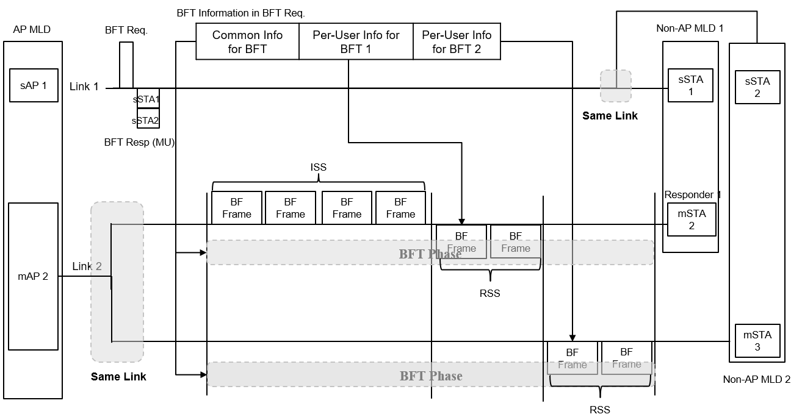
Recap: BFT announcement example [4]
BFT Request frame can be signaled in sub-7 GHz of a MLD device
BFT Request frame can contain Common Info and/or Per-User Info for BFT

Slide 4
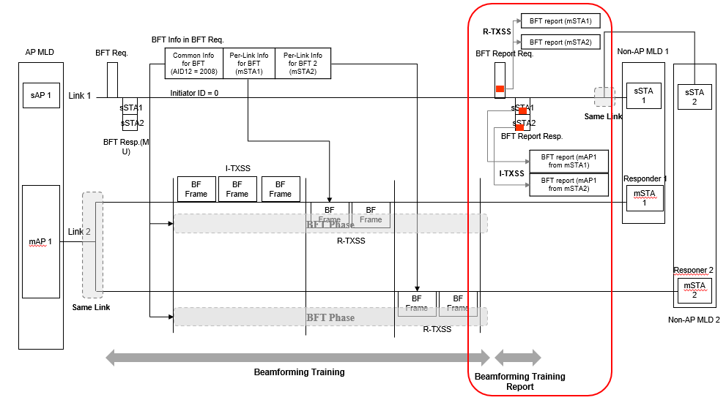
BFT report procedure example 1
Beamforming Training Report for mSTAs operating in mmWave link can be performed via not a mmWave link but a sub-7GHz link
The BFT report is solicited by sAP1 to gather mSTAs, or it can be performed in an unsolicited manner if necessary

Slide 5
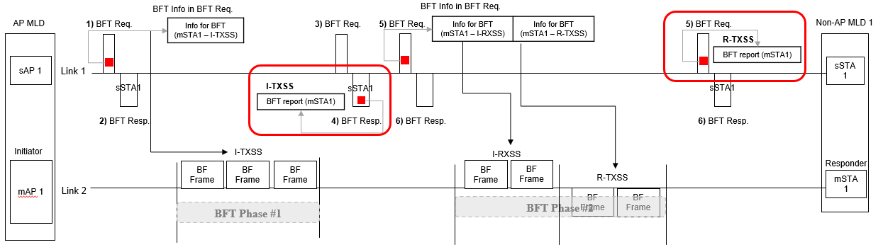
BFT report procedure example 2
BFT Announcements and BFT Reports can be performed separately in some specific scenario. In this example, a BFT Report from the responder is required following the I-TXSS BFT procedure to perform the I-RXSS procedure.
The BFT report for I-TXSS can be included in the responder’s 4) BFT Resp.
The additional 5) BFT Req. can be performed by the sAP1 after the I-RXSS based on the BFT feedback obtained in 4) BFT Resp.
The BFT report for R-TXSS can be included in the initiator’s 5) BFT Resq.
Notes:
I-RXSS를 빼고 I-TXSS를 먼저 하고 중간에 다른 동작 후에 R-TXSS를 scheduling하는 예시로 수정

Slide 6
BFT Report information example
  Total Sector
  Total number of sectors in BFT
  Best Sector (Sector Select)
  The value of the Sector ID within the frame that was received with best quality in the immediately preceding BFT
  Directional Antenna Select
  The value of the Directional Antenna ID within the frame that was received with best quality in the immediately preceding BFT
  SNR Report
  The value of the SNR from the frame that was received with best quality during the immediately preceding BFT. It is indicated in the Best Sector
  Sector Quality Report list
  The SNR values of whole sectors or some SNR values of sectors larger than specific RSSI value (e.g. Threshold value)
  This can be used to select second best sector if the best sector is not working
  If the Best Sector is included in this list, some of the information above can be omitted

Slide 7
Consideration for unified container for BFT Announcement and BFT Report
Type
  This may be the main type of IMMW specific information for the BFT Announcement, Reports, and so on.
    E,g., Type = IMMW info
  This allows the information to be distinguished from other features, such as feedback information regarding unavailability in the 11bn standard
    Subtype
  This can be used to distinguish the type of information related to IMMW operation
    E.g., Subtype = BFT Announcement, BFT Report
BFT information
  The “Type” and “Subtype” can determine the content of the IMMW information
The container for BFT can be included in any type of enhanced(reused) frames for both announcements and reports (e.g. BFT announcements and/or BFT reports can be included in the BSRP, NDPA, M-BA and/or other frames)

Slide 8
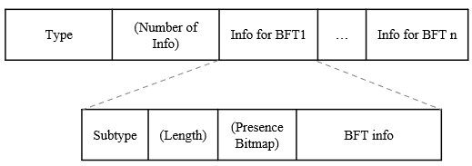
Unified BFT information format example
BFT information format
BFT Announcement example
    BFT Report example
Type = IMMW Info | (Number of Info) | Info for BFT 1 Subtype = BFT Announcement | … | Info for BFT n Subtype = BFT Announcement
Type = IMMW Info | (Number of Info) | Info for BFT 1 Subtype = BFT Report

Slide 9
Candidate for BFT request frames to be transmitted by an AP in sub 7GHz
 | BFT request (Announcement) | BFT request (Report) | Solicit response frame | Reusability
Trigger frame(e.g. BSRP, BFRP) | O | O | O | O
NDPA | O (with no Ack) | O | X | O
MU-RTS | O | O | O (with no information in the response) | O
New Control | O | O | O | X
New Action | O | O | O | X
BSRP(or BSRP NTB) can be used for BFT Announcement request and/or BFT Report request, and the response frame can be the Multi-STA BlockAck which is already defined in 11bn NDPA can be used for BFT Announcement notification without Ack from a peer device (This would be a cons for BFT scheduling – no acknowledgement for the schedule) MU-RTS can be used for BFT Announcement request, however the response frame which is the CTS frame could not contain any information New Control and Action frames can be defined for any purpose such as BFT Announcement request/response, notification and report. However, an ID space should be consumed for the new frame
√

Slide 10
Candidate for BFT response frames to be transmitted by a non-AP STA in sub 7GHz
 | Response frame for BFT Announcements and BFT Reports | Unsolicited report | Reusability
M-BA | O | O | O
CTS | X | X | X
New Control | O | O | X
New Action | O | O | X
M-BA(Multi-STA BlockAck) can be used for the response frame from the request frame transmitted by an AP For the response of the BFT Announcement request, the status code (Success/Fail, Reason code, and so on) can be included For the response of the BFT Report request, BFT Report info. from a non-AP STA can be included The CTS frame solicited by the MU-RTS frame cannot include additional information such as BFT Announcements or Reports New Control and Action frames can be defined for any purpose such as BFT request/response and notification. However, an ID space should be consumed for the new frame
√
* To reuse or enhance legacy frame, BSRP and M-BA request/response combination for BFT Announcement and Report may be one of good options

Slide 11
Conclusion
This contribution provides examples for MLO-based Beamforming Training Report (BFT Report)
  From these examples, we can identify key discussion points for a unified design of BFT Announcements and Reports signaling in Sub-7GHz links
We discussed the unified format for BFT information that applies to both BFT Announcements and BFT Reports
  The unified BFT information format can be applied to both existing frames and new control/action frames
  Several frames are compared to identify which frame type is proper to signal the BFT procedure in Sub-7GHz link
To reuse or enhance legacy frame, BSRP and M-BA request/response combination may be a good approach for BFT Announcements and Reports

Slide 12
Straw Poll 1
Do you support the following text in 11bq?
  11bq defines new frames or reuses/enhances existing frames, where a STA affiliated with an MLD and operating in a Sub-7GHz band indicates information to report beamforming training(BFT) feedback for a mmWave band
    Details are TBD

Slide 13
Straw Poll 2
Do you support the following text in 11bq?
  11bq defines a unified signaling method, where a STA affiliated with an MLD and operating in a Sub-7GHz band indicates information to facilitate beamforming training(BFT) and report beamforming training(BFT) feedback for a mmWave band

Slide 14
Straw Poll 3
Which combination of methods do you prefer for a unified signaling approach, in which a STA affiliated with an MLD and operating in a sub-7GHz band indicates information to facilitate and report beamforming training (BFT) for a mmWave band?
  Trigger frame(e.g. BSRP (NTB) Trigger frame) is the BFT request, and Multi-STA BlockAck is the BFT response for both BFT Announcements and BFT Reports
  NDP Announcement frame for BFT Announcements, and BSRP (NTB) Trigger frame and Multi-STA BlockAck combination for BFT Reports
  New Control/Action frame for BFT Announcements and BFT Reports
  Other combination
  SP Result: 1) , 2) , 3) , 4)

Slide 15
References
[1] IEEE P802.11-REVme™/D7.0
[2] 24/1312, Draft P802.11bq PAR
[3] 11-25/431, MLO-based Scheduling for IMMW
[4] 11-25/841, Some considerations for MLO-based BFT Announcement

