Slide 1
PSRC update rules in P-EDCA
Date: 2025-07-14
Authors:
Name | Affiliations | Address | Phone | email
Jason Yuchen Guo | Huawei Technologies |  |  | guoyuchen@huawei.com
Yunbo Li
Guogang Huang
Ming Gan
Yue Zhao
Maolin Zhang
Zhenpeng Shi

Slide 2
Introduction
P-EDCA recap:
When conditions satisfy (for AC_VO traffic, QSRC reaches a certain value, PSRC is less than or equal to a certain value), STAs operating in the PEDCA mode can transmit a defer signal (DS-CTS frame), and start P-EDCA contention (CW = 7)
When the backoff counter in the P-EDCA contention reaches 0, the STA shall transmit a RTS to the intended receiver to obtain a TXOP.
The duration of the defer signal is set to 97us to cover the maximum duration of the P-EDCA contention
  97us = 34us + 7 * 9us, where
  34us is AIFS_VO
  7 is the maximum value of the backoff counter in the P-EDCA contention
  9us is the slot time

Slide 3
Problem Statement
According to the current draft text:
  A P-EDCA STA that participated in a P-EDCA contention but did not initiate a TXOP (see 10.23.2.4) during the P-EDCA contention may start another P-EDCA contention by sending the DS-CTS frame
  PSRC shall be incremented by 1 with every transmission of the DS-CTS frame
Problem:
  The P-EDCA STA has the same treatment when the following two events happen
    Event A: it did not initiate TXOP during the P-EDCA contention
    Event B: it initiated a TXOP but did not receive the CTS frame in response to the RTS frame
  which is not reasonable, because a STA will lose the chance of using P-EDCA even when it didn’t transmit any frame to obtain a TXOP.
  Note that a STA under EDCA gets different treatments for the two events.

Slide 4
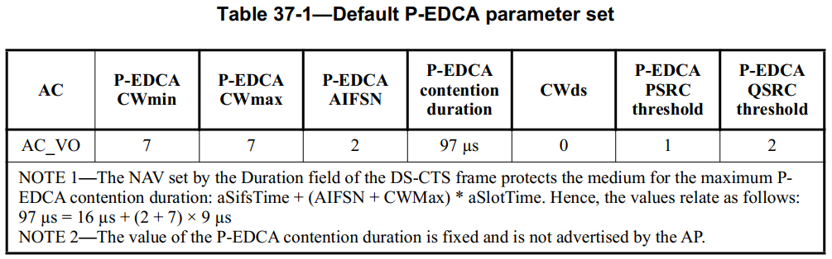
Problem Statement
Besides, if there are many STAs doing P-EDCA contention at the same time, only the STA has the smallest backoff counter value can obtain the TXOP if no other STA chooses the same value. All the other STAs that have sent DS-CTS will increase PSRC by one. Once PSRC reaches the limit, those STAs can not do P-EDCA contention, until the current packet has been successfully transmitted
E.g., if there are 10 STAs doing P-EDCA, 8 of them cannot benefit from P-EDCA using the current default P-EDCA parameters

Slide 5
Solution
It is proposed that PSRC is increased by one only when the STA finishes backoff during P-EDCA contention, and transmits the RTS frame
If the STA transmits DS-CTS, and the channel becomes busy during the P-EDCA contention, PSRC stays unchanged.
Benefit: with the proposed PSRC update rule, even when there are many STAs doing P-EDCA, most of them can still benefit from P-EDCA, we should give all of them at least a chance to initiate a TXOP during P-EDCA contention.
An alternative is to change P-EDCA parameters according to the number of P-EDCA STAs. However, the proposed rule is more efficient since it is adaptive to the P-EDCA load by nature, which prevents the time/energy consuming BSS parameter update procedure. On the other hand, AP may not know the exact number of STAs doing P-EDCA contention as the P-EDCA conditions are not satisfied for some STAs (e.g., due to lack of AC_VO traffic, QSRC limit not reached yet)

Slide 6
Simulation Results
Scenario:
One BSS
STA number: 15, 20, 25
Traffic direction: UL
Traffic rate: 5Mbps, 10Mbps
P-EDCA parameters: default
Comparison:
Old rule: PSRC is incremented by one for each transmission of DS-CTS frame
New rule: PSRC is incremented by one for each transmission of RTS during P-EDCA contention

Slide 7
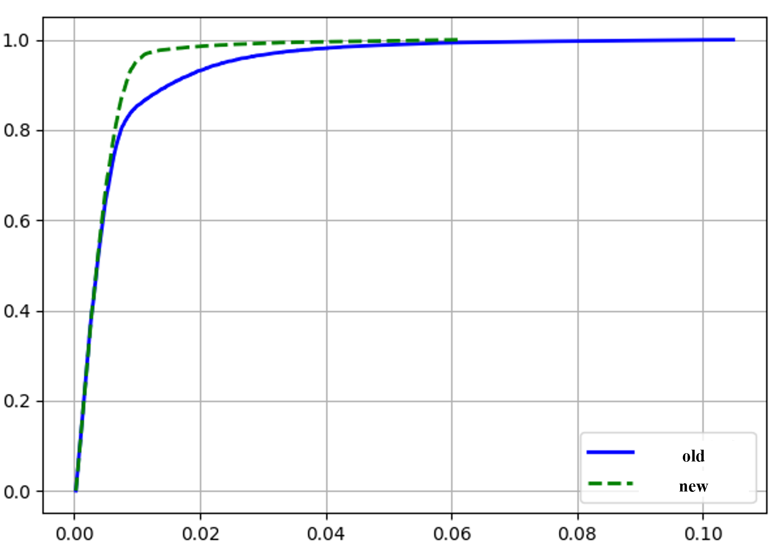
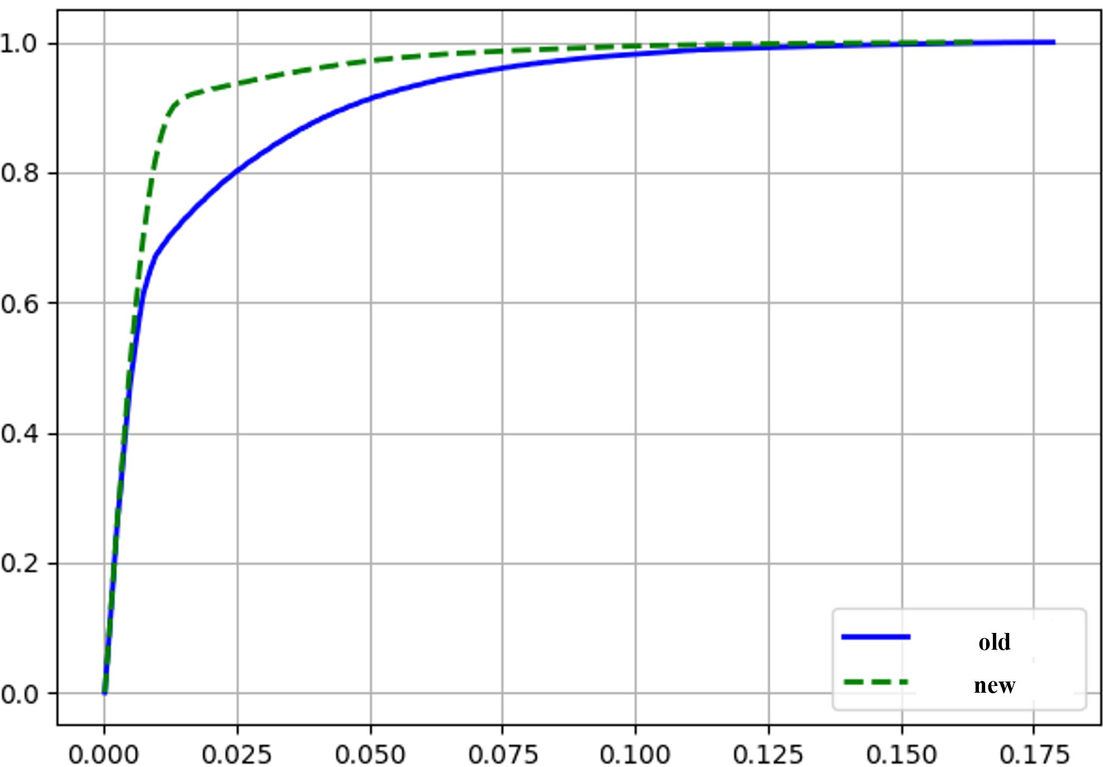
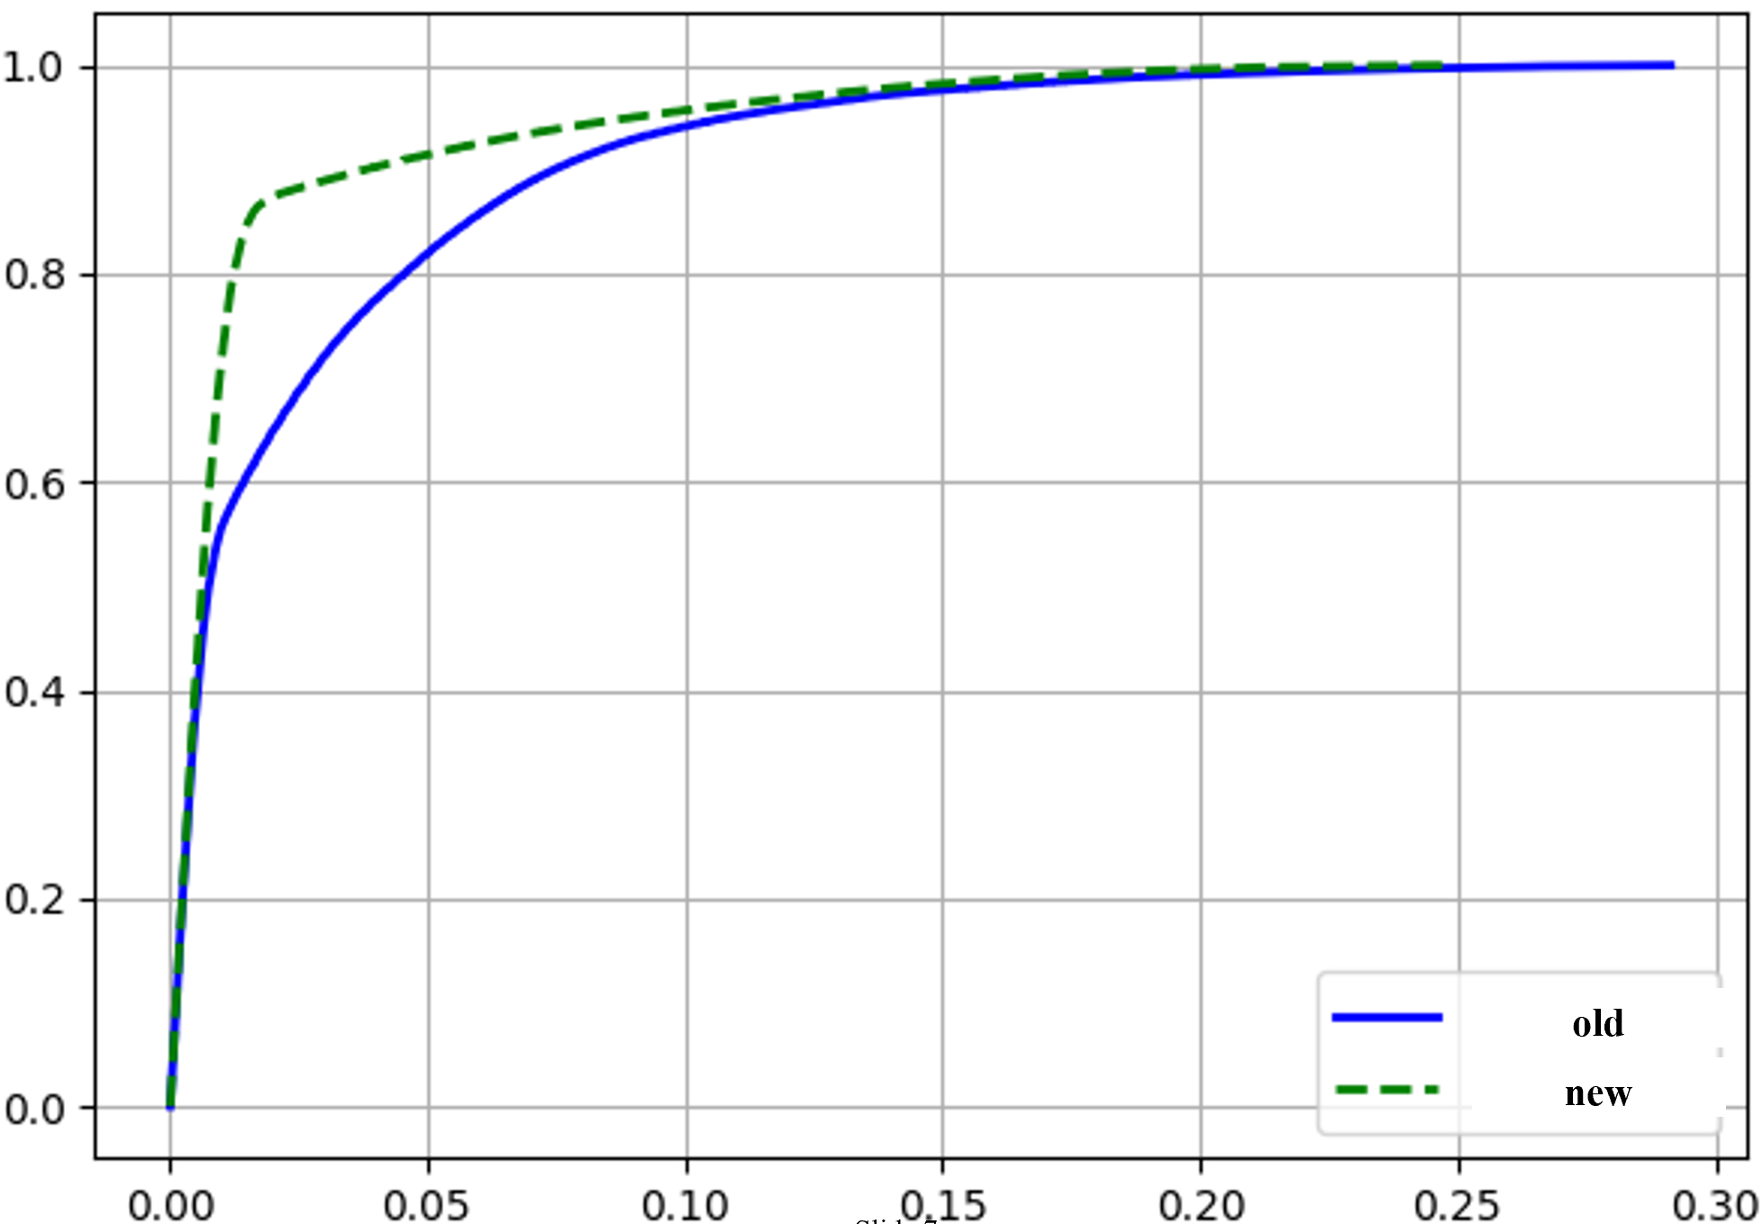
Simulation Results
Traffic rate: 5Mbps
Delay CDF – 15 STAs
Delay CDF – 20 STAs
Delay CDF – 25 STAs
 | 15STA |  |  | 20STA |  |  | 25STA
 | old | new | reduction | old | new | reduction | old | new | reduction
90% percentile delay（S） | 0.0152 | 0.00821 | 46% | 0.0459 | 0.0130 | 72% | 0.0749 | 0.0247 | 67%
99% percentile delay（S） | 0.0523 | 0.0258 | 51% | 0.118 | 0.0850 | 28% | 0.195 | 0.172 | 12%

Slide 8
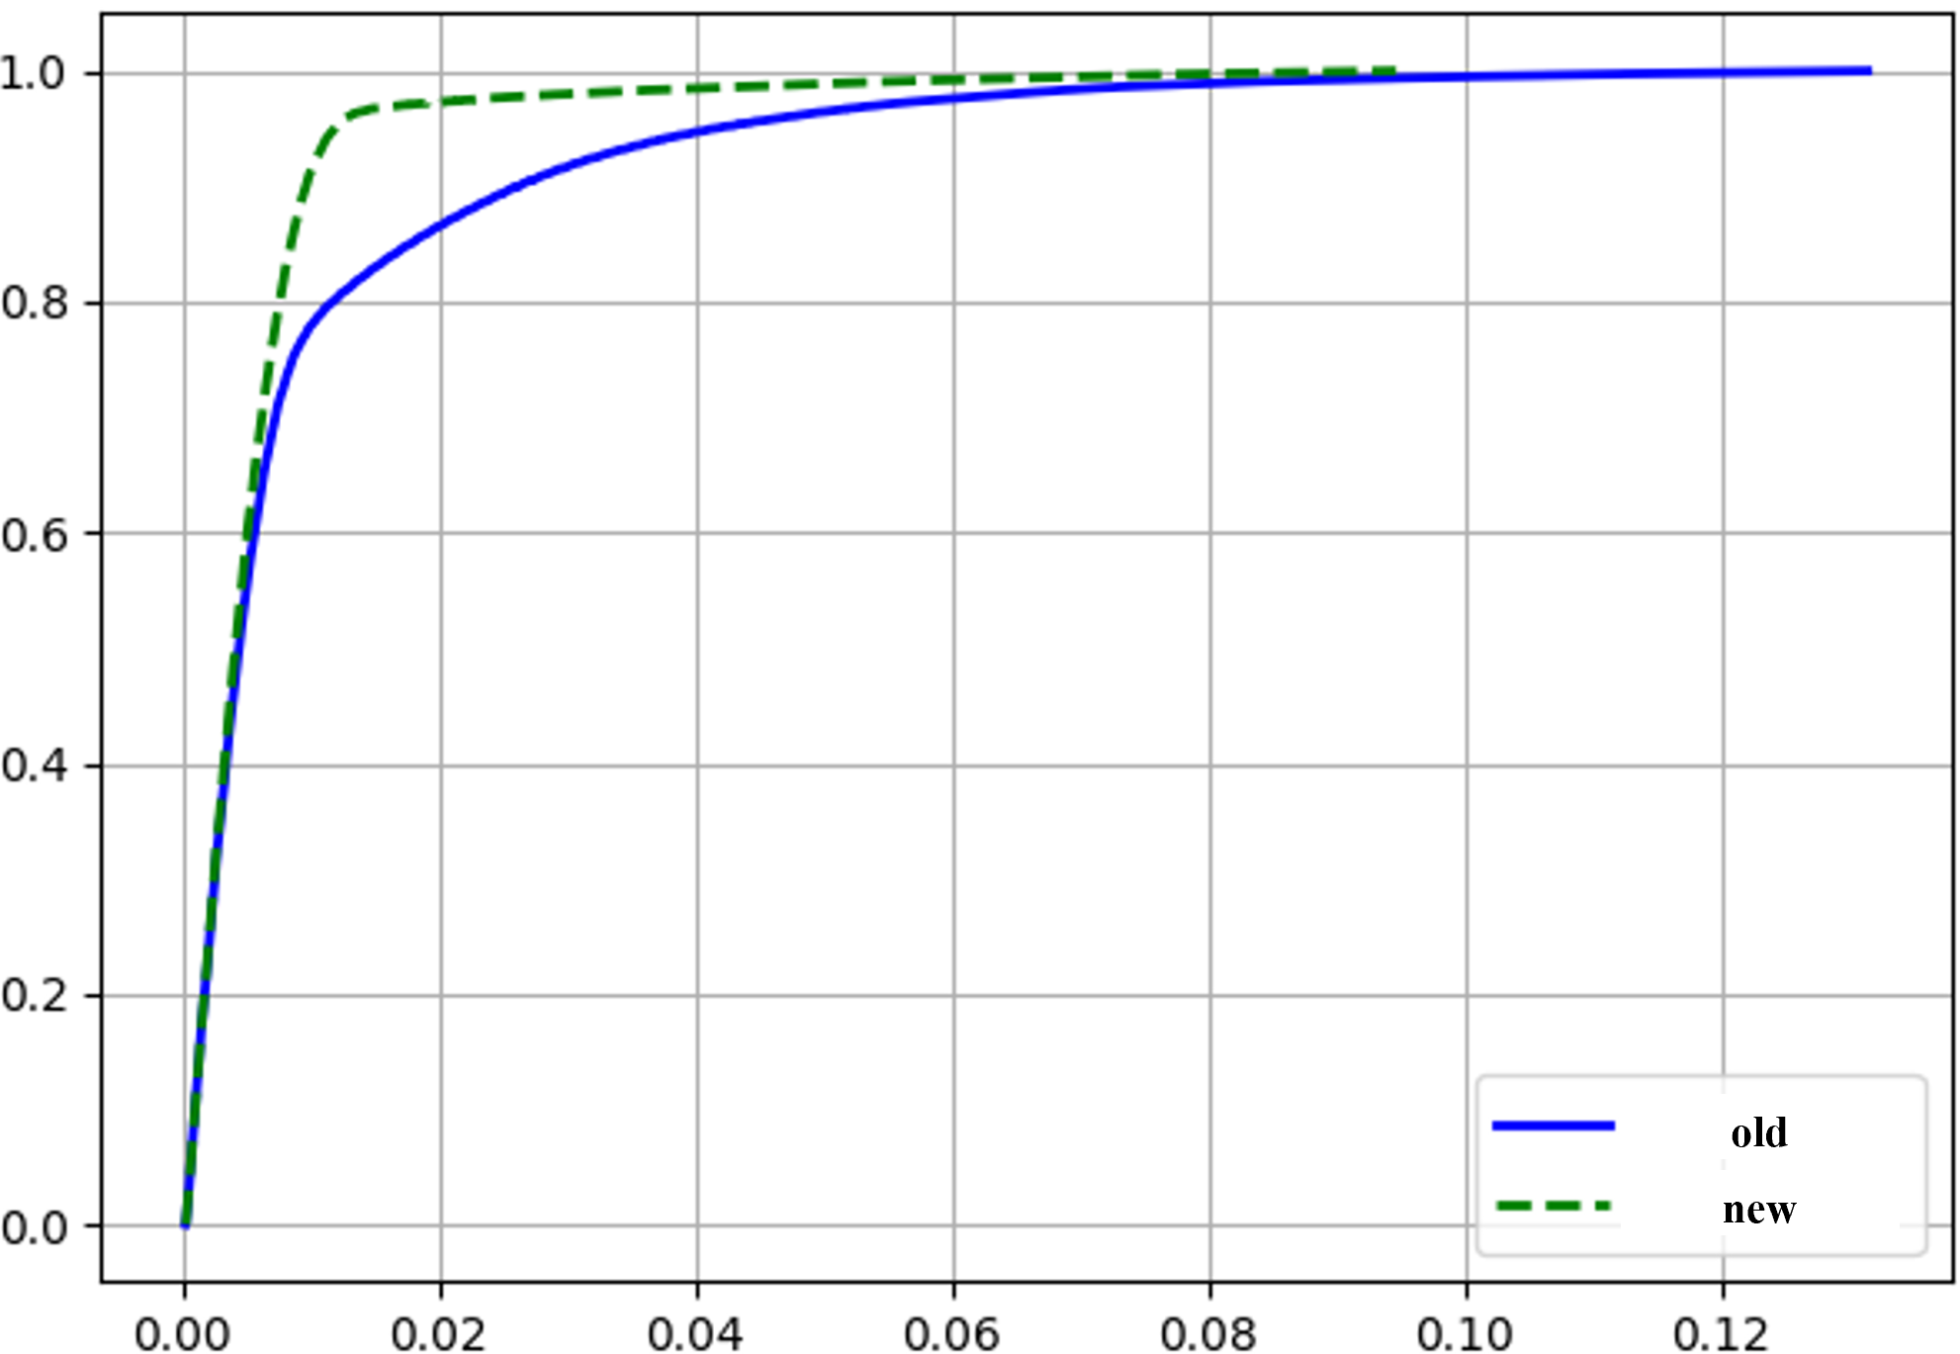
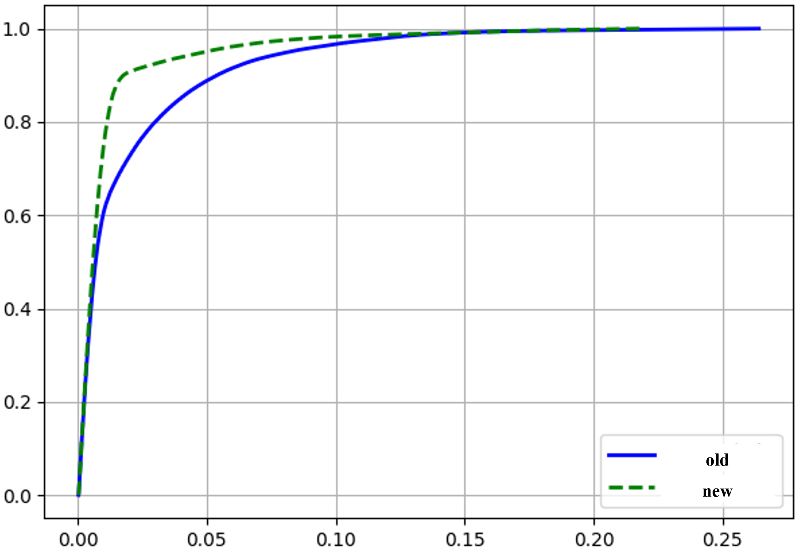
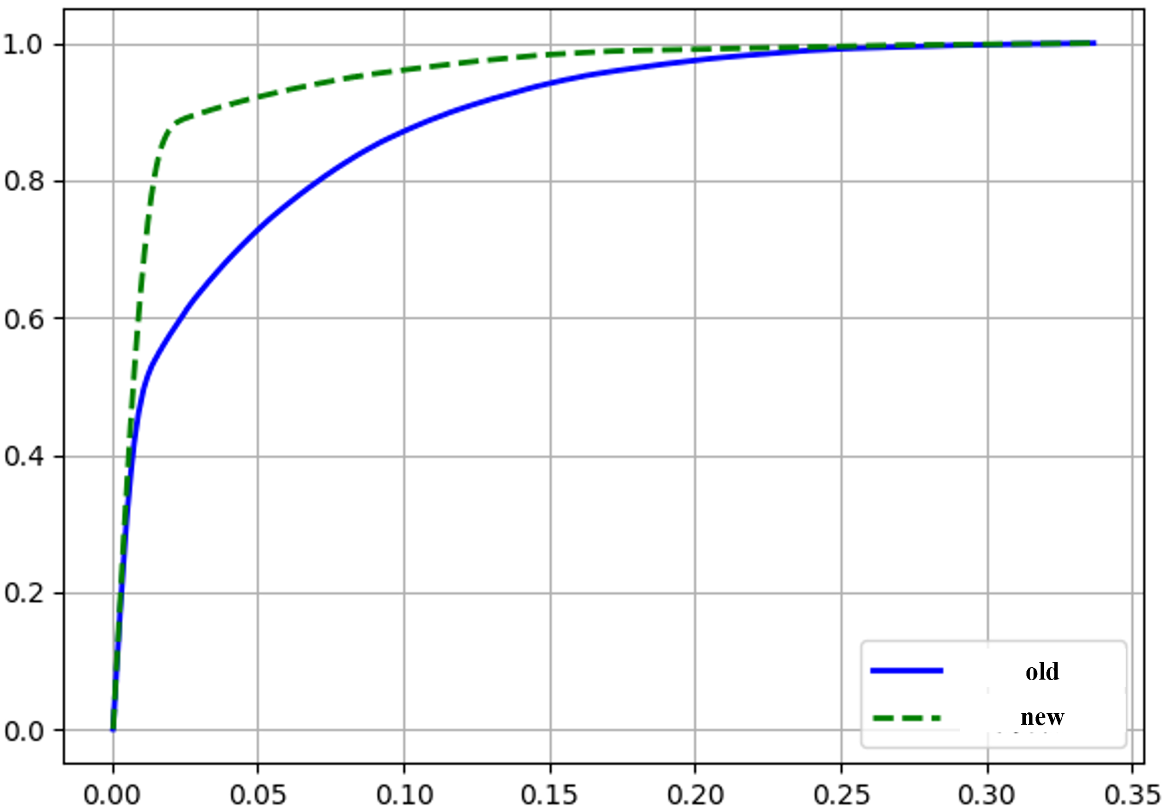
Simulation Results
Traffic rate: 10Mbps
Delay CDF – 15 STAs
Delay CDF – 20 STAs
Delay CDF – 25 STAs
 | 15STA |  |  | 20STA |  |  | 25STA
 | old | new | reduction | old | new | reduction | old | new | reduction
90% percentile delay（S） | 0.0263 | 0.0097 | 63% | 0.0711 | 0.0177 | 75% | 0.117 | 0.0319 | 73%
99% percentile delay（S） | 0.0813 | 0.0529 | 35% | 0.184 | 0.139 | 24% | 0.242 | 0.187 | 23%

Slide 9
Summary
We propose a new rule for updating PSRC in P-EDCA
Simulation results show that the new rule can further reduce the tail of the latency.

Slide 10
SP
Do you support to change the PSRC update rule in P-EDCA as follows:
  PSRC is increased by one only when the STA finishes backoff during P-EDCA contention, and transmits the RTS frame.

