Slide 1
Rules for transmitting RTS in P-EDCA
Date: 2025-07-14
Authors:
Name | Affiliations | Address | Phone | email
Jason Yuchen Guo | Huawei Technologies |  |  | guoyuchen@huawei.com

Slide 2
Introduction
P-EDCA recap:
When conditions satisfy (for AC_VO traffic, QSRC reaches a certain value, PSRC is less than or equal to a certain value), STAs operating in the PEDCA mode can transmit a defer signal (DS-CTS frame), and start P-EDCA contention (CW = 7)
When the backoff counter in the P-EDCA contention reaches 0, the STA shall transmit a RTS to the intended receiver to obtain a TXOP.
The duration of the defer signal is set to 97us to cover the maximum duration of the P-EDCA contention
  97us = 34us + 7 * 9us, where
  34us is AIFS_VO
  7 is the maximum value of the backoff counter in the P-EDCA contention
  9us is the slot time

Slide 3
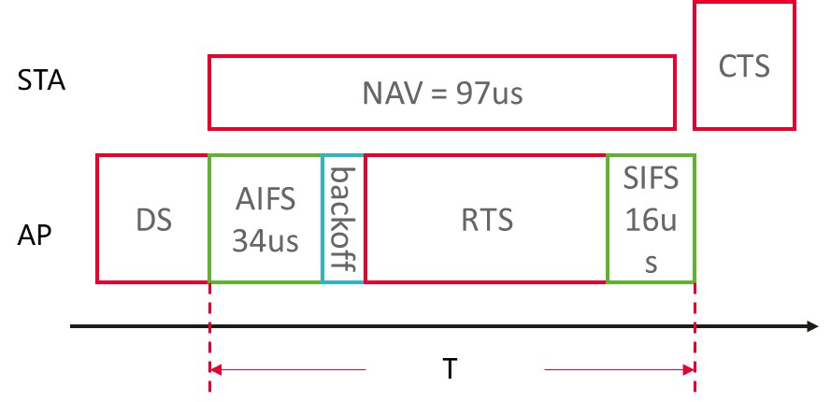
Problem Statement
Assume AP transmit a DS-CTS in order to transmit data to STA2,
STA2 will also receive the DS-CTS, and set NAV of 97us after receiving the DS
It is mentioned in [1] that if the initial value of the backoff counter during the P-EDCA contention is very small, the RTS will be sent very early, when STA2 receives the RTS, its NAV has not expired yet, so it cannot respond CTS
E.g., in the figure below, STA can not respond CTS if T < 97us

Slide 4
Observation
The duration of T depends on the backoff time and the RTS frame length
The backoff time depends on the initial value of the backoff counter in the P-EDCA contention
The RTS frame length depends on the rate of the PPDU carrying the RTS
Frame | # of Octets | PPDU type | Preamble Length | Data Rate | Data bits | Data Length | PPDU Length
RTS | 20 | Non-HT / Non-HT Dup | 20us | 6Mbps | 182 | 32us | 52us
RTS | 20 | Non-HT / Non-HT Dup | 20us | 12Mbps | 182 | 16us | 36us
RTS | 20 | Non-HT / Non-HT Dup | 20us | 24Mbps | 182 | 8us | 28us

Slide 5
Solution
We can calculate the duration of T based on different values of RTS rate and different initial values of the backoff counter
T | 0 | 1 | 2 | 3
6Mbps | 102us | 111us | 120us | 129us
12Mbps | 86us | 95us | 104us | 113us
24Mbps | 78us | 87us | 96us | 105us
Different initial values of the backoff counter
Different values of RTS rate
One way is to adaptively change the rate of the RTS based on the initial value of the backoff counter
The other way is to simply setup a rule
  The P-EDCA STA shall ensure the duration from the end of the PPDU carrying the DS-CTS frame until the end of the PPDU carrying the RTS frame is longer than a threshold (e.g., 81us)

Slide 6
Summary
We propose rules for transmitting RTS in P-EDCA

Slide 7
SP
Do you support to add a sentence in 37.5 Prioritized EDCA:
  The P-EDCA STA shall ensure the duration from the end of the PPDU carrying the DS-CTS frame until the end of the PPDU carrying the RTS frame is longer than a threshold of P-EDCA contention duration minus SIFS.

Slide 8
Reference
[1] 11-25/0092r2 High-Priority EDCA Management

