Slide 1
Beacon Request Enhancement for Co-SR
Date: 2025-06-20
Authors:
Name | Affiliations | Address | Phone | email
Jason Yuchen Guo | Huawei Technologies |  |  | guoyuchen@huawei.com

Slide 2
Introduction
Beacon Request/Report procedure defined in the baseline can be used for channel quality measurement to enable coordinated spatial reuse (Co-SR) transmission
In the Beacon Request/Report procedure, AP1 can request its associated STA1 to feedback the measurement result of the channel between another AP (e.g., AP2) and STA1

Slide 3
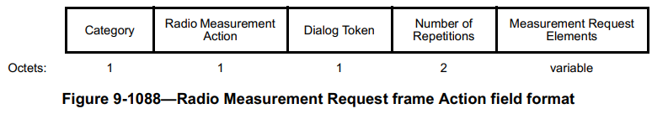
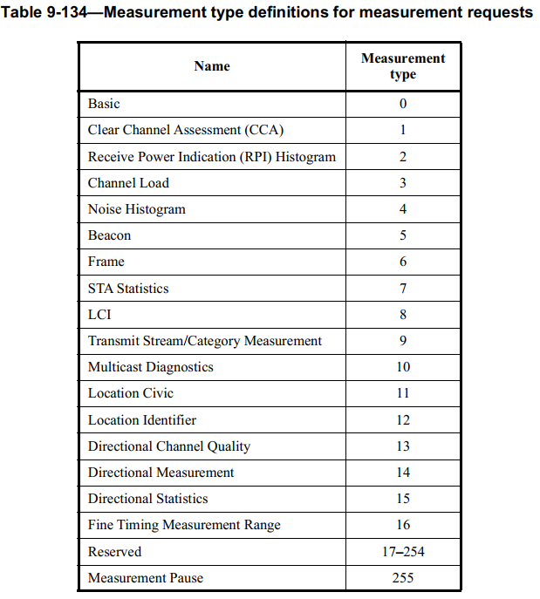
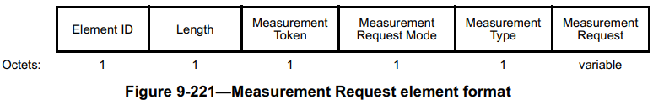
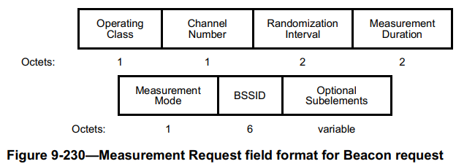
Recap: Beacon Request/Report
The Beacon Request/Report is a specific measurement type of the Radio Measurement
When the Measurement Type subfield is set to 5, the corresponding Measurement Request is a Beacon Request

Slide 4
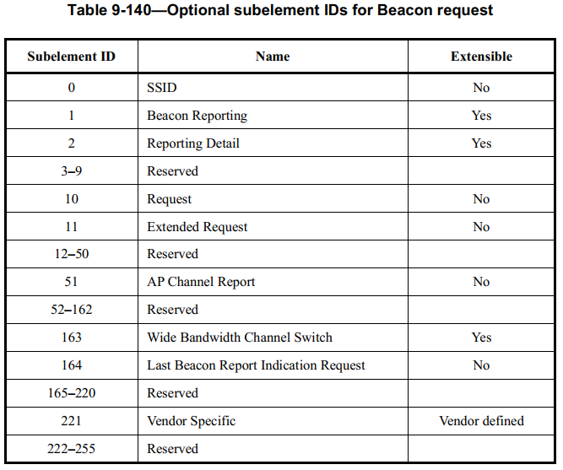
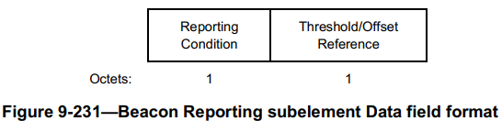
Recap: Beacon Request/Report
The Measurement Request field for Beacon request can carry subelements
The Beacon Reporting subelement indicates the condition for issuing a Beacon report

Slide 5
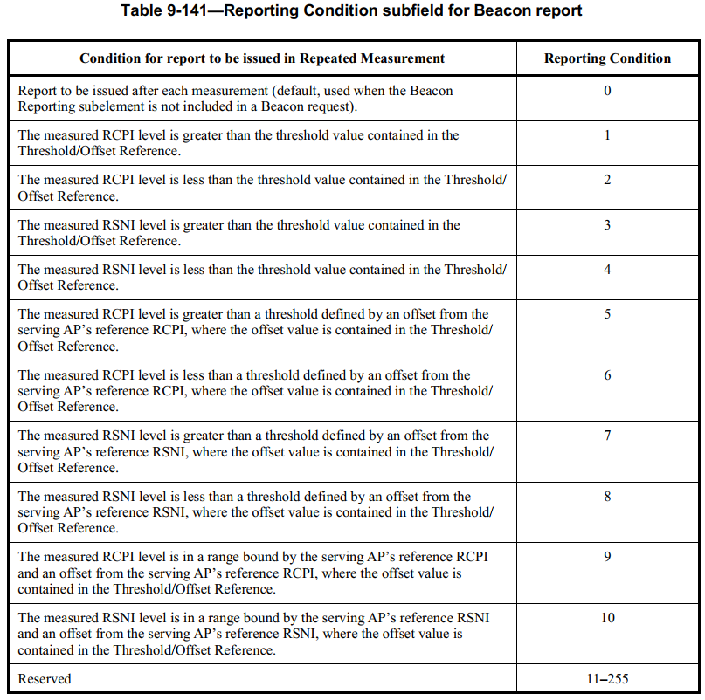
Recap: Beacon Request/Report
Eleven conditions are defined so far, some of them matches the Co-SR scenario
E.g., in condition 5, the Beacon report is issued when the RCPI difference between the serving AP and the interfering AP is smaller than a certain threshold
The AP can set the Threshold/Offset Reference field to a certain value that will trigger the AP to select a lower MCS for the non-AP STA during Co-SR transmission once a Beacon report is received from the non-AP STA
Similarly, in condition 6, the AP can set the Threshold/Offset Reference field to a certain value that will trigger the AP to select a higher MCS

Slide 6
Motivation
In Co-SR, AP may want the STA to do Beacon measurement repetitively, and only wants the STA to send Beacon report when there’s a big change of the RCPI/RSNI comparing with the last reported value
  This will trigger the AP to use a different MCS for the non-AP STA during Co-SR transmission
The current conditions for sending Beacon report do not fully satisfy the above need
Note that in the current conditions, the non-AP STA will keep sending the Beacon report once the condition is satisfied, and the AP needs to send another Beacon request to the non-AP STA to set another condition to trigger the next MCS change.

Slide 7
Proposal
We propose to define a new reporting condition as below:
The difference between the measured RCPI level of the serving AP and the measured RCPI level of the reported AP is greater than a threshold defined by an offset from the last reported value, where the offset value is contained in the Threshold/Offset Reference
Discussion:
  The difference between the measured RCPI level of the serving AP and the measured RCPI level of the reported AP can be regarded as signal to interference ratio (SIR), which decides the MCS in an interference limited scenario
  If the SIR has been changed for a certain amount of dBs (indicated in the Threshold/Offset Reference field) from the last reported value, then a different MCS should be considered to be used for the following Co-SR transmission.

Slide 8
Summary
We propose enhancements to the Beacon request/report procedure in the baseline to improve the performance of Co-SR
A new condition to send Beacon report is defined to match the Co-SR scenario better

Slide 9
SP
Do you support to include in the 11bn SFD:
  Define a new reporting condition for the Beacon report as follows:
    The difference between the measured RCPI level of the serving AP and the measured RCPI level of the reported AP is greater than a threshold defined by an offset from the last reported value, where the offset value is contained in the Threshold/Offset Reference

