Slide 1
Enhanced Beacon Report
Date: 2025-06-04
Authors:

Slide 2
Abstract
Beacon Request/Report in baseline 802.11-2024:
  AP sends Beacon Request to STA
  STA measures received signal strength/quality in downlink and sends the measurements in Beacon Report to the AP
This contribution presents Enhanced Beacon Report
  Beacon Report initiated from non-AP STAs
  Enable OBSS AP to measure UL RSSI on frames sent from cross-BSS STAs
  Beacon Report with framework for request/measurement/report
The proposed Enhanced Beacon Report can be used to improve performance/efficiency for multi-BSS/multi-AP scenarios, such as Co-SR (coordinated spatial reuse), Co-BF (coordinated beamforming), and roaming.

Slide 3
Background
Previous contribution ([1] 25/0655): OBSS RSSI measurements for Co-BF/Co-SR user selection
  Non-AP STA measures OBSS RSSI from the OBSS AP (the other Co-BF/Co-SR AP)
  Non-AP STA reports the OBSS RSSI measurements to its associated AP
  AP selects the candidate STA for Co-BF/Co-SR based on the OBSS RSSI measurements (or can be used for other purposes)
Beacon report can be enhanced to achieve such purpose
  The baseline Beacon request/report is initiated by the AP for DL OBSS RSSI measurements
    AP sends Beacon request to a STA.
    STA measures DL OBSS RSSI for the OBSS AP(s) specified in the Beacon request.
    The STA sends the measured DL OBSS RSSI in Beacon report to its associated AP.

Slide 4
Recap: OBSS RSSI Measurements for Co-BF/Co-SR User Selection
Non-AP STA measures OBSS RSSI from the OBSS AP (the other Co-BF/Co-SR AP)
  Passive: non-AP STA measures OBSS RSSI by Beacons from the OBSS AP, low overhead
  Active: non-AP STA sends a request frame to the OBSS AP and measures OBSS RSSI by the response frame from the OBSS AP. The OBSS AP may measure OBSS RSSI by the request frame.
    Probe Request/Probe Response
    RTS/CTS [4]
    NDPA/NDP [5, 6]
OBSS RSSI measurements can be used for user selection for Co-BF/Co-SR. Non-AP STA can
  report the OBSS RSSI measurements to its associated AP, and the AP selects the candidate STA for Co-BF/Co-SR (or can be used for other purposes)
  use the OBSS RSSI measurements to decide to continue/stop Co-BF/Co-SR and indicate to the AP
It can coexist with other criteria/ways for selecting candidate Co-BF/Co-SR STAs.
This can be done by enhancing the Beacon Report mechanism.

Slide 5
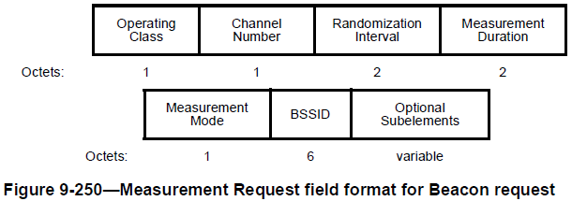
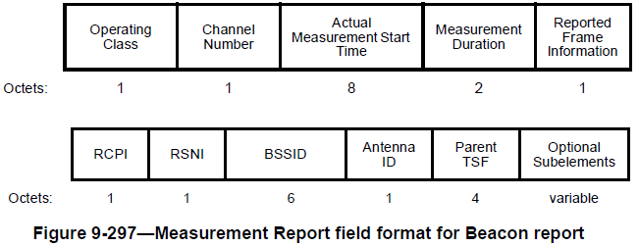
Recap: Beacon Request/Report
AP sends Beacon Request to STA.
If STA accepts the Beacon request, it measures the RCPI/RSNI (received channel power/received signal-to-noise indication) by the received Beacon, Measurement Pilot, or Probe Response frame sent from OBSS AP(s), in the downlink.
STA reports the measured RCPI/RSNI in Beacon Report to the AP.
Beacon Request is initiated by the AP.
Beacon Report contains the measured RCPI/RSNI in the downlink.

Slide 6
Requirements for Enhanced Beacon Report
Existing Beacon Request/Report: initiated by the AP for DL OBSS RSSI measurements/reports
Requirements for Enhanced Beacon Report:
  Non-AP STAs should be able to initiate Beacon report [1]
    With limited prior information or stale information, it is not efficient for APs to randomly select certain non-AP STAs and initiate Beacon request/report with the selected non-AP STAs
    Non-AP STAs can passively monitor OBSS RSSIs and initiate Beacon report when necessary
  UL OBSS RSSI is important for multi-BSS/multi-AP scenarios, e.g., Co-BF, Co-SR, and roaming
    Co-BF APs need to detect/decode frames, e.g., ICR/CSI, from cross-BSS non-AP STAs [slide14]
    Co-SR APs need to select the Ack mode/parameters, e.g., in different time/frequency slots or concurrently, depending on whether Co-SR APs can hear Ack/BA from cross-BSS STAs [slide15]
    For roaming, target APs need to ensure UL link is good for roaming execution
  Beacon Request/Report should be aligned with APs/STAs’ capability/policy/MAPC negotiation
    Need to avoid frequent or unintended requests/measurements/reports of OBSS RSSIs

Slide 7
Proposed Changes (1/3): Enhanced Beacon Report Initiated by Non-AP STAs
Allow non-AP STAs to initiate Beacon report, subject to other requirements
AP may specify which OBSS AP/channel to monitor and certain Reporting Condition
OBSS RSSIs can be carried in the following frames sent from non-AP STAs to associated AP
  Option 1: Beacon report
    Solicited: in response to Beacon request. The Beacon request can be
      (Baseline) individually/group addressed: not efficient for the AP to select certain STAs and send the request
      (Option 1.a) broadcast, with enhancements to triggered autonomous reporting defined in baseline
    Unsolicited (Option 1.b): non-AP STA may initiate Beacon report without explicit Beacon request
  Option 2: Multi-STA BlockAck, in response to BSRP or other frames
    Solicited (Option 2.a): there is explicit request in the BSRP or other frames sent from the AP
    Unsolicited (Option 2.b): no explicit/immediate request in the frame soliciting the Multi-STA BlockAck
  Option 3: BSRP, unsolicited: non-AP STA may send OBSS RSSI report in BSRP to its associated AP
Multi-STA BlockAck and BSRP can be sent during Co-BF/Co-SR preparation, sounding or data transmission phases. A non-AP STA may reject Co-BF/Co-SR based on measured OBSS RSSIs.

Slide 8
Proposed Changes (2/3): Enhanced Beacon Report for UL OBSS RSSI Measurements
UL OBSS RSSI: RSSI measured by OBSS AP on frames sent from cross-BSS STAs, either
  addressed to the associated AP, e.g., Beacon Report and cross-BSS CSI, overheard by the OBSS AP
  addressed to the OBSS AP, e.g., Probe Request and cross-BSS CSI
For Co-SR and Co-BF, UL OBSS RSSI is important to select the suitable candidate STAs and select the right transmission modes/parameters.
Allow AP to measure UL OBSS RSSI by Beacon Report or TBD frames from cross-BSS STAs
  The OBSS AP needs to be aware of Beacon Request/Report between the AP and in-BSS STAs
  The OBSS AP may also measure UL OBSS RSSI on other frames, such as ICR/CSI report/BA (during Co-SR/Co-BF data transmission or sounding) and Probe Request sent from cross-BSS STAs
Allow non-AP STA to include additional information, e.g., TX power, in Beacon Report or TBD frames from cross-BSS STAs
  The OBSS AP needs to infer the OBSS RSSI of ICR/CSI/Ack by the UL OBSS RSSI measured by other frames or with different transmit parameters

Slide 9
Proposed Changes (3/3): Framework for OBSS RSSI Request/Measurement/Report
Which STA can participate:
  AP may specify which OBSS AP/in-BSS STA can participate, plus certain Reporting Condition rules
  APs/STAs with Co-BF/Co-SR enabled; APs with MAPC/Co-BF/Co-SR negotiation enabled [9, 10]
    No measurement/report if the associated AP and OBSS AP do not have Co-BF/Co-SR negotiation enabled
Which frame can be used to measure OBSS RSSI
  DL OBSS RSSI:
    Beacon, Measurement Pilot, and Probe Response (already covered in baseline Beacon request/report)
    Co-BF/Co-SR Invite/Response, ICF, NDPA/NDP, Trigger
  UL OBSS RSSI: Probe Request, Beacon Report, ICR, CSI report, BA
When can OBSS RSSI be requested/measured/reported
  Existing rules: Beacon request/report, Probe Request
  New rules: MAPC/Co-BF/Co-SR negotiation, Co-BF/Co-SR preparation/invite/response, Reporting Condition, Measurement Duration/Mode

Slide 10
Conclusions
This contribution presents Enhanced Beacon Report
  Beacon report initiated from non-AP STAs
  To support OBSS AP to measure UL OBSS RSSI
  Framework for OBSS RSSI request/measurement/report
The proposed Enhanced Beacon Report can be used to improve performance/efficiency for multi-BSS/multi-AP scenarios, such as Co-SR, Co-BF, and roaming.

Slide 11
References
[1] 802.11-25/0655r1, User Selection for Co-BF/Co-SR based on OBSS RSSI measurements, Yongsen Ma (Samsung)
[2] 802.11-25/0412r3, CoBF Frame Sequences and Signaling Details, Sherief Helwa (Qualcomm)
[3] 802.11-25/0247r1, M-AP CoBF Sounding Sequence, Arik Klein (Huawei)
[4] 802.11-24/1879r0, Proposals for Expeditious Discovery of APs for Initial Association and Roaming, Neel Krishnan (Apple Inc)
[5] 802.11-24/2122r0, Fast RSSI Measurement Follow-up, Guogang Huang (Huawei)
[6] 802.11-24/1414r2, Channel Measurement Based on Control Frame Exchange, Guogang Huang (Huawei)
[7] 802.11-23/1832r0, Multi-AP Coordinated Spatial Reuse, Hassan Omar (Huawei)
[8] 802.11-25/0189r2, Elicitation of Response Transmissions in Coordinated Spatial Reuse, Hassan Omar (Huawei)
[9] 802.11-24/1220r2, A Framework for Coordinated Access Points, Giovanni Chisci (Qualcomm)
[10] 802.11-25/0378r0, Multi-AP Coordination Negotiation Indication, Yongsen Ma (Samsung)

Slide 12
Straw Polls
SP1: Do you support that a UHR non-AP STA may initiate a frame exchange sequence to send OBSS RSSI reports to its associated AP in TBD conditions.
SP2: Which of the following frame option(s) do you prefer to allow a UHR non-AP STA to initiate OBSS RSSI reports to its associated AP?
Option 1.a: unsolicited Beacon report, without explicit Beacon request
Option 1.b: Beacon report in response to broadcast Beacon request with conditional triggered autonomous reporting
Option 2: Multi-STA BlockAck
Option 3: BSRP GI3
Other options

Slide 13
Backup

Slide 14
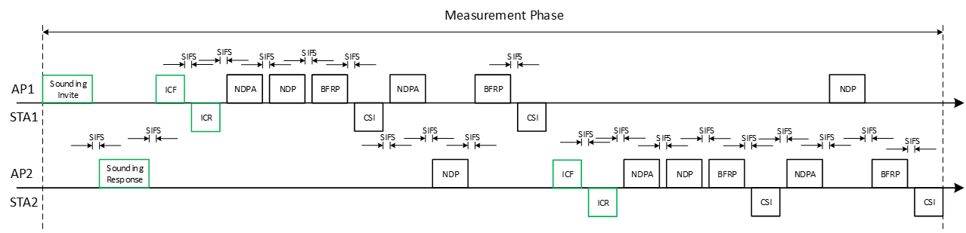
Recap: Co-BF Sounding and Transmission Sequence
AP2 needs to detect/decode the frames, e.g., ICR, CSI, BA, from STA1
STA1 needs to detect/decode the frames, e.g., NDP, from AP2
AP1 needs to detect/decode the frames, e.g., ICR, CSI, from STA2
STA2 needs to detect/decode the frames, e.g., NDP, from AP1
Co-BF APs/STAs need to avoid frame failures or add extra frames to address potential issues, e.g., MU-RTS and TXOP return [3]
Co-BF Measurement Phase and Transmission Phase [2] 802.11-25/0412r3
[back]

Slide 15
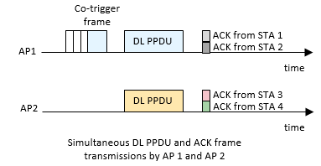
Recap: Co-SR Transmission Sequence
[7] 23/1832r0, [8] 25/0189r2
Sharing AP sends a frame, e.g., MU-RTS or BSRP, to shared AP, and shared AP sends BAR to solicit BA
Successful ACK transmission from STA1 to the sharing AP
If shared AP cannot hear the ACK from cross-BSS STA, sharing AP needs to send a frame, e.g., MU-RTS or BSRP, to shared AP, and then shared AP can send BAR to request BA from in-BSS STA.
Co-trigger
Co-trigger
ACK
ACK
Sharing AP
DL PPDU
Sharing AP
DL PPDU
SIFS
SIFS
time
SIFS
SIFS
time
BA
Co-trigger
ACK
BA
Shared AP
DL PPDU
BAR
DL PPDU
DL PPDU
BAR
SIFS
Sharing AP
Shared AP
SIFS
time
time
SIFS
SIFS
time
ACK
The Ack policy of a carried frame is set to Block Ack
Block Ack transmitted by STA2 after receiving a Block Ack Request (BAR) frame
Shared AP
DL PPDU
SIFS
time
ACK/BA distributed in different time slots
Simultaneous ACKs, overlapping in time and frequency domain
If ACKs sent from cross-BSS STAs introduce interference for sharing AP or shared AP, with or without UL TX power control, the ACKs addressed to sharing AP and shared AP shall be sent in different time slots or different frequency resource units.
ACK sent in UL by coordinated OFDMA: STA 3 and 4 need to decode the co-trigger frame from AP1 to know how to send ACK/BA to AP2
Simultaneous ACKs, distributed in different frequency resource units
[back]

