Slide 1
AP-directed Roaming
May 2025
Date: 2025-05-30
Authors:
Notes:
September 2012

Slide 2
Introduction
Based on the current 11 Spec., the associated AP is allowed to send an unsolicited BTM Request to guide the non-AP MLD to do the BSS transition.
  It’s very important to enable the AP-directed BSS transition, especially for the network provider. (See appendix for details).
In 11bn, a seamless roaming procedure is proposed, which mainly consists of the following three phases [1]:
  SMD BSS transition preparation, including neighboring AP MLD discovery, recommendation and probe.
  SMD BSS transition execution
  Buffer DL data retrieval
In this contribution, we will give a solution to guide the non-AP MLD to do the SMD BSS transition by reusing existing signaling containers.
  i.e. the current AP MLD informs the non-AP MLD when to initiate which operations at a propriate time point.

Slide 3
Recap SMD BSS Transition Procedure [1]

Slide 4
Proposed AP-directed SMD BSS Transition Procedure

Slide 5
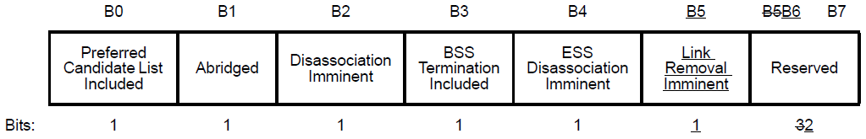
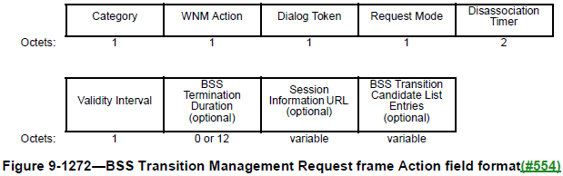
Unsolicited BTM Request
Issue: how does the AP MLD trigger the non-AP MLD to do the SMD BSS transition preparation or execution at a propriate time point especially when the BTM Assurance bit within the UHR MAC Capabilities Information field of the UHR Capabilities element is set to 1?
Solution: similar to add a 1-octet Type field within the Link Reconfiguration Request frame, we propose to also use one bit within the Request Mode of the BTM Request to distinguish this BTM request is to request the SMD BSS transition preparation or execution.
  E.g. Roaming Preparation Imminent

Slide 6
Why this explicit indication is needed?
Considering the following various scenarios, it’s better to explicitly indicate the BTM Request frame is used for the roaming preparation or execution. Otherwise, the non-AP MLD may get it wrong.
  Scenario 1. The non-AP MLD’s moving direction is changed, the AP MLD may recommend a new set of neighboring AP MLDs for the roaming preparation.
    The new set of neighboring AP MLDs may be partially overlapped with the previous set of neighboring AP MLDs.
  Scenario 2. If the previous roaming preparation with a neighboring AP MLD expires, then the current AP MLD may request the non-AP MLD to redo the roaming preparation by sending a new BTM Request frame.
  Scenario 3. In some case, the non-AP MLD may not follow the current AP MLD’s recommendation to do the roaming preparation in time. In this case, the current AP MLD need a way to directly request the non-AP MLD to do the roaming execution.

Slide 7
Pending DL Data Indication
Optionally include a new element (e.g. Per-TID Buffer Report element) to carry the per-TID buffer report of the current AP MLD within the BTM Request frame, which can help the non-AP MLD to make decision on which TID of DL data should be retrieved.
  Optionally include the above new element to carry the per-TID buffer report of the current AP MLD with the Link Reconfiguration Response frame, which can help the non-AP MLD know how much traffic for each requested TID need to be retrieved after the DS mapping change.
During the DL data retrieval, the current AP MLD should include a 8-bits TID bitmap within the A-control field of DL MPDUs to indicate whether there is no more pending DL data for each TID.
Element
ID
Length
Extension
Element ID
8-bits
TID Bitmap
1-octet Buffer Size
Corresponding TID #n
…
1-octet Buffer Size
Corresponding TID #m
Control
ID
8-bits
TID Bitmap

Slide 8
Current AP MLD Terminating DL Data Retrieval
The current AP MLD can delete all the setup links with the non-AP MLD to implicitly terminate the DL data retrieval by sending a UHR Link Reconfiguration Notify frame.
  May add a Reason Code field/element to indicate which specific reason to terminate the DL retrieval, e.g.
    Poor link quality
    Done with DL data retrieval (i.e. no buffer BUs)
    Done with DL data forwarding
    …

Slide 9
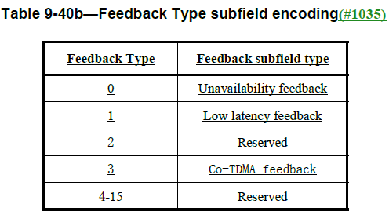
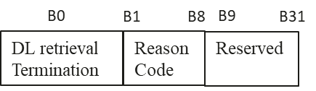
Non-AP MLD Terminating DL Data Retrieval
Generally, there are two options.
  Option 1 (Prefer). The non-AP MLD indicates the termination of the DL data retrieval within the Multi-STA BA by defining a new feedback type [2].
    E.g. Define Feedback Type 4 to indicate the DL Retrieval Termination
  Option 2. The non-AP MLD sends a Link Reconfiguration Request frame with deleting all the setup links to terminate the DL data retrieval.
    Cons. The non-AP MLD needs to contend the channel for the transmission of the Link Reconfiguration Request frame. Considering the DL/UL asymmetry, the non-AP MLD may be not easy to obtain a TXOP during the DL data retrieval period.

Slide 10
Summary
In this contribution, we propose an AP-directed SMD BSS transition method. Specifically,
  Add a Type bit within the Request Mode field of the BTM Request to guide the non-AP MLD to do the SMD BSS transition preparation or execution
    Define a Per-TID Buffer Report element and include it within the BTM Request frame to help the non-AP MLD makes decision on which TID of DL data should be requested to retrieve.
    Also include this Per-TID Buffer Report element within the Link Reconfiguration Response frame to tell the non-AP MLD know how much traffic for each requested TID need to be retrieved after the DS mapping change.
  The current AP MLD sends the Link Reconfiguration Notify with deleting all the setup links to terminate the DL data retrieval.
  The non-AP MLD indicates the termination of the DL data retrieval within the Multi-STA BA by defining a new feedback type.

Slide 11
References
[1] 11-25-0566-10-00bn-pdt-mac-on-seamless-roaming-part-1.docx
[2] Draft P802.11bn_D0.2

Slide 12
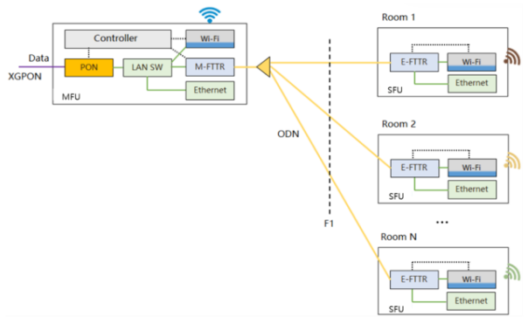
Appendix
In some scenarios, the AP/network side has better understanding when to initiate the roaming preparation and roaming execution. For example,
  Enterprise scenario with AP equipping a scanning radio
  Home scenario with FTTR
    All the APs are deployed in the same160 MHz channel. All the APs can monitor the RSSI of a non-AP STA.

Slide 13
SP 1
Do you support to add a Type bit within the Request Mode field of the BTM Request frame to distinguish the roaming preparation request and the roaming execution request?
  Note. The current AP MLD can send an unsolicited BTM Request frame to guide the non-AP MLD to initiate the roaming preparation or the roaming execution at a propriate time point.

Slide 14
SP 2
Do you support to use a new Feedback Type value to provide the DL retrieval termination indication within the Multi-STA BA frame?

Slide 15
SP 3
Do you support that the current AP MLD can terminate the DL retrieval by sending a Link Reconfiguration Notify frame with deleting all the setup links?
  A newly defined element may be included within the Link Reconfiguration Notify frame to indicate which specific reason to terminate the DL retrieval.

