Slide 1
On Determination of Co-BF MAP Sync-reference and Sync-follower Roles
Date: 2025-07-14
Authors:

Slide 2
Introduction
Concept of Co-BF MAP sync-reference and sync-follower roles was introduced in [1].
CFO correction procedures in Co-BF sounding sequences and Co-BF transmissions were proposed in [2] and [3]. They were based on assumption that Co-BF MAPs’ sync-reference and sync-follower roles were already determined.
In [3], two options were suggested to determine sync-reference and sync-follower roles.
Sync-reference determined during sounding invite and sounding response exchange at the beginning of a sounding session – we refer this option as dynamic scheme
The AP initiating the pre-sounding exchange in the first TXOP of a sounding session becomes the reference AP
Sync-reference determined at group formation

Slide 3
Semi-static Sync-reference And Sync-follower Roles
In this contribution, we propose semi-static sync-reference and sync-follower roles are determined for Co-BF APs
The sync-reference and sync-follower roles are determined at group formation and can be changed using re-grouping procedure.

Slide 4
Why Semi-static Sync-reference/Follower Roles?
Dynamic role changes don’t bring much benefit
Both sync-reference and sync-follower APs can initiate Co-BF sounding and transmission
Dynamic role changes may complicate Co-BF AP design
Dynamic role changes may require unnecessary changes of CFO post-compensation on CSIs obtained in an earlier sounding period
Dynamic role changes may not be friendly to STAs
Semi-static sync-reference and sync-follower roles are friendly to STAs and simplify AP design
Allows the roles to change with re-grouping procedure while keeping the roles consistent over multiple periods of sounding

Slide 5
Determine Semi-static Sync-reference / Sync-follower Roles
We propose:
The sync-reference and sync-follower roles are determined during Co-BF group formation using the procedure specified in MAPC agreement establishment in Clause 37.13.1.3.2 (MAPC agreement establishment);
The sync-reference and sync-follower roles remain until they are changed with re-grouping using the procedure specified in MAPC agreement update in Clause 37.13.1.3.3 (MAPC agreement update).

Slide 6
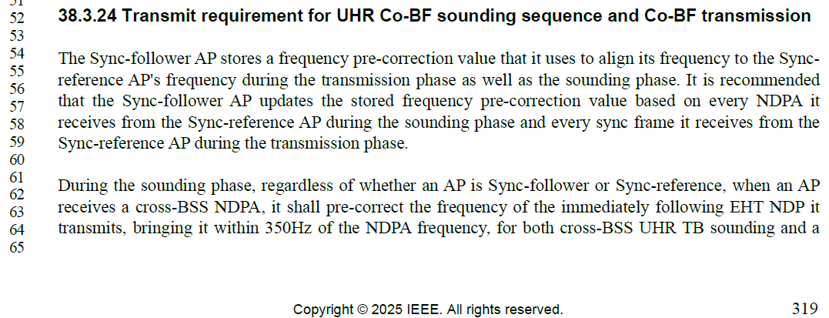
Changes to D0.3
Requirement of semi-static sync-reference and sync-follower roles needs to be added before they are referred to in Clause 38.3.24 (Transmit requirement for UHR Co-BF sounding sequence and Co-BF transmission)

Slide 7
SP
Do you support to insert the following PDT at Page 319 Line 54 in 11bn D0.3?
A Co-BF AP shall be capable of being a sync-reference or a sync-follower. Co-BF APs’ sync-reference and sync-follower roles are determined when a Co-BF MAPC agreement is established using procedures described in Clause 37.13.1.3.2 (MAPC agreement establishment). The sync-reference and sync-follower roles can be changed when a Co-BF MAPC agreement is updated using procedure described in Clause 37.13.1.3.3 (MAPC agreement update).

Slide 8
References
[1] 11-25/0083r0, CFO Correction for COBF, Sameer Vermani, et al. (Qualcomm)
[2] 11-25/0103r0, Simplified Carrier Synchronization for CoBF Transmissions, Julia Feng, et al (Mediatek)
[3] 11-25/0836r1, Follow-up on CFO correction for COBF, Sameer Vermani, et al. (Qualcomm)

