Slide 1
MLO aided operations on mmW band
Date: 2nd September 2025
Name | Affiliation | Address | Phone | Email
Abhishek Patil | Qualcomm Inc. |  |  | appatil@qti.qualcomm.com
George Cherian
Giovanni Chisci
Gaurang Naik
Alfred Asterjadhi
Duncan Ho
Sanket Kalamkar
Sherief Halwa

Slide 2
Background
The millimeter wave (mmW) band offers a large spectrum for Wi-Fi to use
However, the band suffer from high propagation loss and blockage, making reliable operation challenging.
Previous standards (802.11ad/802.11ay) introduced mechanisms to address these issues, but relied on standalone 60 GHz operation, resulting in high overhead.
TGbq) aims to improve mmW efficiency by leveraging recent improvements in Wi-Fi (specifically by using the MLO framework developed by 802.11be).
By utilizing sub-7 GHz links along with mmW, TGbq seeks to enhance reliability and reduce overhead in AP-client connectivity.
This contribution presents a high-level design using the MLO framework to improve efficiency and reliability of mmW operations.

Slide 3
mmW link as a non-standalone link
Non-standalone link: a mmW link would be part of a multi-link setup which also includes at least one other enabled link on the sub7 band.
Disallow any operations (such as T2LM or ML Reconfig) which will result in the mmW link being the only enabled link between the two MLDs
Discovery of an AP on the mmW band: An AP operating on a sub7 link provides information of an IMMW AP via existing mechanisms.
Such as RNR, Basic ML IE, NR IE and ML probing on sub7 link(s)
Disallow discovery procedures (e.g., beaconing, probing etc) on the mmW link
Sub7 AP provides information about the configuration and capabilities of an IMMW STA
E.g., BSSID, TSF offset, BI, channel access schedule etc
Capabilities of an IMMW STA are exchanged on the sub7 link(s)
operational parameters for the mmW link provided on the sub7 link(s)
negotiation of modes of operation for the mmW link performed on sub7 link(s)

Slide 4
Utilize MLO framework to facilitate operations on mmW link
ML setup: Association frames exchanged on sub7 link includes mmW link as part of the multi-link setup.
A STA on mmW link doesn’t need to perform beam training for discovery or association.
Post association, sub7 link(s) serves as a control/feedback channel to manage and orchestrate activities on the mmW link.
Sub7 always available and can serve as a fallback link if mmW link becomes unavailable (due to beam misalignment or reachability).
Management frame offloading:
Utilize MLO framework to move most mgmt. overhead to sub7 link(s) and use the mmW link as a fat data pipe
Establish link-level and MLD-level agreements via frame exchanges on sub7 link(s)
Perform any setups that involve mmW link (including ML setup) on any sub7 link.
Can coordinate beam training operations (e.g., initiating and feedback) via signaling on sub7
Beacon likely absent on mmW link and replace with a lightweight frame with configurable transmission interval.
Sub-7 GHz link(s) provide an indication of whether a lightweight frame is transmitted on the mmW link and, if so, its timing.

Slide 5
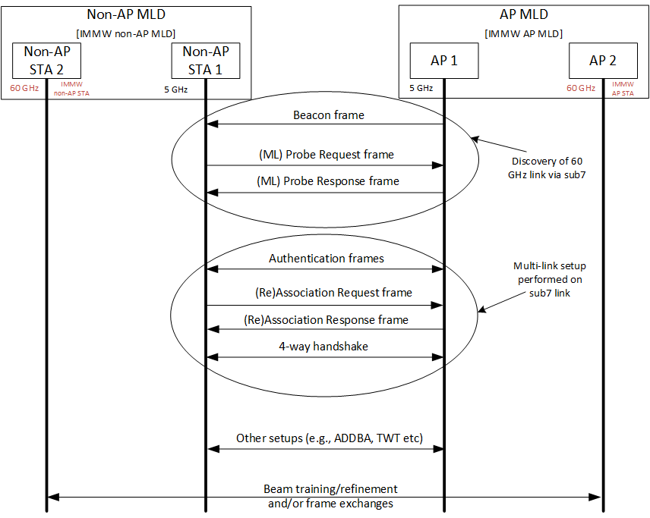
Offload discovery, association and setups to sub7 link(s)

Slide 6
TSF information of mmW link
Various operations on the mmW link will utilize mmW link’s TSF information
However, the IMMW AP might not transmit a beacon.
In addition, the timing requirements of mmW link might be stricter.
Therefore, the TSF information of the mmW link needs to be conveyed via other means.
MLO framework requires an AP to provide TSF offset of another AP that is affiliated with the same AP MLD.
The information is provided in the complete profile of a reported AP carried in the Basic Multi-Link element which is included in a (Re)Association Response or a Probe Response frame.
The TGbe standard requires the TSF offset between affiliated APs of the same MLD be constant with a drift no more than 30 us.
TGbq can leverage MLO framework for providing TSF information of the mmW link via sub7.
In addition, TGbq may put stricter requirements in terms of the timing granularity and allowed drift.

Slide 7
Summary
The contribution provides a summary of several MLO features that TGbq can leverage to improve operations on a mmW link.
use sub-7 GHz link(s) for discovery, set-ups (including ML setup), control, and fallback to improve reliability and efficiency.
offload all/most management and control operations to sub-7 GHz links, allowing the mmW link to function primarily as a high-throughput data channel.
TSF and configuration details for the mmW link are conveyed via sub-7 GHz links using existing MLO mechanisms.

Slide 8
SPs on Terminology
SP 1: Do you support that in TGbq a STA defined by TGbq that supports operation on a mmWave link shall be referred to as an IMMW STA?
If the STA is a non-AP STA, then it is referred to as a non-AP IMMW STA and if the STA is an AP, then it is referred to as an IMMW AP?
SP2: Do you support that in TGbq an MLD that has at least one IMMW STA affiliated will be referred to as an IMMW MLD?

Slide 9
SPs on non-standalone mode
SP 3: Do you support that an IMMW MLD shall have at least one affiliated STA that is operating on an enabled link located in the sub 7.25 GHz band?
SP4: Do you support that an IMMW MLD shall not perform operations (such as TTLM or ML Reconfiguration) which will lead to the IMMW STA(s) being the only affiliated STA(s) with that MLD or the mmWave link(s) being the only enabled link(s)?

Slide 10
SP on disallowance of discovery on IMMW link
SP 5: Do you support that an IMMW STA shall not perform discovery procedures on the mmWave link?

Slide 11
SP on discovery and setup via sub7
SP6: Do you support that an IMMW MLD shall perform ML setup, link reconfiguration, TTLM, SCS that includes an IMMW STA that is affiliated with it by exchanging frames only on any of its sub 7.25 GHz links?
TBD for other setups

