Slide 1
AMP Frame Format
Date: 30 July 2025
Name | Affiliation | Address | Phone | Email
Rojan Chitrakar | Huawei | Singapore |  | rojan.chitrakar@huawei.com
Lei Huang
Ian Bajaj
Mahmoud Hasabelnaby
Notes:
Jul 12, 2010
Page 1

Slide 2
Approved motions related to AMP Frame Format
FM-2: 802.11bp defines an AMP Trigger frame that an AP transmits to solicit UL AMP PPDU(s) from one or more 802.11bp clients and may carry the following content
  Transmitter ID
  Receiver ID(s)
  FCS
  Other parameters TBD.
FM-3: When the AP solicits UL AMP PPDUs from 802.11bp clients using a slot-based procedure, the AMP Trigger frame shall carry the following parameters
  Number of slots for UL PPDU transmissions in that TXOP
  Other parameters TBD.
MM-5: AMP trigger frame may indicate parameters for a slot-based procedure of time slots to AMP non-AP STA(s).
  The exact parameters are TBD.
FM-4: 802.11bp defines an AMP Ack frame that an AMP AP transmits to acknowledge the received UL AMP frame(s).
FM-6: 802.11bp defines an AMP Wake-Up frame, which an AMP AP transmits to AMP-enabled non-AP STA(s) to indicate that the AP intends to exchange non-AMP frames with the non-AP STA
  The expectation is to reuse WUR frame format for the AMP Wake-Up frame and to carry it in an AMP PPDU
PM-18: IEEE 802.11bp defines at least one AMP-Sync in the AMP Downlink PPDU in 2.4 GHz for backscatter communication, and at least one AMP-Sync in the AMP Downlink PPDU in 2.4 GHz for non-backscatter communication. The AMP-Sync is independent of the integrated and non-integrated deployment.

Slide 3

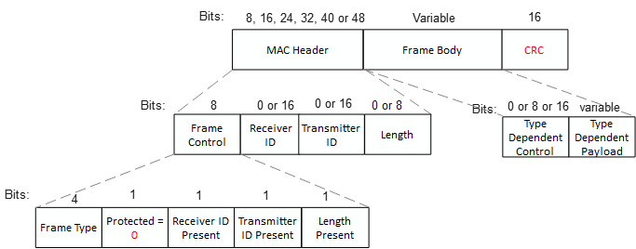
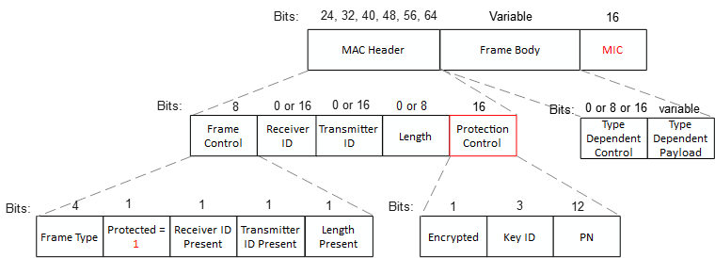
AMP Non-backscatter Frame Format - General
General AMP Frame format:
Similar to WUR frame format, but with variable length MAC Header.
General AMP frames may be unprotected, or protected.
Unprotected AMP Frame format:
Used to carry AMP content without protection (security).
FCS field carries CRC.
Protected AMP Frame format:
Used to carry AMP content with protection (authentication or encryption).
FCS field carries MIC.

Slide 4
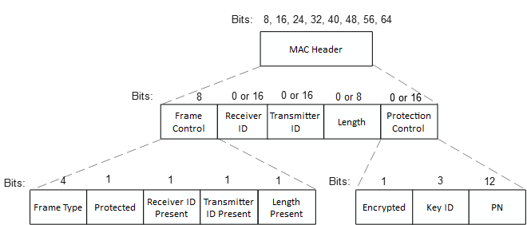
General AMP Frame: MAC Header
Frame Control (8 bits):
Frame Type (4 bits): Indicates various AMP frame types
Protected (1 bit): Protection enabled or not
Receiver ID Present (1 bit): Presence of Receiver ID field
Transmitter ID Present (1 bit): Presence of Transmitter ID field
Length Present (1 bit): Presence of Length field
Receiver ID & Transmitter ID (0 or 16 bits): Carries the Receiver ID or Transmitter ID if applicable.
  Recommend 16-bits ID space to reduce ID collisions and align with UHF RN16.
Length (0 or 8 bits): Indicates the length of the Frame Body field if present
Protection Control (0 or 16 bits):
Encrypted (1 bit): 0: Authenticated; 1: Frame Body is Encrypted
Key ID (3 bits): ID of the security Key
PN (12 bits): PN used for protected AMP frames.

Slide 5
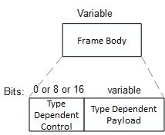
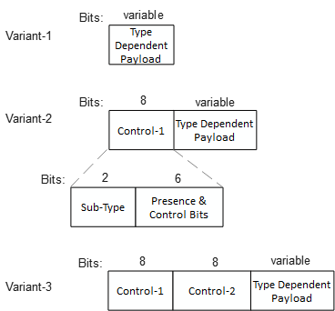
General AMP Frame: Frame Body field
Frame Body field:
Type Dependent Control field (0, 8 or 16 bits): Field optionally present to indicate:
  1. Control-1 (8 bits):
  Sub-Type (2 bits): Indicates AMP frame sub-types
  Presence and Control bits (6 bits): Indicates control bits as well as presence of optional fields in the Type Dependent Payload field.
  2. Control-2 (8 bits):
  Additional Presence and Control bits (8 bits): Additional control and presence bits if required.
NOTE - Presence and size of the Type Dependent Control field (0, 8 or 16 bits) can be fixed by AMP frame Type, or presence of the Control-2 field can be indicated in the control-1 field.
Type Dependent Payload field: Carries the frame payload (either plain text or encrypted).

Slide 6
General AMP Frame: FCS field
Unprotected AMP frames:
Carries the CRC-16 FCS (e.g., as defined in 15.3.3.7 PHY CRC field) for the general AMP frames:
CRC-16 Polynomial: G(x) = X¹⁶ + X¹² + X⁵ + 1
1 bit @256 Kbps = 4 µS. Propose to consider using smaller CRCs for AMP Compact frames
E.g., Use CRC-8, e.g., if AMP frame size is 24-bits or less:
CRC-8 Polynomial: G(x) = X⁸ + X² + 1
Else, use CRC-16.
Protected AMP frames:
Carries the 16-bits MIC (16 LSBs of the MIC generated using the applicable data confidentiality and integrity protocols).
Notes:
8-bits CRC is defined in 25.3.6 CRC calculation & 27.3.11.7.3 (CRC computation) (802.11-2024)

Slide 7
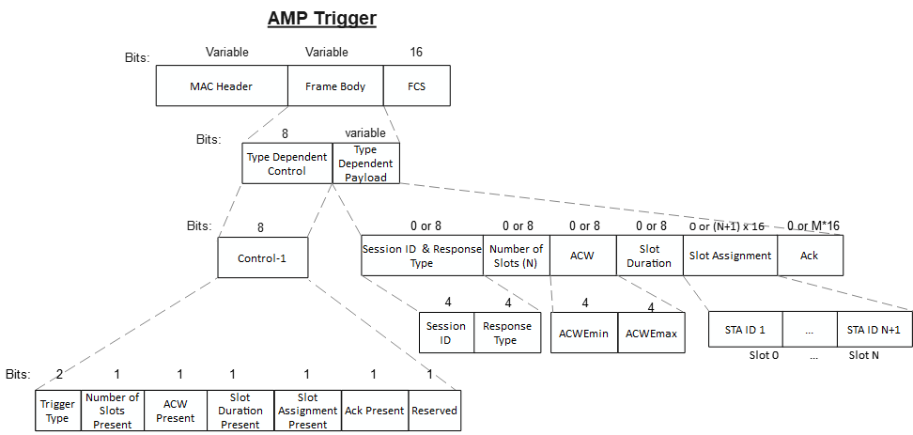
Example: AMP Trigger Frame
Payload contents:
Session ID: Identifies the random access session
Response Type: Type of the solicited uplink response e.g., ID, Sensor Data etc.
Number of Slots: The number of slots allocated for uplink transmissions.
ACW: Parameters for random access contention
Slot Duration: Duration of each time-slot.
Slot Assignment: assignment of slots for scheduled access.
Ack: Acknowledgment for previous uplink transmission(s).

Slide 8
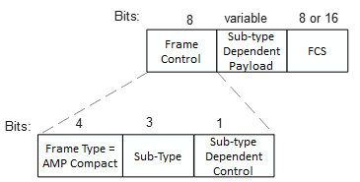
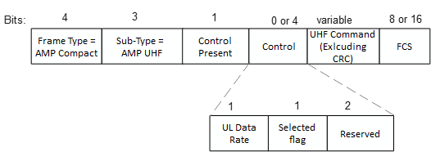

AMP Compact Frames
AMP Compact Frame format: AMP frame format optimized to keep the size small.
Frame Control (8 bits):
Frame Type (4 bits): Indicates AMP Compact frames.
Sub-type (3 bit): Indicates up to 8 sub-types
Sub-type Dependent Control (1 bit): Customized per Sub-type.
Sub-type Dependent Payload:
Customized payload per Sub-type.
Example: AMP Ack Frame (32 bits = 220µS @ 250 Kbps):
Example: AMP UHF Frame:

Slide 9
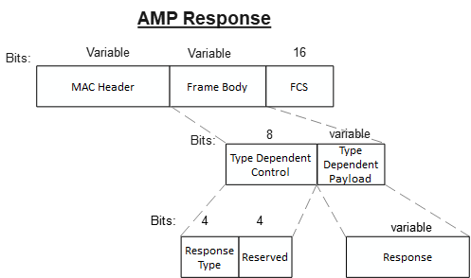
AMP Response Frame
AMP frame to carry uplink response
Payload contents:
Response Type: Type of the uplink response e.g., EPC, Sensor Data etc.
Type Dependent Payload carrying the solicited Response.
Note – In the simplest form of response, e.g., ID, the Frame Body may be absent and the ID included in the ID field in the MAC Header.

Slide 10
Potential Non-backscatter AMP Frame types
AMP frames:
Frame Type | Frame Name | Sub-type | DL / UL | Description
0 | AMP Trigger | AMP Poll | DL | AMP Trigger Frame to initiate random access
 |  | AMP Request | DL | AMP Trigger Frame to initiate scheduled access
 |  | AMP Re-Poll | DL | AMP Trigger Frame to continue random access in a TXOP
1 | AMP Response | - | UL | AMP frame to carry the uplink response other than higher layer data
2 | AMP Compact | AMP Ack | DL | AMP Ack frame
 |  | AMP UHF | DL | AMP frame to carry UHF Commands
3 | AMP SP | - |  | AMP frame to negotiate AMP Service Period (SP)
4 | AMP Beacon | - |  | AMP frame to carry AMP TSF
5 | AMP Data | - | DL/UL | AMP frame to carry higher layer data
6 | AMP Authentication | ? | DL/UL | AMP frame for security negotiation
7 | AWUR | WUR Frame types (up to 5) | DL | AMP frame to carry WUR frames
8 - 15 | Reserved

Slide 11
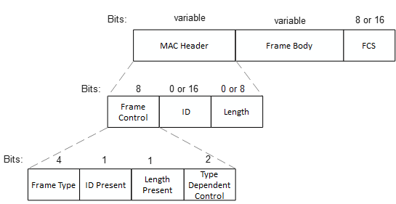
AMP Backscatter Frames
AMP frame for backscatter communication
Frame Control (8 bits):
Frame Type (4 bits): Indicates various AMP frame types
ID Present (1 bit): Presence of ID field
Length Present (1 bit): Presence of Length field
Type Dependent Control (2 bits)
ID (0 or 16 bits): Carries the Receiver ID or Transmitter ID if applicable.
  Recommend 16-bits ID space to reduce ID collisions and align with UHF RN16.
Length (0 or 8 bits): Indicates the length of the Frame Body field if present

Slide 12
Potential AMP Backscatter Frame types
AMP Backscatter frames:
Frame Type | Frame Name | Sub-type | DL / UL | Description
0 | AMP Trigger | AMP Poll | DL | AMP Trigger Frame to initiate random access
 |  | AMP Request | DL | AMP Trigger Frame to initiate scheduled access
 |  | AMP Re-Poll | DL | AMP Trigger Frame to continue random access in a TXOP
1 | AMP Response | - | UL | AMP frame to carry the uplink response other than higher layer data
2 | AMP UHF | - | DL | AMP frame to carry UHF Commands
3 - 15 | Reserved

Slide 13
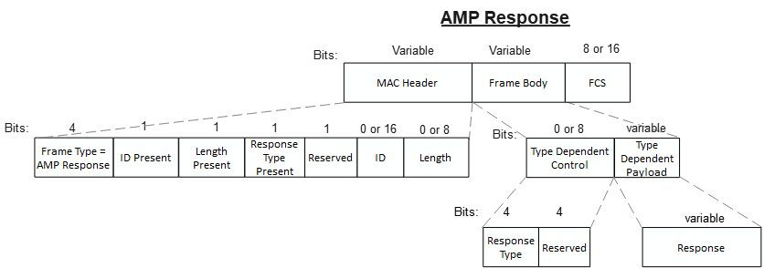
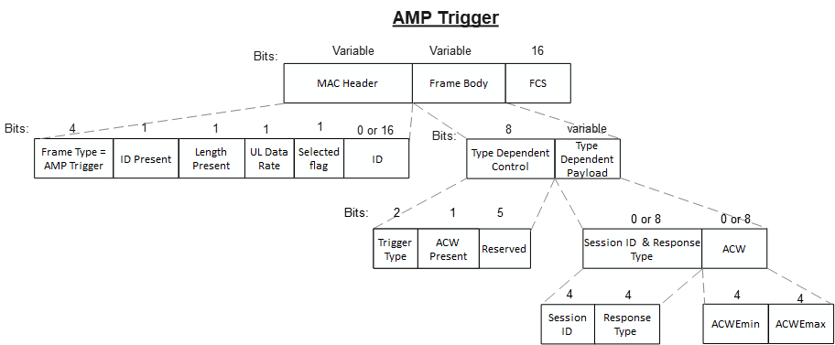
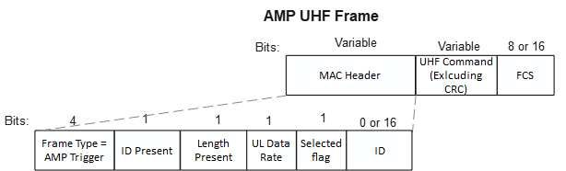
AMP Backscatter Frames - Examples

Slide 14
Summary
We propose to have different frame formats for backscatter and non-backscatter communication.
We provide our views on the general framework for AMP frames and propose two categories of AMP frames for non-backscatter communication:
  General AMP frames emphasizing flexible design to accommodate different use cases. Carries following fields:
    MAC Header
    Frame Body
    FCS
  AMP Compact frames optimized for size. Carries following fields:
    Frame Control
    Sub-type Dependent Payload
    FCS
We also proposed AMP frames with simpler MAC Header for backscatter communication

Slide 15
SP 1
Do you agree to add to 11bp SFD:
802.11bp defines AMP frames for backscatter communication that may have a different frame format than the AMP frames for non-backscatter communication.

Slide 16
SP 2
Do you agree to add to 11bp SFD:
MAC Header of an AMP frame carries the following fields:
  Frame Control
    Always present
  ID
    The number of the ID fields and whether they are always present is TBD.
  Length
    Only present if the Frame Body field is present in the AMP frame.

Slide 17
SP 3
Frame Control of an AMP frame carries the following fields:
  Frame Type (4 bits)
  ID Present (1 bit)
  Length Present (1 bit)
  Other fields are TBD

Slide 18
SP 4
Do you agree to add to 11bp SFD:
The ID field in the MAC Header of an AMP frame is 16 bits (2 Octets).

Slide 19
SP 5
Do you agree to add to 11bp SFD:
The Length field in the MAC Header of an AMP frame is 8 bits (1 Octet)..

Slide 20
SP 6
Do you agree to add to 11bp SFD:
If the AMP frame is protected, the FCS field of the AMP frame carries a 16-bits MIC.

Slide 21
SP 7
Do you agree to add to 11bp SFD:
802.11bp defines an AMP Response frame to carry uplink response from non-AP AMP STAs and carries one or more of the following:
  Response Type
  Uplink Response

Slide 22
SP 8
Do you agree to add to 11bp SFD:
11bp defines an AMP UHF frame type to carry UHF command.
The UHF command is carried in the Payload field.

Slide 23
References
[1] 24/1811r0, Frame format discussion (Liwen Chu et. al.)
[2] 25/0817r0, Channel access for Active Tx non-AP AMP STAs – follow up (Rojan Chitrakar et. al.)
[3] 25/0818r0, Channel access for Backscatter non-AP AMP STAs – way forward (Rojan Chitrakar et. al.)
[4] 24/1198, UL Data Rate for AMP (Yinan et. al.)
[5] 25/0398r0, AMP frames (Alfred Asterjadhi et. al)

Slide 24
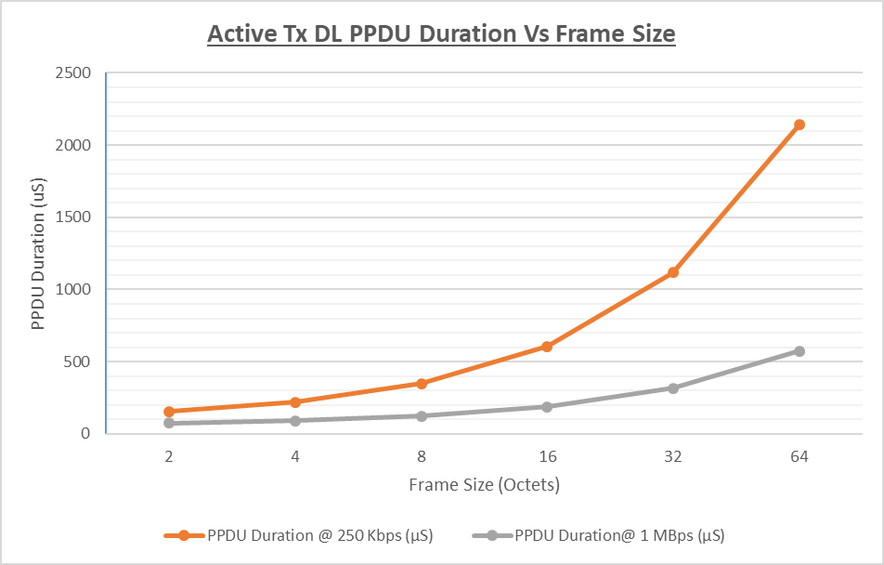
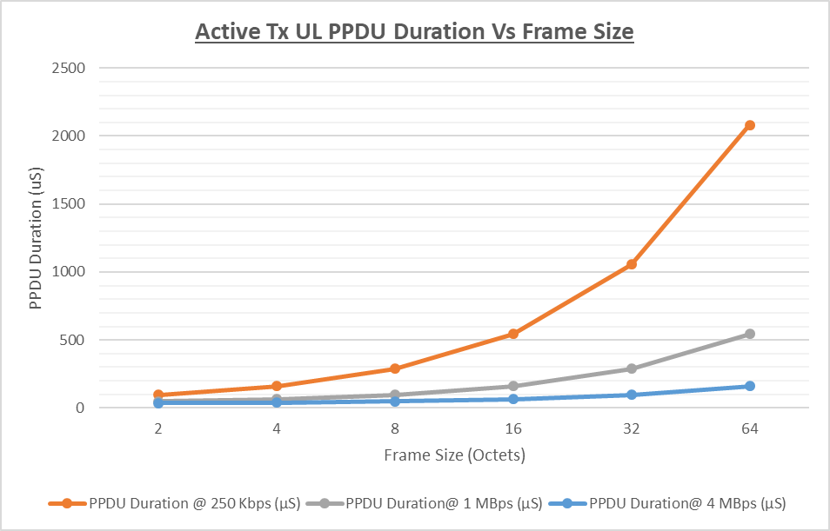
Appendix-I
PPDU Duration (Active Tx):
Notes:
DL Assumptions:
AMP-Sync: 32x2usfor 250 kbps, 16x2uS for 1000 kbps
AMP Preamble: 92us for 250 kbps, 60us for 1000 kbps
UL Assumptions:
AMP-Sync: 16x2uS for all data rates (250 kbps, 1 Mbps, 4 Mbps)
AMP Preamble: 32us for all data rates

Slide 25
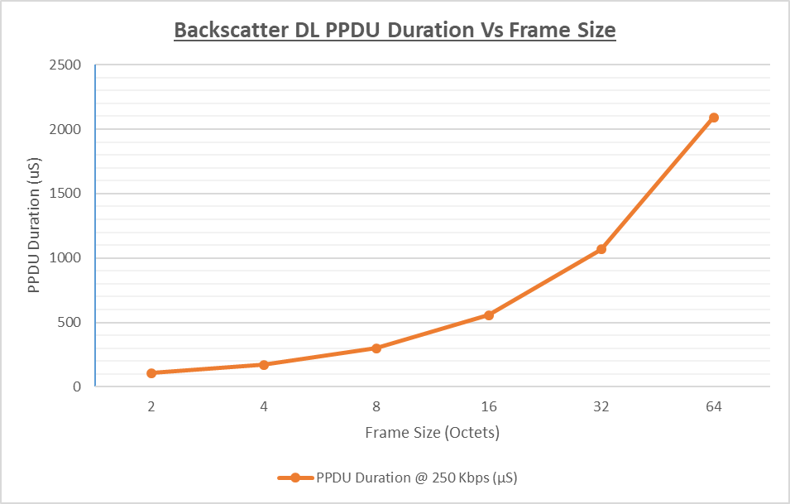
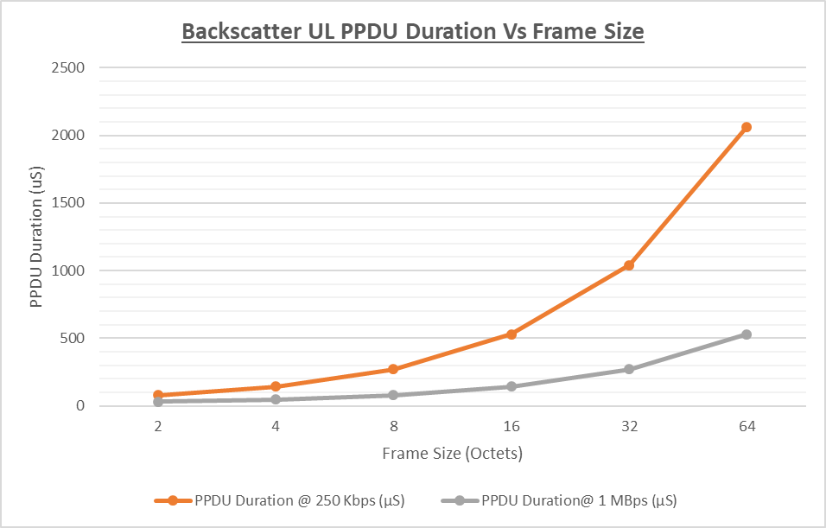
Appendix-II
PPDU Duration (Backscatter):
Notes:
DL Assumptions:
AMP-Sync: 8x2uS for 250 kbps
AMP Preamble: 44us for 250 kbps
UL Assumptions:
AMP-Sync: 8x2uS for all data rates (250 kbps, 1 Mbps)
AMP Preamble: 16us for all data rates

