Slide 1
Faster Association
Date: 2025-07-02
Authors:

Slide 2
Abstract
Currently, BA and IP address setup is started after a non-AP STA is associated (State 4).
This submission proposes that protected association frames encapsulate signaling for IP address and BA setup. This enables:
- Earlier IP address and BA setup
- Shorter delays for associated STA to transmit data
- Reduced number of management frame transmissions required to transmit data

Slide 3
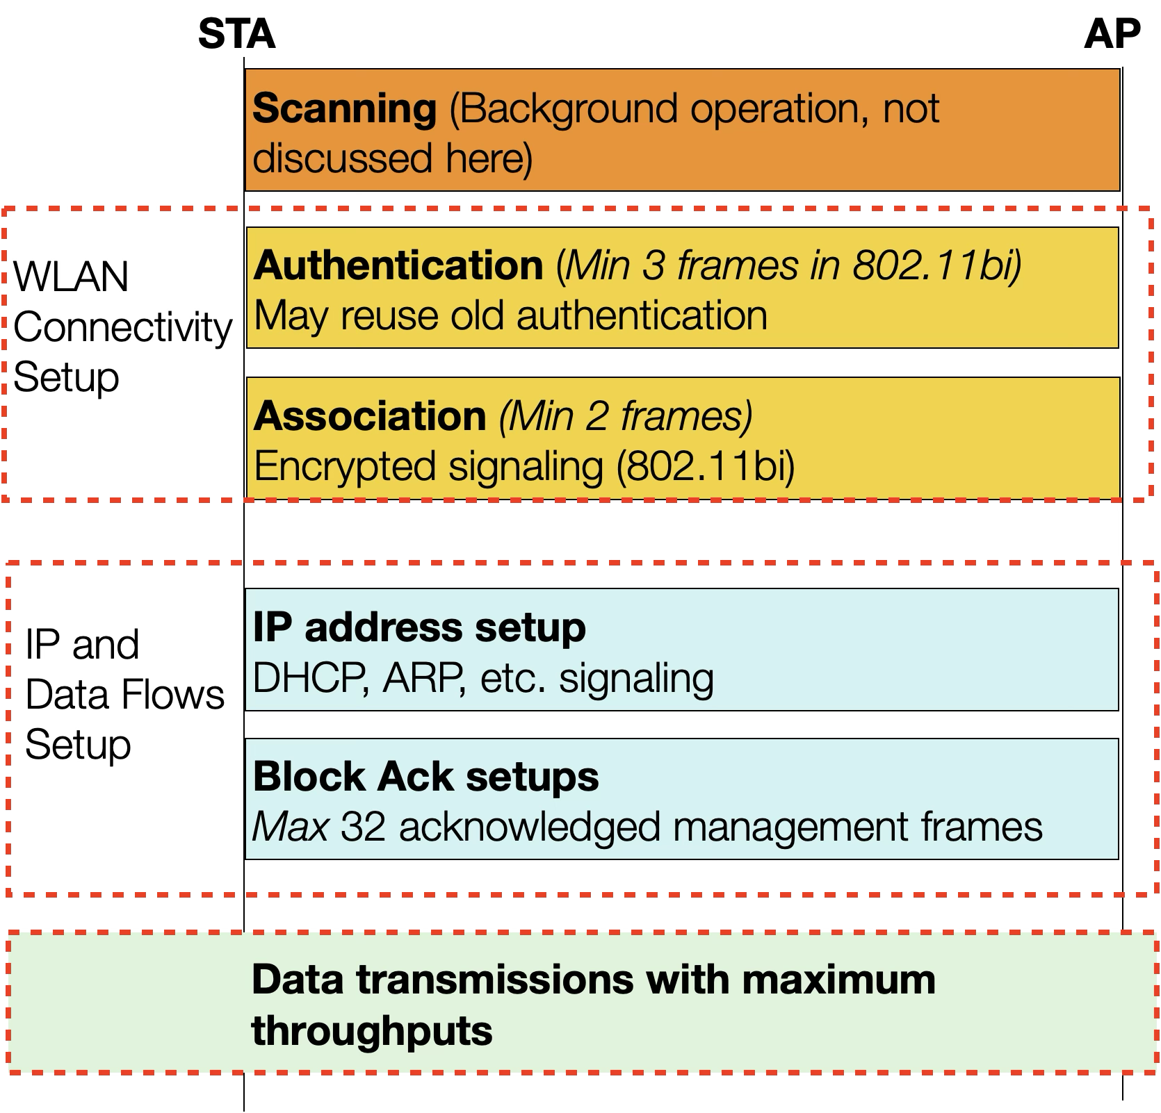
Background – Setup Delays to Enable Data Transmissions
EDPKE reduces the number of signaling frames for authentication and association
EDPKE defines encrypted association signaling:
Avoids attacks on fake frames
Improves STA privacy
Currently, no improvements for IP address and BA setup
Proposal: IP address and BA setup during association reduces setup delays and management overheads

Slide 4
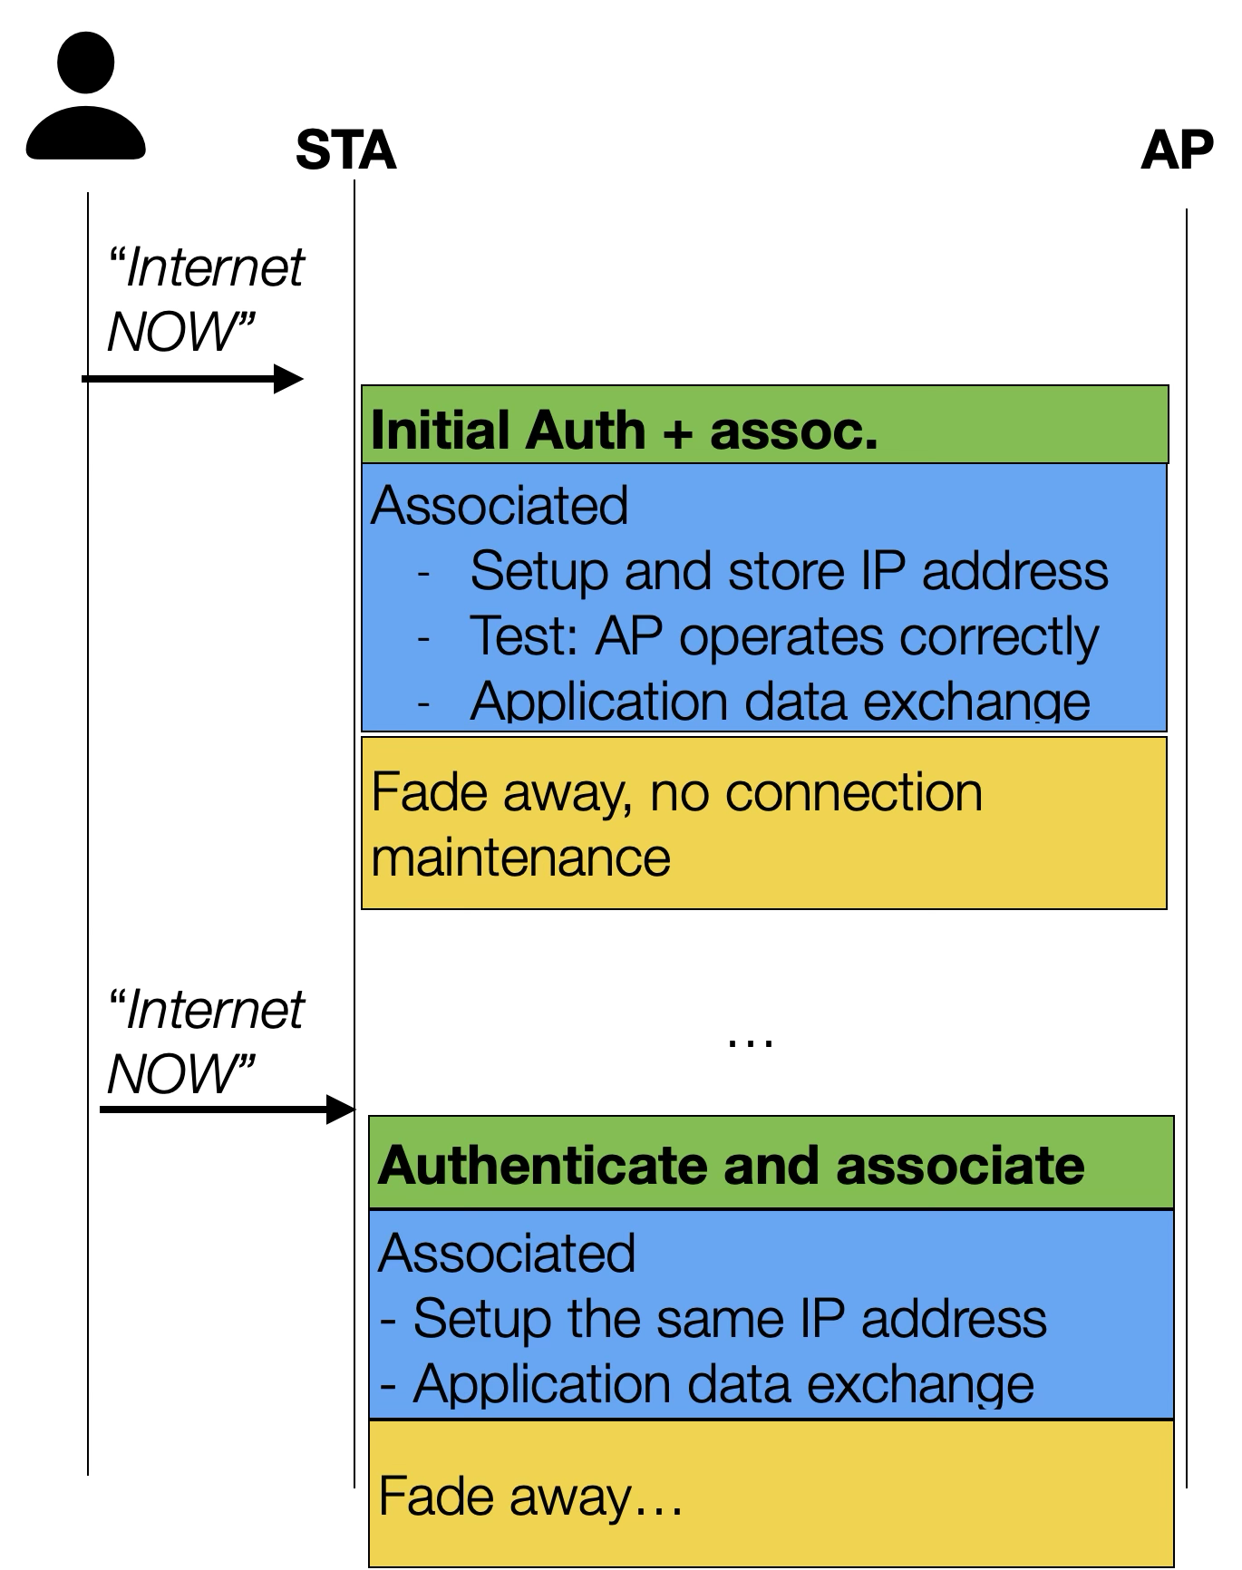
Proposal –Preparations for Fast IPv4 Address Use
The encrypted association signaling allows privacy sensitive payload transmissions
IPv4 address lease times are long
STA may associate and test that IPv4 data transmissions work
To save power, STA lets the association time-out
STA can benefit from the old association if it needs fast Internet access
The old assigned IPv4 address may still be assigned to the STA, which makes IPv4 address setup very fast

Slide 5
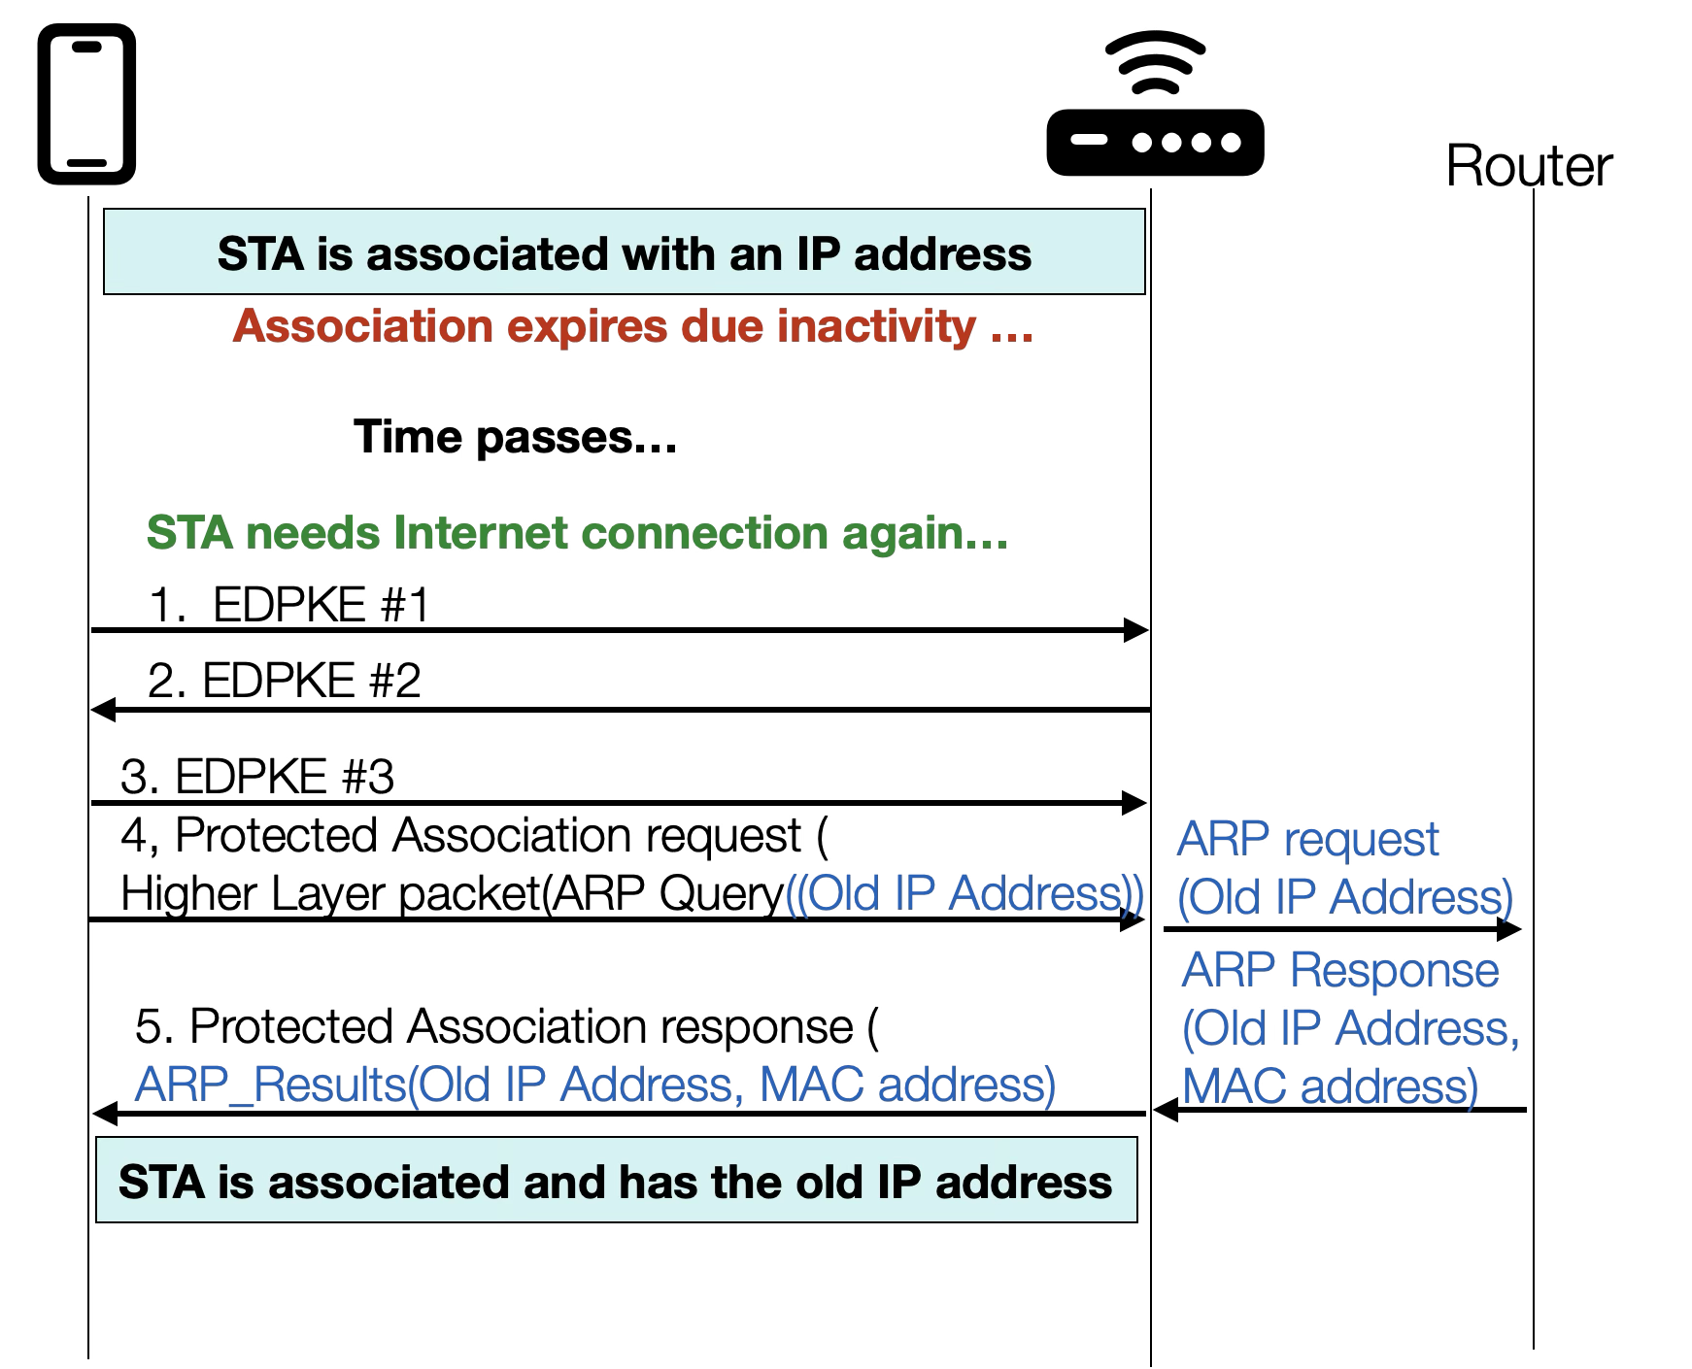
Proposal – Old IPv4 Address Check in Association
To reduce IPv4 address setup delays:
A protected (re)association request may include:
ARP Query to check whether IPv4 address is still assigned to STA,
Or DHCP Request to lease the previous IPv4 address, if the DHCP lease has expired
This operation follows RFC 4436 that guides how to take previously used IPv4 address again into use
AP indicates in (re)association response the ARP or DHCP Response
If the old Pv4 address is not available, the STA may setup a new IP address in associated state

Slide 6
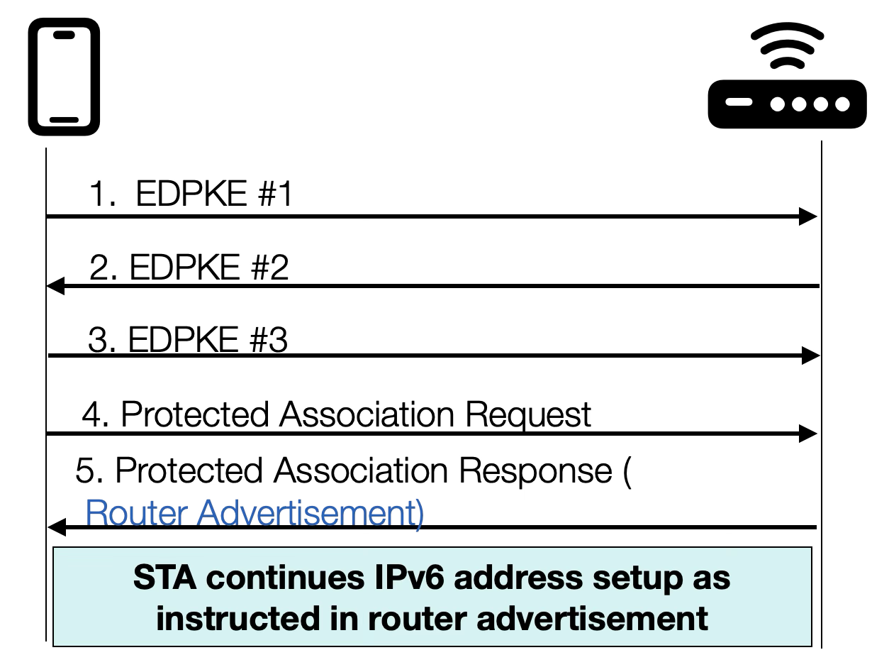
Proposal – IPv6 Address Setup in Association
IPv6 address assignment starts from the router advertisement (RA)
To speed up IPv6 address setup and to reduce signaling overhead:
AP may encapsulate the most recent router advertisement to the (re)association response
The associated STA continues IPv6 address setup according RA information

Slide 7
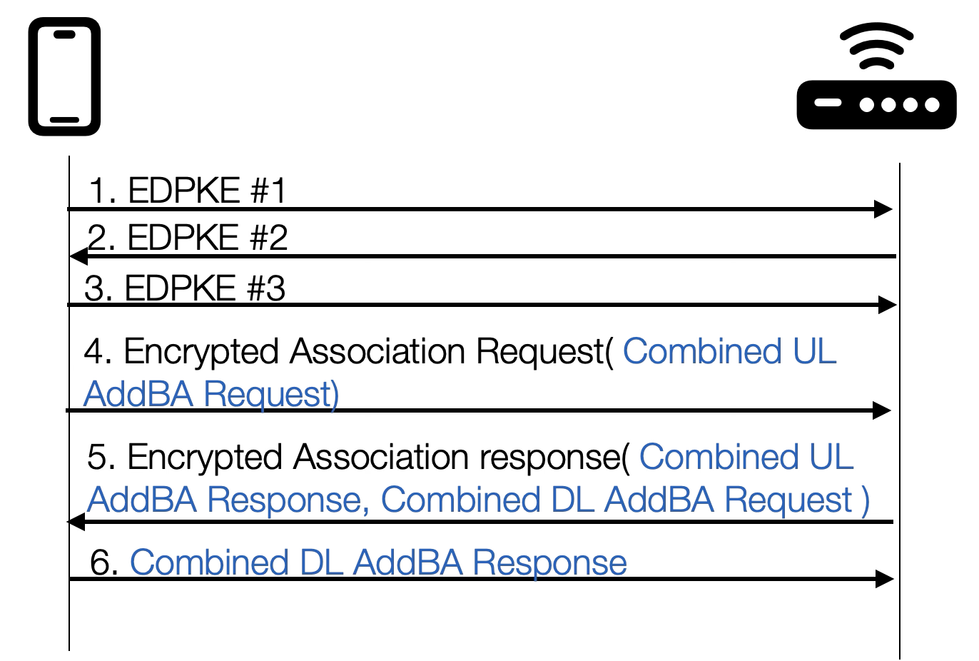
Proposal: BA Setup In Association
New Combined ADDBA element can setup BA for all UPs
Association Request may request BA for all UL UPs
Association Response may carry the UL BA response and DL request
Additional frame (Combined BA Management) communicates all DL BA responses

Slide 8
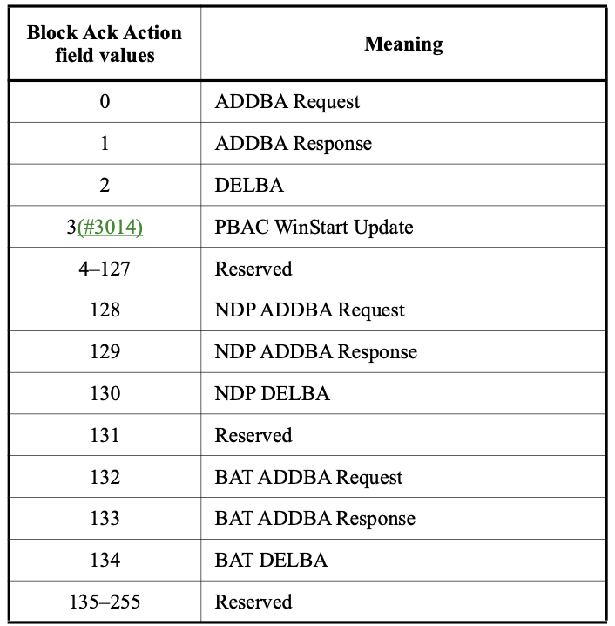
Proposal: Combined BA element
Combined BA Setup element
Combined BA element can setup BA for all UPs
Block Ack Action field defines the signaling type
UP Bitmap signals which UPs are configured
Bit position defines the UP; Value 1 in this position indicates that the Per UP BA Parameters are present for the UP
The Per UP BA Parameters contain the UP specific BA fields (see the next slide)
Block Ack Action field

Slide 9
Per BA Parameters
Per UP BA Parameters
The Per UP Parameters include the existing ADDBA fields
These fields have the same format as in ADDBA frames
The Per UP BA Parameters field is not present in DELBA frame

Slide 10
Summary
This submission proposes that protected association frames encapsulate signaling for IP address and BA setup. This enables:
Earlier IP address and BA setup
Shorter delays for associated STA to transmit data
Reduced number of management frame transmissions required to transmit data

Slide 11
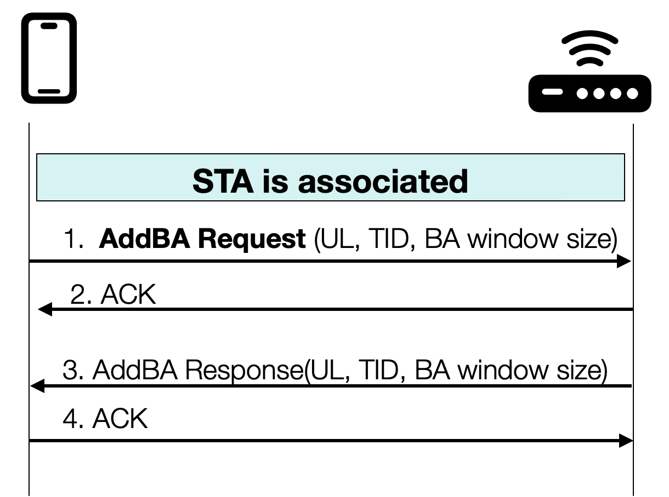
Annex: Challenge – BA Setup signaling
BA setup is allowed only after association
Late start adds delays
BA is setup for each UP and direction (UL and DL) separately
UL and DL BA setup for all TIDs requires (2*2*8) = 32 management frames

